Slide 1

Keras
Keras for Deep Learning Research

Slide 2
Overview
Quick Review of Previous Topics and NNs
Convolutional Neural Networks (CNN)
Hyperparameters of CNN
Image classification with CNN

Slide 3
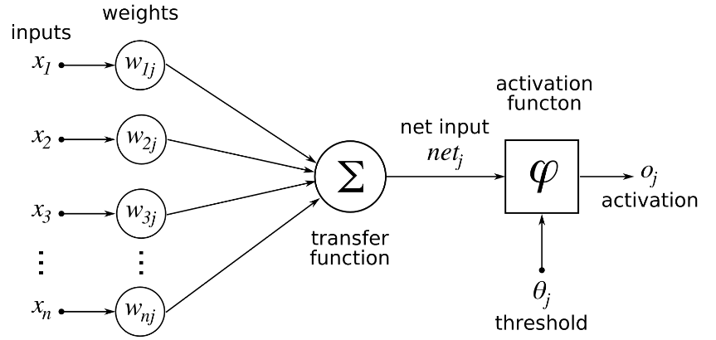
Deep Learning
Single Neuron
We now understand how to perform a calculation in a neuron
w · x + b = z
a = σ(z)
Source: https://www.udemy.com/complete-guide-to-tensorflow-for-deep-learning-with-python/learn/v4/overview

Slide 4
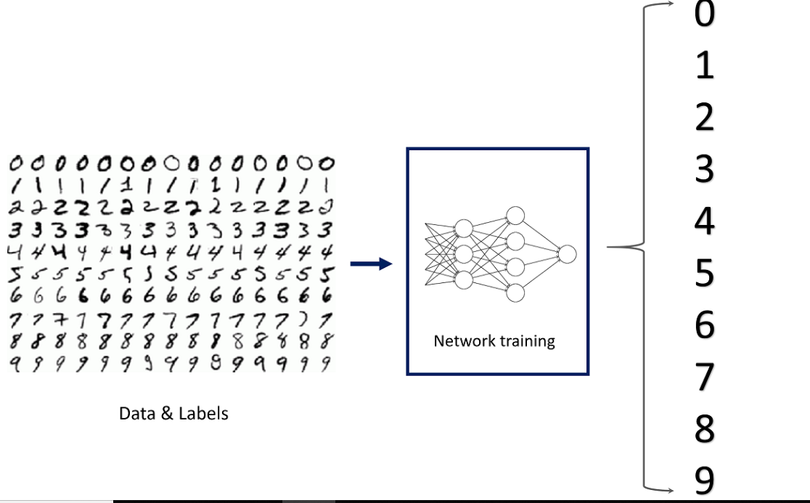
Previously we learned: Image classification on MNIST dataset using NN
.

Slide 5
Convolutional Neural Network (CNN)

Slide 6
Convolutional Neural Network (CNN)
Just like the simple perceptron, CNNs also have their origins in biological research.
Hubel and Wiesel studied the structure of the visual cortex in mammals, winning a Nobel Prize in 1981.
Source: https://en.wikipedia.org/wiki/Convolutional_neural_network

Slide 7
Convolutional Neural Network (CNN)
Their research revealed that neurons in the visual cortex had a small local receptive field.
Source: https://en.wikipedia.org/wiki/Convolutional_neural_network

Slide 8
Convolutional Neural Network (CNN)
This idea then inspired an ANN architecture that would become CNN
Famously implemented in the 1998 paper by Yann LeCun et al.
The LeNet-5 architecture was first used to classify the MNIST data set.
Source: https://en.wikipedia.org/wiki/Convolutional_neural_network

Slide 9
Convolutional Neural Network (CNN)
There are four main operations in the CNN
Convolutions and Filters
Pooling or Sub Sampling
Non Linearity
Classification (Fully Connected Layer)
Source: https://ujjwalkarn.me/2016/08/11/intuitive-explanation-convnets/

Slide 10

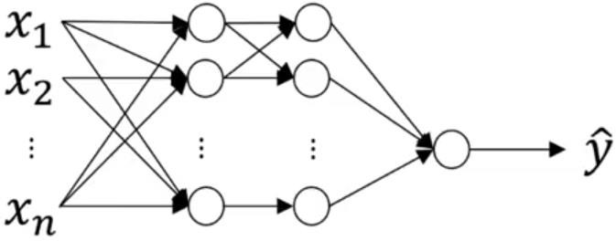
Traditional Neural Network vs. Convolutional Neural Network
32 x 32 x 3 = 3072
1000
32
_{W}12
1000 x 3072
dimensional matrix
32

Slide 11
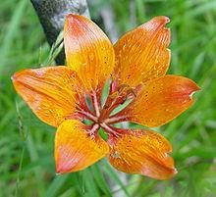
Traditional Neural Network vs. Convolutional Neural Network
1000 x 1000 x 3 = 3,000,000
1000
1000
_{W}12
1000 x 3,000,000
dimensional matrix!!!
= 3,000,000,000 features
1000

Slide 12
Traditional Neural Network vs. Convolutional Neural Network
Salient points:
Spatial relation between features in image is not considered in NN.
NN is not feasible for large images!
In order to perform Computer Vision operations on large images, convolution operation plays an important role.
Thus, CNNs are fundamentally important.

Slide 13
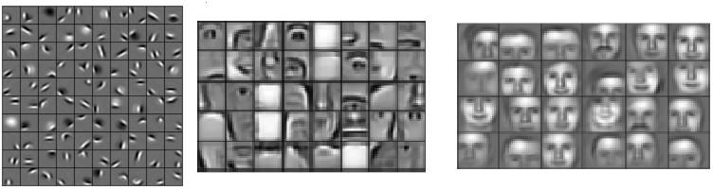
Stages of feature extraction by CNN
Low level features
Mid level features
High level features
Edges, curves and colour
Parts of objects
Complete objects

Slide 14
A toy ConvNet: X’s and O’s
Says whether a picture is of an X or an O
A two-dimensional
array of pixels
CNN
X or O

Slide 15
For example
CNN
X
CNN
O

Slide 16
Trickier cases
CNN
X
translation
scaling
rotation
weight
CNN
O

Slide 17
Deciding is hard
?
=

Slide 18
What computers see
?
=

Slide 19
What computers see

Slide 20
Computers are literal
=
x

Slide 21
ConvNets match pieces of the image
=
=
=

Slide 22
Features match pieces of the image

Slide 28
Filtering: The math behind the match

Slide 29
Foundation of Convolutional Neural Networks
Vertical Edge Detection
3 | 0 | 1 | 2 | 7 | 4
1 | 5 | 8 | 9 | 3 | 1
2 | 7 | 2 | 5 | 1 | 3
0 | 1 | 3 | 1 | 7 | 8
4 | 2 | 1 | 6 | 2 | 8
2 | 4 | 5 | 2 | 3 | 9
-1 | 0 | 1
-1 | 0 | 1
-1 | 0 | 1
*
=

Slide 30
Foundation of Convolutional Neural Networks
Vertical Edge Detection
3 | -1 | 0 | 0 | 1 | 1 | 2 | 7 | 4
1 | -1 | 5 | 0 | 8 | 1 | 9 | 3 | 1
2 | -1 | 7 | 0 | 2 | 1 | 5 | 1 | 3
0 |  | 1 |  | 3 |  | 1 | 7 | 8
4 |  | 2 |  | 1 |  | 6 | 2 | 8
2 |  | 4 |  | 5 |  | 2 | 3 | 9
5
-1 | 0 | 1
-1 | 0 | 1
-1 | 0 | 1
*
=

Slide 31
Foundation of Convolutional Neural Networks
Vertical Edge Detection
3 | 0 | -1 | 1 | 0 | 2 | 1 | 7 | 4
1 | 5 | -1 | 8 | 0 | 9 | 1 | 3 | 1
2 | 7 | -1 | 2 | 0 | 5 | 1 | 1 | 3
0 | 1 |  | 3 |  | 1 |  | 7 | 8
4 | 2 |  | 1 |  | 6 |  | 2 | 8
2 | 4 |  | 5 |  | 2 |  | 3 | 9
5 | 4
-1 | 0 | 1
-1 | 0 | 1
-1 | 0 | 1
*
=

Slide 32
Foundation of Convolutional Neural Networks
Vertical Edge Detection
3 | 0 | 1 | -1 | 2 | 0 | 7 | 1 | 4
1 | 5 | 8 | -1 | 9 | 0 | 3 | 1 | 1
2 | 7 | 2 | -1 | 5 | 0 | 1 | 1 | 3
0 | 1 | 3 |  | 1 |  | 7 |  | 8
4 | 2 | 1 |  | 6 |  | 2 |  | 8
2 | 4 | 5 |  | 2 |  | 3 |  | 9
5 | 4 | 0
-1 | 0 | 1
-1 | 0 | 1
-1 | 0 | 1
*
=

Slide 33
Foundation of Convolutional Neural Networks
Vertical Edge Detection
3 | 0 | 1 | 2 | -1 | 7 | 0 | 4 | 1
1 | 5 | 8 | 9 | -1 | 3 | 0 | 1 | 1
2 | 7 | 2 | 5 | -1 | 1 | 0 | 3 | 1
0 | 1 | 3 | 1 |  | 7 |  | 8
4 | 2 | 1 | 6 |  | 2 |  | 8
2 | 4 | 5 | 2 |  | 3 |  | 9
5 | 4 | 0 | -8
-1 | 0 | 1
-1 | 0 | 1
-1 | 0 | 1
*
=

Slide 34
Foundation of Convolutional Neural Networks
Vertical Edge Detection
3 | 0 | 1 | 2 | 7 | 4
-1 1 | 0 5 | 1 8 | 9 | 3 | 1
₂ -1 | ₇ 0 | ₂ 1 | 5 | 1 | 3
₀ -1 | ₁ 0 | ₃ 1 | 1 | 7 | 8
4 | 2 | 1 | 6 | 2 | 8
2 | 4 | 5 | 2 | 3 | 9
5 | 4 | 0 | -8
10
-1 | 0 | 1
-1 | 0 | 1
-1 | 0 | 1
*
=

Slide 35
Foundation of Convolutional Neural Networks
Vertical Edge Detection
3 | 0 | 1 | 2 | 7 | 4
1 | -1 5 | 0 8 | 1 9 | 3 | 1
2 | ₇ -1 | ₂ 0 | ₅ 1 | 1 | 3
0 | ₁ -1 | ₃ 0 | ₁ 1 | 7 | 8
4 | 2 | 1 | 6 | 2 | 8
2 | 4 | 5 | 2 | 3 | 9
5 | 4 | 0 | -8
10 | 2
-1 | 0 | 1
-1 | 0 | 1
-1 | 0 | 1
*
=

Slide 36
Foundation of Convolutional Neural Networks
Vertical Edge Detection
3 | 0 | 1 | 2 | 7 | 4
1 | 5 | -1 8 | 0 9 | 1 3 | 1
2 | 7 | ₂ -1 | ₅ 0 | ₁ 1 | 3
0 | 1 | ₃ -1 | ₁ 0 | ₇ 1 | 8
4 | 2 | 1 | 6 | 2 | 8
2 | 4 | 5 | 2 | 3 | 9
5 | 4 | 0 | -8
10 | 2 | 2
-1 | 0 | 1
-1 | 0 | 1
-1 | 0 | 1
*
=

Slide 37
Foundation of Convolutional Neural Networks
Vertical Edge Detection
3 | 0 | 1 | 2 | 7 | 4
1 | 5 | 8 | -1 9 | 0 3 | 1 1
2 | 7 | 2 | ₅ -1 | ₁ 0 | ₃ 1
0 | 1 | 3 | ₁ -1 | ₇ 0 | ₈ 1
4 | 2 | 1 | 6 | 2 | 8
2 | 4 | 5 | 2 | 3 | 9
5 | 4 | 0 | -8
10 | 2 | 2 | -3
-1 | 0 | 1
-1 | 0 | 1
-1 | 0 | 1
*
=

Slide 38
Foundation of Convolutional Neural Networks
Vertical Edge Detection
3 | 0 | 1 | 2 | 7 | 4
1 | 5 | 8 | 9 | 3 | 1
₂ -1 | ₇ 0 | ₂ 1 | 5 | 1 | 3
₀ -1 | ₁ 0 | ₃ 1 | 1 | 7 | 8
₄ -1 | ₂ 0 | ₁ 1 | 6 | 2 | 8
2 | 4 | 5 | 2 | 3 | 9
5 | 4 | 0 | -8
10 | 2 | 2 | -3
0
-1 | 0 | 1
-1 | 0 | 1
-1 | 0 | 1
*
=

Slide 39
Foundation of Convolutional Neural Networks
Vertical Edge Detection
3 | 0 | 1 | 2 | 7 | 4
1 | 5 | 8 | 9 | 3 | 1
2 | ₇ -1 | ₂ 0 | ₅ 1 | 1 | 3
0 | ₁ -1 | ₃ 0 | ₁ 1 | 7 | 8
4 | ₂ -1 | ₁ 0 | ₆ 1 | 2 | 8
2 | 4 | 5 | 2 | 3 | 9
5 | 4 | 0 | -8
10 | 2 | 2 | -3
0 | 2
-1 | 0 | 1
-1 | 0 | 1
-1 | 0 | 1
*
=

Slide 40
Foundation of Convolutional Neural Networks
Vertical Edge Detection
3 | 0 | 1 | 2 | 7 | 4
1 | 5 | 8 | 9 | 3 | 1
2 | 7 | ₂ -1 | ₅ 0 | ₁ 1 | 3
0 | 1 | ₃ -1 | ₁ 0 | ₇ 1 | 8
4 | 2 | ₁ -1 | ₆ 0 | ₂ 1 | 8
2 | 4 | 5 | 2 | 3 | 9
5 | 4 | 0 | -8
10 | 2 | 2 | -3
0 | 2 | 4
-1 | 0 | 1
-1 | 0 | 1
-1 | 0 | 1
*
=

Slide 41
Foundation of Convolutional Neural Networks
Vertical Edge Detection
3 | 0 | 1 | 2 | 7 | 4
1 | 5 | 8 | 9 | 3 | 1
2 | 7 | 2 | ₅ -1 | ₁ 0 | ₃ 1
0 | 1 | 3 | ₁ -1 | ₇ 0 | ₈ 1
4 | 2 | 1 | ₆ -1 | ₂ 0 | ₈ 1
2 | 4 | 5 | 2 | 3 | 9
5 | 4 | 0 | -8
10 | 2 | 2 | -3
0 | 2 | 4 | 7
-1 | 0 | 1
-1 | 0 | 1
-1 | 0 | 1
*
=

Slide 42
Foundation of Convolutional Neural Networks
Vertical Edge Detection
3 | 0 | 1 | 2 | 7 | 4
1 | 5 | 8 | 9 | 3 | 1
2 | 7 | 2 | 5 | 1 | 3
₀ -1 | ₁ 0 | ₃ 1 | 1 | 7 | 8
₄ -1 | ₂ 0 | ₁ 1 | 6 | 2 | 8
₂ -1 | ₄ 0 | ₅ 1 | 2 | 3 | 9
5 | 4 | 0 | -8
10 | 2 | 2 | -3
0 | 2 | 4 | 7
3
-1 | 0 | 1
-1 | 0 | 1
-1 | 0 | 1
*
=

Slide 43
Foundation of Convolutional Neural Networks
Vertical Edge Detection
3 | 0 | 1 | 2 | 7 | 4
1 | 5 | 8 | 9 | 3 | 1
2 | 7 | 2 | 5 | 1 | 3
0 | ₁ -1 | ₃ 0 | ₁ 1 | 7 | 8
4 | ₂ -1 | ₁ 0 | ₆ 1 | 2 | 8
2 | ₄ -1 | ₅ 0 | ₂ 1 | 3 | 9
5 | 4 | 0 | -8
10 | 2 | 2 | -3
0 | 2 | 4 | 7
3 | 2
-1 | 0 | 1
-1 | 0 | 1
-1 | 0 | 1
*
=

Slide 44
Foundation of Convolutional Neural Networks
Vertical Edge Detection
3 | 0 | 1 | 2 | 7 | 4
1 | 5 | 8 | 9 | 3 | 1
2 | 7 | 2 | 5 | 1 | 3
0 | 1 | ₃ -1 | ₁ 0 | ₇ 1 | 8
4 | 2 | ₁ -1 | ₆ 0 | ₂ 1 | 8
2 | 4 | ₅ -1 | ₂ 0 | ₃ 1 | 9
5 | 4 | 0 | -8
10 | 2 | 2 | -3
0 | 2 | 4 | 7
3 | 2 | 3
-1 | 0 | 1
-1 | 0 | 1
-1 | 0 | 1
*
=

Slide 45
Foundation of Convolutional Neural Networks
Vertical Edge Detection
3 | 0 | 1 | 2 | 7 | 4
1 | 5 | 8 | 9 | 3 | 1
2 | 7 | 2 | 5 | 1 | 3
0 | 1 | 3 | ₁ -1 | ₇ 0 | ₈ 1
4 | 2 | 1 | ₆ -1 | ₂ 0 | ₈ 1
2 | 4 | 5 | ₂ -1 | ₃ 0 | ₉ 1
5 | 4 | 0 | -8
10 | 2 | 2 | -3
0 | 2 | 4 | 7
3 | 2 | 3 | 16
-1 | 0 | 1
-1 | 0 | 1
-1 | 0 | 1
*
=

Slide 46
Padding
While using convolving operation the size of the original image shrinks.
Also, the information in the edges of the image will not contribute that much to the learning phase
What to do?

Slide 47
Foundation of Convolutional Neural Networks
Padding
Image 6 x 6 | * Filter 3 x 3 | = | Output Image 4 x 4
𝑛 ∗ 𝑛 | 𝑓 ∗ 𝑓 |  | 𝑛𝑜𝑢𝑡 ∗ 𝑛𝑜𝑢𝑡 using 𝑛𝑜𝑢𝑡 = 𝑛 − 𝑓 + 1
Shortcoming of this technique:
Output goes on shrinking as the number of layers increase.
Information from boundary of the image remains unused.
Solution is Zero padding around the edges of the image!

Slide 48
Foundation of Convolutional Neural Networks
Padding
If Image is 6 x 6
𝑛𝑜𝑢𝑡 = 𝑛 − 𝑓 + 1
= 6 − 3 + 1
= 4
Thus, Output Image = 4 x 4

Slide 49
Foundation of Convolutional Neural Networks
Padding
0 | 0 | 0 | 0 | 0 | 0 | 0 | 0
0 |  |  |  |  |  |  | 0
0 |  |  |  |  |  |  | 0
0 |  |  |  |  |  |  | 0
0 |  |  |  |  |  |  | 0
0 |  |  |  |  |  |  | 0
0 |  |  |  |  |  |  | 0
0 | 0 | 0 | 0 | 0 | 0 | 0 | 0
If 𝑝 =1
𝑛𝑜𝑢𝑡 = 𝑛 + 2𝑝 − 𝑓 + 1
= 6 + (2 ∗ 1) − 3 + 1
= 6
Thus, Output Image = 6 x 6

Slide 50
Foundation of Convolutional Neural Networks
Padding
0 | 0 | 0 | 0 | 0 | 0 | 0 | 0 | 0 | 0
0 | 0 | 0 | 0 | 0 | 0 | 0 | 0 | 0 | 0
0 | 0 |  |  |  |  |  |  | 0 | 0
0 | 0 |  |  |  |  |  |  | 0 | 0
0 | 0 |  |  |  |  |  |  | 0 | 0
0 | 0 |  |  |  |  |  |  | 0 | 0
0 | 0 |  |  |  |  |  |  | 0 | 0
0 | 0 |  |  |  |  |  |  | 0 | 0
0 | 0 | 0 | 0 | 0 | 0 | 0 | 0 | 0 | 0
0 | 0 | 0 | 0 | 0 | 0 | 0 | 0 | 0 | 0
If 𝑝 =2
𝑛𝑜𝑢𝑡 = 𝑛 + 2𝑝 − 𝑓 + 1
= 6 + (2 ∗ 2) − 3 + 1
= 6 + 4 − 3 + 1
= 8
Thus, Output Image = 8 x 8

Slide 51
Foundation of Convolutional Neural Networks
Padding
How much to pad?
Valid = no padding.
Follows the formula 𝑛𝑜𝑢𝑡 = 𝑛 − 𝑓 + 1.
Same = Output dimension is Same as input. Follows the formula 𝑛𝑜𝑢𝑡 = 𝑛 + 2𝑝 − 𝑓 + 1.
To keep Output size same as input size: 𝑛 = 𝑛 + 2𝑝 − 𝑓 + 1
𝑝 =
𝑓−1
Thus, filters are generally odd.
2

Slide 52
Foundation of Convolutional Neural Networks
Strided Convolution: Shifting of filter by 𝑠 pixels during convolution. Here,𝑠 = 2.
3 | -1 | 0 | 0 | 1 | 1 | 2 | 7 | 4 | 2
1 | -1 | 5 | 0 | 8 | 1 | 9 | 3 | 1 | 1
2 | -1 | 7 | 0 | 2 | 1 | 5 | 1 | 3 | 5
0 |  | 1 |  | 3 |  | 1 | 7 | 8 | 4
4 |  | 2 |  | 1 |  | 6 | 2 | 8 | 3
2 |  | 4 |  | 5 |  | 2 | 3 | 9 | 8
2 |  | 3 |  | 6 |  | 4 | 2 | 0 | 1
5
-1 | 0 | 1
-1 | 0 | 1
-1 | 0 | 1
*
=

Slide 53
Foundation of Convolutional Neural Networks
Strided Convolution
3 | 0 | 1 | -1 | 2 | 0 | 7 | 1 | 4 | 2
1 | 5 | 8 | -1 | 9 | 0 | 3 | 1 | 1 | 1
2 | 7 | 2 | -1 | 5 | 0 | 1 | 1 | 3 | 5
0 | 1 | 3 |  | 1 |  | 7 |  | 8 | 4
4 | 2 | 1 |  | 6 |  | 2 |  | 8 | 3
2 | 4 | 5 |  | 2 |  | 3 |  | 9 | 8
2 | 3 | 6 |  | 4 |  | 2 |  | 0 | 1
5 | 0
-1 | 0 | 1
-1 | 0 | 1
-1 | 0 | 1
*
=

Slide 54
Foundation of Convolutional Neural Networks
Strided Convolution
3 | 0 | 1 | 2 | 7 | -1 | 4 | 0 | 2 | 1
1 | 5 | 8 | 9 | 3 | -1 | 1 | 0 | 1 | 1
2 | 7 | 2 | 5 | 1 | -1 | 3 | 0 | 5 | 1
0 | 1 | 3 | 1 | 7 |  | 8 |  | 4
4 | 2 | 1 | 6 | 2 |  | 8 |  | 3
2 | 4 | 5 | 2 | 3 |  | 9 |  | 8
2 | 3 | 6 | 4 | 2 |  | 0 |  | 1
5 | 0 | -3
-1 | 0 | 1
-1 | 0 | 1
-1 | 0 | 1
*
=

Slide 55
Foundation of Convolutional Neural Networks
Strided Convolution
3 | 0 | 1 | 2 | 7 | 4 | 2
1 | 5 | 8 | 9 | 3 | 1 | 1
-1 2 | 0 7 | 1 2 | 5 | 1 | 3 | 5
-1 0 | 0 1 | 1 3 | 1 | 7 | 8 | 4
-1 4 | 0 2 | 1 1 | 6 | 2 | 8 | 3
2 | 4 | 5 | 2 | 3 | 9 | 8
2 | 3 | 6 | 4 | 2 | 0 | 1
5 | 0 | -3
0
-1 | 0 | 1
-1 | 0 | 1
-1 | 0 | 1
*
=

Slide 56
Foundation of Convolutional Neural Networks
Strided Convolution
3 | 0 | 1 | 2 | 7 | 4 | 2
1 | 5 | 8 | 9 | 3 | 1 | 1
2 | 7 | -1 2 | 0 5 | 1 1 | 3 | 5
0 | 1 | -1 3 | 0 1 | 1 7 | 8 | 4
4 | 2 | -1 1 | 0 6 | 1 2 | 8 | 3
2 | 4 | 5 | 2 | 3 | 9 | 8
2 | 3 | 6 | 4 | 2 | 0 | 1
5 | 0 | -3
0 | 4
-1 | 0 | 1
-1 | 0 | 1
-1 | 0 | 1
*
=

Slide 57
Foundation of Convolutional Neural Networks
Strided Convolution
3 | 0 | 1 | 2 | 7 | 4 | 2
1 | 5 | 8 | 9 | 3 | 1 | 1
2 | 7 | 2 | 5 | -1 1 | 0 3 | 1 5
0 | 1 | 3 | 1 | -1 7 | 0 8 | 1 4
4 | 2 | 1 | 6 | -1 2 | 0 8 | 1 3
2 | 4 | 5 | 2 | 3 | 9 | 8
2 | 3 | 6 | 4 | 2 | 0 | 1
5 | 0 | -3
0 | 4 | 2
-1 | 0 | 1
-1 | 0 | 1
-1 | 0 | 1
*
=

Slide 58
Foundation of Convolutional Neural Networks
Strided Convolution
3 | 0 | 1 | 2 | 7 | 4 | 2
1 | 5 | 8 | 9 | 3 | 1 | 1
2 | 7 | 2 | 5 | 1 | 3 | 5
0 | 1 | 3 | 1 | 7 | 8 | 4
₄ -1 | ₂ 0 | ₁ 1 | 6 | 2 | 8 | 3
₂ -1 | ₄ 0 | ₅ 1 | 2 | 3 | 9 | 8
₂ -1 | ₃ 0 | ₆ 1 | 4 | 2 | 0 | 1
5 | 0 | -3
0 | 4 | 2
4
-1 | 0 | 1
-1 | 0 | 1
-1 | 0 | 1
*
=

Slide 59
Foundation of Convolutional Neural Networks
Strided Convolution
3 | 0 | 1 | 2 | 7 | 4 | 2
1 | 5 | 8 | 9 | 3 | 1 | 1
2 | 7 | 2 | 5 | 1 | 3 | 5
0 | 1 | 3 | 1 | 7 | 8 | 4
4 | 2 | ₁ -1 | ₆ 0 | ₂ 1 | 8 | 3
2 | 4 | ₅ -1 | ₂ 0 | ₃ 1 | 9 | 8
2 | 3 | ₆ -1 | ₄ 0 | ₂ 1 | 0 | 1
5 | 0 | -3
0 | 4 | 2
4 | -5
-1 | 0 | 1
-1 | 0 | 1
-1 | 0 | 1
*
=

Slide 60
Foundation of Convolutional Neural Networks
Strided Convolution
3 | 0 | 1 | 2 | 7 | 4 | 2
1 | 5 | 8 | 9 | 3 | 1 | 1
2 | 7 | 2 | 5 | 1 | 3 | 5
0 | 1 | 3 | 1 | 7 | 8 | 4
4 | 2 | 1 | 6 | ₂-1 | ₈ 0 | ₃1
2 | 4 | 5 | 2 | ₃-1 | ₉ 0 | ₈1
2 | 3 | 6 | 4 | ₂-1 | ₀ 0 | ₁1
5 | 0 | -3
0 | 4 | 2
4 | -5 | 5
-1 | 0 | 1
-1 | 0 | 1
-1 | 0 | 1
*
=

Slide 61
Foundation of Convolutional Neural Networks
Strided Convolution
3 | 0 | 1 | 2 | 7 | 4 | 2
1 | 5 | 8 | 9 | 3 | 1 | 1
2 | 7 | 2 | 5 | 1 | 3 | 5
0 | 1 | 3 | 1 | 7 | 8 | 4
4 | 2 | 1 | 6 | ₂-1 | ₈ 0 | ₃1
2 | 4 | 5 | 2 | ₃-1 | ₉ 0 | ₈1
2 | 3 | 6 | 4 | ₂-1 | ₀ 0 | ₁1
5 | 0 | -3
0 | 4 | 2
4 | -5 | 5
-1 | 0 | 1
-1 | 0 | 1
-1 | 0 | 1
*
=
Here, Stride(S)=2,
𝑛+2𝑝−𝑓 ₊ ₁
7+2∗0−3 ₊ ₁
Thus, 𝑛𝑜𝑢𝑡 =
=
= ⁴ + 1
𝑠
2
2
4
= ₂ + 1 = 3
If input image is 6x6 then Output Image will be ?

Slide 62
Foundation of Convolutional Neural Networks
Strided Convolution
3 | 0 | 1 | 2 | 7 | 4 | 2
1 | 5 | 8 | 9 | 3 | 1 | 1
2 | 7 | 2 | 5 | 1 | 3 | 5
0 | 1 | 3 | 1 | 7 | 8 | 4
4 | 2 | 1 | 6 | ₂-1 | ₈ 0 | ₃1
2 | 4 | 5 | 2 | ₃-1 | ₉ 0 | ₈1
2 | 3 | 6 | 4 | ₂-1 | ₀ 0 | ₁1
5 | 0 | -3
0 | 4 | 2
4 | -5 | 5
-1 | 0 | 1
-1 | 0 | 1
-1 | 0 | 1
*
=
Here, Stride(S)=2,
𝑛+2𝑝−𝑓 ₊ ₁
7+2∗0−3 ₊ ₁
Thus, 𝑛𝑜𝑢𝑡 =
=
= ⁴ + 1
𝑠
2
2
4
= ₂ + 1 = 3
If input image is 6x6 then Output Image will be still 2x2 if all other factors are constant.

Slide 63
Foundation of Convolutional Neural Networks
Summary of Convolution
For an 𝑛 ∗ 𝑛 image and filter 𝑓 ∗ 𝑓 with padding 𝑝 and a stride of 𝑠 pixels,
Output image dimension is given by:
𝑛 + 2𝑝 − 𝑓
𝑛 + 2𝑝 − 𝑓
+ 1 ∗
+ 1
𝑠
𝑠

Slide 64
Convolution on Colour images
Image
Filter
Output
*
=
?
6x6x3
3x3

Slide 65
Convolution on Colour images
Image
 |  |  |  |  |  |  |  |  |  |  |  |  |  |  | Filter |  |  |  |  |  | Output
 |  |  |  |  |  |  |  |  |  |  |  |  |  |  | * |  |  |  | =
 |  |  |  |  | 6x6x3 |  |  |  |  |  |  |  |  |  | 3x3x3 |  |  |  |  |  | 4x4x1

Slide 66
Convolution on Colour images
Image
Filter
Output
*
=
6x6x3
3x3x3
4x4x1

Slide 67
Convolution on Colour images
Image
Filter
Output
*
=
6x6x3
3x3x3
4x4x1

Slide 68
Convolution on Colour images
Image
Filter
Output
*
=
6x6x3
3x3x3
4x4x1

Slide 69
Convolution on Colour images
Image
Filter
Output
*
=
6x6x3
3x3x3
4x4x1

Slide 70
Convolution on Colour images
Image
Filter
Output
*
=
6x6x3
3x3x3
4x4x1

Slide 71
Convolution on Colour images
Image
Filter
Output
*
=
6x6x3
3x3x3
4x4x1

Slide 72
Convolution on Colour images
Image
Filter
Output
*
=
6x6x3
3x3x3
4x4x1

Slide 73
Convolution on Colour images
Image
Filter
Output
*
=
6x6x3
3x3x3
4x4x1

Slide 74
Convolution on Colour images
Image
Filter
Output
*
=
6x6x3
3x3x3
4x4x1

Slide 75
Convolution on Colour images
Image
Filter
Output
*
=
6x6x3
3x3x3
4x4x1

Slide 76
Convolution on Colour images
Image
Filter
Output
*
=
6x6x3
3x3x3
4x4x1

Slide 77
Convolution on Colour images
Image
Filter
Output
*
=
6x6x3
3x3x3
4x4x1

Slide 78
Convolution on Colour images
Image
Filter
Output
*
=
6x6x3
3x3x3
4x4x1

Slide 79
Convolution on Colour images
Image
Filter
Output
*
=
6x6x3
3x3x3
4x4x1

Slide 80
Convolution on Colour images
Image
Filter
Output
*
=
6x6x3
3x3x3
4x4x1

Slide 81
Convolution on Colour images
Image
Filter
Output
*
=
6x6x3
3x3x3
4x4x1

Slide 82
Convolution on Colour images
Image
Filter
Output
*
=
6x6x3
3x3x3
4x4x1

Slide 83
Pooling Layer
Purpose:
To reduce the size of the layer to speed up computation.
To retain robust features.
Types:
Max Pooling
Average Pooling

Slide 84
Pooling Layer
1 | 3 | 2 | 1
3 | 6 | 8 | 9
8 | 3 | 3 | 9
4 | 6 | 8 | 2
Max
6 | 9
8 | 9

Slide 85
Pooling Layer
1 | 3 | 2 | 1
3 | 6 | 8 | 9
8 | 3 | 3 | 9
4 | 6 | 8 | 2
3.25 | 5
5.25 | 5.5
Average
Max
6 | 9
8 | 9

Slide 86
Pooling Layer
1 | 3 | 2 | 1
3 | 6 | 8 | 9
8 | 3 | 3 | 9
4 | 6 | 8 | 2
3.25 | 5
5.25 | 5.5
Average
Max
6 | 9
8 | 9
Salient features:
Follows the process of convolution with filters of size 𝑓, stride 𝑠 and padding 𝑝 (not used much) as the hyperparameters.
Filters have no weights. So, no trainable parameters.
Pooling operation is carried out channel-wise. Thus, number of channels remain unchanged.

Slide 87
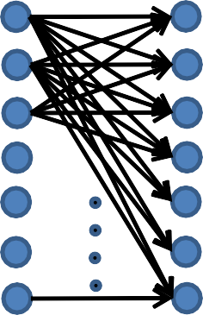
Why Convolutional ?
FC Neural Network
Conv. Neural Network
𝑓 = 5
𝑠 = 1
𝑝 = 0
6 𝑓𝑖𝑙𝑡𝑒𝑟𝑠
𝑓 = 5
𝑠 = 1
𝑝 = 0
6 𝑓𝑖𝑙𝑡𝑒𝑟𝑠
32 ∗ 32 ∗ 3
28 ∗ 28 ∗ 6
32 ∗ 32 ∗ 3
= 3072
28 ∗ 28 ∗ 6
= 4704
6 filters * 5*5*3
= 450 weights + 6 biases
= 456 parameters
3072 ∗ 4704
= 𝟏, 𝟒𝟒, 𝟓𝟎, 𝟔𝟖𝟖 parameters

Slide 88
Why Convolutional ?
 |  |  | 0 | 0 | 0
 |  |  | 0 | 0 | 0
 |  |  | 0 | 0 | 0
10 | 10 | 10 | 0 | 0 | 0
10 | 10 | 10 | 0 | 0 | 0
10 | 10 | 10 | 0 | 0 | 0
10
10
10
1 | 0 | -1
1 | 0 | -1
1 | 0 | -1
0
10
10
10
10
10
10
*
=

Slide 89
Why Convolutional ?
 |  |  |  | 0 | 0
 |  |  |  | 0 | 0
 |  |  |  | 0 | 0
10 | 10 | 10 | 0 | 0 | 0
10 | 10 | 10 | 0 | 0 | 0
10 | 10 | 10 | 0 | 0 | 0
10
10
10
0
1 | 0 | -1
1 | 0 | -1
1 | 0 | -1
0 | 30
10
10
10
0
10
10
10
0
*
=
Parameter Sharing: A feature detector that is useful in one part of the image may also be useful on another part of the same image.

Slide 90
Why Convolutional ?
 |  |  | 0 | 0 | 0
 |  |  | 0 | 0 | 0
 |  |  | 0 | 0 | 0
10 | 10 | 10 | 0 | 0 | 0
10 | 10 | 10 | 0 | 0 | 0
10 | 10 | 10 | 0 | 0 | 0
10
10
10
1 | 0 | -1
1 | 0 | -1
1 | 0 | -1
0 | 30 | 30 | 0
0 | 30 | 30 | 0
0 | 30 | 30 | 0
0 | 30 | 30 | 0
10
10
10
10
10
10
*
=
Parameter Sharing: A feature detector that is useful in one part of the image may also be useful on another part of the same image.
Sparcity of connections: In each layer, output depends only on small number of inputs.

Slide 91
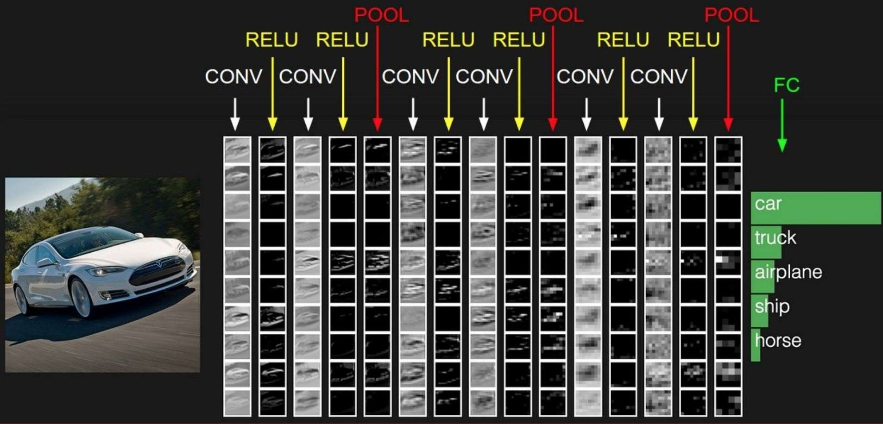
LAYERS IN CNN

Slide 92
A few important terms
Forward pass: Process of passing the data from input layer to output layer.
Cost Function: Difference between the predicted and true output of a NN.
Backpropagation: The process of updating parameters of a network depending on the cost function (using optimization algorithms viz., Gradient Descent, SGDM, ADAGrad, etc.) to minimize the cost.
Mini-batch: Number of images passing at once through the network.
Learning Rate: Speed by which the parameters are updated.
Iteration: A mini-batch performing a forward and a backward pass through
the network is an iteration.
Epoch: When the complete dataset undergoes a forward and a backward pass, an epoch is completed.

Slide 93
Visualize the graph on Tensorboard
tbCallBack = keras.callbacks.TensorBoard(log_dir='./Graph', histogram_freq=0,
write_graph=True, write_images=True)
model.fit(...inputs and parameters..., callbacks=[tbCallBack])
If you want to visualize the files created during training, run in your terminal
tensorboard --logdir path_to_current_dir/Graph

Slide 94
Use case: Image classification

Slide 95
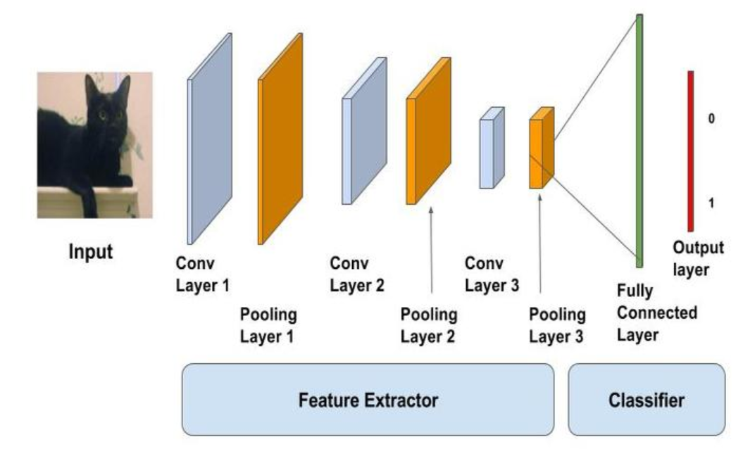
Image Classification on Cifar10

Slide 96
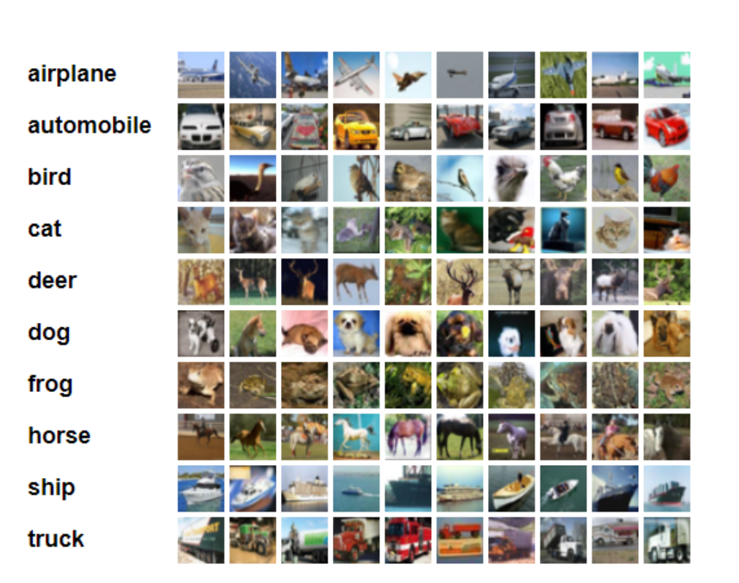
Data set: Cifar10
containing 60.000 different images
size of all images in this dataset is 32x32x3 (RGB)

Slide 97
Load data set
(x_train, y_train), (x_test, y_test) = cifar10.load_data() y_train = to_categorical(y_train, num_classes) y_test = to_categorical(y_test, num_classes)
X_train /= 255.0
X_test /= 255.0
Using one hot encoding to transform the output variable into a binary matrix
Normalizing the data

Slide 98
structure of the model
We will use a structure with two convolutional layers
followed by max pooling
and a flattening out of the network to fully connected layers to make predictions

Slide 99
Our baseline network structure can be summarized as follows:
Convolutional input layer, 32 feature maps with a size of 3×3, a rectifier activation function and a weight constraint of max norm set to 3.
Dropout set to 20%.
Convolutional layer, 32 feature maps with a size of 3×3, a rectifier activation function and a weight constraint of max norm set to 3.
Max Pool layer with size 2×2.
Flatten layer.
Fully connected layer with 512 units and a rectifier activation function.
Dropout set to 50%.
Fully connected output layer with 10 units and a softmax activation function

Slide 100
Convolutional layer
model = Sequential() model.add(Conv2D(32, (3, 3), padding='same', input_shape=x_train.shape[1:])) model.add(Activation('relu')) model.add(MaxPooling2D(pool_size=(2, 2))) model.add(Dropout(0.3))

Slide 101
Flatten layer
model.add(Flatten()) model.add(Dense(80)) model.add(Activation('relu')) model.add(Dropout(0.3)) model.add(Dense(num_classes)) model.add(Activation('softmax'))

Slide 102
Fitting model
model.compile(loss='categorical_crossentropy', optimizer=SGD, metrics=['accuracy']) model.fit(x_train, y_train, batch_size=batch_size, epochs=epochs, validation_split=0.2, shuffle=True) scores = model.evaluate(x_test, y_test, verbose=1) print('Test loss:', scores[0]) print('Test accuracy:', scores[1]) model.save('./model' + '.h5')

Slide 103
References
https://becominghuman.ai/back-propagation-in-convolutional-neural-networks-intuition-and-code-714ef1c38199
http://www.wildml.com/2015/12/implementing-a-cnn-for-text-classification-in-tensorflow/
https://towardsdatascience.com/a-walkthrough-of-convolutional-neural-network-7f474f91d7bd
http://cs231n.github.io/convolutional-networks/
https://www.youtube.com/watch?v=AgkfIQ4IGaM
https://adeshpande3.github.io/adeshpande3.github.io/A-Beginner's-Guide-To-Understanding-Convolutional-Neural-Networks/
https://www.youtube.com/watch?v=YRhxdVk_sIs
https://www.youtube.com/watch?v=FmpDIaiMIeA&t=748s
https://medium.com/@2017csm1006/forward-and-backpropagation-in-convolutional-neural-network-4dfa96d7b37e
https://brohrer.github.io/how_convolutional_neural_networks_work.html

