Slide 1

WIPRO NGA PROGRAM – C++ LSP BATCH
Capstone Project Presentation – 12 August 2024
Project Title - Online Auction System using Client-Server Architecture
Presented by – Dharani Priya T
www. rpsconsulting. in

Slide 2

PROJECT OVERVIEW
The online auction system project implements a client-server application where users can participate in auctions by bidding on items through a networked interface. Server handles commands such as listing available items, displaying current bids and bidders, accepting new bids, and providing final results when the auction ends. The client connects to the server, sends commands for bidding or querying item statuses, and receives updates in real time. The system demonstrates fundamental network programming, concurrent processing, multi-threading and synchronization primitives to efficient communication between components.

Slide 3
INTRODUCTION
The online auction system is a client-server application designed to facilitate online auctions for various items. The system allows clients to bid on items and retrieve auction status in real-time. With the increasing demand for online auction systems, it is essential to develop a secure, efficient, and reliable platform that can handle a large number of bidders and provide accurate results. The auction system aims to address this need by providing a robust and scalable solution for conducting online auctions.

Slide 4
MOTIVATION
Traditional auction methods fall short in addressing the dynamic and real-time demands of a global audience. The need for an online auction system that offers real-time bidding, robust security, and scalable performance. By developing this online auction system, we aim to address these challenges head-on, that enhances user experience, ensures fair play, and supports a wide range of auction scenarios. By leveraging advanced technology and we aim to set a new standard in online auction systems, ensuring a superior experience for all users.

Slide 5
PROJECT SCOPE
To develop a secure and reliable online auction system that can handle bidders.
To provide a user-friendly interface for bidders to place their bids
To ensure the accuracy and integrity of the bidding process
To provide real-time updates of auction status
To handle multiple client connections concurrently using multi-threading

Slide 6
Various application tools used
Network tool:
GCC compiler
Text editor
System monitoring tool:
netstat
lsof
pidstat
Debugging tools:
GDB(GNU debugger)
valgrind
Shell script

Slide 7
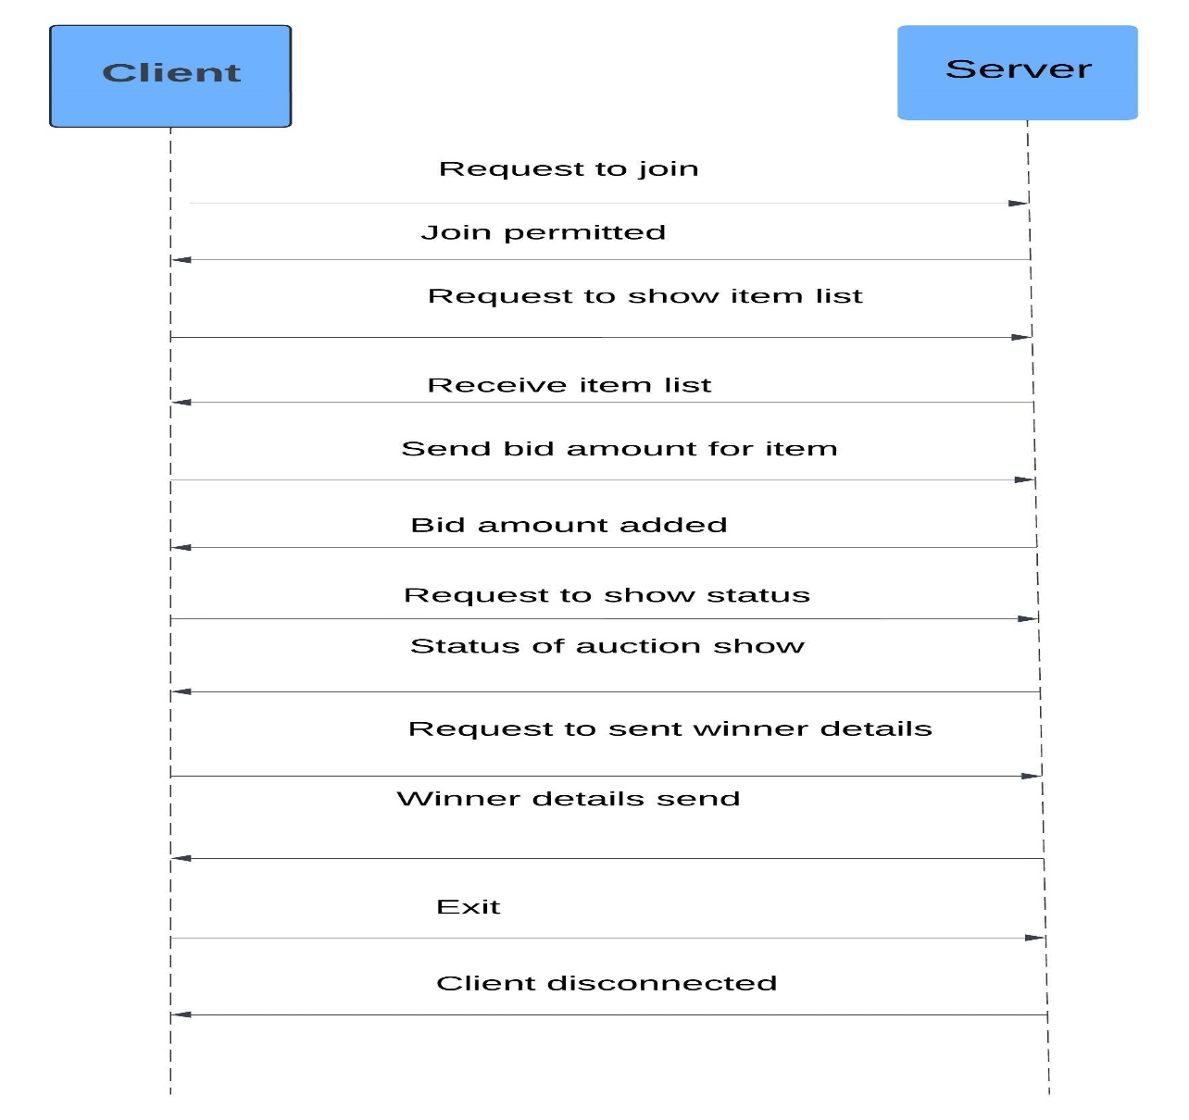
SYSTEM FLOW

Slide 8
MODULES
In this project, there are two main modules used:
Server Module
Client Module
SERVER MODULE
The server is responsible for maintaining the auction status and handling client connections.
Socket Management
Socket Creation
Binding
Listening
Connection Management
Accepting Connections
Thread Creation
Client Handling
Command Processing
Item Management
Concurrency Management:

Slide 9
2. CLIENT MODULE The client is responsible for bidding on items and retrieving auction status
Connection setup
Socket creation
Server connection
Command interface
Input handling
Response handling
Command execution
Command syntax

Slide 10
List of functions used
Server functions:
socket()
int server_fd = socket(AF_INET, SOCK_STREAM, 0);
2. bind()
bind(server_fd, (struct sockaddr *)&address, sizeof(address));
3.listen()
listen(server_fd, MAX_CLIENTS);
4. accept()
new_socket = accept(server_fd, (struct sockaddr *)&address, (socklen_t*)&addrlen);
5. pthread_create()
pthread_create(&thread_id, NULL, handle_client, (void*)new_client);
6. read()
int bytes_read = read(client_sock , buffer, sizeof(buffer) - 1);
7.write()
write(client_sock , response, strlen(response));
8. close()
close(client_sock);
9. pthread_mutex_lock() & pthread_mutex_unlock()
pthread_mutex_lock(&lock); pthread_mutex_unlock(&lock);
10. pthread_mutex_init()
pthread_mutex_init(&lock, NULL);

Slide 11
Client functions: 1. inet_pton() inet_pton(AF_INET, "127.0.0.1", &serv_addr.sin_addr); 2. connect() connect(sock, (struct sockaddr *)&serv_addr, sizeof(serv_addr)); 3. send() send(sock, input, strlen(input), 0); 4. read() int valread = read(sock, buffer, sizeof(buffer) - 1); Utility functions: 1. snprintf() snprintf(item_status, sizeof(item_status), "Item: %s, Highest Bid: %d, Highest Bidder: %s\n", items[i].name, items[i].highestBid, items[i].highestBidder); 2. strtok() char* command = strtok(buffer, " "); 3. strcpy() strcpy(items[i].name, “Painting"); 4. strcspn() input[strcspn(input, "\n")] = '\0';

Slide 12
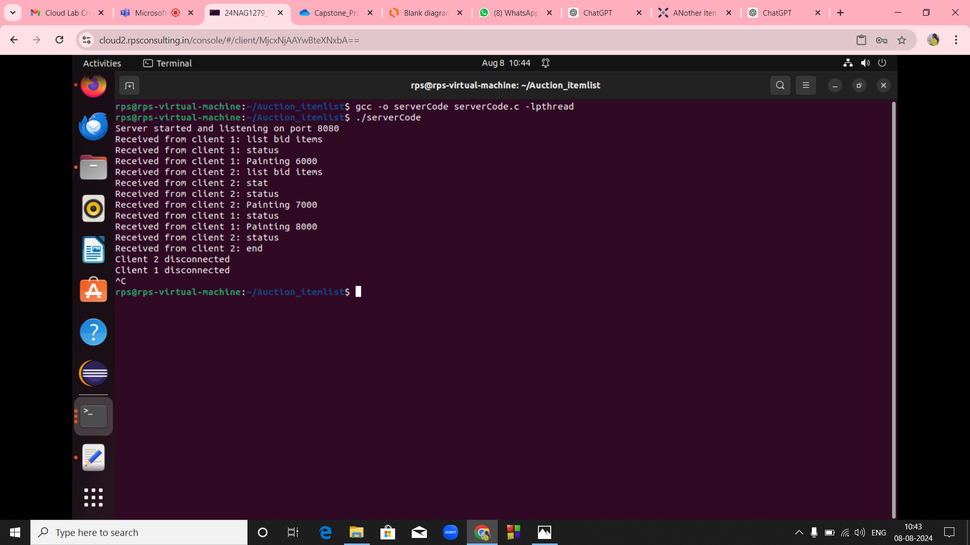
OUTPUT SCREENSHOT
Server terminal

Slide 13
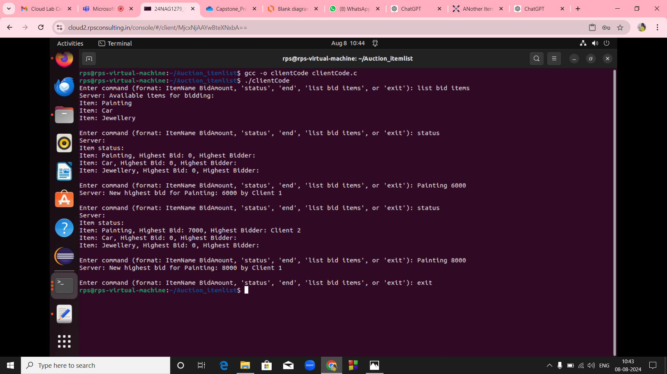
Client 1 terminal

Slide 14
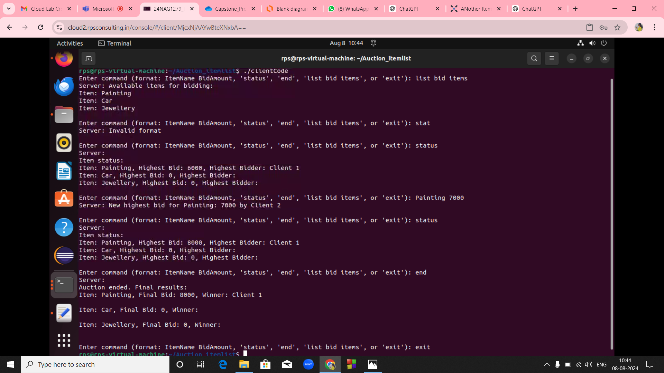
Client 2 terminal

Slide 15
FUTURE ENHANCEMENTS
To elevate an online auction system utilizing client-server architecture several key enhancements can be applied. Expanding the platform with multi-language and regional compliance features will cater to a global audience, and integrating in-app support and user feedback systems will facilitate ongoing improvements and user assistance.
These enhancements aim to address various aspects of the auction system, from improving security and scalability to enhancing user experience and adding new functionalities. Implementing these changes will help create a more robust, feature-rich, and user-friendly auction system.
2024 - RPS Consulting all r ights reserved

Slide 16
CONCLUSION
The auction system successfully demonstrates a implementation of a client-server application with concurrent bid handling and status reporting. By using multithreading and mutexes, the system can manage multiple clients and ensure data consistency. The system is tested using unit testing, integration testing, and system testing to ensure that it functions correctly. It has been tested using various scenarios and has proven to be robust and scalable.
2024 - RPS Consulting all r ights reserved

