Slide 1
A Comparative Study of Indirect Supervision Techniques for Ultra-Fine Entity Typing
422273- Y. Dharani
422160 – J. Ramya
421170 – K. Elizabeth
Under the guidance of Dr. Hima Bindu. K

Slide 2
Objective
In this project, we aim to conduct a comparative evaluation of various indirect supervision techniques in Natural Language Processing, using Ultra-Fine Entity Typing (UFET) as a representative task.
We try to find how different weak supervision techniques like NLI transformation, distant supervision, and masked language modeling perform in capturing fine-grained semantic types for entities without depending on large-scale manual annotation.
To build and compare three diverse approaches for labeling entities in context, especially when labeled data is limited or noisy.

Slide 3
What is Ultra-Fine Entity Typing?
Given a sentence and an entity mention, predict context-sensitive, fine-grained type labels.
For example,
in “Elon Musk founded SpaceX in 2002.”
Elon Musk should be typed as “founder” and not just person.
in “In late 2015 Leonardo DeCaprio starred in The Revenant”
Leonardo DeCaprio should be typed as “filmdirector”, “actor” or “award winner”

Slide 4
What is Ultra-Fine Entity Typing?
Fine-grained types (victim, criminal) are important for context-sensitive tasks such as :
Coreference Resolution
Question Answering
Information Extraction
Summarization
Key Challenges are :
Large Number of types.
Scarcity of annotated data per type.
Need for models that understand both entity and context.

Slide 5
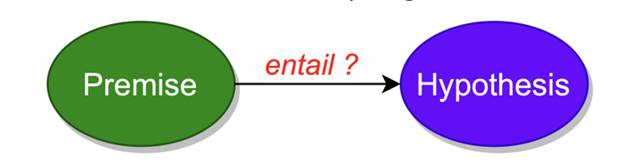
Approach 1 – NLI Based (LITE)
We use Indirect supervision from NLI to predict best labels for an entity.
NLI determines relationship between two sentences i.e. premise and a hypothesis.
It classify the relationship into one of the three categories :
Entailment
Contradiction
Neutral

Slide 6
Approach 1 – NLI Based (LITE)
Premise: The original sentence.
Hypothesis: “[Entity] is a [Label]” (e.g., “Elon Musk is a founder.”)
Use RoBERTa-large MNLI to classify (Entailment / Neutral / Contradiction).
Label types with high entailment score are selected.
Pros: Zero-shot friendly, label semantics preserved.

Slide 7
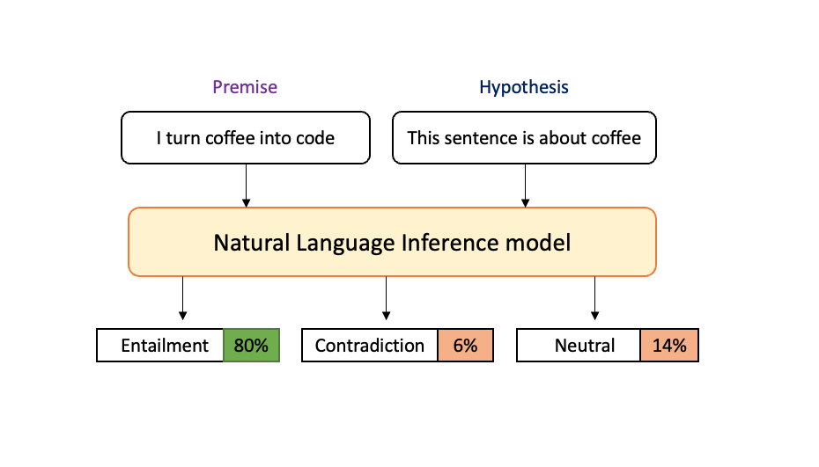
Approach 1 – NLI Based (LITE)

Slide 8
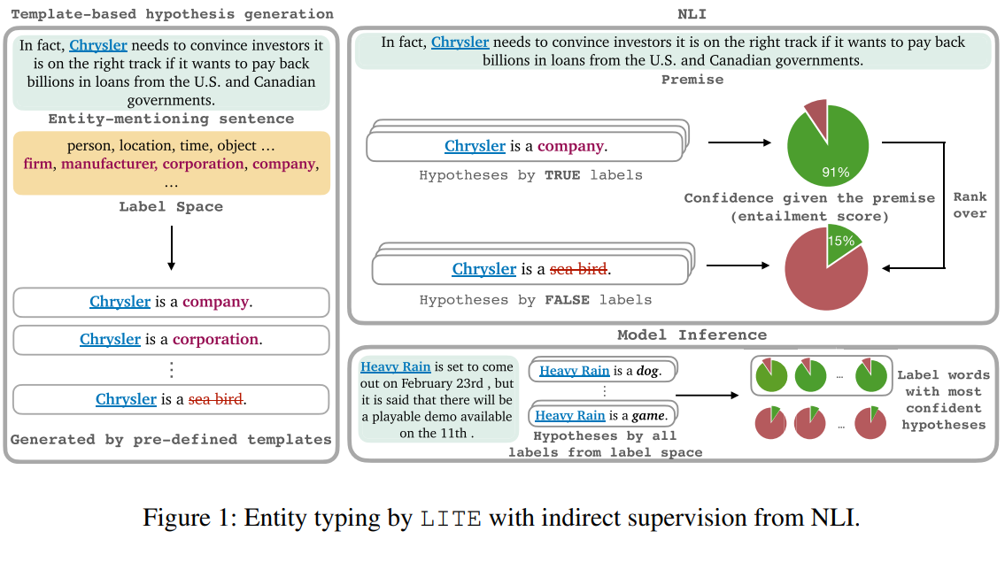
Approach 1 – NLI Based (LITE)
This figure adapted from LITE

Slide 9
Approach 2 – Distant Supervision
Distant Supervision: A technique for auto-labeling large datasets using existing knowledge bases, commonly used in NLP tasks like relation extraction.
Dataset is built using :
Head Words: The main word in a phrase that defines its syntactic role. Example: "the big, red ball" → Head word: ball.
Entity Linking: Automatically identifies and links text mentions of entities to entries in knowledge bases like Wikipedia or Wikidata.

Slide 10
Approach 2 – Distant Supervision
Model architecture – Model is based on
bidirectional LSTM for contextual encoding.
Context Representation
Sentence S -> x1 x2 …… xn xi -> wi (pretrained word embedding which are taken from glove) li -> location embedding i.e whether xi is before, inside or after the mention. [xi, li] <- input to bidirectional LSTM.
hi -> contextualized representation for each token.

Slide 11

Approach 2 – Distant Supervision
ai -> weight for each token.
Wa, Ua -> attention parameters which allow the model to focus on important tokens in the sentence.
Context c is the weighted sum of contextualized token representation using MLP based attention.
c = Σ aᵢ * hᵢ

Slide 12
Approach 2 – Distant Supervision
The input is representated as :
r = [c; m]
c -> context vector
m -> mention representation
Label prediction :
Wt -> Type label embedding matrix
n -> Number of labels in prediction space
d -> Dimension of R

Slide 13
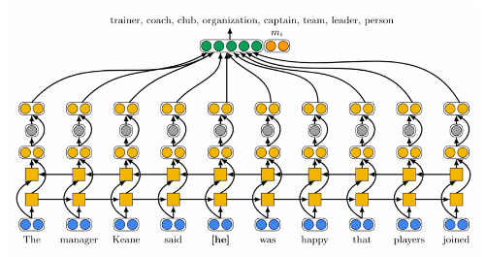
Approach 2 – Distant Supervision
Architecture for Ultra-Fine Entity Typing with distant supervision, reproduced from presentation slides by Choi et al.
Architecture

Slide 14
Approach 2 – Distant Supervision
We predict each types probability via a sigmoid of its inner product with r.
y = sigmoid(Wt.r)
Every type t, for which yt > 0.5 we output is as a prediction for the given input sentence and the entity mentioned.
Pros : Learns task-specific representations.
Cons : Susceptible to noisy labels.

Slide 15
Approach 3 – Weak Supervision with Masked Language Models
Treat UFET as a cloze task (fill in the blank type) using BERT.
Input : Replace entity with “[MASK] such as entity”
Predict masked token and map to label space.
Training: Fine-tune BERT on masked-labeled sentences.
Pros: Leverages pre-trained contextual knowledge.
Cons: Mapping predicted tokens back to label space.

Slide 16
Approach 3 – Weak Supervision with Masked Language Models
Inject Hearst pattern (like [MASK] such as M) into sentences to let BERT predict which word fits.
Example:
Original: "Leonardo DiCaprio starred in The Revenant.“
Modified: [MASK] such as Leonardo DiCaprio starred in The Revenant.
BERT might predict: “actor”, “star”, “filmmaker” → used as type labels.

Slide 17
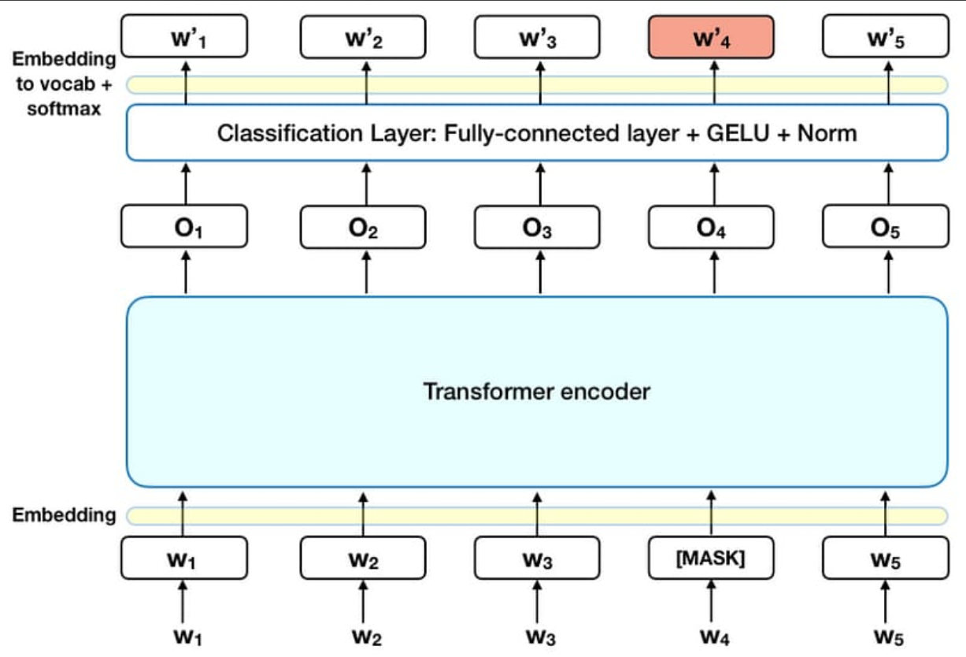
Approach 3 – Weak Supervision with Masked Language Models

Slide 18
Comparative Analysis Table
Aspect | NLI-based | Distant Supervision | Weak Supervision (MLM with [MASK])
Input Format | Sentence as premise + [Entity] is a [Label] as hypothesis | Sentence + mention-level representations | Sentence with entity replaced by [MASK].
Label Prediction | Based on entailment scores across all labels. | Softmax over label space. | Predict masked token and map to closest label(s).
Trivial Strength | Easily scalable to large label sets. | Simple architecture, interpretable. | Leverages strong MLM prior knowledge.
Trivial Limitation | Computationally expensive (O(n_labels)). | Needs good quality weakly labeled data. | Mapping MLM output to label space can be ambiguous.
Non-Trivial Strength | Converts entity typing to a hypothesis testing problem. | Learns task-specific mention+context patterns. | Learns to predict entity types implicitly via cloze-like tasks.
Non-Trivial Limitation | Assumes labels are well-formed English phrases. | Suffers from noisy supervision, hard to generalize. | May predict surface forms not directly matching label set.

Slide 19
Comparative Analysis Table
Feature / Aspect | NLI-Based (LITE) | Distant Supervision | MLM-Based
Supervision Type | NLI-label hypotheses | KB-linked + headwords | Masked token prediction
Core Model | RoBERTa-large MNLI | BiLSTM + attention | BERT-base uncased
Zero-shot Generalization | High | Low | Medium
Training Time | Low | Medium | High
Scalability | Low (O(n_labels)) | High | Medium

Slide 20
Evaluation Results
 | RoBERTa-NLI | BiLSTM (Distant Sup.) | BERT (Masked LM)
Paper | Precision : 53.3% Recall : 46.6% F1 score : 49.7 | Precision : 41.4% Recall : 9.9% F1 score : 16 | Precision : 58.3% Recall : 54.4% F1 score : 56.3
Our Model | Precision : 49.56% Recall : 40.5% F1 score : 48 | Precision : 25.82% Recall : 5.31% F1 score : 8.81 | Precision : 37.06% Recall : 58% F1 score : 45.22

Slide 21
Conclusion
Natural Language Inference (NLI)-based models are great for zero-shot generalization.
Distant supervision can label huge datasets without manual work, but the data is often noisy or imperfect.
The masked language model (MLM) method is clever because it turns entity typing into a fill-in-the-blank task (like “cloze” tests).The smart part is using BERT's pretrained knowledge to guess the type of an entity, even when it's not directly stated.

Slide 22
References
Li, Bangzheng, Yin, Wenpeng, and Chen, Muhao. Ultra-fine Entity Typing with Indirect Supervision from Natural Language Inference. Transactions of the Association for Computational Linguistics, Vol. 10, pp. 607–622, 2022. indirectSupervisionNLP.
Choi, Eunsol, Levy, Omer, Choi, Yejin, and Zettlemoyer, Luke. Ultra-Fine Entity Typing. Transactions of the Association for Computational Linguistics, Vol. 8, pp. 149–164, 2020. DOI: LITE.
Choi, Eunsol, Levy, Omer, Choi, Yejin, and Zettlemoyer, Luke. Ultra-Fine Entity Typing. In Proceedings of the 56th Annual Meeting of the Association for Computational Linguistics (Volume 1: Long Papers), edited by Iryna Gurevych and Yusuke Miyao, pages 87–96, July 2018, Melbourne, Australia. Association for Computational Linguistics. DOI: Distant_supervision
Dai, Hongliang, Song, Yangqiu, and Wang, Haixun. Ultra-Fine Entity Typing with Weak Supervision from a Masked Language Model. arXiv preprint, 2021. arXiv:2106.04098. Available at: MLM.

Slide 23
Thank You

