Slide 1
Big Social Data Analytics
CBUSV2031U.LA_E18

Slide 2
Dharanidaran dap.digi@cbs.dk

Slide 3
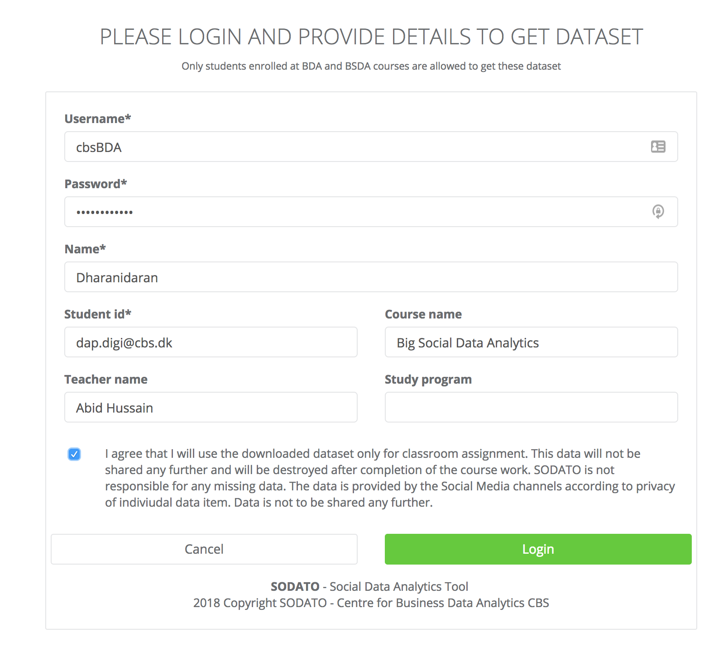
Get your Data
https://sodato.cbs.dk/software/datasetlibrary/

