Slide 1


Flight Delay Prediction Using Gradient-Boosted Ensemble Models
Presented by Dharanidhar beere
Msc Data Science
University Of Hertfordshire
Github Link:https://github.com/DharanidharBeere/Flight-Delay-Prediction
db24acd@herts.ac.uk
24077147

Slide 2


Project Overview
Flight delays are a common problem in the airline industry. They affect passengers, airline operations, and scheduling. Delays can cause extra costs, missed flights, and poor travel experience.
Machine learning can be used to analyse historical flight data and predict delays. This project focuses on building a prediction model to find on what factors flight delay is occuring.

Slide 3
01.
Compare multiple ML models
Research Question
02.
Evaluate using ROC-AUC, Accuracy
Can ensemble models (e.g., XGBoost) improve flight delay prediction compared to traditional models?
03.
Identify key delay factors

Slide 4
Dataset Features:Flight date (day, month),Departure time,Airline carrier,Flight distance,Delay status (target variable)
01
Dataset
Primary Dataset (Main):
U.S. Bureau of Transportation Statistics – Airline On-Time Performance Data
https://www.transtats.bts.gov/ONTIME/
Alternative / Mirror Dataset (Same data, easier access):
Kaggle – U.S. Flight Delays and Cancellations
https://www.kaggle.com/datasets/usdot/flight-delays
Dataset Characteristics:Large-scale real-world dataset,Contains both numerical and categorical data,Time-based and operational features
02
03
Target Variable:Binary classification:
0 → On-time flight
1 → Delayed flight
Flight delays are influenced by time, airline operations, and distance

Slide 5
Ideation Process
The project follows a step-by-step process from problem understanding to model evaluation. Each step helps improve accuracy and reliability.
It includes data preparation, feature selection, model training, and performance evaluation.
01
02
03
04
Clean the flight dataset
Handle missing values and remove incorrect records
Process flight details
Convert airline, origin, and destination into usable format
Create important features
Extract hour, day, month and peak hour vs non-peak hour
Prepare data for modelling
Select important features and make data ready for training
We extracted time-based and operational features like peak hours, airline, and distance, which strongly influence flight delays.

Slide 6
Model Selection and Pipeline
Why These Models?
Logistic Regression → Used as a baseline model for comparison
Random Forest → Reduces variance and improves stability
Gradient Boosting → Builds strong models from weak learners
XGBoost → Provides regularisation and high predictive performance
These models were selected to compare traditional and ensemble approaches.
Logistic Regression acts as a baseline, while Random Forest and Gradient Boosting improve performance through ensemble learning.
XGBoost was chosen for its regularisation and high accuracy.
The project follows a standard pipeline from data preprocessing to model evaluation.

Slide 7
Creation Process
The project was implemented using Python and machine learning libraries. The dataset was cleaned, processed, and used to train multiple models.
Different models were compared to identify the best performing approach for flight delay prediction.
Data cleaning and preprocessing (handling missing values).
Feature engineering to improve model performance including peak hour vs non-peak hour (peak hours = busiest flight times i.e: 09:00 am).
Created time-based features like hour, day, and month.
Training models such as Logistic Regression, Random Forest, Gradient Boosting, and XGBoost.
Evaluating and comparing models to select the best one

Slide 8
SWOT Analysis
(SWOT = Strengths, Weaknesses, Opportunities, Threats)
Weaknesses
Threats
Weaknesses: Limited to U.S. dataset, no weather or external factors included.
Threats: Changes in flight patterns, data quality issues, model overfitting.
Strengths
Opportunities
Strengths: Accurate predictions, use of ensemble models, real-world dataset.
Opportunities: Expand to real-time flight monitoring, include weather or airline schedules.
"Our XGBoost model is neither overfitting nor underfitting. It performs well on both training and test data, showing it can generalize to new flights."

Slide 9
Important Features
Departure time: Flights leaving during peak hours are more likely to be delayed.
Airline carrier: Some airlines have higher or lower average delays due to operational efficiency.
Flight distance: Longer flights have a higher risk of delay propagation.
Day of week / Month: Time-based variables affect delay probability.
The key features influencing flight delays were analysed across all models. Ensemble models such as Random Forest, Gradient Boosting, and XGBoost highlight which factors matter most.

Slide 10
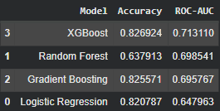
Performance Comparison of Models
All models were evaluated using accuracy, ROC-AUC. Ensemble models outperform Logistic Regression, with XGBoost achieving the highest predictive performance.

Slide 11
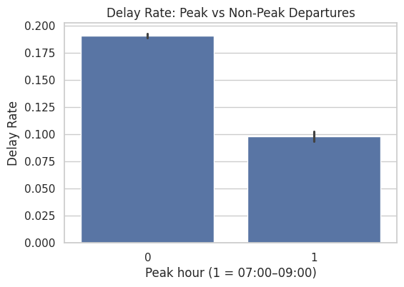
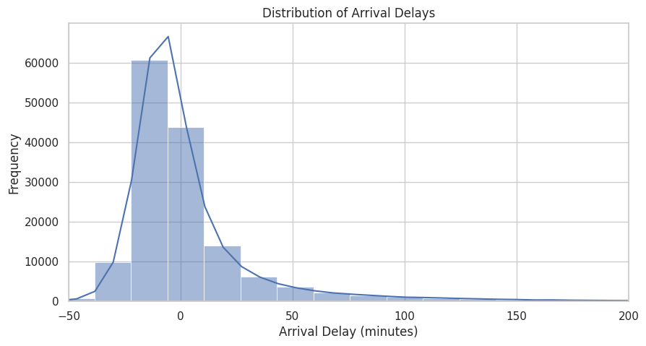
Visualizations
This graph shows that flights during peak hours have more delays than non-peak hours. This is because airports are busier at that time. So, peak hour is an important factor in our model.0 -Non-peak (less busy),1 -Peak (busy time)
Most flights are on time or have small delays, but a few flights have big delays.”

Slide 12
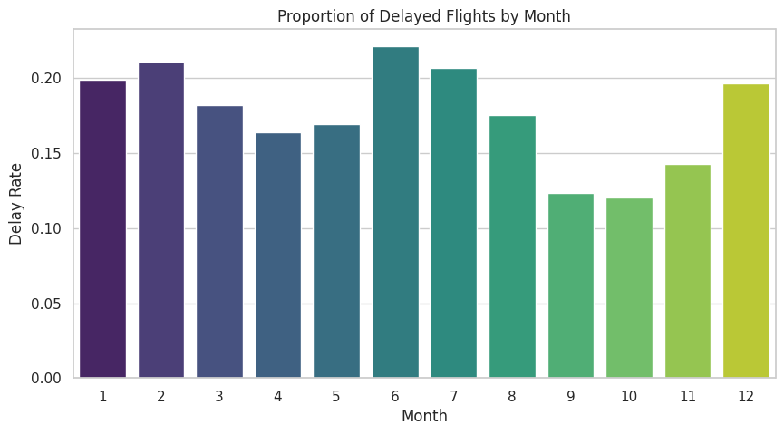
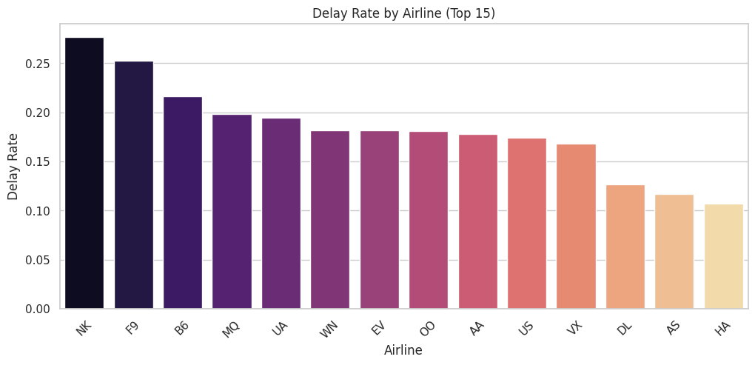
Visualizations
Delay rates change depending on the month
Summer and winter have more delays
Fall months have fewer delays
This shows a seasonal pattern
So, month is an important feature
#so delay depends on airline
This graph shows that some airlines have more delays than others. A few airlines perform better with fewer delays.
“Delays depend on the month and the airline. Some months and airlines have more delays than others.”

Slide 13
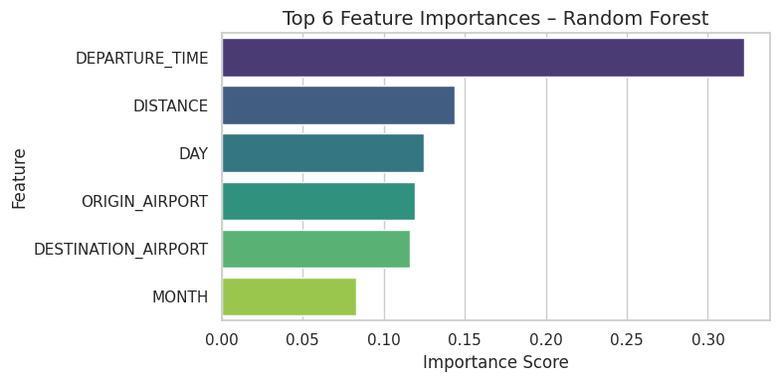
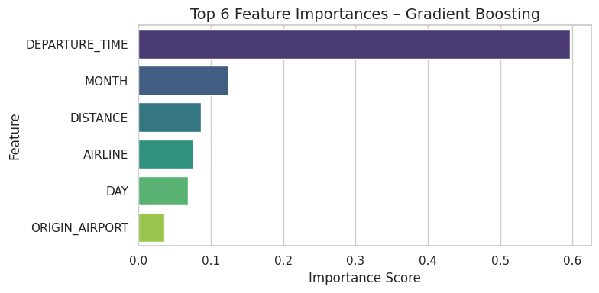
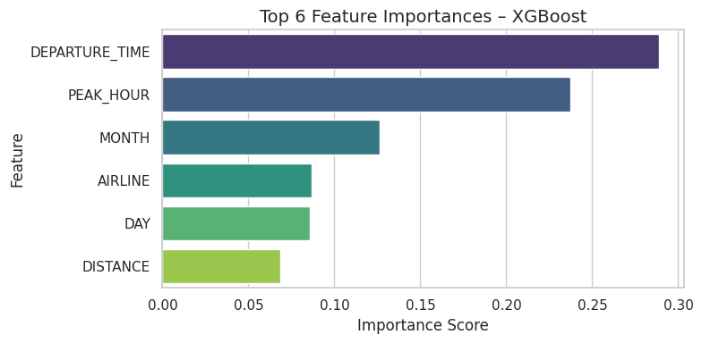
Visualizations
These graphs show which features are most important for predicting flight delays. Departure time is the top factor in all models. XGBoost also highlights peak hour as very important, which helps improve prediction accuracy.”

Slide 14
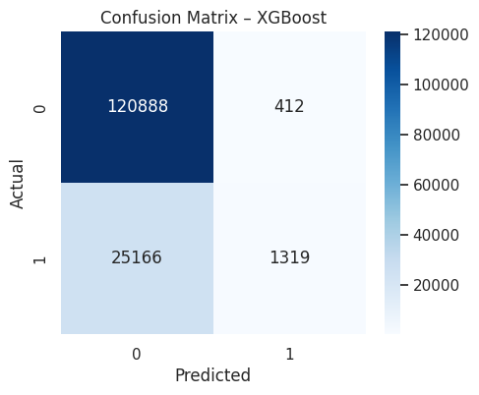
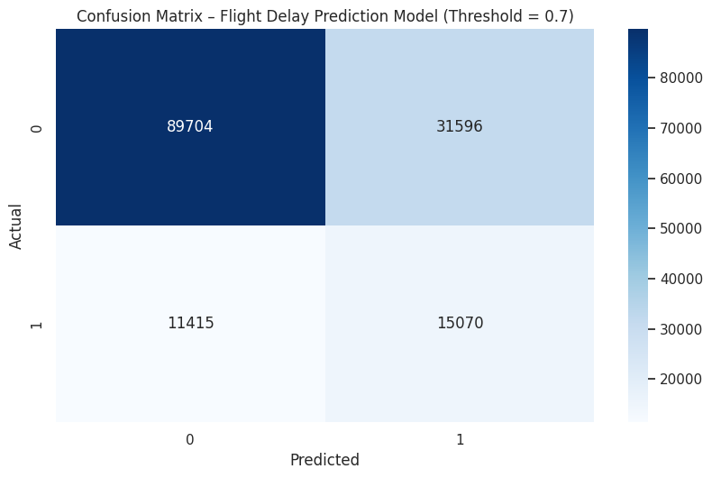
Most non-delayed flights (0) are predicted correctly
Many delayed flights (1) are wrongly predicted as non-delay
Overall, the model is less accurate for delay prediction
Non-delayed flights are still correctly predicted
More delayed flights are correctly identified
Performance improved due to XGBoost’s ability to reduce bias through sequential learning and regularisation.
The model is not perfect—it makes both correct and incorrect predictions. Initially, it misclassified many delayed flights, but after tuning, it significantly improved delay detection while increasing false alarms.

Slide 15
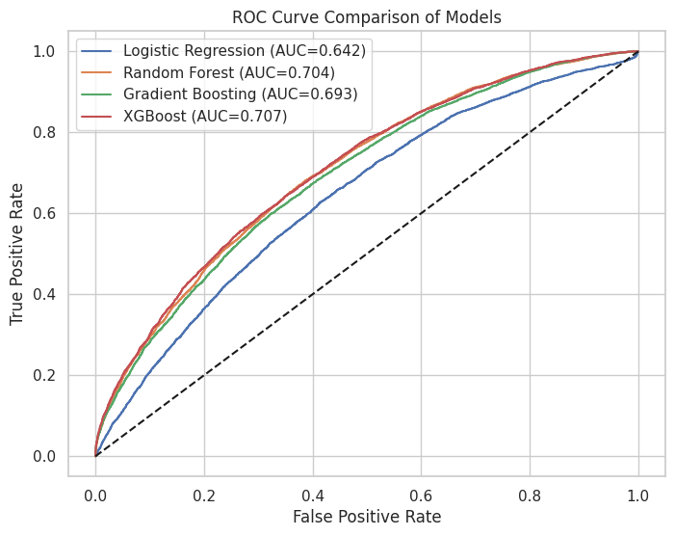
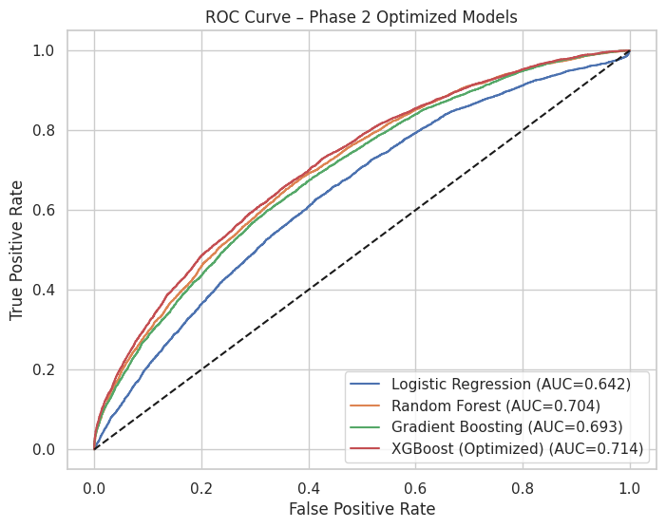
Visualizations
ROC curves show how well our models predict flight delays. The area under the curve (AUC) tells us the model’s overall accuracy — higher AUC means better predictions."
Shows how well each model predicts flight delays before optimization.
XGBoost already performs best among all models.
Logistic Regression has the lowest performance (closest to the dotted random line).
Random Forest and Gradient Boosting perform moderately.
Shows the models after tuning hyperparameters.
XGBoost performance improved further (higher curve and AUC).
Other models remain almost the same because they weren’t tuned.
The dotted line represents a random classifier baseline (AUC = 0.5), so curves above this line are better than random guessing.
ROC shows model performance, and AUC tells us how accurate it is.

Slide 16
Critical Analysis of Model Results
The models were evaluated to identify strengths, weaknesses, and opportunities for improvement. XGBoost performed best, but careful analysis shows areas for further improvement.
Accuracy vs ROC-AUC: Ensemble models provide better performance than Logistic Regression.
Confusion Matrix: Most delays are correctly predicted; some false positives/negatives remain.
Comparison with Literature: Results align with previous research that ensemble methods improve prediction accuracy.
Limitations:
Dataset limited to U.S. flights
No weather or external factors included
Further feature engineering could improve predictions

Slide 17
Conclusion
The project demonstrates that machine learning can predict flight delays effectively.
XGBoost is the best-performing model, showing high accuracy and ROC-AUC.
Ensemble models improve delay prediction over traditional methods.
XGBoost provides the most accurate predictions among the models tested.
Future Work:
Include weather and real-time data
Expand to international flights
Deploy a live predictive system

Slide 18
References
Breiman, L. (2001) ‘Random Forests’, Machine Learning, 45(1), pp. 5–32. https://link.springer.com/article/10.1023/A:1010933404324
Chen, T. and Guestrin, C. (2016) ‘XGBoost: A scalable tree boosting system’, Proceedings of the 22nd ACM SIGKDD International Conference on Knowledge Discovery and Data Mining, pp. 785–794. https://dl.acm.org/doi/epdf/10.1145/2939672.2939785
Kim, S., Park, E. Prediction of flight departure delays caused by weather conditions adopting data-driven approaches. J Big Data 11, 11 (2024). https://doi.org/10.1186/s40537-023-00867-5
Jerome H. Friedman. "Greedy function approximation: A gradient boosting machine.." Ann. Statist. 29 (5) 1189 - 1232, October 2001. https://doi.org/10.1214/aos/1013203451
Gopichand, G., Sarath, T., Devi, V.L. et al. Flight Delay Prediction Based on Delay Time Using Predictive Analytics. Int. J. Aeronaut. Space Sci. 26, 1940–1953 (2025). https://doi.org/10.1007/s42405-024-00855-w
Yuemin Tang. 2021. Airline Flight Delay Prediction Using Machine Learning Models. In 2021 5th International Conference on E-Business and Internet (ICEBI 2021), October 15-17, 2021, Singapore, Singapore. ACM, New York, NY, USA, 7 Pages. https://doi.org/10.1145/3497701.3497725
Alla, H., Arezki, S., Moumoun, L., Balouki, Y. (2025). A Machine Learning Approach to Analyze Flight Delays Causal Factors: A Predictive System. In: Arezki, S., Ouaissa, M., Ouaissa, M., Krichen, M., Nayyar, A. (eds) Emerging Disruptive Technologies for Society 5.0 in Developing Countries. Advances in Science, Technology & Innovation. Springer, Cham. https://doi.org/10.1007/978-3-031-63701-8_4

Slide 19

THANK YOU

