Slide 1

AGRIAI Hackathon 2025
TITLE PAGE
Problem Statement Title:
Develop an AI-driven system to assists farmers
Theme: AgriSense AI
Team Name: INNOVATORS
S.No | Name | College | Year
1 | S.A.DHARANIDHARAN | KONGUNADU COLLEGE OF ENGINEERING AND TECHNOLOGY, TRICHY, TAMILNADU | II
2 | P.GOKULNATH |  | II
3 | A.RITHIK |  | II

Slide 2
IDEA TITLE
FarmSense AI: Intelligent Agricultural Ecosystem
FarmSense AI is a comprehensive agricultural intelligence system that combines drone technology, IoT sensors, and advanced AI to create a "digital twin" of the farm. This innovative approach provides farmers with a virtual replica of their farmland that updates in real-time, enabling precise monitoring and predictive analytic
Key Components:
Autonomous Drone Network with Multispectral Imaging
Smart Soil Sensors with LoRaWAN Connectivity
AI-Powered Digital Twin Platform
Mobile App with Augmented Reality Interface

Slide 3
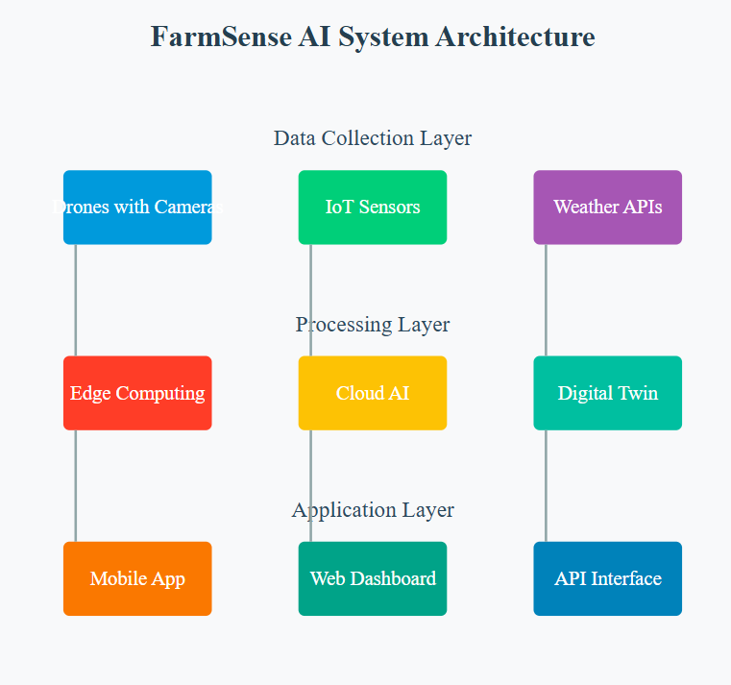
TECHNICAL APPROACH
AI/ML Technologies:
TensorFlow for image processing and prediction models
PyTorch for real-time data analysis
OpenCV for computer vision
FastAI for transfer learning
Hardware:
Custom-designed IoT sensors with LoRaWAN connectivity
DJI Agricultural Drones with multispectral cameras
Edge computing devices for local processing
Backend:
Django REST Framework for API development
PostgreSQL for data storage
Redis for caching
Frontend:
React Native for mobile app development
Three.js for 3D visualization
AR.js for augmented reality features

Slide 4
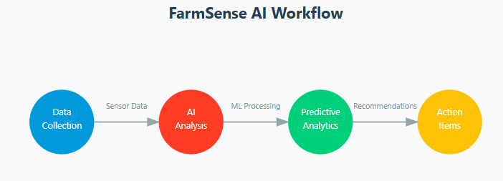
FEASIBILITY AND VIABILITY
Technical Feasibility:
All proposed technologies are currently available
Open-source frameworks reduce development costs
Scalable architecture ensures future growth
Economic Feasibility:
Initial setup costs offset by reduced crop losses
Subscription-based model for sustainability
Integration with existing government schemes
Potential Challenges and Risks
1.Technical Challenges:
Internet connectivity in rural areas
Battery life of IoT devices
Accuracy of predictions in extreme weather
2. Implementation Challenges:
Farmer adoption and training
Hardware maintenance
Data privacy concerns
Solutions to Challenges
Technical Solutions:
Offline-first approach with local processing
Solar-powered sensors with optimized power consumption
Edge computing for reduced internet dependency
Implementation Solutions:
User-friendly interface with local language support
Partnership with local agricultural extension services
Regular training workshops and support

Slide 5
IMPACT AND BENEFITS
Potential Impact
Agricultural Impact:
30-40% reduction in crop losses
25% increase in yield through optimized farming practices
20% reduction in water usage
Economic Impact:
Increased farmer income through better crop management
Reduced expenses on pesticides and fertilizers
New employment opportunities in agri-tech
Environmental Impact:
Reduced water wastage
Optimal use of agricultural inputs
Lower chemical usage through precise application
Social Benefits
Community Development:
Knowledge sharing platform for farmers
Better decision-making capabilities
Reduced crop failure risk
Sustainable Agriculture:
Promotion of sustainable farming practices
Reduced environmental impact
Long-term soil health improvement

Slide 6
RESEARCH AND REFERENCES
Research Papers:
"Digital Twin Technology in Agriculture: A Comprehensive Review" - Agricultural Systems Journal
"Machine Learning Applications in Pest Detection" - IEEE AgriTech Proceedings
"IoT Sensors in Precision Agriculture" - Smart Agriculture Journal
Data Sources:
Indian Meteorological Department API
National Agricultural Research Database
Global Soil Database
Local Agricultural Universities' Research Data
Technology References:
TensorFlow Documentation
DJI Agricultural Drone Specifications
LoRaWAN Protocol Guidelines
OpenCV Computer Vision Library

