Slide 1

CGB1201 – JAVA PROGRAMMING
Department of Artificial Intelligence and Data Science
Academic Year: 2024 – 2025 (Odd Semester)
Register Number : 2303811724322076
Name : DHARANIKA P
Year : II Year
Semester : III
Section : A
Date : 7.12.2024

Slide 2
Title of the Project
Personal Finance Management System

Slide 3
Problem Identification
Many individuals struggle to track their income and spending consistently, leading to poor financial decisions and instability.
Users often have difficulty creating and sticking to a budget, leading to overspending or mismanagement of funds.
Users often lack a clear plan to achieve long-term financial goals like saving for retirement, a home, or an emergency fund.

Slide 4
Objective
The system helps users manage and track their income, expenses, savings, and investments, providing insights into their financial situation through detailed transaction records.
Users can set budgets for various categories, track their spending, and monitor progress towards savings and investment goals.
The system offers tools to analyze spending and generate financial reports, helping users make informed decisions for financial stability and long-term goals.

Slide 5
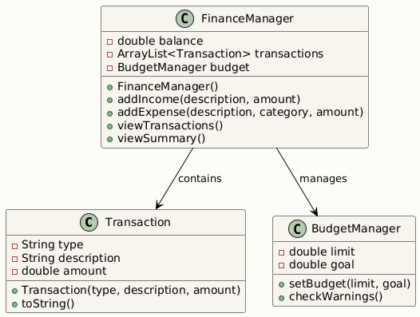
Proposed Architecture

Slide 6
Java Programming - Concepts Used
Event-Driven Programming: Uses ActionListener for handling button clicks (add income, expense, view transactions, etc.).
AWT GUI Components: Frame, Button, TextField, TextArea, Label are used for creating the user interface
String Manipulation: Uses string concatenation and String.format() for displaying messages and transaction summaries.
Event Listeners: Implements ActionListener to trigger actions when buttons are clicked.

Slide 7
List of Modules
Transaction Class Module
Personal Finance ManagerAWT Class Module
GUI Components and Layout Module
Action Handlers and Events Module and Budget and Warning Module

Slide 8
Module Description
Transaction Class Module: Represents financial transactions (Income/Expense) with details like type, category, description, and amount.
PersonalFinanceManagerAWT Class Module: The main application class integrates the GUI, transaction management, and financial calculations. It coordinates all modules, serving as the central point for managing finances and user interactions.
GUI Components and Layout Module: Organizes input fields, buttons, and display areas using GridBagLayout for a user-friendly design that ensures seamless input and output handling.

Slide 9
Module Description (Cont..)
Action Handlers and Events Module and Budget and Warning Module : Processes user actions (e.g., button clicks), links them to operations like adding transactions or generating summaries and handles input validation while dynamically updating financial records.Tracks budget and savings goals, issuing alerts for overspending or unmet savings targets. It helps users maintain financial discipline by providing real-time warnings and reminders.

Slide 10
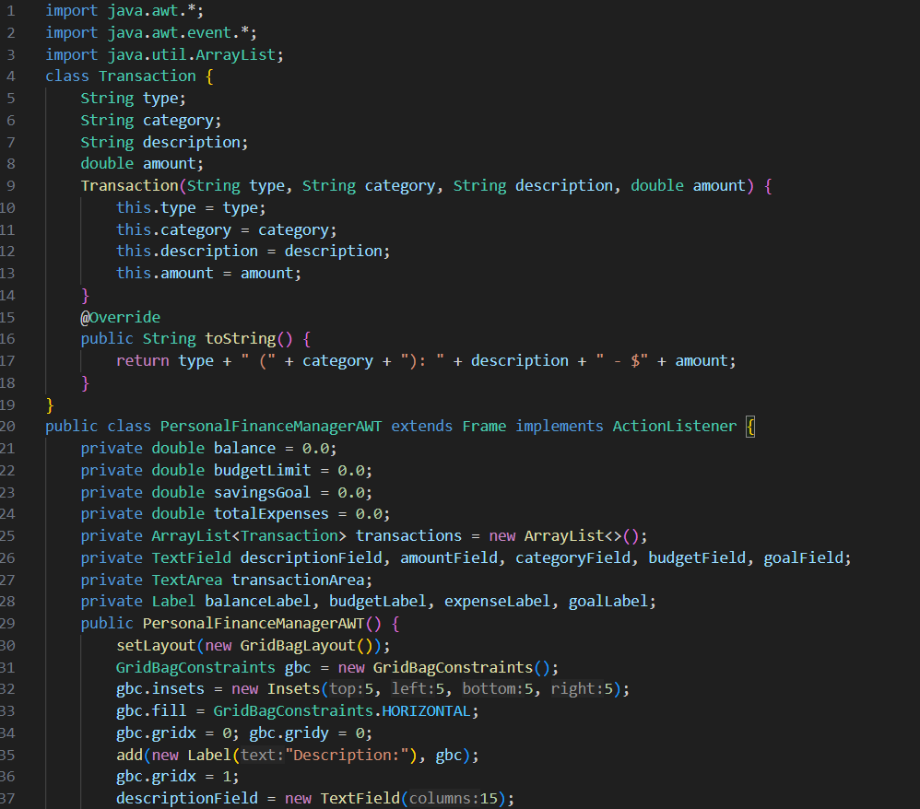
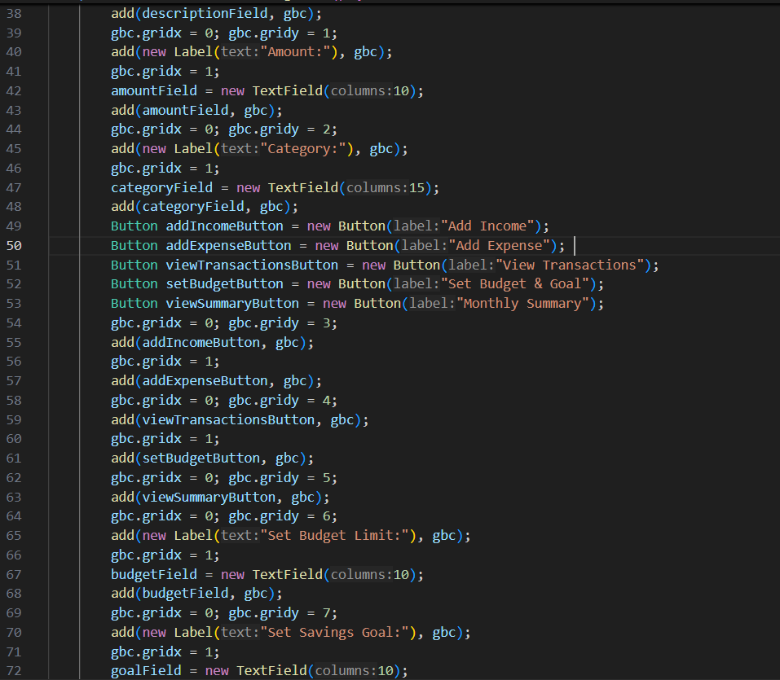
Source Code

Slide 11
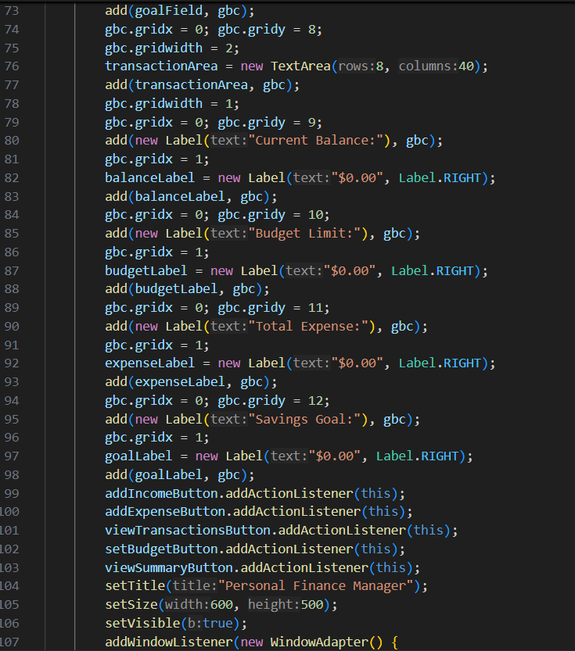
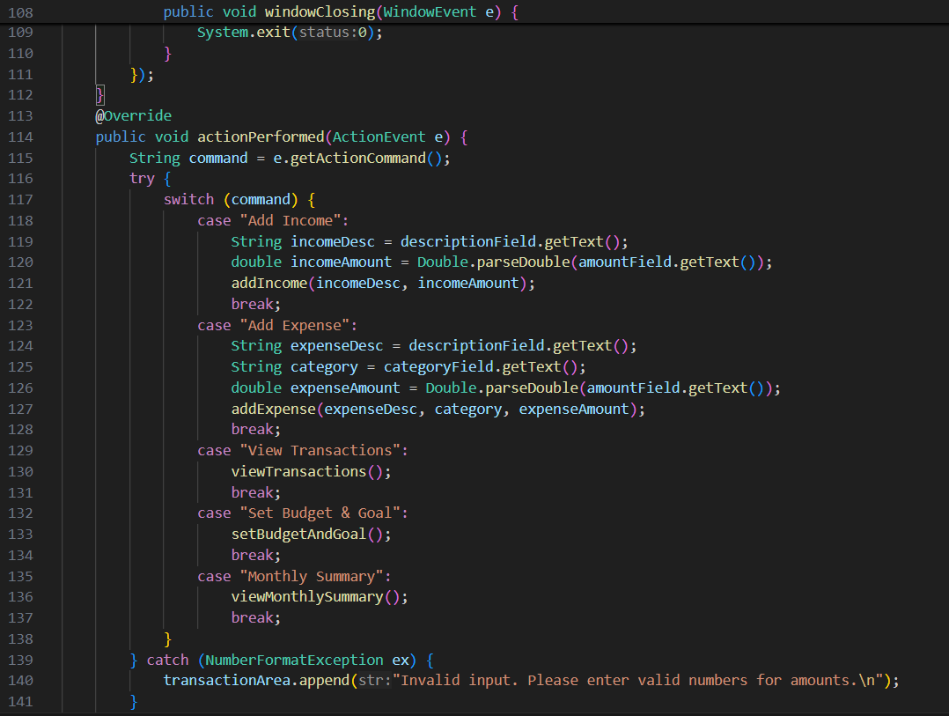
Source Code(Cont..)

Slide 12
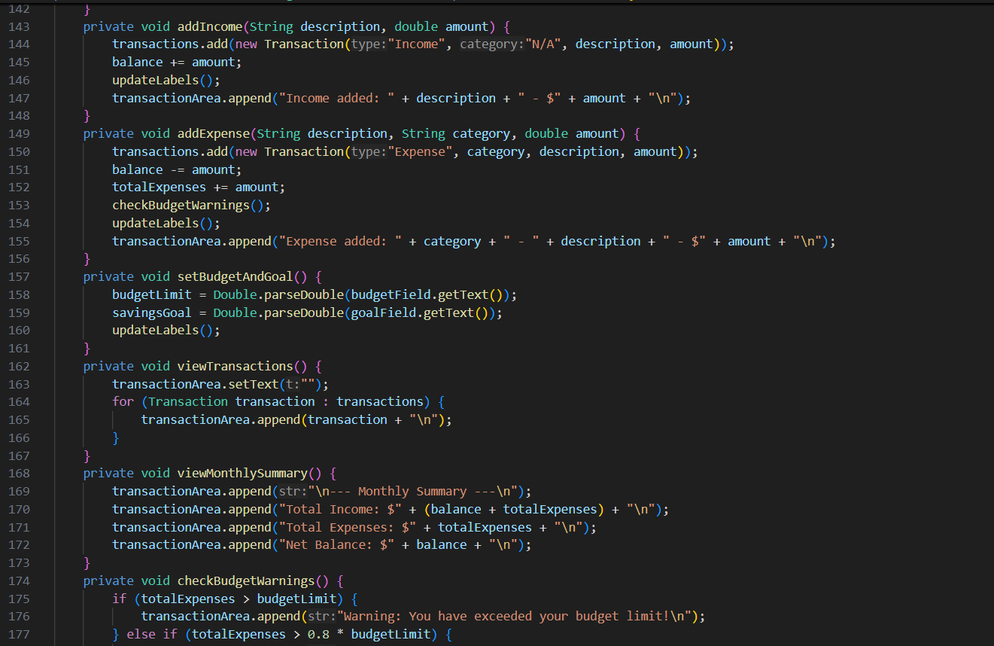
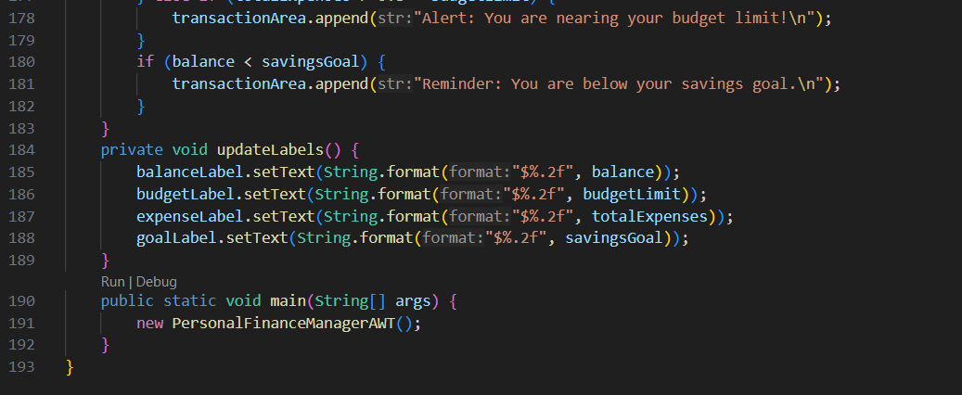
Source Code(Cont..)

Slide 13
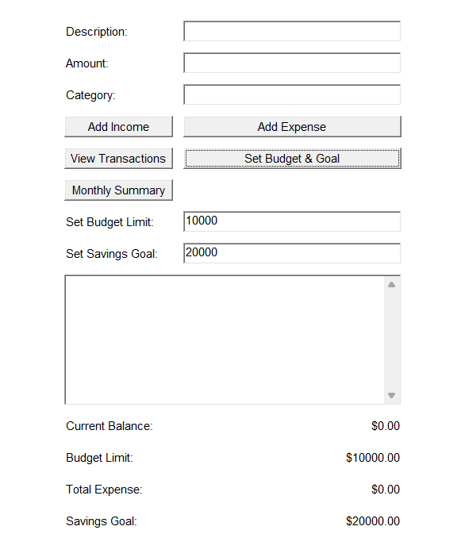
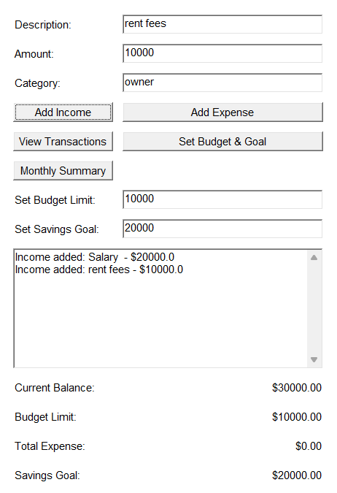
Results
Set Budget and Goal
Add Income

Slide 14
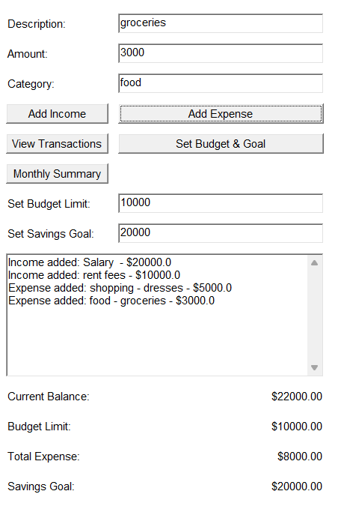
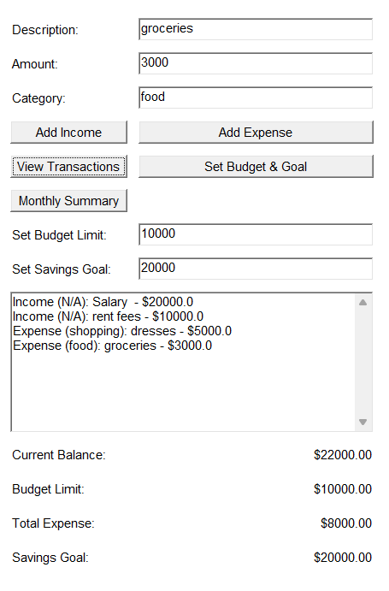
Results
Add Expense
View Transaction

Slide 15
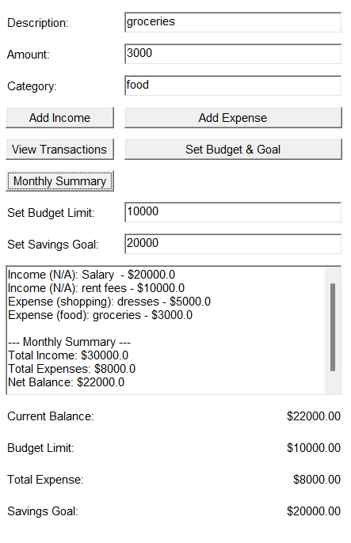
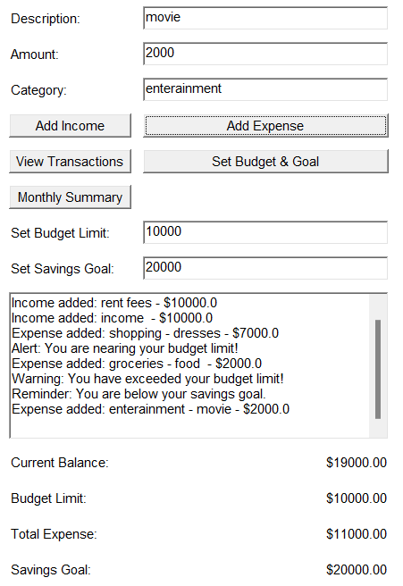
Results
Monthly Summary
Alert &Warning Message

Slide 16
Conclusion
The Personal Finance Manager application offers an easy way to manage personal finances by tracking income, expenses, budgets, and savings goals.
Its user-friendly interface provides real-time feedback on overspending and savings targets.
With detailed transaction tracking and organized financial data, it help users maintain control over their finances and plan for future goals.

Slide 17
Thank You
ANY QUERIES???

