Slide 1
Project PRESENTATION
UIT2211 Software Development Project

Slide 2
Helpdesk ticketing System

Slide 3
TEAM MEMBERS
Name Register Number
DEVANITHIMARAN E 3122235002029
DHARANIKARAN S 3122235002030
DHAYA ANANTH M M 3122235002031
DHIVAKARAN S 3122235002032

Slide 4
PROBLEM STATEMENT
An organization like SSN College of Engineering wants to develop a Helpdesk ticketing system. Any member of the organization should be able to log a request/complaint regarding certain services. The system should assign a unique ticket number for each request. A ticket should be assigned to a service engineer based on the service type. A service engineer should be able to view all the tickets assigned to them. Once the service is completed, the service engineer will close the ticket. The management should be able to generate various reports for analyzing and improving the services.

Slide 5
OBJECTIVE
To develop a comprehensive Helpdesk ticketing system for SSN College of Engineering that facilitates efficient logging, tracking, and resolution of service requests and complaints from members of the organization. The system will automate the assignment of unique ticket numbers, allocate tickets to relevant service engineers based on service types, and enable engineers to manage and close assigned tickets.Through this system, SSN College of Engineering aims to enhance service delivery, streamline communication, and optimize resource allocation.

Slide 6
CLIENT DETAILS
9585366456
SSNCE,Chennai-603110.
jaishp@ssn.edu.in
Dr.Jaish P
Department of Mathematics,

Slide 7
REQUIREMENT ENGINEERING
User and Engineer Roles
Users should be able to file complaints or requests by filling out a form specifying the issue, location, and other details. They should be able to view the status of their submitted tickets, including updates on their resolution.After a ticket is marked as resolved, users should have the option to provide feedback on the service they received.
Engineers should be able to update the ticket status to reflect the progress and completion of the service.

Slide 8
REQUIREMENT ENGINEERING
Admin:
Admins should be able to view all tickets submitted, regardless of the service type.
Display feedback provided by users on resolved tickets.
Ticket Creation:
Each new complaint should receive a unique identifier.
Notify users via email with the details and ticket number upon creation.
Allocate tickets to service engineers based on the type of service requested.

Slide 9
NON-FUNCTIONAL REQUIREMENTS
FUNCTIONAL REQUIREMENTS
Actions should respond within 2 seconds.
Intuitive and user-friendly.
Accessible from various devices and OS.
Minimal CPU and memory usage.
Export data in common formats
( JSON).
User Management
Ticket Management
Feedback Management
Data Storage and Retrieval
Search Functionality
Notification System
Admin,Service Engineer,Client Dashboard

Slide 10
OTHER IMPLEMENTATION DETAILS
Bank end used:
Data structures used- Hashtable , Stack and List adt
Flask in used to integrate front-end and Back-end
JSON files are used for storing data
Front end used: HTML, CSS, Javascript
Hosting done on pythonanywhere
Sprint 1 – 3 was scheduled for 2 weeks each
Sprint 4 was scheduled for 1 week

Slide 11
INDIVIDUAL CONTRIBUTION
Team members name: DEVANITHIMARAN E , DHIVAKARAN S
Work description: Both of us have involved in designing and implementing the html templates. Setting up routes for various pages and ensuring they render the correct templates. Handling the logic for redirecting agents to their specific help topic pages. Handling form submissions for signup, signin, complaint logging, and feedback submission.
Modules worked:
Frontend Templates(DEVANITHIMARAN-homepage,signin,signup,adminpage,feedback-form)
Frontend Templates(DHIVAKARAN-complaint log page,service engineer dashboards,ticket-status page(except resolved ticket page)
Routing
Form Handling

Slide 12
IMPLEMENTATION DETAILS
Sprint | Epic | User Story | Remarks on implementation
1 | Frontend Development & Routing | User friendly pages to perform various tasks | Created various pages and configured their respective routes
3 | Form handling | Submit complaint and feedback | Created and managed form handling

Slide 13
RISK MANAGEMENT
Risk management | Risk Description | Probability | Impact | Mitigation Plan
Integration Issues | Challenges in integrating frontend with backend for complaint logging and ticket system. | Medium | High | Conduct regular integration testing ,referring many websites,github and youtube
Coordination issues | Coordination of my pair coder | Medium | High | Discussing through Whatsapp and having clear conversation through phone calls
Client demand management | Meeting client demands | High | Medium | Completing essential requirements first and working on desirable ones

Slide 14
TEST LOG REPORT
TC id | RS# | Test case description/ condition | Test case input | Expected Output | Result (PASS/ FAIL)
1. | 1 | Verify complaint log form submission with all required fields filled. | Enter valid details for help topic, description, location, room no, mob no, preferred time, click submit. | Complaint is successfully logged, and confirmation email is sent. | PASS
2 | 3 | Verify complaint log visibility after logging in. | Log in with a valid user account and navigate to complaint log. | User's complaint log is displayed with all relevant complaints listed. | PASS
3 | 2 | Verify all essential details in all pages and proper functionality | Regular review of html,css and js code | All essential details are displayed with proper functionality | PASS

Slide 15
INDIVIDUAL CONTRIBUTION
2.Team member name: DHARANIKARAN S
Work description: Designing and implementing the backend logic for the complaint logging system, including the creation of ticket generation, email notifications, and data management. Additionally, managed the integration of the backend with the frontend for smooth user interactions, also implemented various data structures to enhance the efficiency and organization of the system.
Modules worked:
Complaint Logging System
Email Notifications
Feedback System
Data Structures Implementation:
Hashtable(Ticket Management)
Stack and List ADT(feedback management)

Slide 16
IMPLEMENTATION DETAILS
Sprint | Epic | User Story | Remarks on implementation
1 | Complaint Logging system | log a complaint with details such as help topic, description, location, and preferred time. | Implemented form handling, data validation, ticket ID generation, and integration with HashTable for efficient ticket management.
3 | Email Notification System | receive an email notification when submit a complaint. | Implemented email sending functionality using SMTP and smtplib, ensuring users receive ticket confirmation emails upon complaint submission.

Slide 17
Sprint | Epic | User Story | Remarks on implementation
4 | Feedback System | provide feedback for resolved tickets.. | Designed and implemented the feedback system using a stack-based ADT to store and manage feedback entries efficiently.

Slide 18
RISK MANAGEMENT
Risk management | Risk Description | Probability | Impact | Mitigation Plan
Monitoring & Testing | Difficulty in integrating HashTable with complaint logging system | Medium | High | Ensure thorough testing and debugging of the HashTable implementation
Monitoring & Testing | Email notification failures due to SMTP server issues | Medium | High | Monitor SMTP server status and maintain logs for email transactions.
Data Integrity | Feedback system inefficiencies leading to data loss or corruption | Low | Medium | data validation for feedback entries. Regularly back up feedback data.

Slide 19
TEST LOG REPORT
TC id | RS# | Test case description/ condition | Test case input | Expected Output | Result (PASS/ FAIL)
1. | 5 | Validate email notification upon complaint submission | Enter a proper email address while signing in | Confirmation email received by the user with the correct ticket details | PASS
2 | 9 | Verify feedback submission for resolved tickets | Ticket ID: 181083, Rating: 5, Feedback: “Your service is excellent" | Feedback is recorded and stored in the system | PASS

Slide 20
INDIVIDUAL CONTRIBUTION
2.Team member name: DHAYA ANANTH M M
Work description: Responsible for data management and file handling within the project. This included implementing functions for reading from and writing to JSON files, ensuring all necessary JSON files were correctly initialized and managed, and handling the loading and saving of data between JSON files and hash tables. Additionally, implemented logic to manage resolved tickets, ensuring they were stored separately and could be retrieved as needed.
Modules worked:
JSON File Management
Data Loading and Saving
Resolved Tickets Handling

Slide 21
IMPLEMENTATION DETAILS
Sprint | Epic | User Story | Remarks on implementation
1 | JSON File Management | To manage JSON files for storing and retrieving data so that the application maintains data consistency. | Implemented functions to read and write JSON files, ensuring all necessary files are initialized and managed.
4 | Resolved Tickets Handling | To manage resolved tickets separately so that they are stored and retrieved efficiently. | Implemented logic to handle resolved tickets, ensuring they are stored in separate JSON files and can be retrieved as needed.

Slide 22
RISK MANAGEMENT
Risk management | Risk Description | Probability | Impact | Mitigation Plan
Data Integrity Management | Risk of data corruption or loss during file read/write operations | Medium | High | Implement robust error handling, validation checks
KeyError | Encountered when trying to access a key that does not exist in a dictionary. | High | Medium | proper name convention with respect to the keys in hashtable

Slide 23
TEST LOG REPORT
TC id | RS# | Test case description/ condition | Test case input | Expected Output | Result (PASS/ FAIL)
1. | 11 | Ensure data is correctly written to and read from a JSON file | JSON data structure to write | Data is written to file and correctly read back | PASS

Slide 24
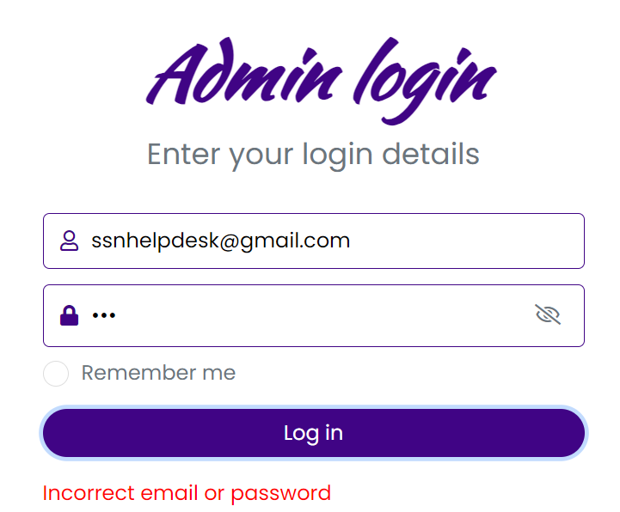
SCREENSHOTS OF USER INTERFACES AND TEST CASES OUTPUTS
Implementation of signin and signing up logic and management of user datas:
Error for mismatched login credentials:

Slide 25
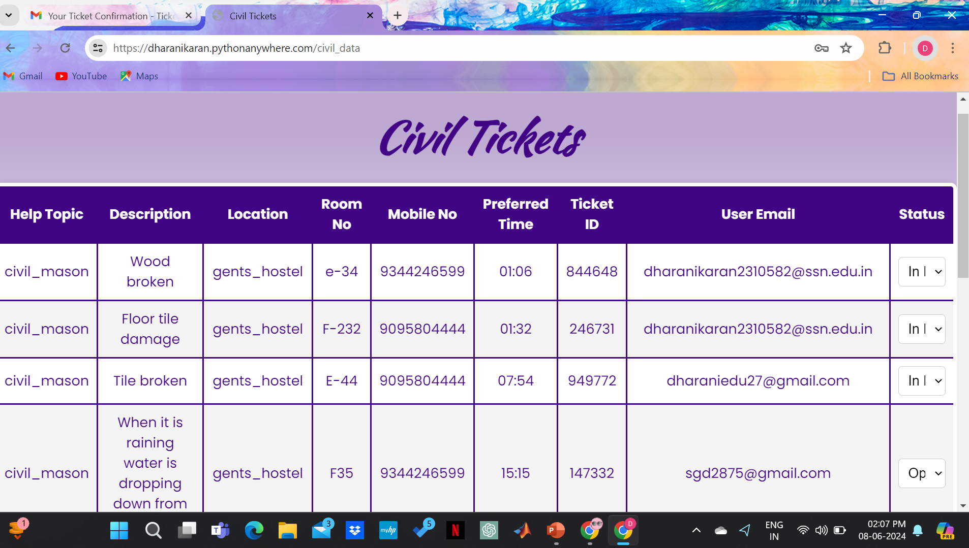
Technician’s Dashboard:

Slide 26
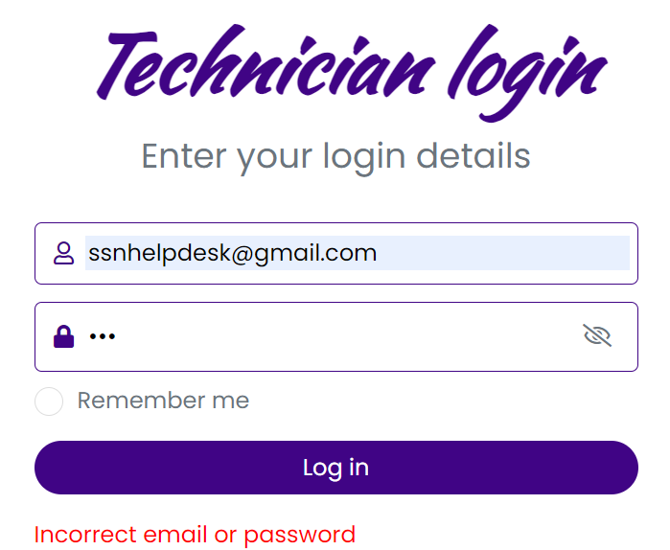
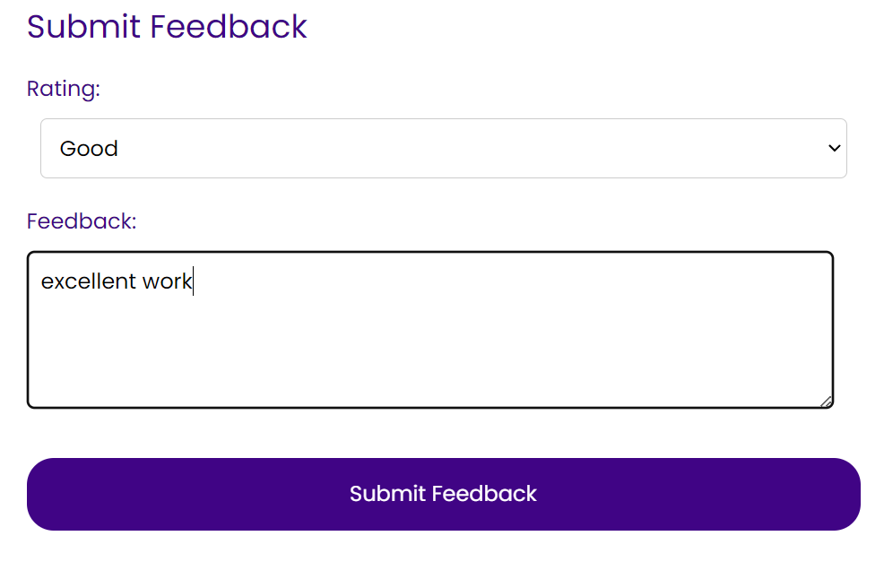
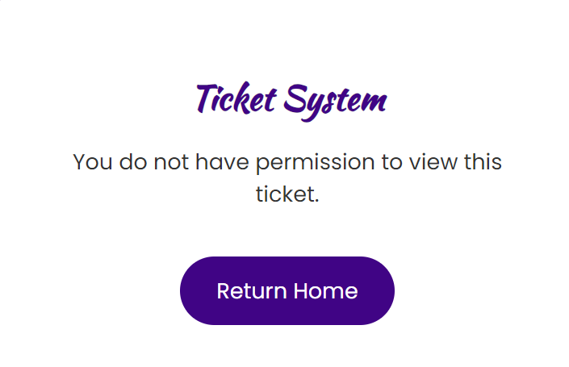
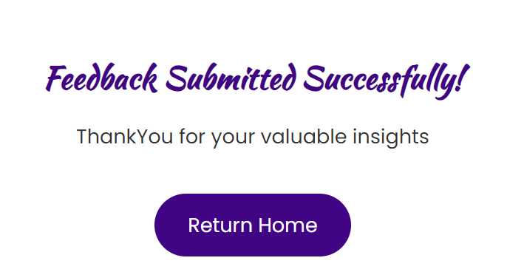
Logging in using invalid credentials:
Trying to access the ticket of different user:
feedback submission:
After-feedback submission:

Slide 27
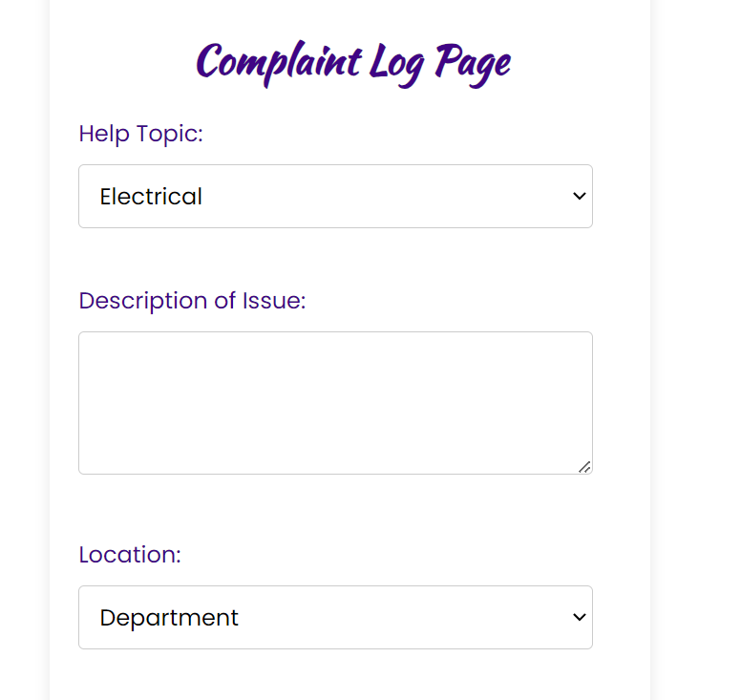
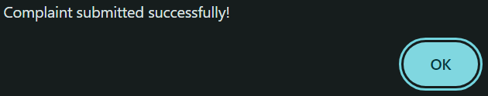
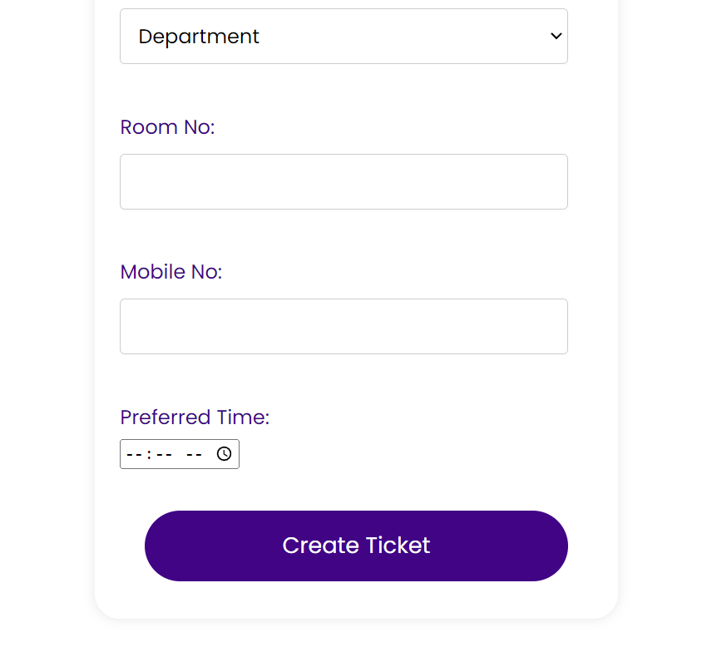
After ticket creation:

Slide 28
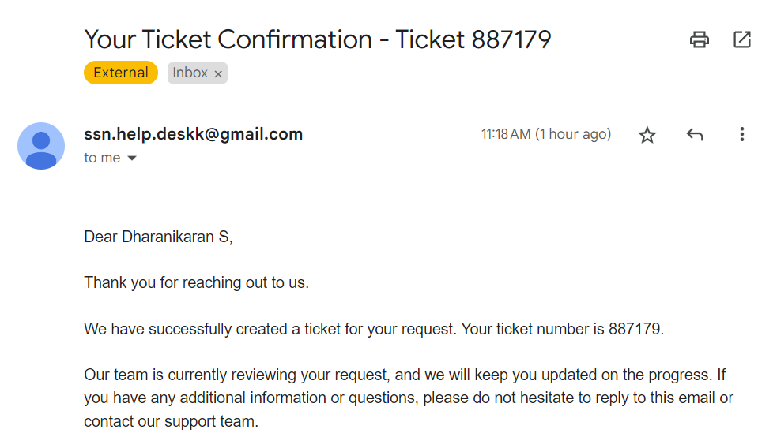
Email notification after complaint submission:

Slide 29
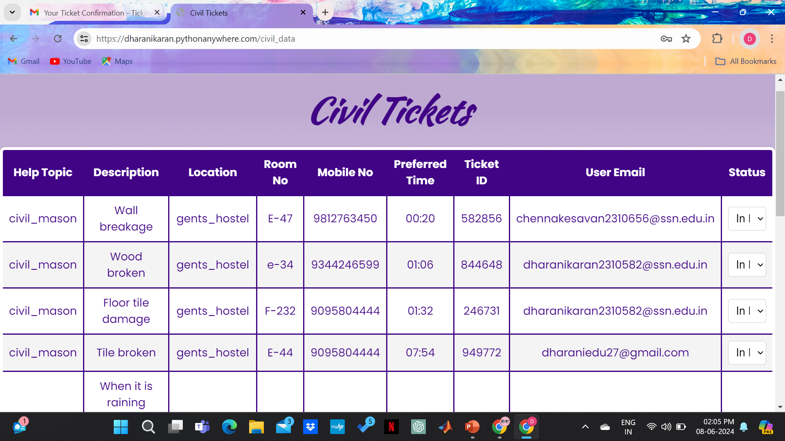
Retrival of data from hashtable(before resolving ticket:582856):

Slide 30
Deletion of data from hashtable(after resolving ticket:582856):

Slide 31
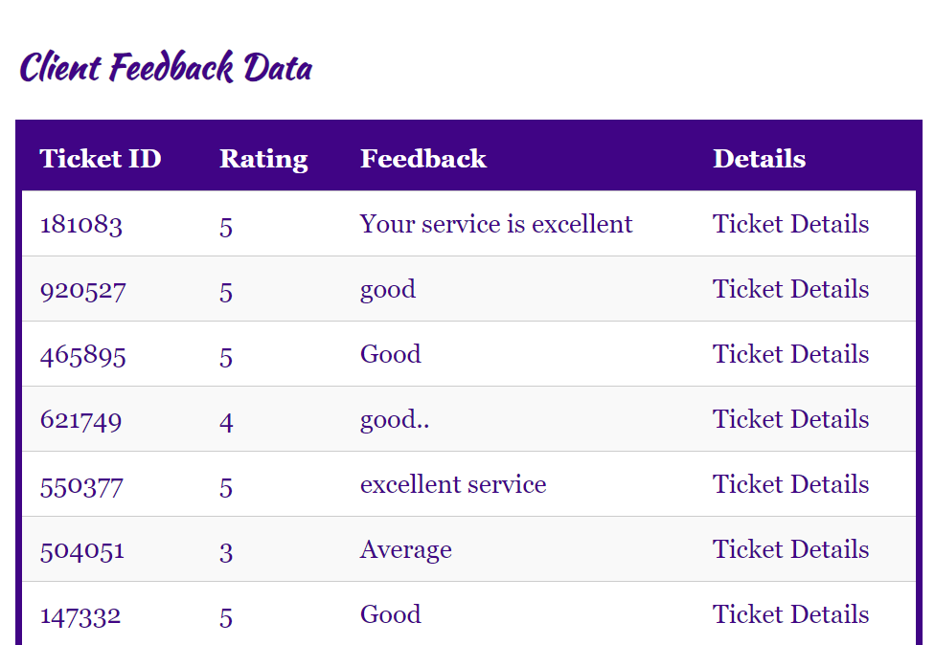
Feedback Submission:

Slide 32
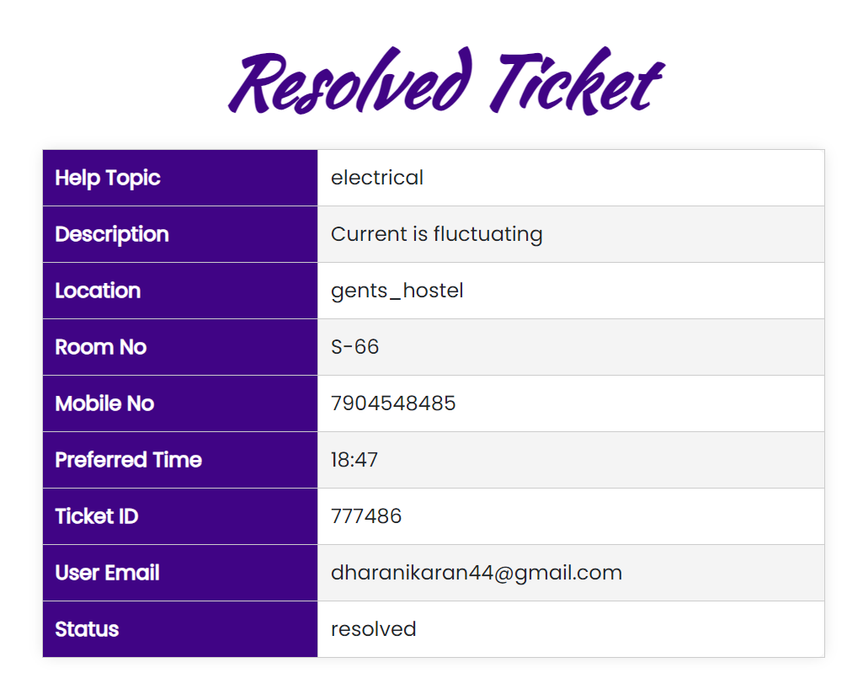
Resolved-Ticket management(Reading and writing resolved tickets directly from json):

Slide 33
DESIGN DETAILS
Users:
Technician
Admin
Members of Organization

Slide 34
HOMEPAGE
MEMBER LOGIN
AGENT LOGIN
TECHNICIAN
LOGIN

Slide 35
MEMBER LOGIN/TECHNICIAN LOGIN/ADMIN LOGIN
SIGNUP/LOGIN PAGE
(Sign-up for new user and sign-in for already existing user)
SIGN-UP
NAME
EMAIL ID
CREATE PASSWORD
CONFIRM PASSWORD
SIGN-IN
EMAIL ID
PASSWORD

Slide 36
CLIENT LOGIN
CREATE TICKET
TICKET STATUS
COMPLAIN LOG PAGE
HELP TOPIC
SUBJECT OF ISSUE
DESCRIPTION OF ISSUE
LOCATION(DEPT/HOSTEL)
DEPT/HOSTEL ROOM NO
MOB.NO
PREFERRED TIME
TICKET NO
STATUS
SUBJECT
WILL BE DISPLAYED

Slide 37
TECHNICIAN LOGIN
ADMIN LOGIN
TICKET NO
CONTACT EMAIL
SUBJECT
LOCATION
UPDATE TICKET STATUS(INPROGRESS/CLOSE)
TICKET ID
FEEDBACK
RATING
TICKET DETAILS

Slide 38
FEEDBACK FROM CLIENT
We are very satisfied with the final product. The Help Desk Ticketing System has streamlined our complaint logging process significantly. The interface is user-friendly, and the functionality covers all our requirements.
-Jaish.P , Dept. of Mathematics

Slide 39
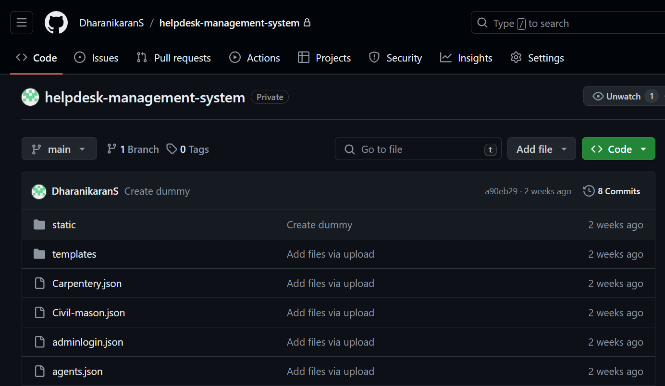
GITHUB REPOSITORY
https://github.com/DharanikaranS/helpdesk-management-system
LINK:

Slide 40

WEBSITE LINK

Slide 41
REFERENCES
StackoverFlow(https://stackoverflow.com/)
Youtube(https://youtube.com/playlist?list=PL-osiE80TeTs4UjLw5MM6OjgkjFeUxCYH&si=MzepalBTSZBv5K0D)
GeeksforGeeks(https://www.geeksforgeeks.org/learn-data-structures-and-algorithms-dsa-tutorial/)

Slide 42
Thank You!

