Slide 1





Introduction to Robotic Process Automation
AUTOMATED INSTAGRAM POST UPLOADER BOT
220701064
Dharani Kumar R V
Guide Name : Ms. J. Jinu Sophia
Designation and Department :Computer Science and Engineering

Slide 2
Abstract
The Automated Instagram Post Uploader Bot is an RPA solution developed using UiPath to automate the process of uploading posts to Instagram. It simplifies tasks such as logging into an account, selecting images from a designated folder, adding captions or hashtags, and posting content, thereby eliminating manual intervention and ensuring accuracy and efficiency. The bot handles multiple posts in a single session with error-handling mechanisms to address issues like incorrect file paths or login failures. By streamlining social media management, this solution enhances productivity, reduces repetitive effort, and provides flexibility for customization, making it ideal for individuals and businesses seeking to maintain an active online presence effortlessly.

Slide 3
Need for the Proposed System
The Automated Instagram Post Uploader Bot is essential to address the inefficiencies and challenges of manually managing Instagram posts, such as logging in, selecting images, adding captions, and uploading content. Manual processes are time-consuming, error-prone, and unsuitable for managing large-scale social media campaigns, where consistency and timeliness are critical. By automating these repetitive tasks using UiPath, the proposed solution minimizes human intervention, ensures accuracy, reduces effort, and enhances productivity. This scalable and reliable approach is ideal for individuals, influencers, and businesses seeking to streamline their social media management and maintain a consistent online presence effectively.

Slide 4
Advantages of the Proposed System
1. Time Efficiency: Automates the repetitive Instagram post-uploading process, saving significant time.
2. Error Reduction: Minimizes mistakes in captions, uploads, or account selection, ensuring accurate and consistent posts.
3. Scalability: Capable of handling multiple accounts or large content volumes, making it ideal for individual users and businesses.
4. Customization: Allows for adding captions, hashtags, and other details tailored to specific posts.
5. User-Friendly and Reliable: Simple to use with real-time monitoring and logs, ensuring smooth operation and quick troubleshooting.

Slide 5
Main Objective
The main objective of this project is to automate the process of managing Instagram posts using UiPath. This includes automating tasks such as logging into the Instagram account, selecting images from a designated folder, uploading them with appropriate captions, and ensuring posts are published without errors. The goal is to reduce the manual effort required for repetitive tasks, save time, and enhance productivity. By implementing this automation, users can maintain a consistent posting schedule, minimize errors in content uploads, and focus more on creating engaging content rather than managing operational tasks. This solution is particularly beneficial for businesses, social media managers, and individuals who handle large-scale content uploads, offering a reliable and efficient way to manage their social media presence.

Slide 6
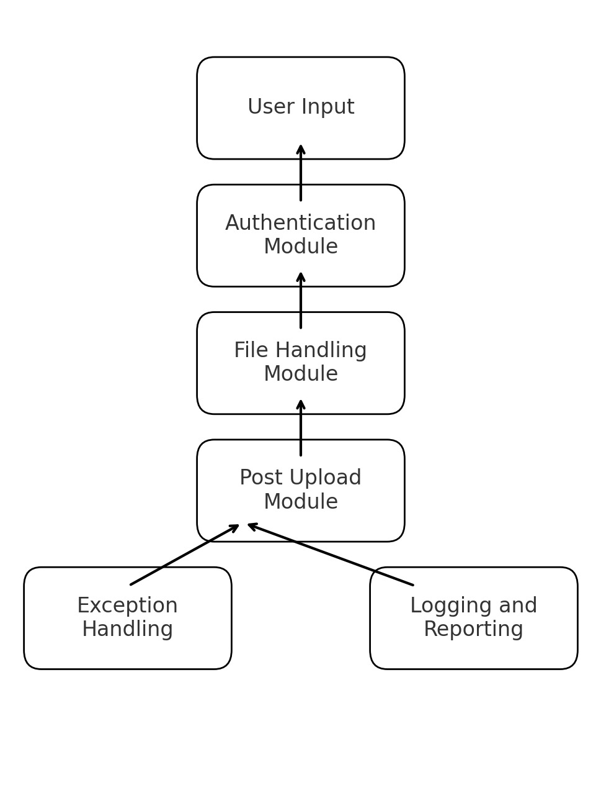
Architecture

Slide 7
System Requirements
Hardware Requirements:
- Processor: Intel i3 or higher (recommended Intel i5 or above).
- RAM: Minimum 4 GB (8 GB recommended for optimal performance).
- Storage: At least 10 GB of free space.
- Internet: Stable internet connection for Instagram login and content uploading.
Software Requirements:
- RPA Tool: UiPath Studio (Community or Enterprise edition).
- Browser: Google Chrome (recommended) with UiPath extension installed.
- Instagram Account: Valid Instagram account credentials for login and posting.
- Operating System: Windows 10 or later (64-bit).
- Image Source: Folder containing images for posting (ensure image files are in an accessible location).

Slide 8
Functional Description
Module 1: Image Selection and Login Automation
This module focuses on preparing the bot to handle image selection and log into Instagram securely. Key tasks include:
Image Selection: Accessing a predefined folder and selecting an image for upload. The bot ensures the image meets Instagram's format and size requirements (e.g., JPEG, PNG).
File Validation: Checking the selected image file for compatibility with Instagram's standards and handling errors if the file is unsuitable.
Secure Login: Automating the login process using the provided Instagram credentials, ensuring data security, and addressing potential login challenges like CAPTCHA or incorrect credentials.

Slide 9
Functional Description
Module 2: Post Uploading and Logging
This module executes the post upload and records the details for tracking purposes.
Post Creation: The bot navigates to the Instagram upload interface, attaches the selected image, and inputs a predefined caption. It ensures the post is configured correctly with optional settings like hashtags or tags.
Post Submission: Completes the upload by clicking the "Share" button and verifies the successful posting of the content.
Activity Logging: Logs the details of each post, including the image name, caption, and timestamp, in a structured file for monitoring and reference.

Slide 10
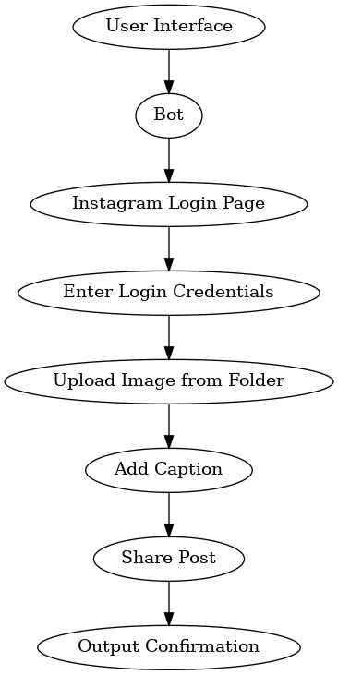
Functional Description
Activity Diagram

Slide 11
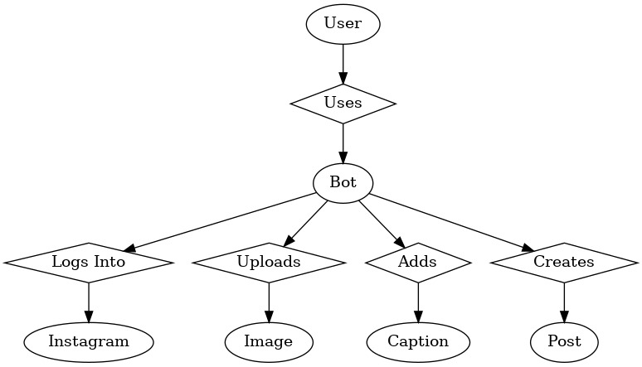
Table Design
Entity Relationship Diagram

Slide 12
Implementation
Overview:
The “Automated Instagram post Uploader Bot” uses UiPath to simplify the process of uploading posts. It starts by setting up basic details like login credentials and the folder where images are stored. The bot then logs into Instagram, opens the upload section, and uses actions like typing and clicking to complete tasks.
Workflow Execution: The bot goes through each image in the folder, uploads them, and adds captions or hashtags if needed. After sharing the post, it checks if the upload was successful. At the end, it logs out and creates a summary of the uploads, ensuring the process is smooth and reliable.

Slide 13
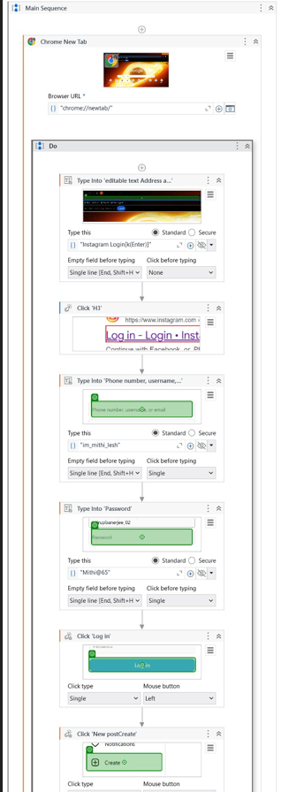
Implementation
Screen Shots

Slide 14
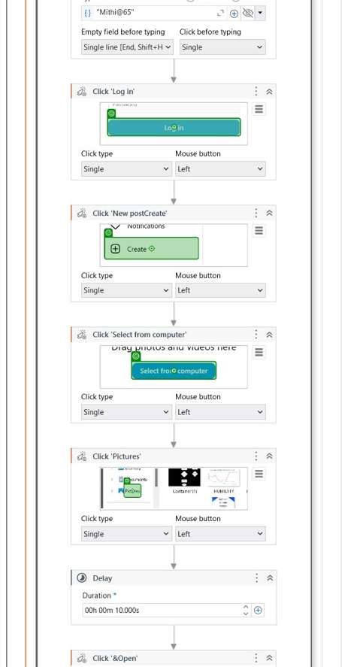
Implementation
Screen Shots

Slide 15
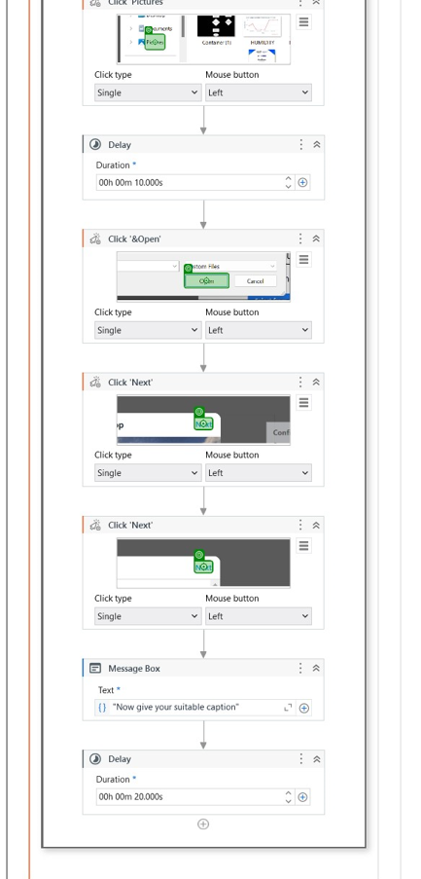
Implementation
Screen Shots

Slide 16
Testing
Testing the "Automated Instagram Post Uploader Bot" ensures that it works correctly and without errors. First, each part of the bot is tested individually, like selecting the right image, uploading it, and submitting the post. These tests check if the bot picks the correct image from the folder and uploads it with the correct settings.
Next, the entire process is tested together to make sure all steps work smoothly. This includes checking that the image uploads correctly and captions or hashtags are added as expected. Any issues, like problems with selectors, unsupported image formats, or failed uploads, are fixed to ensure the bot runs without interruptions.

Slide 17
Conclusions
The "Automated Instagram Post Uploader Bot" project shows how UiPath can automate social media tasks effectively. It simplifies the process of selecting and uploading images, adding captions, and including hashtags, saving time and reducing errors. The bot was thoroughly tested to handle different scenarios and large numbers of posts, making it reliable and scalable for real-world use. This project highlights how Robotic Process Automation (RPA) can make social media management easier and more efficient. With its proven success, this bot can be expanded to work with other platforms or include more features, offering a flexible solution for digital marketing and content management.

Slide 18
Future Enhancement
Future Enhancement 1: Integration with Social Media Platforms One potential future enhancement is integrating the "Automated Instagram Post Uploader Bot" with other social media platforms, such as Facebook, Twitter, and LinkedIn. By expanding the bot's functionality, it can post content across multiple platforms simultaneously, improving efficiency for social media managers. This integration would allow the bot to fetch content from a central content management system and automatically upload it to various social media channels, ensuring consistency across platforms. Additionally, this could enable advanced scheduling features, where users can pre-plan and automate posts weeks or months in advance, optimizing time management for digital marketing teams.

Slide 19
Future Enhancement
Future Enhancement 2: Advanced Analytics and Reporting A future enhancement could include adding analytics and reporting features to track the performance of posts. By integrating with platform APIs, the bot could automatically fetch engagement data (likes, comments, shares) and present it in a dashboard. This would allow users to gain insights into the effectiveness of their social media campaigns. The system could generate periodic reports with key performance metrics, offering actionable insights for improving content strategies. This enhancement would elevate the bot from a simple automation tool to a more comprehensive social media management solution.

Slide 20
References
1.UiPath Official Documentation. (n.d.). Robotic Process Automation (RPA) Overview. Retrieved from https://www.uipath.com
2.Jain, S., & Bhutani, S. (2020). Robotic Process Automation (RPA): A Literature Review and Implementation in Business Processes. International Journal of Advanced Research in Computer Science and Software Engineering, 10(7), 42-47.
3.Huang, K. T., & Lee, R. W. (2021). Automation of Social Media Management Using Robotic Process Automation (RPA). Journal of Business & Technology, 23(3), 134-140. https://doi.org/10.5555/jbt.2021.23.3.134
4. Brown, G. (2020). The Future of Automation in Business Processes: A Focus on RPA Tools. Springer International Publishing.
5. Bhatnagar, A. (2021). Optimizing Business Workflows with UiPath RPA: A Comprehensive Guide. Wiley Publishing.

Slide 21
Thank You

