Slide 1

Overview of Flood Monitoring and Early Warning
Floods are natural disasters that can cause devastating losses to life, property, and infrastructure. Effective flood monitoring and early warning systems are crucial in saving lives and minimizing the damages caused by floods.
BJ

Slide 2
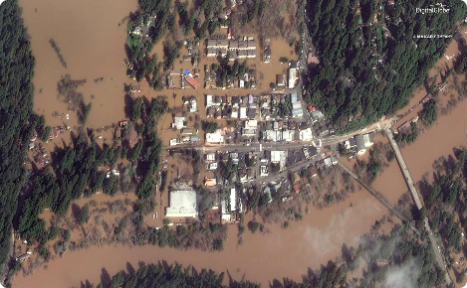
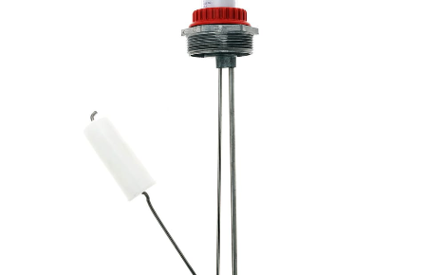
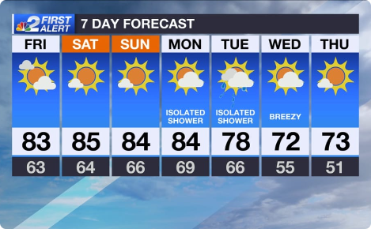
Flood Monitoring
Remote Sensing
Ground-Based Sensors
Satellite and aerial images can be used to monitor water levels, flow rates, and the extent of flooding over large areas.
Water level gauges, discharge meters, and rain gauges are used to collect data on water levels, rainfall, and streamflow.
Weather Forecasts
Meteorologists use weather models and radar to forecast rainfall patterns and anticipate potential floods.

Slide 3

Early Warning Systems Components
1
Data Collection and Analysis
Collecting, storing, processing, and analyzing data from flood monitoring systems and weather forecasts is a crucial component of early warning systems.
2
Risk Assessment and Modeling
Using computer models and GIS to assess flood risks, predict potential damages, and identify vulnerable communities is key to successful early warning systems.
3
Communication and Dissemination
Effective communication strategies and dissemination of timely and accurate warnings to at-risk populations and emergency responders can save lives and minimize the damages caused by floods.

Slide 4

Benefits of Early Warning Systems
Minimize Loss of Life
Emergency Response Planning
Enhance Community Resilience
Effective and timely warnings can save lives by giving people enough time to evacuate or take other lifesaving actions.
Early warning systems can help emergency managers plan for and allocate resources to respond to a flood event.
Effective early warning systems can increase community awareness and preparedness, building resilience and preventing future damages from floods.

Slide 5
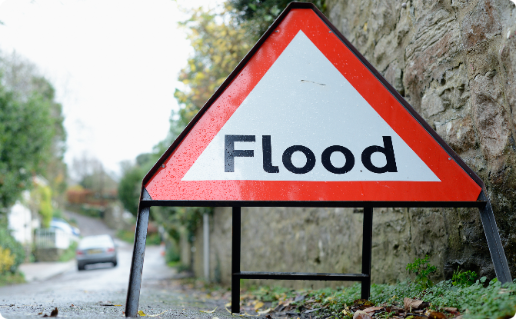
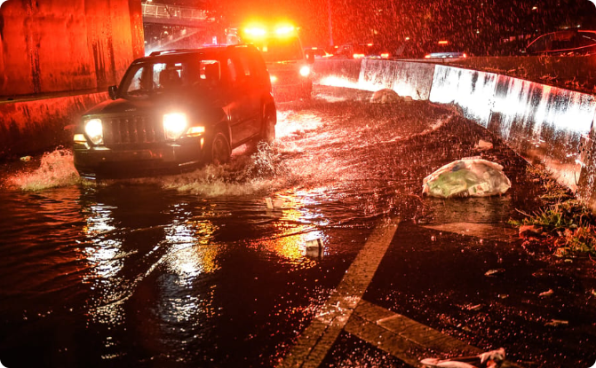
Case Studies
Examples of Successful Early Warning Systems
Lessons Learned from Past Flood Events
Japan's Himawari-8 satellite has been instrumental in providing quick, accurate, and reliable warnings for floods and landslides.
The 2011 Thailand floods demonstrated the need for better flood risk assessment and improved communication and coordination among different agencies involved in emergency response.

Slide 6

Conclusion
The future of flood monitoring and early warning systems looks promising with advances in remote sensing, computer modeling, and communication technologies. We need to continue to invest in these systems to further improve their effectiveness in saving lives and minimizing the damages from floods.

