Slide 1
Employee salary analysis and predictions

Slide 2
objective
Analyze employee salaries and predict future trends.
Goals:
Understand current salary distribution
Identify disparities by gender and department
Forecast future salaries.

Slide 3
Technologies used
Programming Language
Python: Primary language used for data analysis and visualization.
Libraries/Frameworks:
Pandas: For data manipulation, cleaning, and preprocessing.
Matplotlib: For creating static visualizations such as bar charts, line charts, and scatter plots.
Seaborn: For statistical data visualization, providing a high-level interface for drawing attractive graphs.
NumPy: For numerical computations and handling large arrays of data
Data Visualization Tools:
Matplotlib & Seaborn: Used within Python to generate a variety of visualizations.

Slide 4
Data collection
Source: Employee Salary data(CSV file)
Content: Employee details (e.g., department, gender, salary)

Slide 5
Data Preprocessing
Objective: Clean and prepare data for analysis.
Steps:
Remove rows with missing values.
Convert salary to numeric format.
Create dummy variables for categorical data.

Slide 6
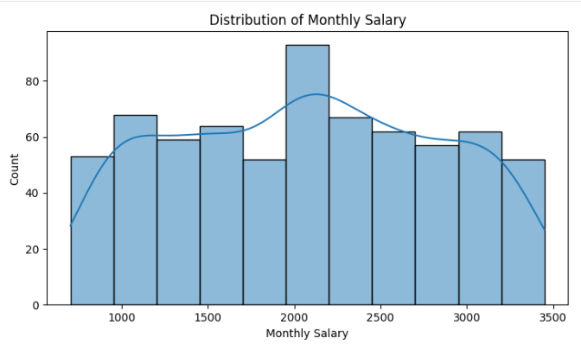
Data analysis: average salary
Metric | Measurement | Target | Actual
Audience attendance | # of attendees | 150 | 120
Engagement duration | Minutes | 60 | 75
Q&A interaction | # of questions | 10 | 15
Positive feedback | Percentage (%) | 90 | 95
Rate of information retention | Percentage (%) | 80 | 85
Objective: Calculate average
salaries by gender.
Process:
Group by gender.
Compute mean salary.
Visualization: Bar plot showing
average salaries by gender.

Slide 7
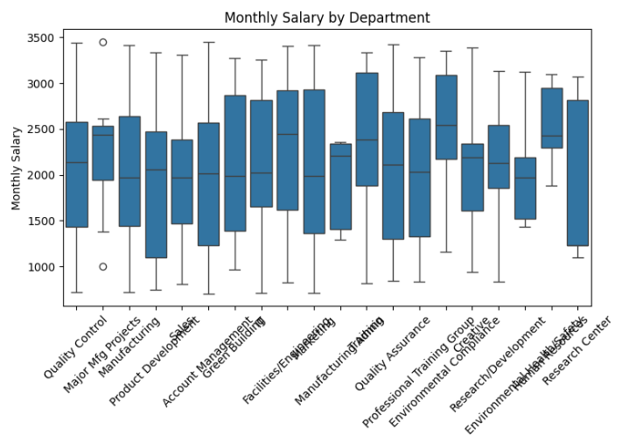
Highest salary by Department
Metric | Measurement | Target | Actual
Audience attendance | # of attendees | 150 | 120
Engagement duration | Minutes | 60 | 75
Q&A interaction | # of questions | 10 | 15
Positive feedback | Percentage (%) | 90 | 95
Rate of information retention | Percentage (%) | 80 | 85
Objective: Identify the highest
salary in each department.
Process:
Group by department and gender.
Find the maximum salary.
Visualization: Bar plot showing highest
salaries by department for men and women.

Slide 8
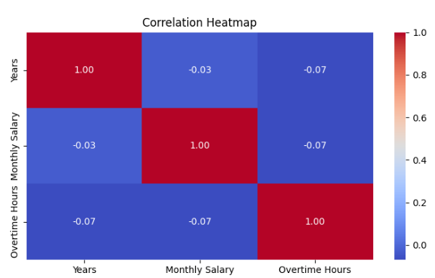
Future salaries
Metric | Measurement | Target | Actual
Audience attendance | # of attendees | 150 | 120
Engagement duration | Minutes | 60 | 75
Q&A interaction | # of questions | 10 | 15
Positive feedback | Percentage (%) | 90 | 95
Rate of information retention | Percentage (%) | 80 | 85
Objective: Predict salaries for the next year based on a growth rate.
Process:
Apply growth rate to current salaries.
Predict future salaries for each department and gender.
Visualization: Bar plot showing predicted salaries for the next year.

Slide 9
Visualization with fast api
Objective: Serve visualizations through a web API.
Tools:
FastAPI for API creation.
base64 encoding for image display.
Demonstration: Example of how plots are served through FastAPI.

Slide 10
achievements
Insights:
Understanding of salary distribution and disparities.
Predictions for future salaries.
Impact:
Assist in financial planning and decision-making.

Slide 11
Conclusion
Summary:
Overview of the analysis process and results.
Future Work:
Explore additional factors influencing salaries.
Refine prediction models for accuracy.

Slide 12
Thank you

