Slide 1

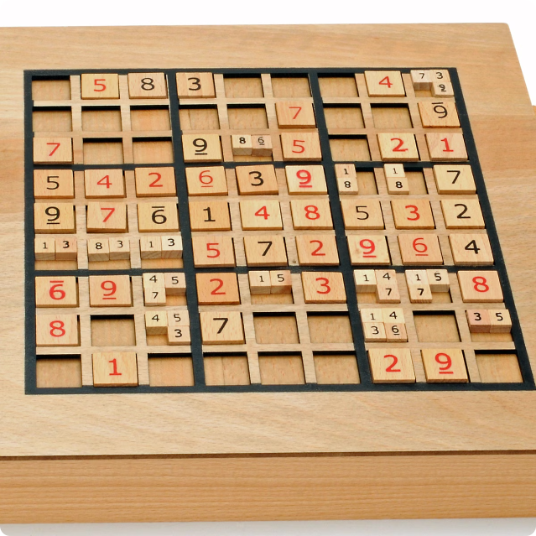
Sudoku Solver Visualizer
Sudoku, a popular logic-based puzzle, requires players to fill a 9x9 grid with numbers from 1 to 9, ensuring each row, column, and 3x3 subgrid contains unique digits. This project aims to develop a software application that can solve Sudoku puzzles, generate random puzzles, and provide a user-friendly interface for interacting with the solver.

Slide 2

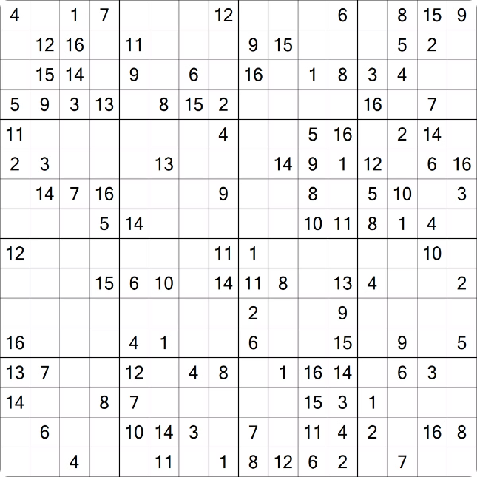
Background and Project Scope
Solver Algorithm
The application utilizes a robust backtracking algorithm, systematically exploring possible number placements and backtracking when an invalid placement is encountered.
GUI
The user interface provides an interactive 9x9 grid for inputting puzzles and displaying the solution process with visual feedback.
Random Puzzle Generation
Users can generate new puzzles by filling the grid and then removing a specified number of cells to create a solvable puzzle.

Slide 3
GUI Design and Functionality
The graphical user interface (GUI) is designed for ease of use and clear visual feedback. The main component is a 9x9 grid of text fields that users can interact with to input or view puzzles.
Grid Display
Control Buttons
Visual Feedback
The grid is designed for easy readability and usability, with clear visual cues for user input, solver-generated numbers, and random puzzle numbers.
Four buttons control the application: "Solve" initiates the solving process, "Stop" halts it, "Reset" clears the grid, and "Random Fill" generates a new puzzle.
Color coding provides immediate feedback on the solver's progress, highlighting user input in white, solver-generated numbers in yellow, and random numbers in green.

Slide 4


Implementation Details
The project is implemented using Java, taking advantage of its powerful object-oriented features and the Swing toolkit for building the GUI. Threading is used to run the solving algorithm in a separate thread, ensuring the responsiveness of the interface.
1
Java
The primary programming language, providing extensive libraries for handling graphical interfaces, data structures, and algorithms.
2
Swing
A GUI toolkit for creating the interface components, including buttons, text fields, and the Sudoku grid.
3
Threading
Used to run the solver algorithm in a separate thread, avoiding blocking the main thread and maintaining a responsive GUI.
4
Random
Leveraged for generating random numbers and creating Sudoku puzzles with varying difficulties.

Slide 5
Algorithm Explanation
The heart of the project is the backtracking algorithm, a recursive approach for solving Sudoku puzzles. This algorithm systematically fills in the grid, checking for validity at each step.
1
Initialization
Start by selecting an empty cell in the grid.
2
Number Assignment
Try assigning numbers from 1 to 9 to the selected cell.
3
Validity Check
Check if the assigned number is valid according to Sudoku rules (unique in row, column, and subgrid).
4
Backtracking
If the number is invalid, backtrack to the previous cell and try the next number. If all numbers have been tried, return to the previous cell.
5
Termination
Continue this process until all cells are filled or backtracking reaches the starting point without finding a solution.

Slide 6


GUI Design and Implementation
The GUI is designed using the ‘BorderLayout’ layout manager, with the Sudoku grid occupying the center and the control panel positioned at the bottom. Custom fonts, colors, and borders enhance visual appeal and user experience.
Component
Function
Sudoku Grid
Displays the puzzle and allows user input.
Control Buttons
Provide user interaction for solving, stopping, resetting, and generating puzzles.
Color Coding
Provides visual feedback on user input, solver progress, and random puzzle numbers.

Slide 7






Code Explanation
The project’s code comprises multiple classes, each responsible for specific functionalities, such as GUI setup, puzzle generation, and the solving algorithm.
Main Class
Extends ‘JFrame’ and sets up the GUI components, including the grid and control buttons.
Grid Reset & Random Fill
Methods responsible for clearing the grid and generating a random puzzle.
Sudoku Solver Algorithm
The core algorithm utilizes backtracking to solve the Sudoku puzzle.
Solver Runnable Class
Implements ‘Runnable’ to execute the solving algorithm in a separate thread.

Slide 8

Conclusion
The Sudoku Solver project successfully combines a user-friendly interface with a powerful backtracking algorithm, providing an engaging and educational experience. Future improvements could include advanced solving techniques, more interactive feedback, and support for different grid sizes and difficulty levels.
1
User-friendly Interface
2
Robust Algorithm
3
Random Puzzle Generation
4
Educational Value
The intuitive GUI facilitates easy interaction with the solver and visual feedback.
The backtracking algorithm effectively solves Sudoku puzzles, ensuring accurate results.
The project allows users to generate new puzzles with varying difficulty levels.
The project demonstrates the application of logic-based algorithms and GUI development.

Slide 9
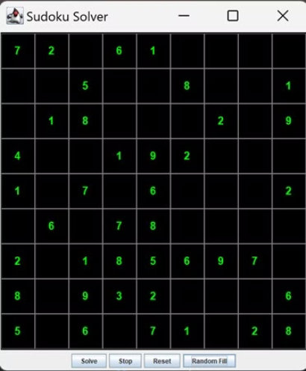
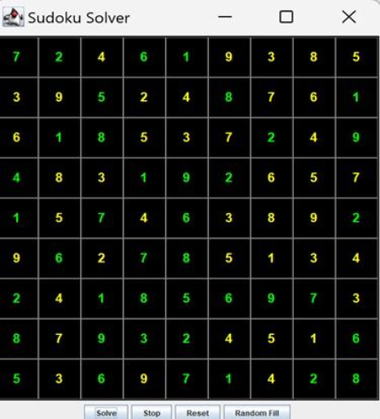
INPUT
OUTPUT

