Slide 1



Smart Peer-to-Peer Academic Sharing Platform (KEC Exclusive)
Mentor Name: S.Sujitha M.Tech,
IT – A,
Kongu Engineering College
BY
BOOMADEVI S 23ITR016
DHARANYA A 23ITR028
ABISHA REBEKKAL T 23ITR001

Slide 2
Problem Statement
No centralized platform for sharing academic resources in KEC.
Resources are shared via social media – unstructured and temporary.
Lack of access control, ratings, or organized search/request system.
No proper organization or categorization of content.

Slide 3
Objectives
Build a centralized platform for KEC students and faculty.
Enable secure login, upload/download of notes, books, and QPs.
Provide chat, request system, ratings, and tracking.
Allow uploading and downloading of notes and question papers.
Implement a request feature to ask for specific study materials

Slide 4
Tech Stack
Frontend: React.js
Backend: Spring Boot
Authentication: Google + JWT
Database: MySQL
Storage: Local / Firebase
Tools: Postman, GitHub

Slide 5
Modules
Authentication (Google + JWT)
Profile Management
Upload & View Resources
Download Tracker & Ratings
Chat & Request System

Slide 6
Algorithm
Authentication :
- Google Authentication Algorithm with JWT Token Generation.
Profile Management - User Profile CRUD Operation Algorithm with Validation Logic.
Upload & View Resources
- Hashing Algorithm
- Retrieval Algorithm

Slide 7
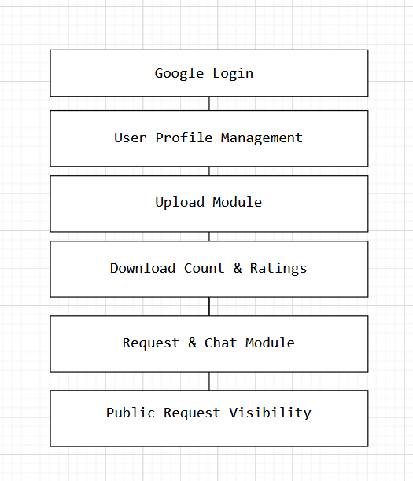

Slide 8
Thank you!

