Slide 1

Adventure Works Cycles
Adventure Works Cycles

Slide 3
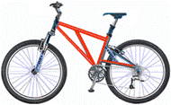
Adventure Works Cycles
 | Adventure Works Cycles

Slide 4
Details
Analyzing
Estimation
Implementing
Testing

Slide 5
Ole Object
MS Word Object

