Slide 1

Support Analysis

Slide 2
RTL (right to left) conversion support
RTL (right to left) text
יישומונים 80 ועוד
دعم الزاوي على أساس
Bidirectional text
עיצובים מובנים bidirectional אישית
Hebrew text with Left to Right
עיצובים מובנים וניתנים להתאמה אישית
הדגמה זמינה ב
http://js.syncfusion.com/demos/web/

Slide 3
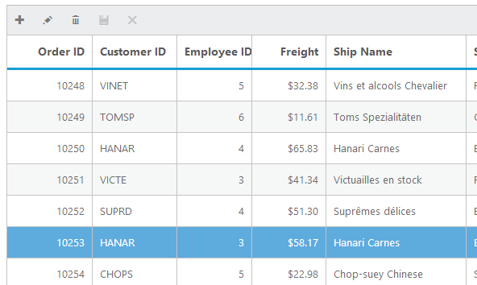
Grid
v

Slide 4
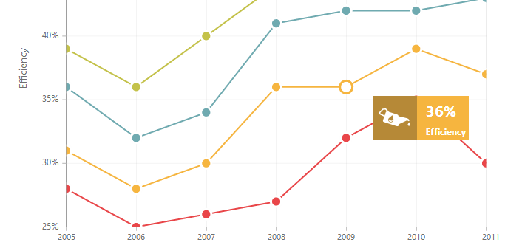
Chart
20 chart types

Slide 5
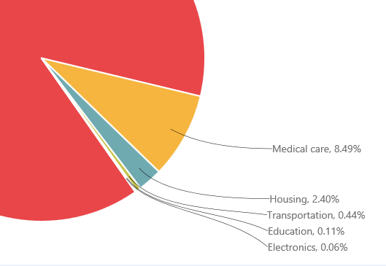
Chart smart labels
i

Slide 6
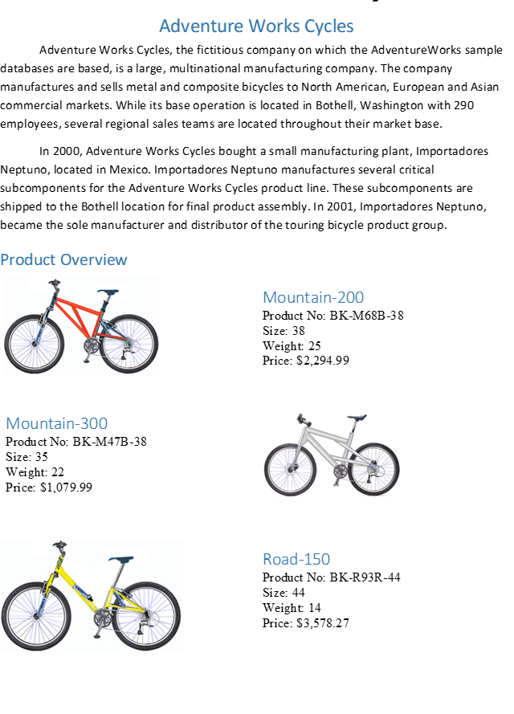
Chart Rows

Slide 7
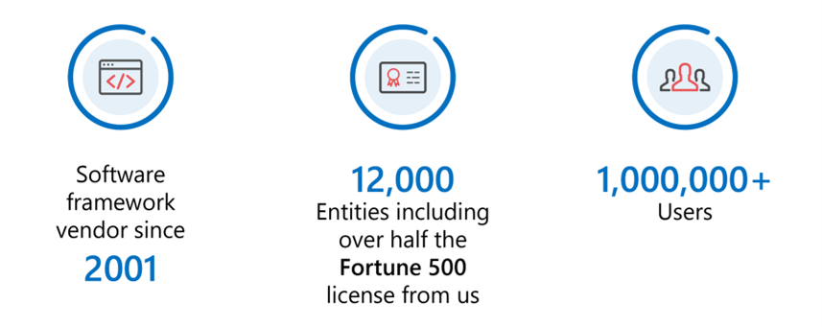
Chart Rotate labels

Slide 8
Range Navigator

Slide 9
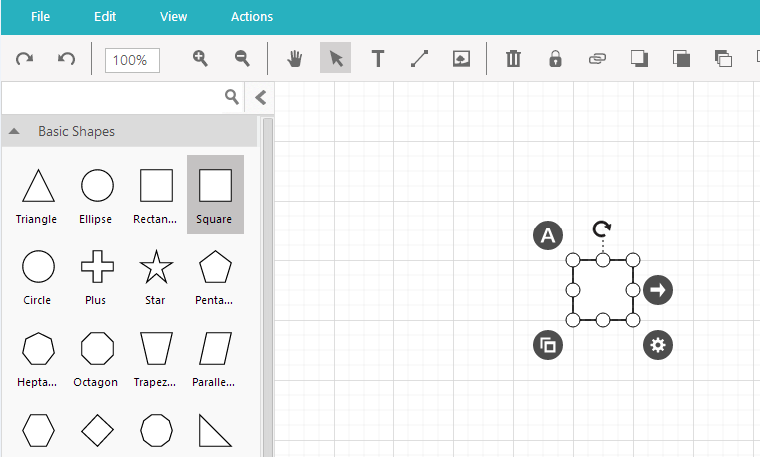
Diagram

Slide 10

Diagram Mindmap

Slide 11

Gantt

Slide 12

Range Navigator

Slide 13
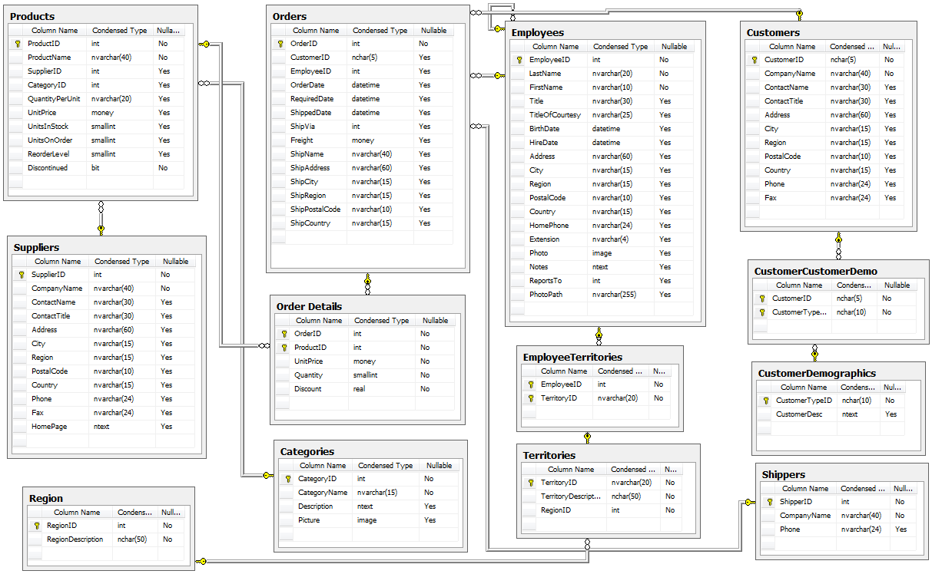
Schedule

Slide 14
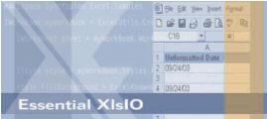
Bullet Graph

Slide 15

Linear Gauge

Slide 16
Chart
20 chart types

Slide 17
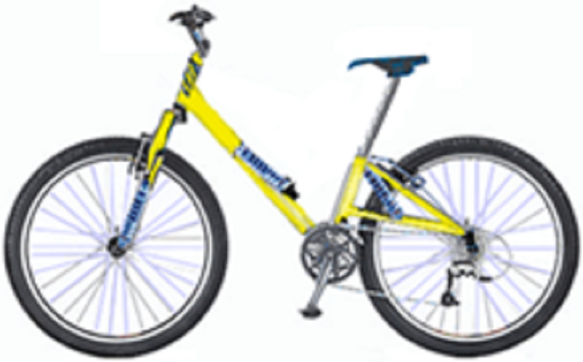
Time Picker

Slide 18

Maps

Slide 19
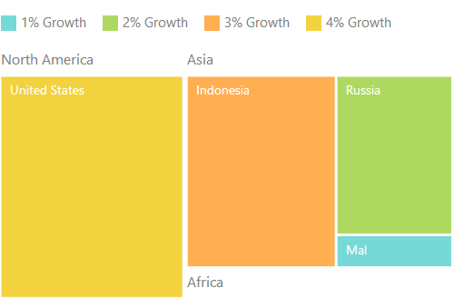
Treemap

Slide 20
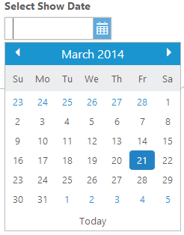
Date Picker

Slide 21

Time Picker

Slide 22
Linear Gauge

Slide 23

Time Picker

Slide 24
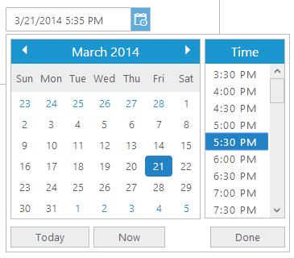
Date Time Picker

Slide 25

Text Boxes

Slide 26
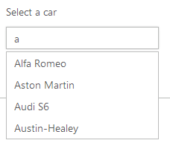
Auto Complete

Slide 27

Tree View

Slide 28

Rich Text Box

Slide 29

Rotator

Slide 30

Tabs

Slide 31

Menu

Slide 32
Olap Grid

Slide 33
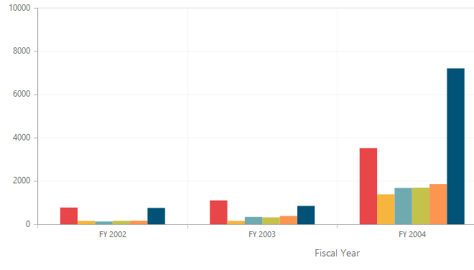
Olap Chart

Slide 34
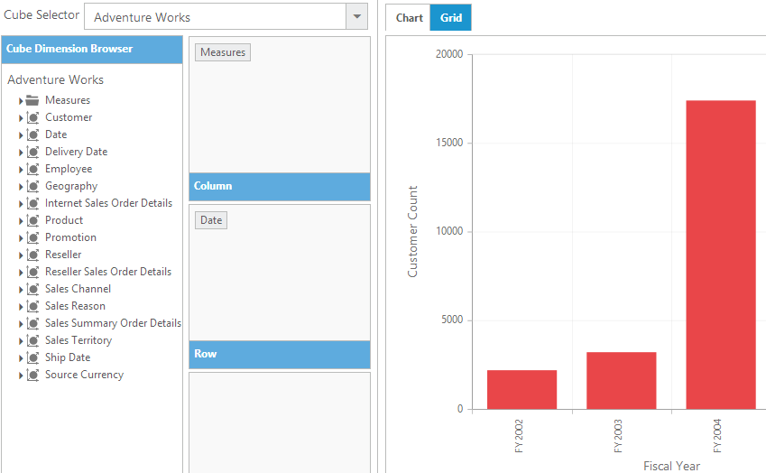

Olap Client

Slide 35
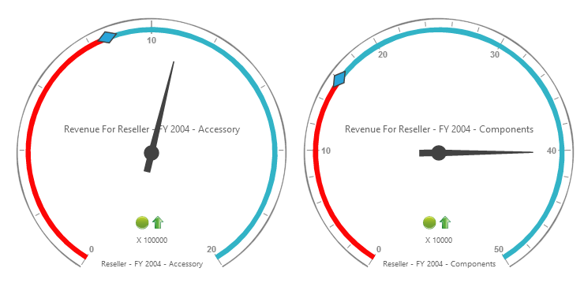
Olap Gauge

Slide 36
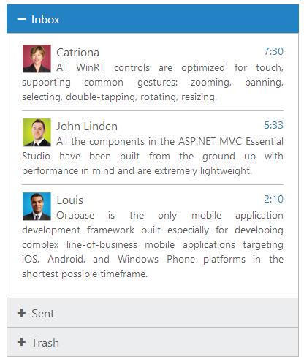
Accordion

Slide 37

Progress Bar

Slide 38

Rating

Slide 39
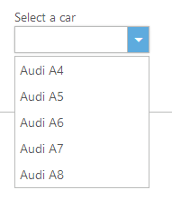
Drop DownList

Slide 40
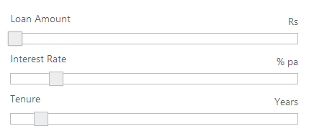
Slider

Slide 41
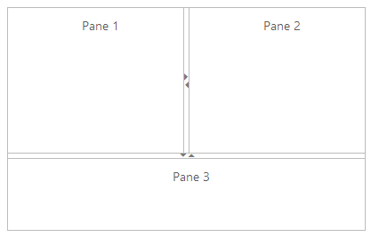
Splitter

Slide 42
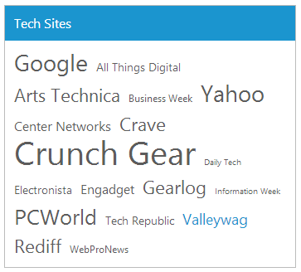
Tag Cloud

Slide 43
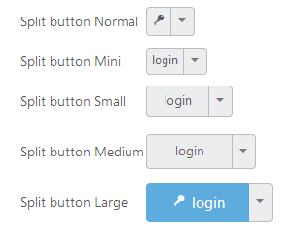
Button

Slide 44

Toolbar

Slide 45


Waiting Popup

Slide 46
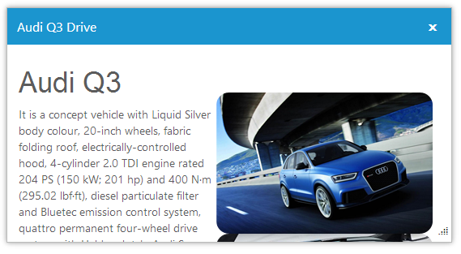
Dialog

Slide 47
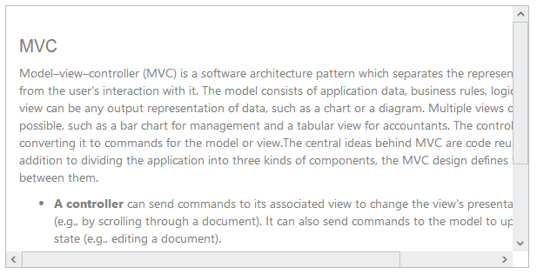
Scrollbar

Slide 48

Barcode

Slide 49


Demo
Contact Us

Slide 50
Support Analysis

Slide 51
RTL (right to left) conversion support
RTL (right to left) text
יישומונים 80 ועוד
دعم الزاوي على أساس
Bidirectional text
עיצובים מובנים bidirectional אישית
Hebrew text with Left to Right
עיצובים מובנים וניתנים להתאמה אישית
הדגמה זמינה ב
http://js.syncfusion.com/demos/web/

Slide 52
Grid
v

Slide 53
Chart
20 chart types

Slide 54
Chart smart labels
i

Slide 55
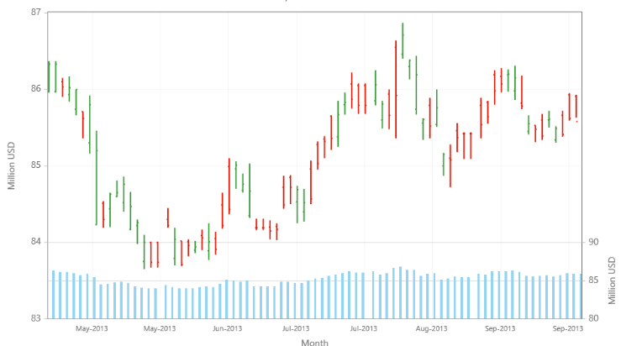
Chart Rows

Slide 56
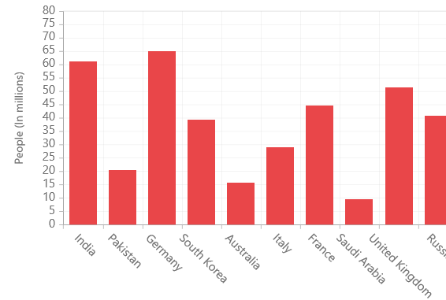
Chart Rotate labels

Slide 57
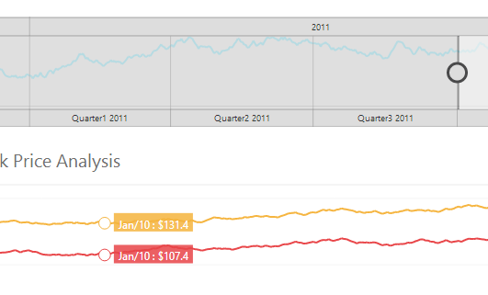
Range Navigator

Slide 58
Diagram

Slide 59
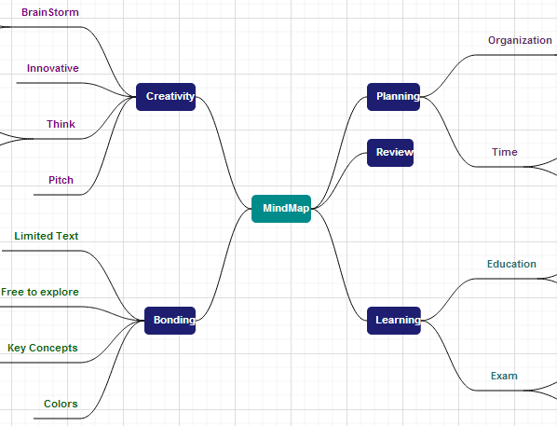
Diagram Mindmap

Slide 60
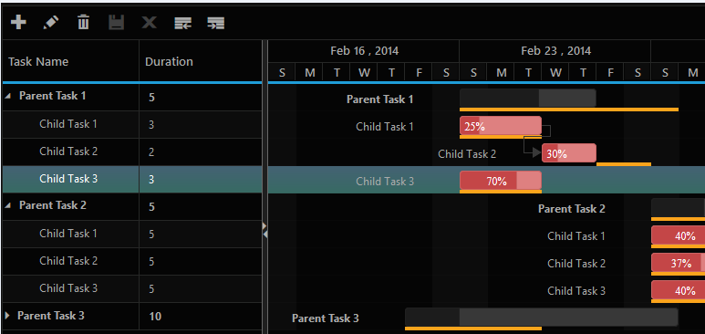
Gantt

Slide 61
Range Navigator

Slide 62
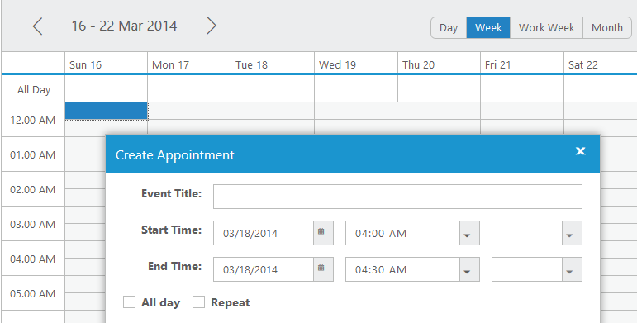
Schedule

Slide 63
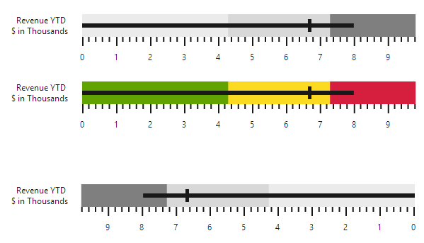
Bullet Graph

Slide 64
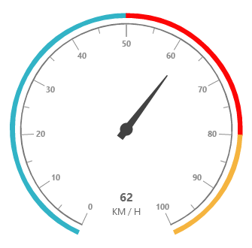
Bullet Graph

Slide 65


Linear Gauge

Slide 66
Schedule

Slide 67
Linear Gauge

Slide 68
Maps

Slide 69
Treemap

Slide 70
Date Picker

Slide 71
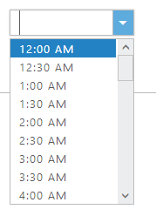
Time Picker

Slide 72
Linear Gauge

Slide 73
Time Picker

Slide 74
Date Time Picker

Slide 75
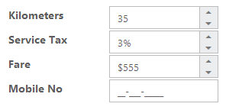
Text Boxes

Slide 76
Auto Complete

Slide 77
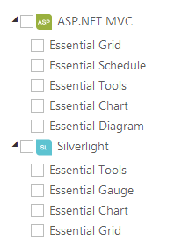
Tree View

Slide 78
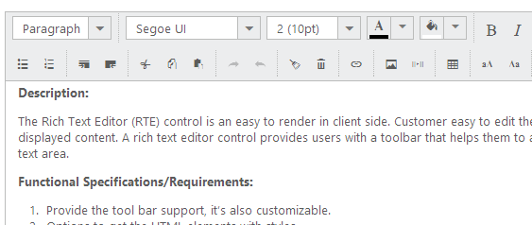
Rich Text Box

Slide 79
Rotator

Slide 80
Tabs

Slide 81
Menu

Slide 82
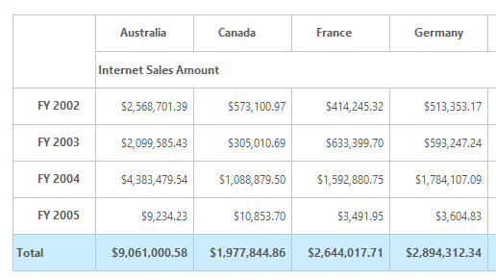
Olap Grid

Slide 83
Olap Chart

Slide 84
Olap Client

Slide 85
Olap Gauge

Slide 86
Accordion

Slide 87
Progress Bar

Slide 88
Rating

Slide 89
Drop DownList

Slide 90
Slider

Slide 91
Splitter

Slide 92
Tag Cloud

Slide 93
Button

Slide 94
Toolbar

Slide 95
Waiting Popup

Slide 96
Dialog

Slide 97
Scrollbar

Slide 98
Barcode

Slide 99
Demo
Essential JS Demo
http://js.syncfusion.com/demos/web/
Contact Us
sales@syncfusion.com

