Slide 1

Adventure Works Cycles
Adventure Works Cycles, the fictitious company on which the Adventure Works sample databases are based, is a large, multinational manufacturing company. The company manufactures and sells metal and composite bicycles to North American, European and Asian commercial markets.
In 2000, Adventure Works Cycles bought a small manufacturing plant, Importadores Neptuno, located in Mexico.
Importadores Neptuno manufactures several critical subcomponents for the Adventure Works Cycles product line.
Cycle

Slide 2
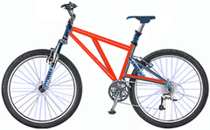
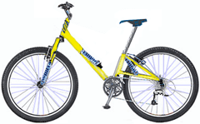
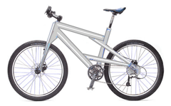
Product Overview
 | Mountain-200 Product No: BK-M68B-38 Size: 38 Weight: 25 Price: $2,294.99
Mountain-300 Product No: BK-M47B-38 Size: 35 Weight: 22 Price: $1,079.99
 | Road-150 Product No: BK-R93R-44 Size: 44 Weight: 14 Price: $3,578.27

Slide 4
Target Vs PERFORMANCE
Month | Product A | Product B | Product C | Product D | Product E | Product F | Average | Target
Jan | 20000 | 4200 | 8000 | 12000 | 4700 | 15000 | 10650 | 35000
Feb | 8300 | 19000 | 21000 | 15230 | 7230 | 1800 | 12093 | 18000
Mar | 4600 | 9000 | 7500 | 8000 | 30000 | 22000 | 13517 | 13200
Apr | 3530 | 13430 | 3550 | 10670 | 27860 | 5414 | 10742 | 50000
May | 10293 | 23760 | 10378 | 24857 | 12104 | 21350 | 17124 | 25460
Jun | 9070 | 8218 | 23480 | 20492 | 9103 | 12300 | 13777 | 21600
Jul | 23500 | 19230 | 87390 | 25030 | 28000 | 11890 | 32507 | 37800
Aug | 39000 | 30301 | 78356 | 21121 | 30443 | 23230 | 37075 | 40900
Sep | 14340 | 19403 | 89024 | 1230 | 12561 | 29000 | 27593 | 29800

Slide 5
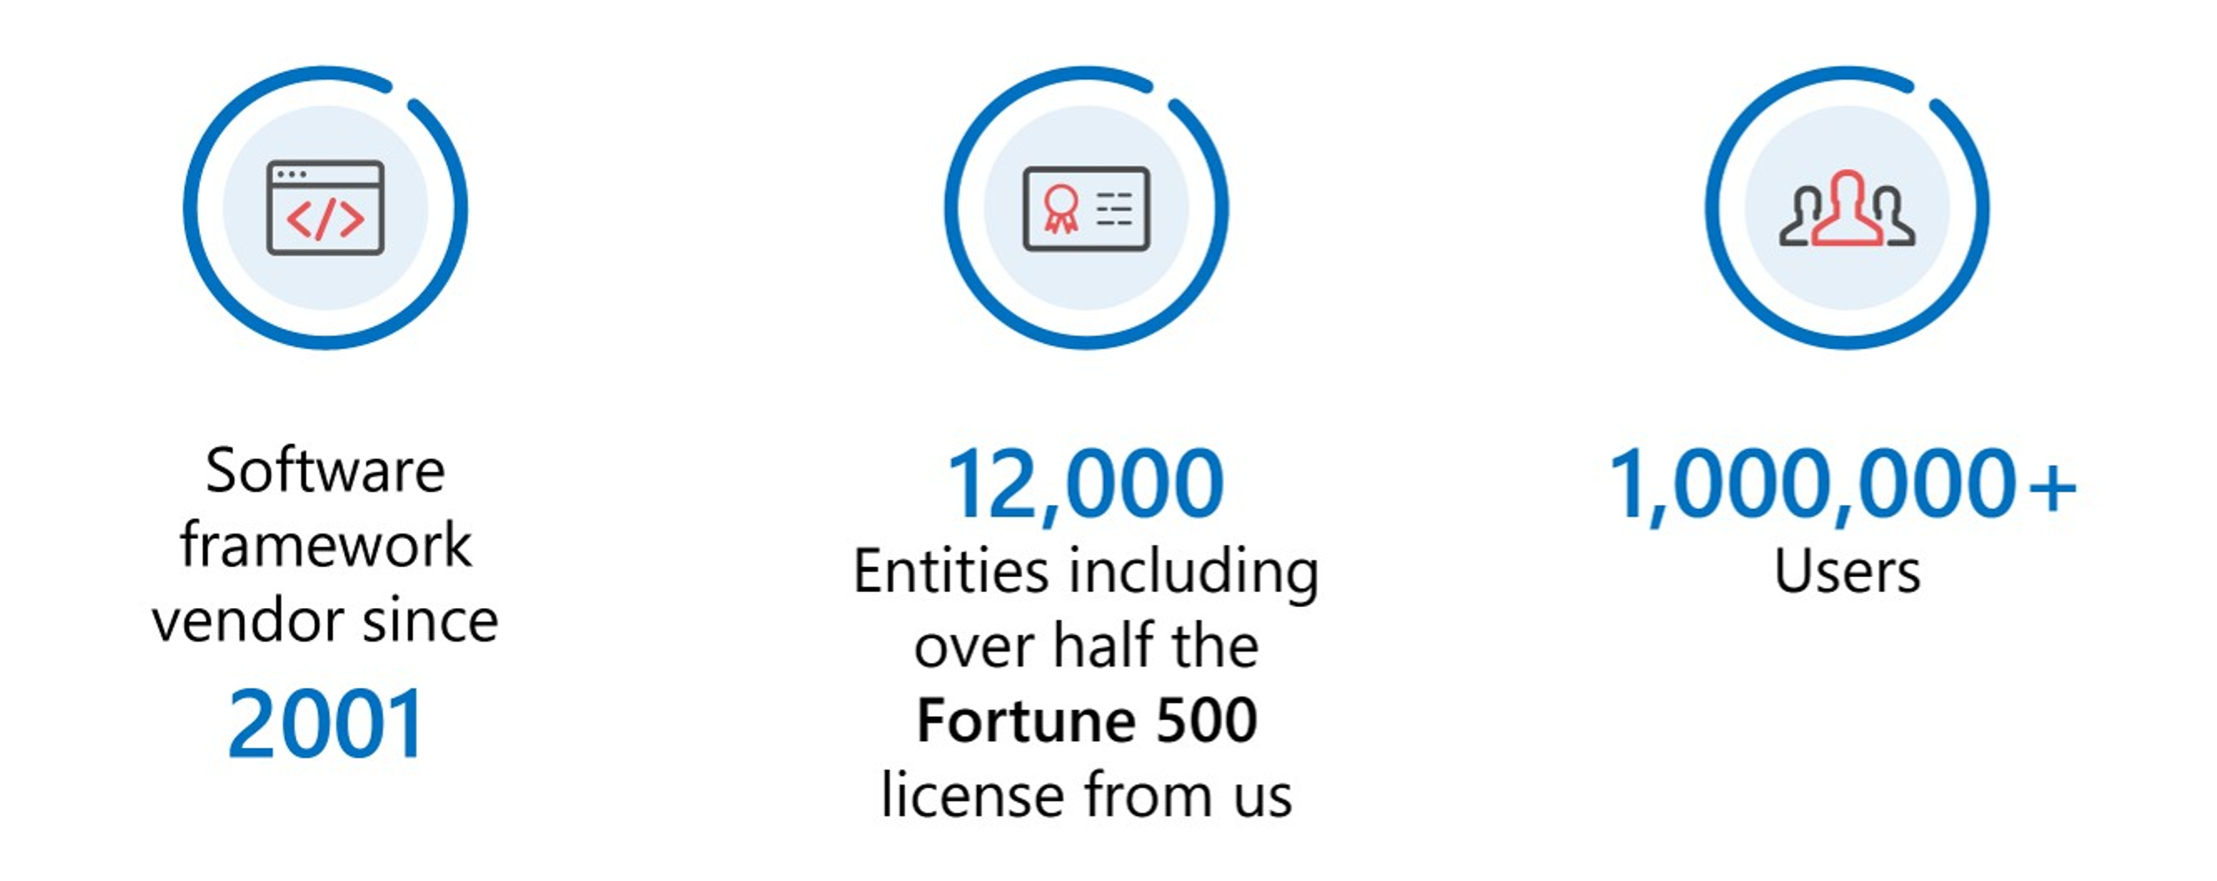
About Adventure Works Cycles

