Slide 1
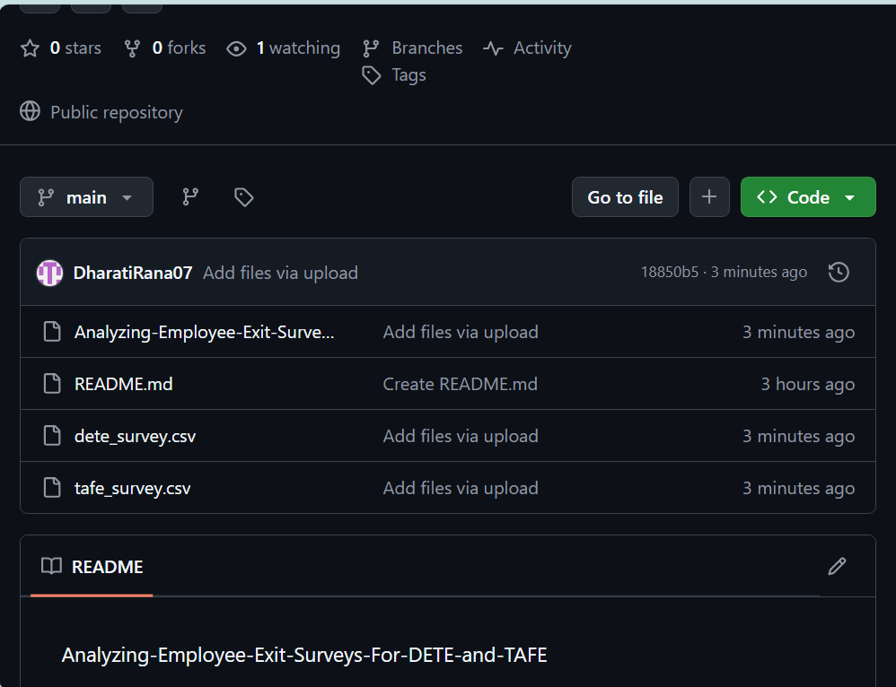
Analyzing Employee Exit Surveys for DETE and TAFE
This presentation outlines key insights from analyzing employee exit surveys for the Department of Education and Training (DETE) and the Technical and Further Education (TAFE) sectors. It explores the importance of employee exit surveys, the methodology used for analyzing data, and provides recommendations for improving employee retention.
DR
by Dharati Rana

Slide 2
Understanding the Importance of Employee Exit Surveys
Valuable Insights
Targeted Improvements
Exit surveys provide valuable insights into the reasons behind employee departures, shedding light on organizational strengths and weaknesses.
Understanding why employees leave helps organizations identify and address issues impacting employee satisfaction, motivation, and retention.

Slide 3
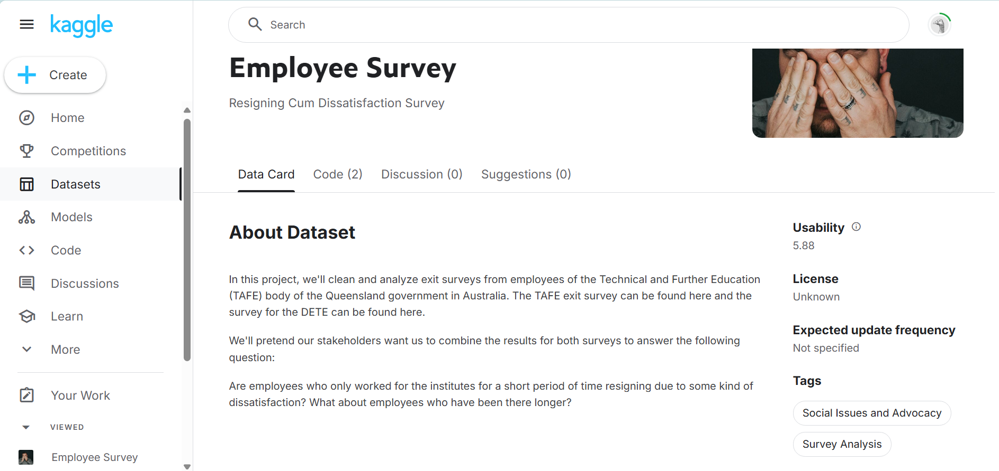
Methodology
1
Data Collection
2
Data Cleaning
3
Quantitative and Qualitative Analysis
Exit surveys were collected from DETE and TAFE employees who resigned between January 2022 and December 2023.
Data cleaning ensured accuracy, removing incomplete or duplicate entries, and standardizing response formats.
Statistical analysis was combined with qualitative insights derived from open-ended responses to identify underlying patterns.

Slide 4
Reasons for Leaving: Identifying the Top Factors
Compensation
Career Advancement
Work-Life Balance
Management
Salary and benefits remain critical drivers of employee satisfaction. We'll analyze compensation discrepancies and explore strategies for competitive packages.
Opportunities for growth and professional development are essential. We'll examine the availability and effectiveness of internal training and promotion pathways.
Flexible work arrangements and a healthy work-life balance are increasingly sought after. We'll explore employee needs and potential solutions.
Effective leadership and supportive supervisors are crucial for employee morale. We'll identify areas for improvement in management practices and communication.

Slide 5
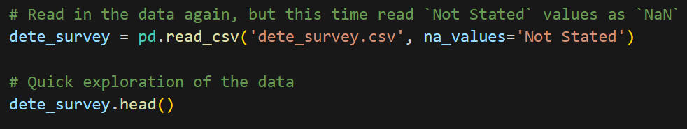
Cleaning and Preprocessing the Survey Data
1
Missing Values
Handling missing values is crucial. We employed imputation techniques to estimate missing data based on available information.
2
Inconsistencies
Identifying and correcting inconsistencies in survey responses ensures data accuracy and reliability for analysis.

Slide 6
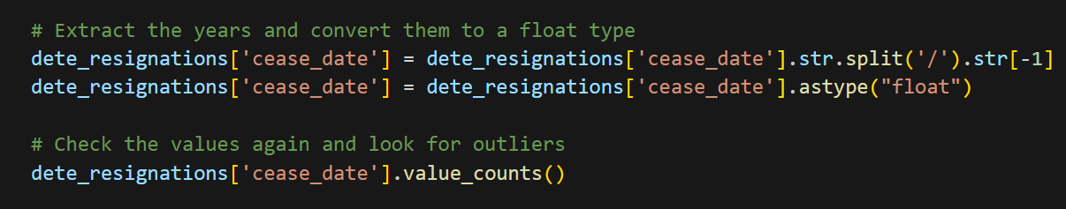
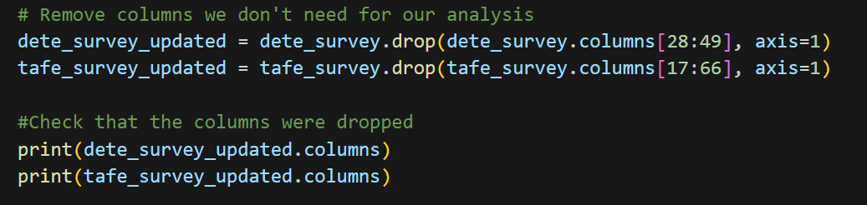
3
Data Transformation
Transforming data into a consistent format, such as numerical values, enables effective analysis and comparison across different categories
4
Drop Unnecessary Data Columns

Slide 7
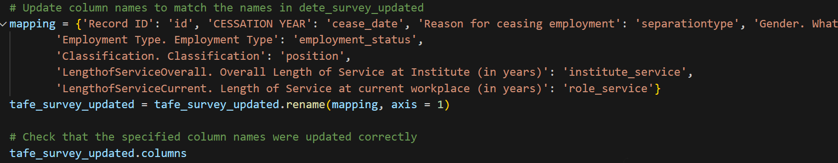
5
Rename Data Columns
Standardize the names of the columns we want to work with, because we eventually want to combine the dataframes.
.
6
Filter Data

Slide 8
Identify Dissatisfied Employees
Identify any employees who resigned because they were dissatisfied. Below are the columns we'll use to categorize employees as "dissatisfied" from each dataframe:
1. tafe_survey_updated:
- `Contributing Factors. Dissatisfaction`
- `Contributing Factors. Job Dissatisfaction`
2. dafe_survey_updated:
- `job_dissatisfaction`
- `dissatisfaction_with_the_department`
- `physical_work_environment`
- `lack_of_recognition`
- `lack_of_job_security`
- `work_location`
- `employment_conditions`
- `work_life_balance`
- `workload`
If the employee indicated any of the factors above caused them to resign, we'll mark them as `dissatisfied` in a new column. After our changes, the new `dissatisfied` column will contain just the following values:
- `True`: indicates a person resigned because they were dissatisfied in some way
- `False`: indicates a person resigned because of a reason other than dissatisfaction with the job
- `NaN`: indicates the value is missing

Slide 9


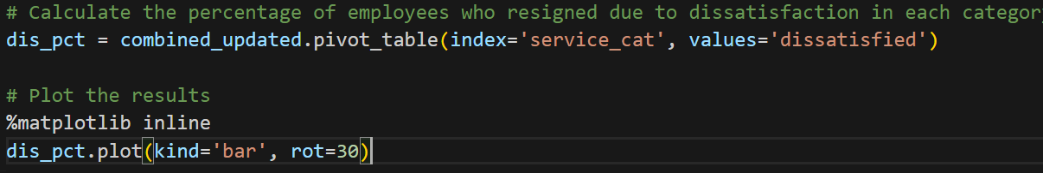
Exploratory Data Analysis
Frequency Distribution
Descriptive Statistics
Analyzing the distribution of responses across key survey variables, like job satisfaction, career opportunities, and work-life balance.
Calculating measures like mean, median, and standard deviation to understand the central tendencies and variability of responses.

Slide 10
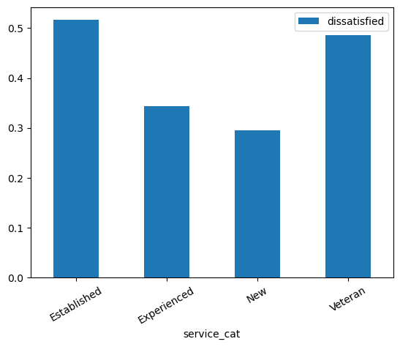
CONCLUSION
From the initial analysis above, we can tentatively conclude that employees with 7 or more years of service are more likely to resign due to some kind of dissatisfaction with the job than employees with less than 7 years of service. However, we need to handle the rest of the missing data to finalize our analysis.

Slide 11



Recommendations for Improving Employee Retention
Improve Career Development
Enhance Compensation and Benefits
Foster a Positive Work Environment
Implement clear career paths, provide mentorship programs, and offer training and development opportunities.
Review salary structures, offer competitive benefits packages, and provide flexible work arrangements.
Create a culture of respect, support, and collaboration, with clear communication and effective leadership.

Slide 12
THANK YOU

