Slide 1
A Presentation on Abnormalities Detection and Predictive Maintenance for Industrial Equipment
By
Dharin Dave

Slide 2
Contents
Introduction
Objectives
Dataset
Implementation / Approach
Challenges
Outcomes
Conclusion

Slide 3
Introduction
In the industrial sector, maintaining the seamless operation of equipment is critical for ensuring productivity and profitability.
However, companies frequently face challenges due to unplanned equipment failures, which can lead to substantial operational disruptions and financial setbacks.
The complexity of modern machinery, coupled with the vast amounts of data they generate, makes it difficult to detect anomalies that could signal impending failures.
This situation is further complicated by the significant operational and financial impacts that arise from such failures, including increased maintenance costs, reduced equipment lifespan, and potential safety risks.
Addressing these issues requires a comprehensive understanding of the problem to develop effective strategies for minimizing downtime and optimizing maintenance practices.

Slide 4
Objectives
Facilitate Data-Driven Anomaly Detection: Implement a dashboard to upload and analyze industrial equipment data, using machine learning models like Random Forest, Logistic Regression, and XGBoost to detect abnormalities and predict potential equipment failures.
Enhance Visualization and Interpretability: Provide comprehensive visualizations, including feature importance, correlation heatmaps, and ROC curves, to help users understand model performance and the factors influencing equipment anomalies.
Enable Interactive Anomaly Analysis : Offer interactive tools for users to explore data distributions, detect anomalies using methods like Z-score and Isolation Forest, and visualize anomalies in relation to different equipment and environmental features.

Slide 5
Dataset
This dataset is publicly available on Kaggle and contains simulated data representing real-time monitoring of various industrial equipment, including turbines, compressors, and pumps. Each row in the dataset corresponds to a unique observation capturing key parameters such as temperature, pressure, vibration, and humidity. The dataset also includes information about the equipment type, location, and whether the equipment is classified as faulty.

Slide 6
Dataset – Column Description
Temperature: Temperature reading at the time of observation (in °C).
Pressure: Pressure reading at the time of observation (in bar).
Vibration: Vibration level reading (normalized units).
Humidity: Humidity percentage recorded at the location of the equipment.
Equipment: Type of industrial equipment being monitored (e.g., Turbine, Compressor, Pump).
Location: Location of the equipment (city name).
Faulty: Binary indicator (0 = Not Faulty, 1 = Faulty) to specify whether the equipment is functioning properly or requires maintenance.

Slide 7
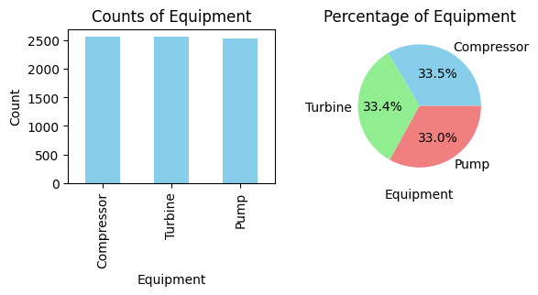
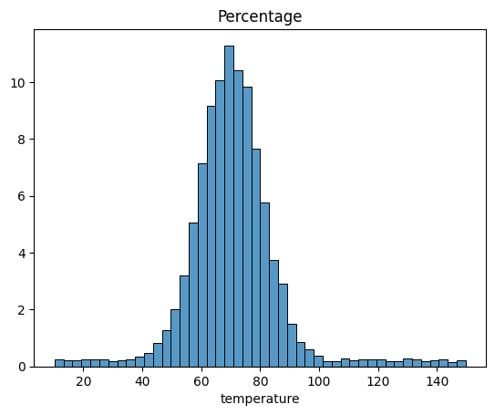
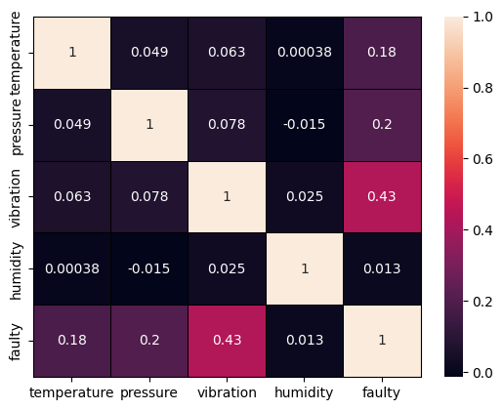
Implementation / Approach - EDA
Histograms: Used to visualize the distribution of numerical features such as temperature, pressure, vibration, and humidity. These graphs help identify the spread, central tendency, and potential outliers in the data for each feature, both overall and segmented by equipment type and location.
Pie Charts: Employed to show the proportional distribution of categorical variables like equipment types and faulty vs. non-faulty equipment. These charts provide a quick visual representation of the dataset's composition.
Correlation Heatmap: A heatmap is used to display the correlation matrix of numerical features, highlighting relationships between variables. This graph helps identify potential multicollinearity issues and understand how different features might influence the target variable, 'faulty'.

Slide 8
Implementation / Approach - Preprocessing
Transforming Negative Vibration Values: In datasets where vibration measurements are critical, negative values may be erroneous or irrelevant. To address this, any negative values in the 'vibration' feature are set to 0. This transformation ensures that all vibration data are non-negative, aligning with the physical reality of vibration measurements.
Scaling/Normalizing Numerical Features: To ensure that numerical features like temperature, pressure, and humidity are on a similar scale, scaling or normalization is applied. Techniques such as Min-Max Scaling or Standardization (Z-score normalization) are commonly used. This step is crucial for improving the performance of machine learning algorithms, particularly those sensitive to feature scales, such as k-Nearest Neighbors and gradient descent-based models.
One-Hot Encoding Categorical Features: Categorical variables such as 'equipment' and 'location' are transformed using one-hot encoding. This process converts each category into a binary vector, allowing machine learning algorithms to interpret categorical data effectively. Each unique category becomes a new binary feature, where a value of 1 indicates the presence of the category, and 0 indicates its absence. This transformation is essential for algorithms that require numerical input.

Slide 9
Implementation / Approach – Model Training
Random Forest: An ensemble method that builds multiple decision trees to improve prediction accuracy and robustness against overfitting, providing insights into feature importance.
Logistic Regression: A linear model for binary classification that estimates probabilities using the logistic function, valued for its simplicity, interpretability, and efficiency.
XGBoost: An efficient implementation of gradient boosting that excels in accuracy and speed, handling complex patterns and missing data well, often used in competitive data science tasks.

Slide 10
Challenges
Overfitting to Minority Class: When using techniques like oversampling to increase the representation of the faulty class, there's a risk that the model may overfit by learning noise and specific patterns that do not generalize well to new data.
Data Sparsity in Minority Class: The limited number of faulty instances can lead to insufficient data for capturing the diversity and variability within this class, making it difficult for the model to learn robust patterns and accurately predict faults in varied scenarios.
Evaluation Challenges: Standard performance metrics like accuracy can be misleading in skewed datasets. It becomes crucial to focus on metrics that better reflect the model's ability to correctly identify minority class instances, such as precision, recall, and F1-score, which require careful interpretation and balance.

Slide 11
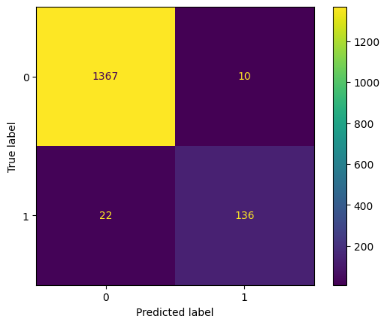
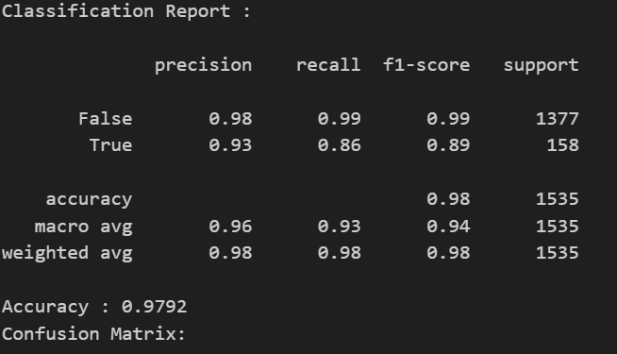
Outcomes – Random Forest

Slide 12
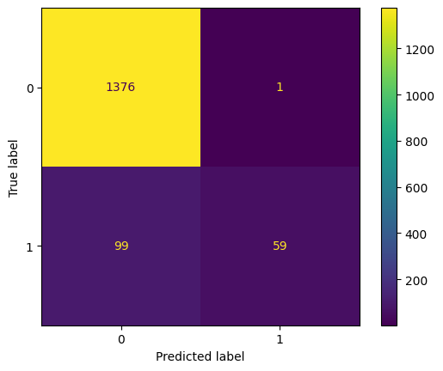
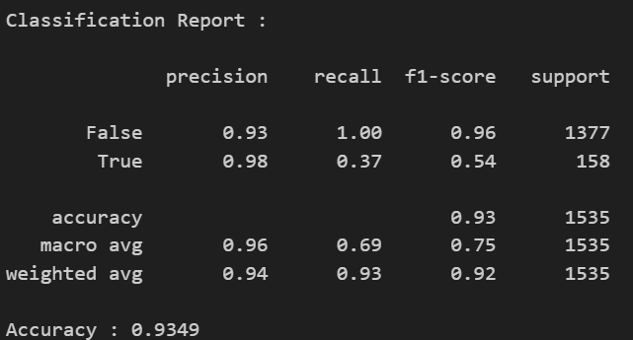
Outcomes – Logistic Regression

Slide 13

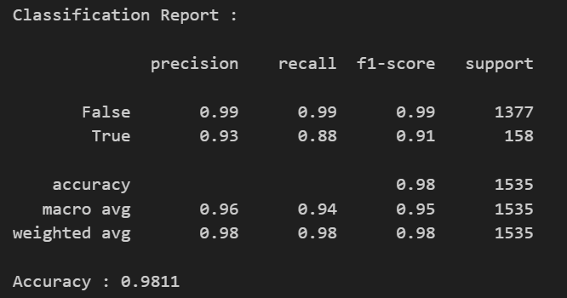
Outcomes – XGBoost Classifier

Slide 14
Conclusion
Performance Comparison: XGBoost Classifier slightly outperforms Random Forest in terms of overall accuracy and F1-score for the minority class (True), indicating it handles the imbalance and complexity of the dataset more effectively. Both models significantly outperform Logistic Regression, particularly in recall for the True class.
Recall and Precision Trade-offs: Random Forest and XGBoost show a better balance between precision and recall for the True class compared to Logistic Regression, which has high precision but very low recall. This suggests that Logistic Regression struggles to correctly identify True instances, leading to many false negatives.
Model Selection: Given the importance of accurately detecting the minority class, XGBoost is the most suitable choice, offering the best combination of precision, recall, and F1-score for the True class. However, the Random Forest is also a strong contender, with slightly lower performance metrics. Both models are preferable over Logistic Regression for this task.

Slide 15
Thank you

