Slide 1
Name: Varshini PJ Roll number: CB.SC.I5DAS18039 Title: Fashion Recommendation System

Slide 2
Tentative Problem:
Fashion Recommendation System (FRS) can be defined as a means of feature matching between fashion products and users or consumers under specific matching criteria.
The idea is to build a content based recommendation system to support black owned small businesses, being an ally to the Black Lives Matter Movement.
The FRS is coupled with a Graphical User Interface to support the users’ queries for similar products. Users will be able to upload an image and get recommendations based on the style of the uploaded image. The recommendations will be from black owned small business sites.

Slide 3
First Review Recap:
I’ve chosen to create my own dataset using Web Scraping, supporting small businesses (as readymade datasets are unavailable).
The mapping dataset is created by scraping all the needful information from the brand websites, using BeautifulSoup.
The information collected includes - Product Name, Product Link, Image Link, Price.
The training dataset has been chosen to be the DeepFashion and many types of models have been trained on it.
The structure and idea for the GUI has been scripted and the basic code structure was formed.
All the bottlenecks faced during coding for WebScraping were discussed.

Slide 4
Training dataset: DeepFashion
The selected dataset is a benchmark of the DeepFashion dataset - Category and Attribute Prediction Benchmark dataset, created by Ziwei Liu et al.,
It is a 3gb dataset which contains low resolution images (high resolution images are a bottleneck).
It has 38 classes - Anorak, Blazer, Blouse, Bomber, Button-Down, Caftan, Capris, Cardigan, Chinos, Coat, etc.
This dataset contains 289,222 diverse clothes images labeled with 1000 different attributes. From which I used 98 attributes that correspond to style, fabric, season, and type of the pattern such as abstract-print, floral,etc.,
It is a multi-class dataset, so that our model can classify images into multiple classes.

Slide 5
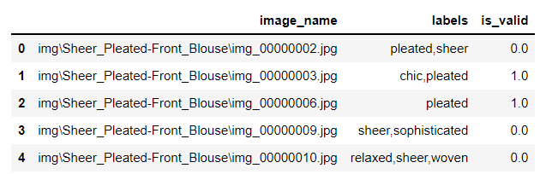
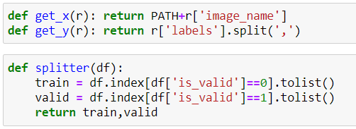
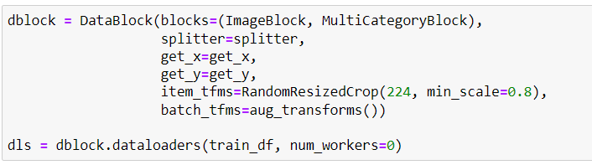
Model Building: Creating DataBlock
Training data are stored in multilabel-train.csv . It contains the following data:
The dataset contains the location of the images, labels stored as a string object, and whether the image belongs to a validation set.
To load the images, we use a DataBlock, that expects as input the full path to the image as an independent variable and the list of strings as the labels. For that, we create two helper functions to parse the input format -get_x and the get_y.The splitter function will create train and validation sets based on the is_valid column.

Slide 6
Data Augmentation and Evaluation Metric:
Data Augmentation:
RandomResizedCrop randomly crops a part of the image. Each epoch it crops a different part of the image.This is used in the latter part of the code to zoom into the pictures if any model-cloth picture is involved.
aug_transforms - creates a list of augmentations such as horizontal flip, rotation, zoom, warp, and lighting transforms.
Evaluation metric:
FBeta is a generalization of F-score. While F-score is defined as the harmonic mean of precision and recall and gives each the same weight, FBeta adds a configuration parameter called beta. The beta parameter determines the weight of recall in the combined score.
beta < 1 lends more weight to precision, while beta > 1 favors recall (beta -> 0 considers only precision, beta -> +inf only recall).
In case of no prediction, it will give us a 0 FBeta score.

Slide 7
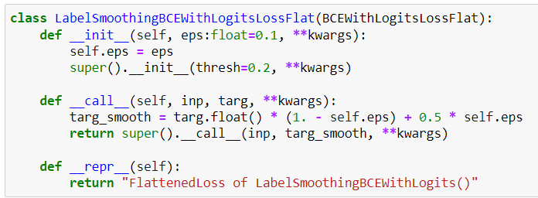
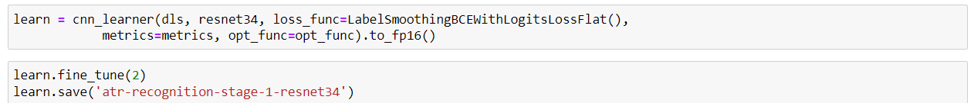
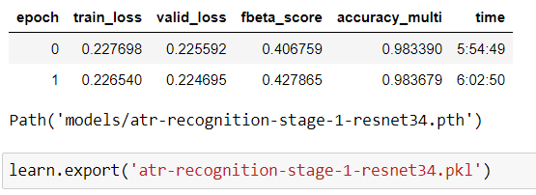
Loss Function and Model Creation:
Loss Function:
Model:
Model predicts
the attributes
of the clothes

Slide 8
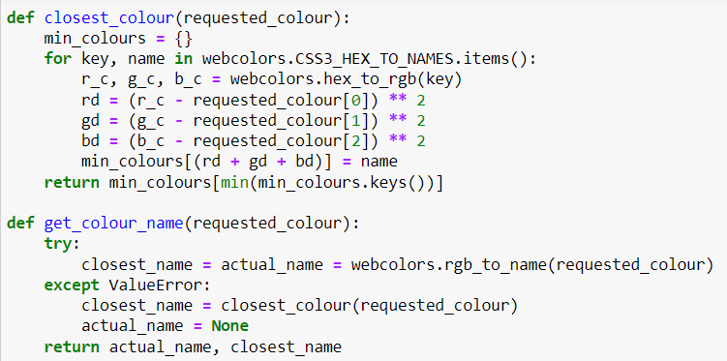
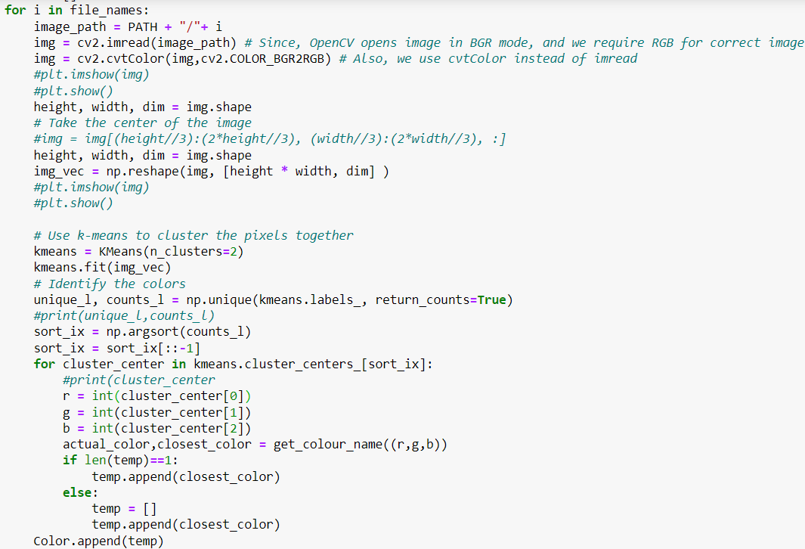
Color Prediction:
We’ll be finding 2 colors - actual and the closest color of the cloth that is present in the mapping data.
The below code makes use of KMeans algorithm to take the centroid of the clusters to find the actual and the closest colors. KMeans algorithm returns the centroid of the clusters as a 3-value pair of RGB values. Since, for the cluster centroid the average of the RGB values is taken. The value we receive won’t always have an exact RGB to name conversion. Hence, we find the closest color in order to map it to the closest RGB value which has a color name

Slide 9
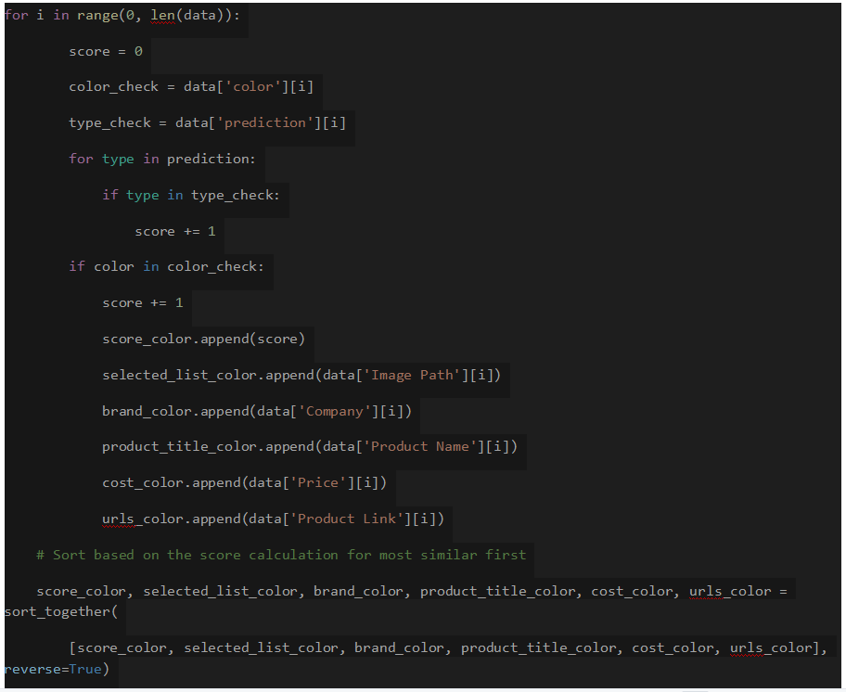
Recommendation System:
RECOMMENDER:
CODE:
The recommendation system works on the user’s uploaded image. It first tries to predict the cloth attributes and its corresponding color for the user’s uploaded image of choice.
If one class matches with the user’s input, we give it a score of 1 and if 2 classes match, we give it a score of 2. Similarly, for the color for every color match a score of 1 is added. By adding all these scores together, we get the final score for how similar our dress is with the user’s uploaded dress.

Slide 10
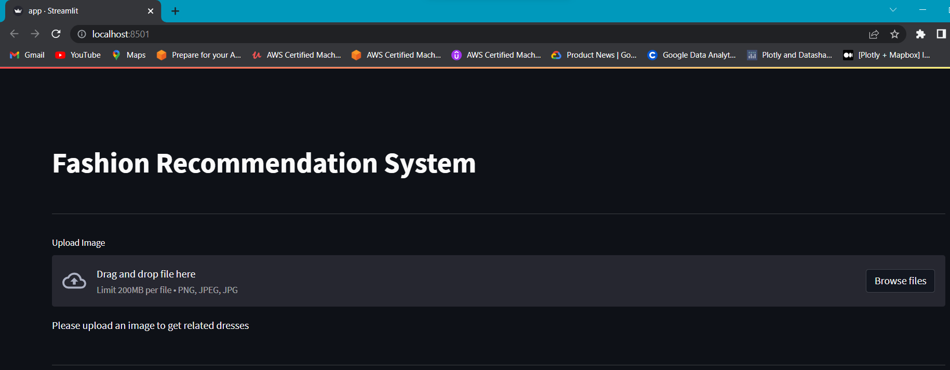
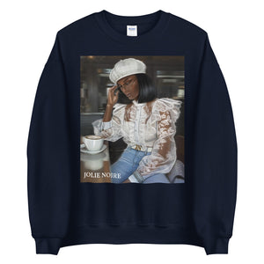
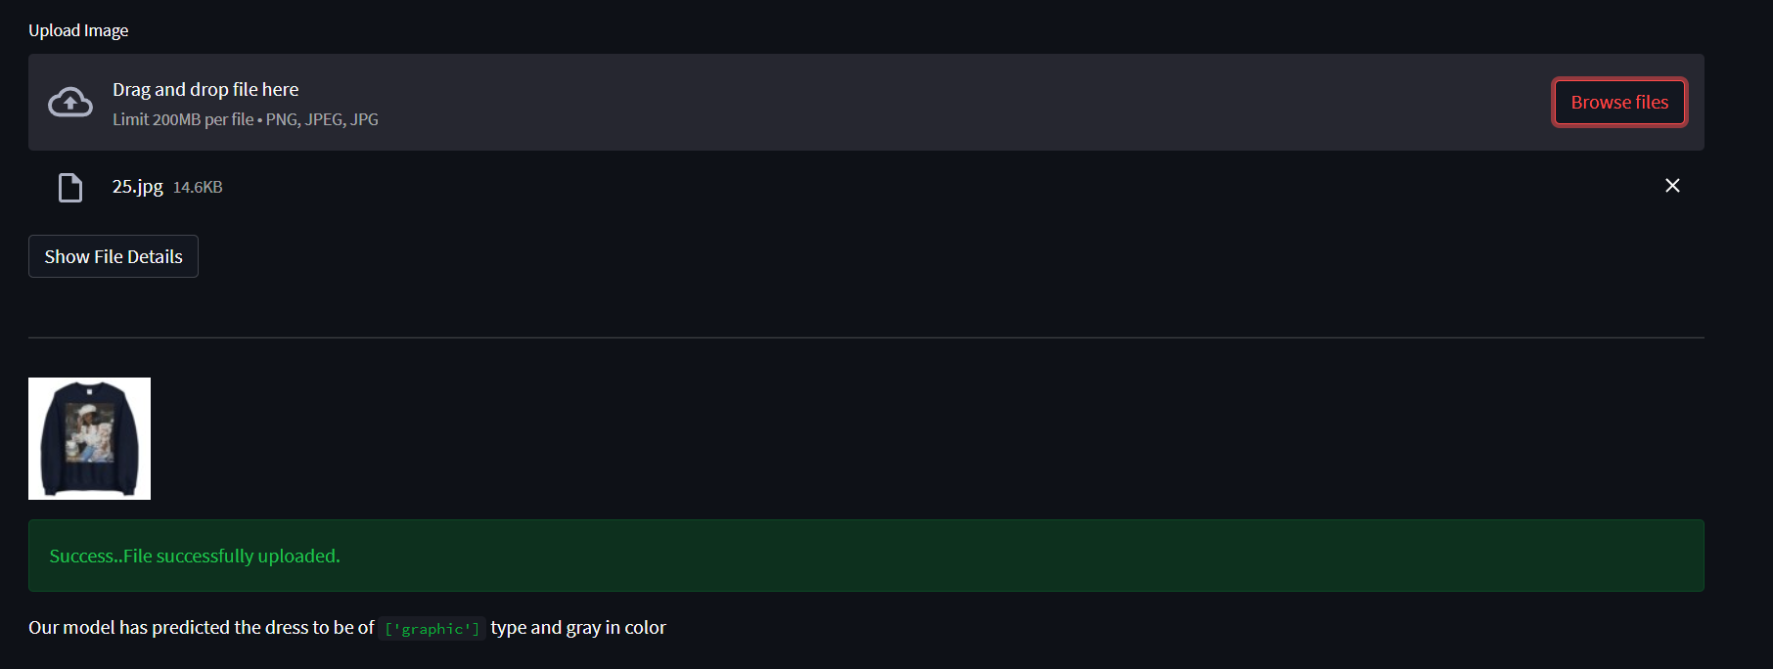
UI:
This is the uploaded image, the model predicted it to be a “graphic” type and “gray” color.

Slide 11
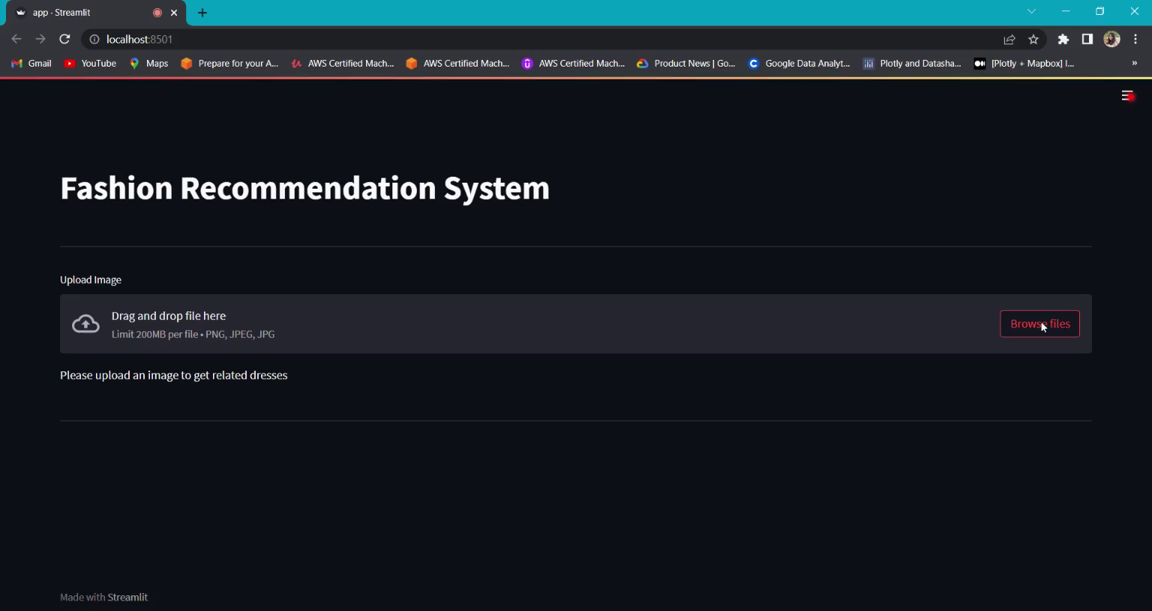
Video Demo:

Slide 12
References:
Paper for DeepFashion : https://openaccess.thecvf.com/content_cvpr_2016/papers/Liu_DeepFashion_Powering_Robust_CVPR_2016_paper.pdf
ResNet34 :https://models.roboflow.com/classification/resnet34#:~:text=Resnet34%20is%20a%2034%20layer,images%20across%20200%20different%20classes.
Streamlit documentations: https://docs.streamlit.io/
Cosmopolitan 100 black owned businesses: https://www.cosmopolitan.com/style-beauty/fashion/g32733776/black-owned-clothing-brands/
Inspiration: https://github.com/codingbunnie/WISH-by-NANAFashionRecommendationEngine

