Slide 1


Sales Data Analysis and Reporting for a Retail Chain

Slide 2

The aim of this.
Project Plan
The aim of this project is to use Python, SQL, and Excel to analyze sales data and generate meaningful reports for a retail chain.

Slide 3
Process
Data Source
Data Collection
Data Cleaning
Data Analysis
Reporting

Slide 4

Data Source
Dataset includes the following fields:
•TransactionID: A unique identifier for each transaction
•TransactionTime: The time the transaction took place
•ItemCode: The code of the item purchased
•ItemDescription: A description of the item purchased
•NumberOfItemsPurchased: The number of items purchased in the transaction
•CostPerItem: The cost per item
•Country: The country where the transaction took place

Slide 5
Data Collection
1.Data Collection: Download the data from Kaggle as a csv file and
place it on the proper path
2.Database Setup: Set up a SQL database to hold the data. Design
the database schema, and create the necessary tables using SQL
DDL commands.

Slide 6
Data Cleaning
1. Data Cleaning: Use SQL queries and Python (pandas) to clean the data. Look for and handle missing or inconsistent data, outliers, etc.
2. Data Preparation: Prepare the data for analysis. This may involve creating additional calculated fields, such as total sales value, month/year fields for time-based analysis, etc. Again, this can be done using a combination of SQL and Python

Slide 7

Data Analysis
Data Exploration: Use SQL queries and Python (pandas, matplotlib, seaborn, etc) to explore the data and identify trends and patterns.
2. Advanced Analysis: Perform more complex analysis as needed. For example, time series analysis for sales trends, cohort analysis for customer behavior, etc. Python's advanced data analysis libraries can be very useful here.

Slide 8
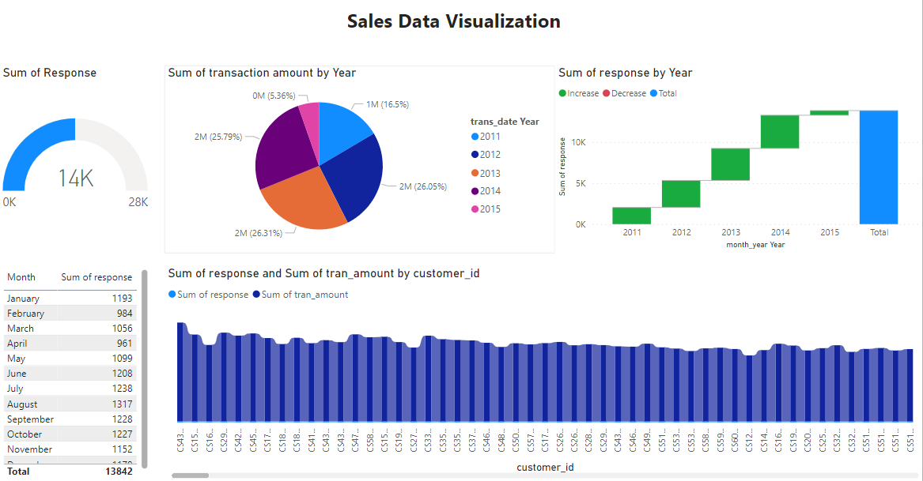
Reporting link

Slide 9
Thank you!

