Slide 1
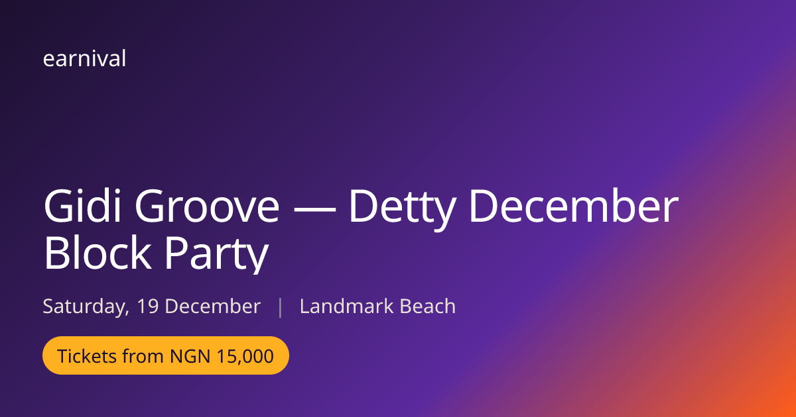
earnival
Every event is a
temporary economy.
Nobody banks it.
Earnival is the payment, storefront and settlement layer for the economy that comes alive whenever people gather — tickets, vendor shops, cashless payment, the gate, and automatic payouts on one link.
A live event page, as it unfurls when the link is shared.
Seed round · Lagos, Nigeria
Notes:
Open with the thesis: an event creates a burst of commerce that no rail captures. Earnival is that rail. Everything in this deck is running software, not mockups.

Slide 2
THE PROBLEM
The money moves. The record doesn't.
Nigerian events run on cash and scattered bank transfers. When the gates close, every trail dies — and the pain lands differently on each side of the same transaction.
Organisers
Vendors
Attendees
Create the footfall, capture only ticket revenue. The food, merch and art that sold because of their event is invisible to them — and earns them nothing.
Lose revenue the moment a customer pays into an unauthorised account. No storefront that outlives the night, and no record of anyone who bought.
Queue to buy, settle for a second choice because the vendor silently ran out, and lose every seller they discovered when the event ends.
No existing rail treats the event as the organising unit of commerce — ticketing, storefronts, cashless payment, orders, pickup and settlement in one connected system.
Notes:
Three actors, one transaction, three different failures. The gap is structural, not a tooling gap.

Slide 3
EVIDENCE
We have run this three times, by hand.
Three Earnival-operated pilots, before any of this was software. When a cashless rail exists, the majority of spend moves onto it — including at an event with no tickets at all.
~80%
~75%
>1,000
OF IN-EVENT SALES ONLINE
OF PAYMENTS PROCESSED ONLINE
PEOPLE, NON-TICKETED
DDP end-of-year party series, 2023–2025
>2,000 people · 6 vendors
FSN Minileague, 2025
4-month season · 11 vendors
Lere to the World, 2025
4 vendors · rail still worked
Honest framing: these are founder-reported pilot figures without an instrumented dashboard behind them. The platform now carries its own telemetry, so the next event is measured, not estimated.
Notes:
Lead with the behaviour change being proven manually. Flag the measurement caveat before an investor finds it.

Slide 4
WHY NOW
A seasonal economy the size of a small country.
$21.8bn
Diaspora remittance
Dollars looking for a trusted way to spend into events at home
₦39.6bn
Detty December spend
~3.6m participants — the seasonal peak of the event economy
$384.5m
Festive air travel
Travel demand tied directly to the event season
$14.8bn
Creative economy (2025)
The macro backdrop Earnival's category sits inside
Founder field research — figures to be re-sourced with citations before any data room.
Notes:
Don't over-claim. The point is the season is large and concentrated, which suits a per-event product.

Slide 5
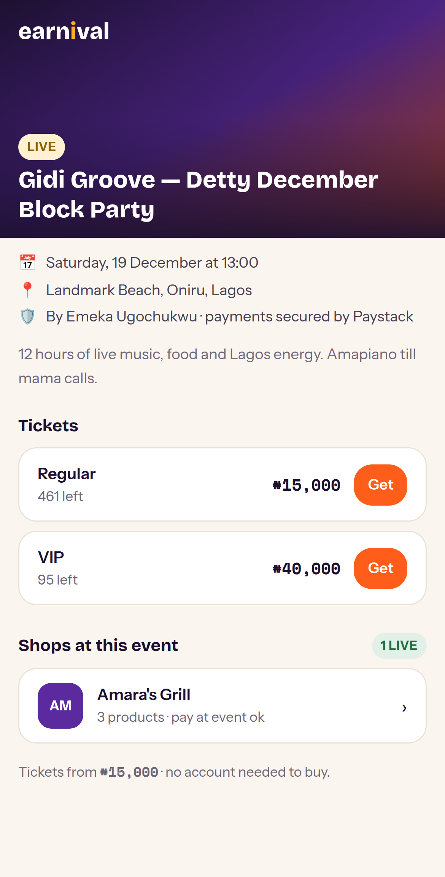
THE SOLUTION
One link does all of it.
That link sells tickets, hosts the vendors' shops, takes cashless payment for both, gets everyone through the gate, and pays every party what they are owed — with the split agreed in advance and visible to both sides before anyone accepts.
The vitamin
Tickets that work — bought without an account, delivered by email, scannable at a gate that keeps working offline.
The painkiller
Vendors sell cashless from a permanent storefront and get paid automatically, without chasing anyone.
The steroid
The organiser earns a share of every vendor sale their event created — a revenue line that did not exist for them before.
The public event page
Notes:
The three-tier framing lands: table stakes, real pain, and the thing nobody else offers.

Slide 6
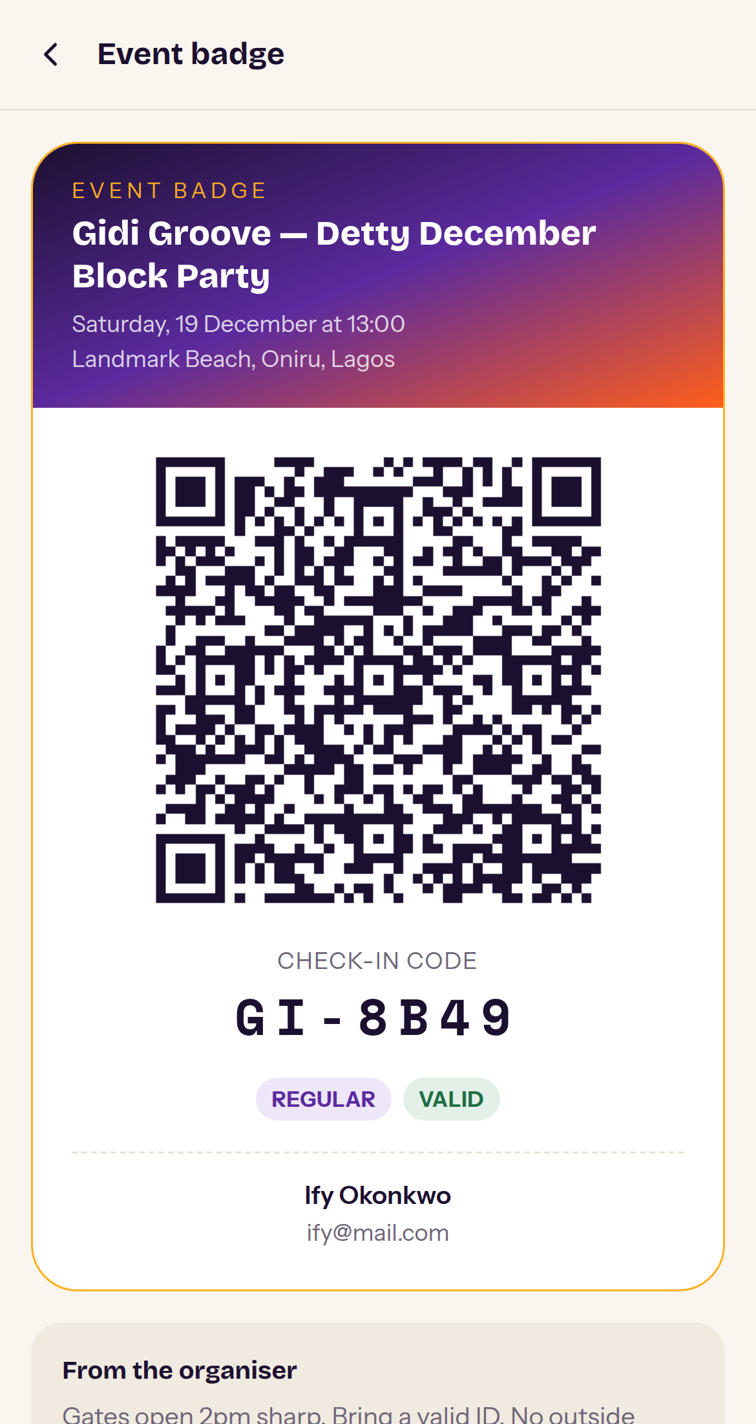
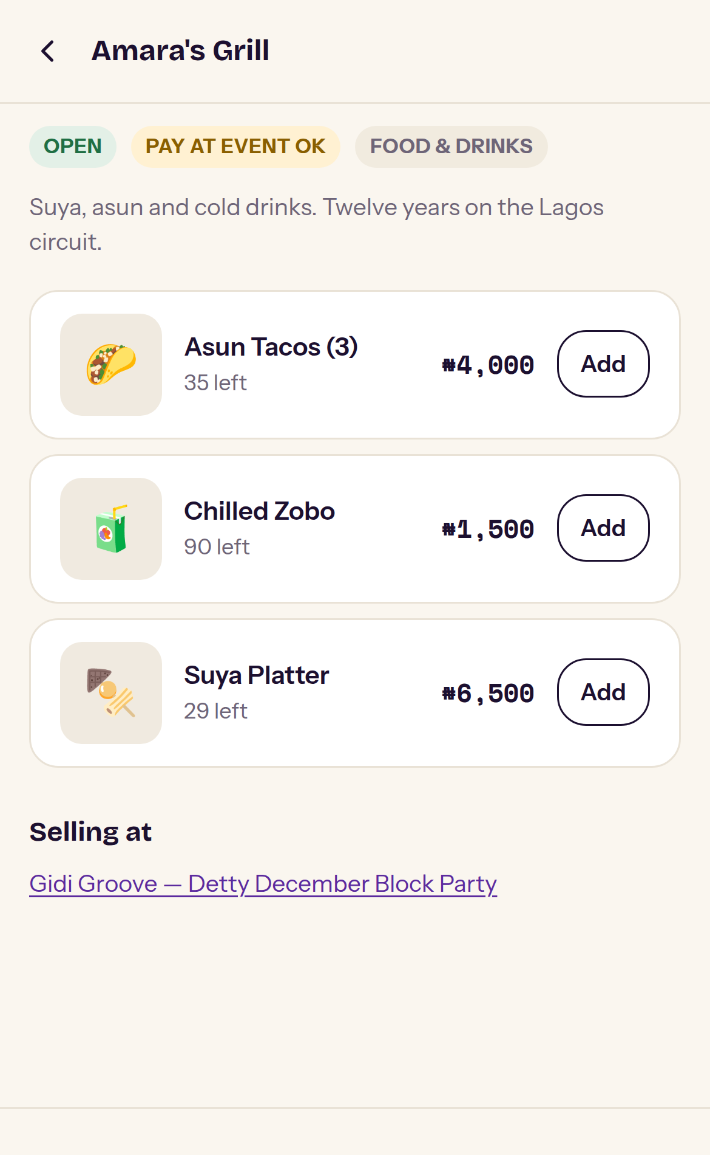
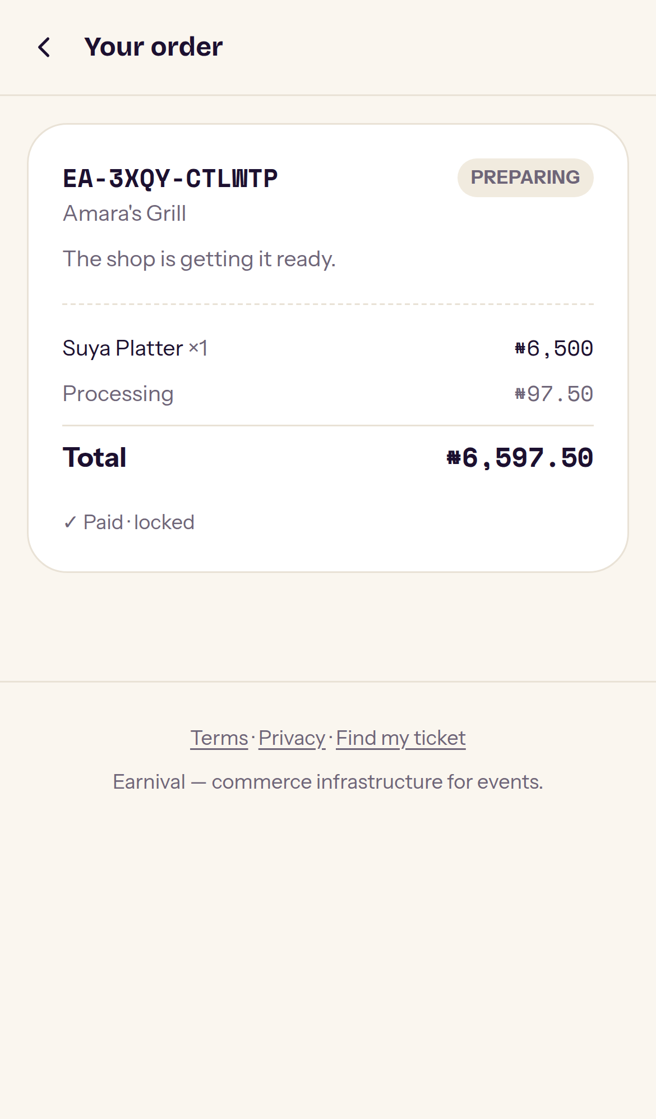
PRODUCT · THE BUYER
Thirty seconds, no account, no app.
Anyone can buy with a name, an email and a phone number. The ticket arrives as a signed QR badge; orders from several shops in one basket become one order per shop, each tracked separately.
Buy a ticket
The badge that gets you in
Vendor storefront
Track the order
Live build. Demonstration data.
Notes:
Emphasise: no account required to buy is a conversion decision, not a shortcut.

Slide 7
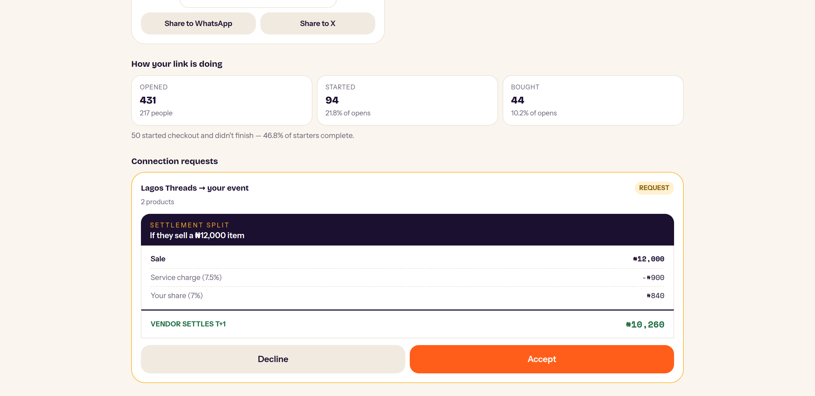
THE MOAT
The Connection: a governed link that carries money.
A shop is only purchasable through an event it has an ACTIVE connection with. The revenue share is agreed up front, shown as a worked example before anyone accepts, and snapshot onto every order — so a later edit can never rewrite an existing order's split.
No blind accepts
The organiser sees exactly what each party receives on a sample sale.
Terms are snapshot
Edits apply to future orders only. History is immutable.
This is the flywheel
Organisers recruit vendors; vendors recruit each other.
Live build. Demonstration data.
Notes:
This is the defensibility slide. Ticketing tools stop at ticketing; booth tools don't move money; processors are event-blind. The Connection object is what none of them have.

Slide 8
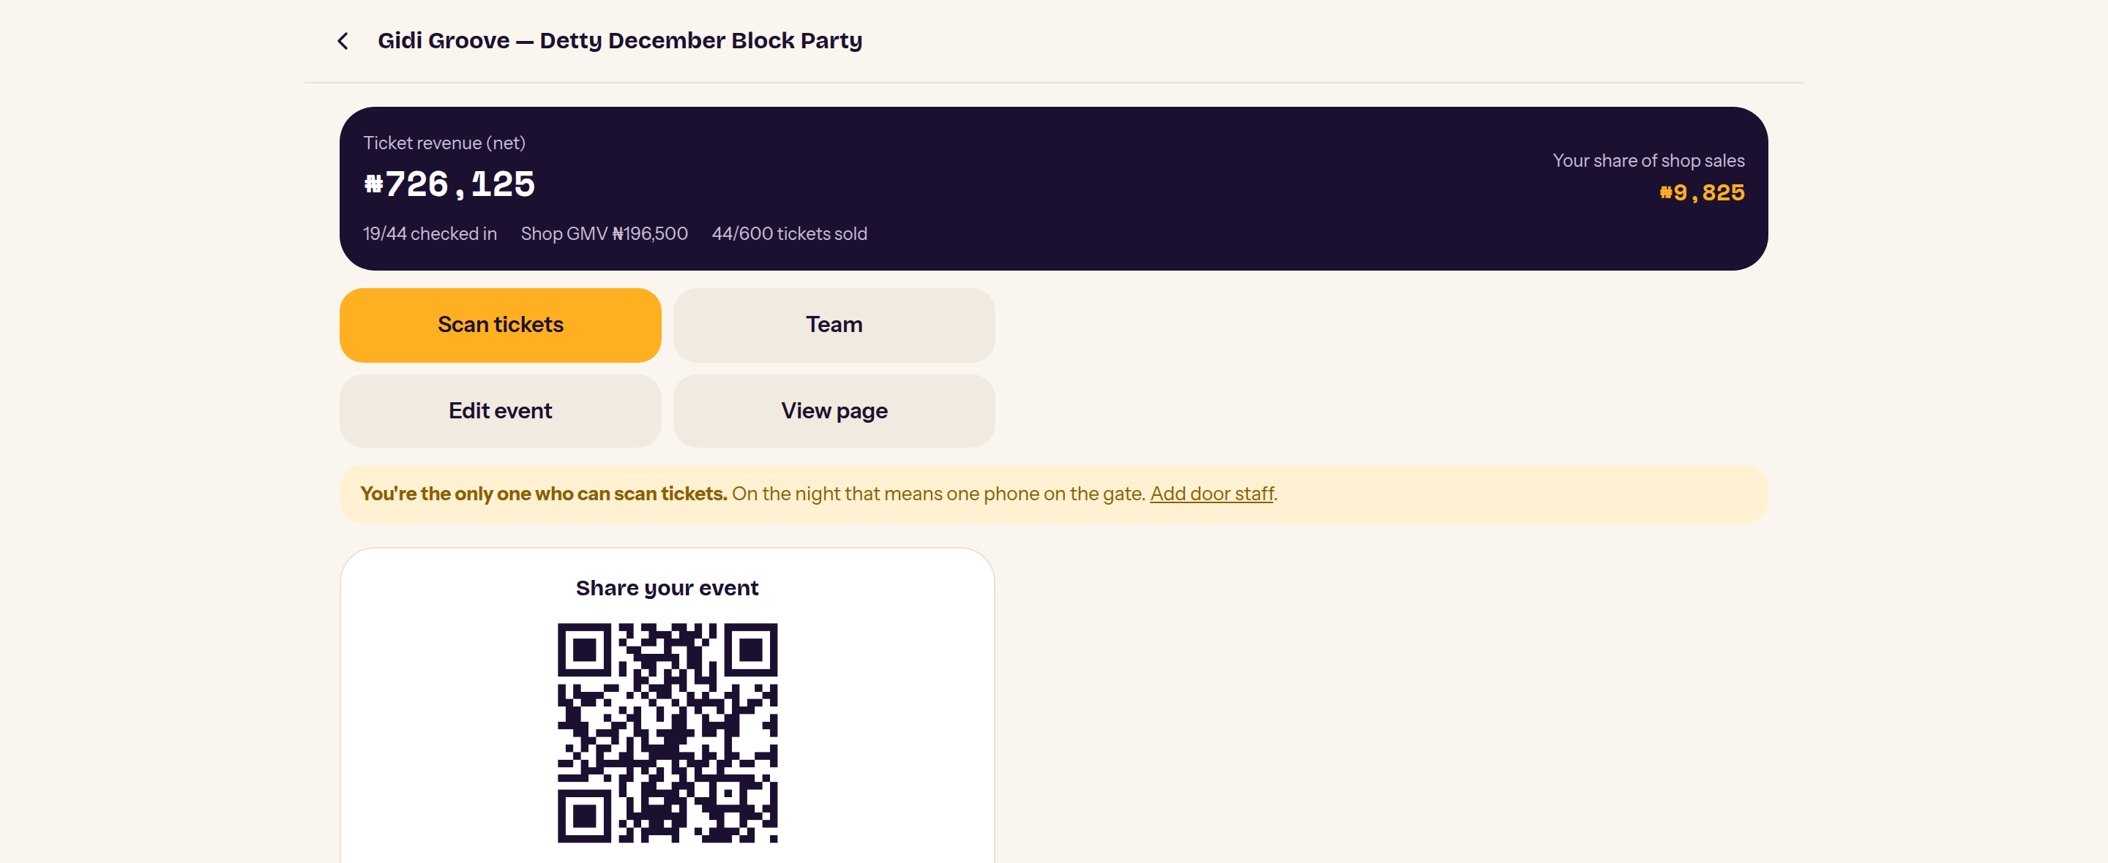
PRODUCT · THE ORGANISER
A revenue line that did not exist before.
What the organiser now sees
Ticket revenue, net of all fees
Their share of every vendor sale
Shop GMV the event generated
Tickets sold against capacity
Live check-in progress
A funnel: opens, checkout starts, purchases
Before Earnival, the last three of these did not exist for an organiser at all.
₦726k
₦196k
₦9,825
TICKET REVENUE (NET)
SHOP GMV
ORGANISER'S SHARE
Live build. Demonstration data.
Notes:
The ₦9,825 is small on purpose — it is one shop at 5%. Multiply by a real vendor roster.

Slide 9
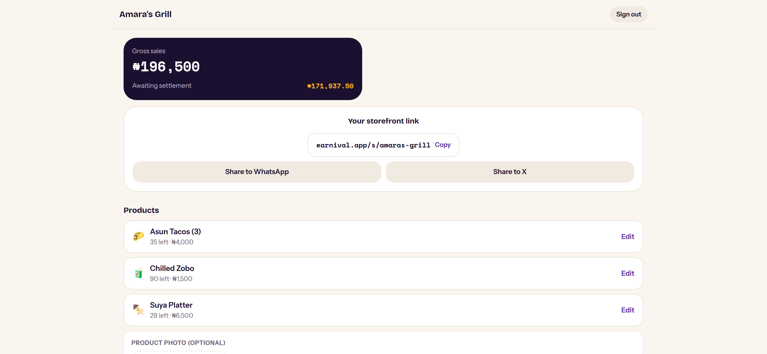
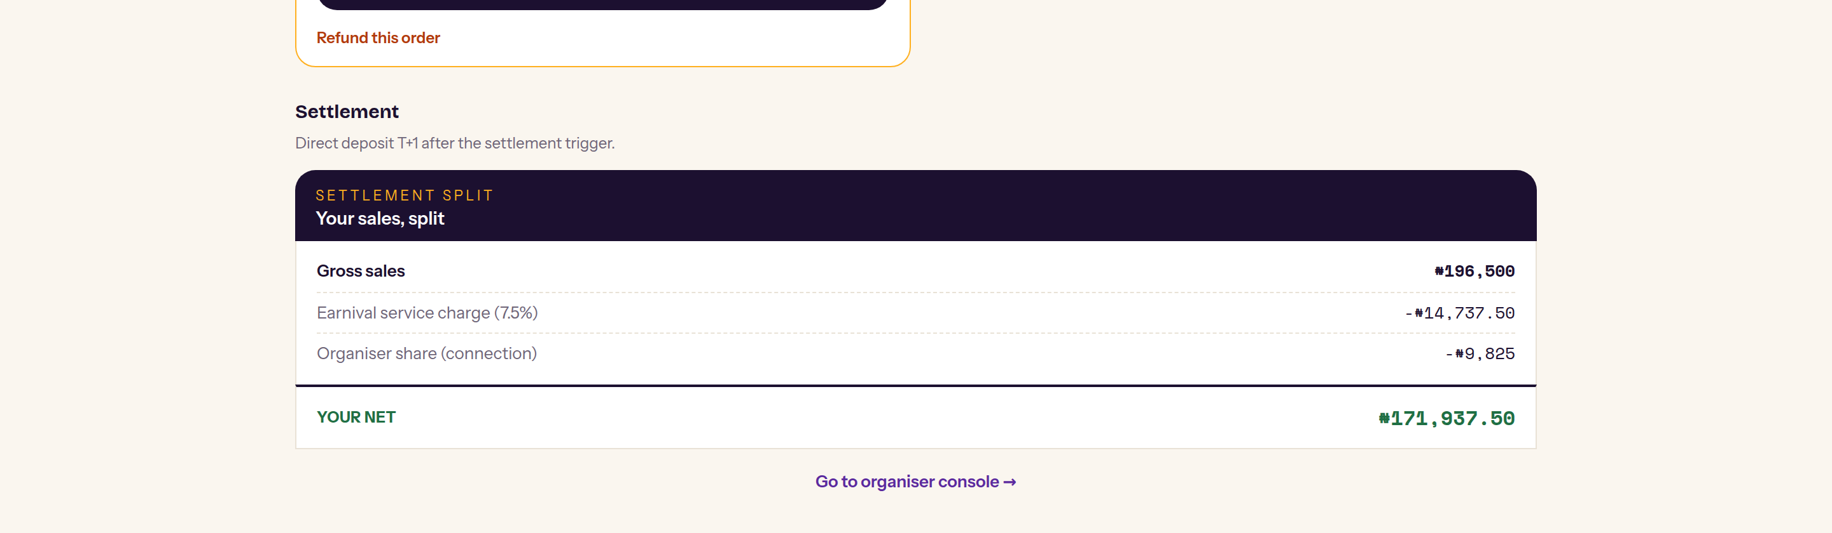
PRODUCT · THE VENDOR
A storefront that outlives the event.
Permanent, not per-event
The shop has its own URL and QR. It survives every event it connects to, and carries its customers with it.
Every split sums to the gross
Service charge, organiser share and vendor net are computed in integer kobo. Rounding remainders go to the vendor — they never evaporate.
Paid without chasing anyone
Settlement claims ledger entries atomically, then pays out to a bank account verified with the bank first.
Live build. Demonstration data.
Notes:
Point at the settlement breakdown: ₦196,500 gross, ₦14,737.50 service charge, ₦9,825 organiser, ₦171,937.50 net. It sums exactly.

Slide 10
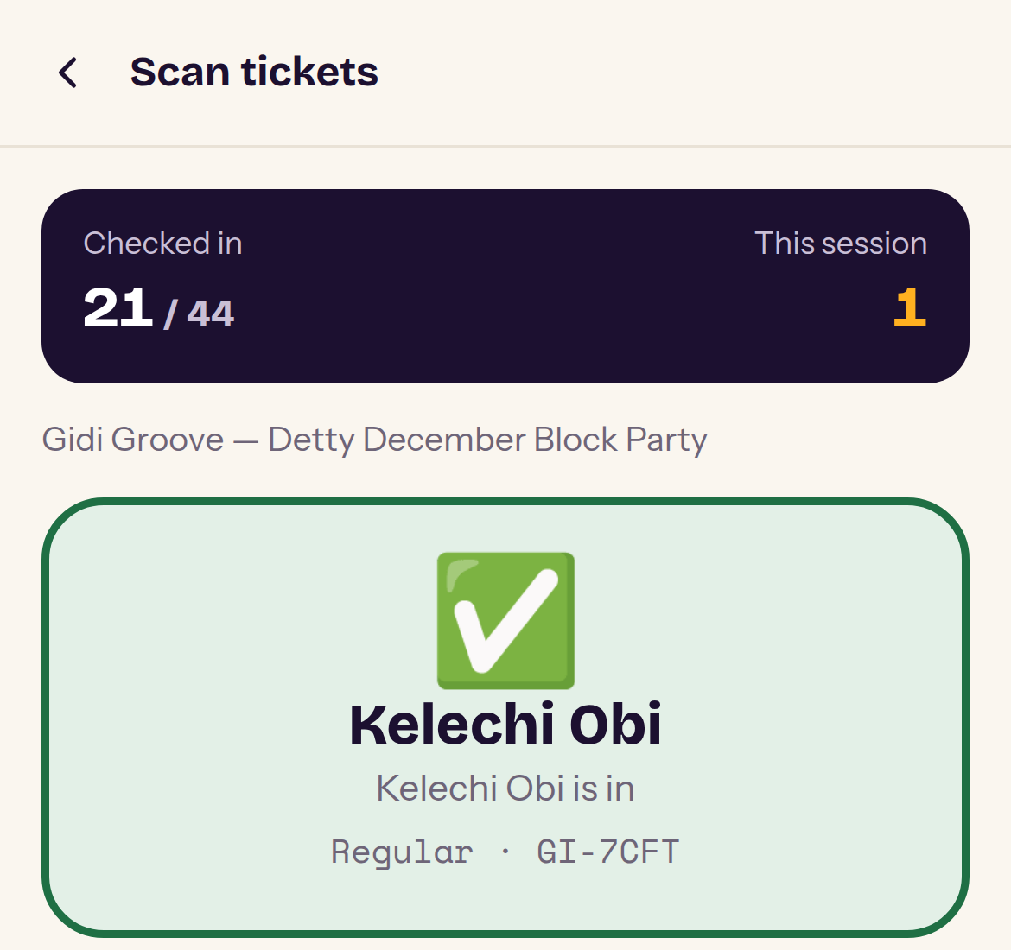
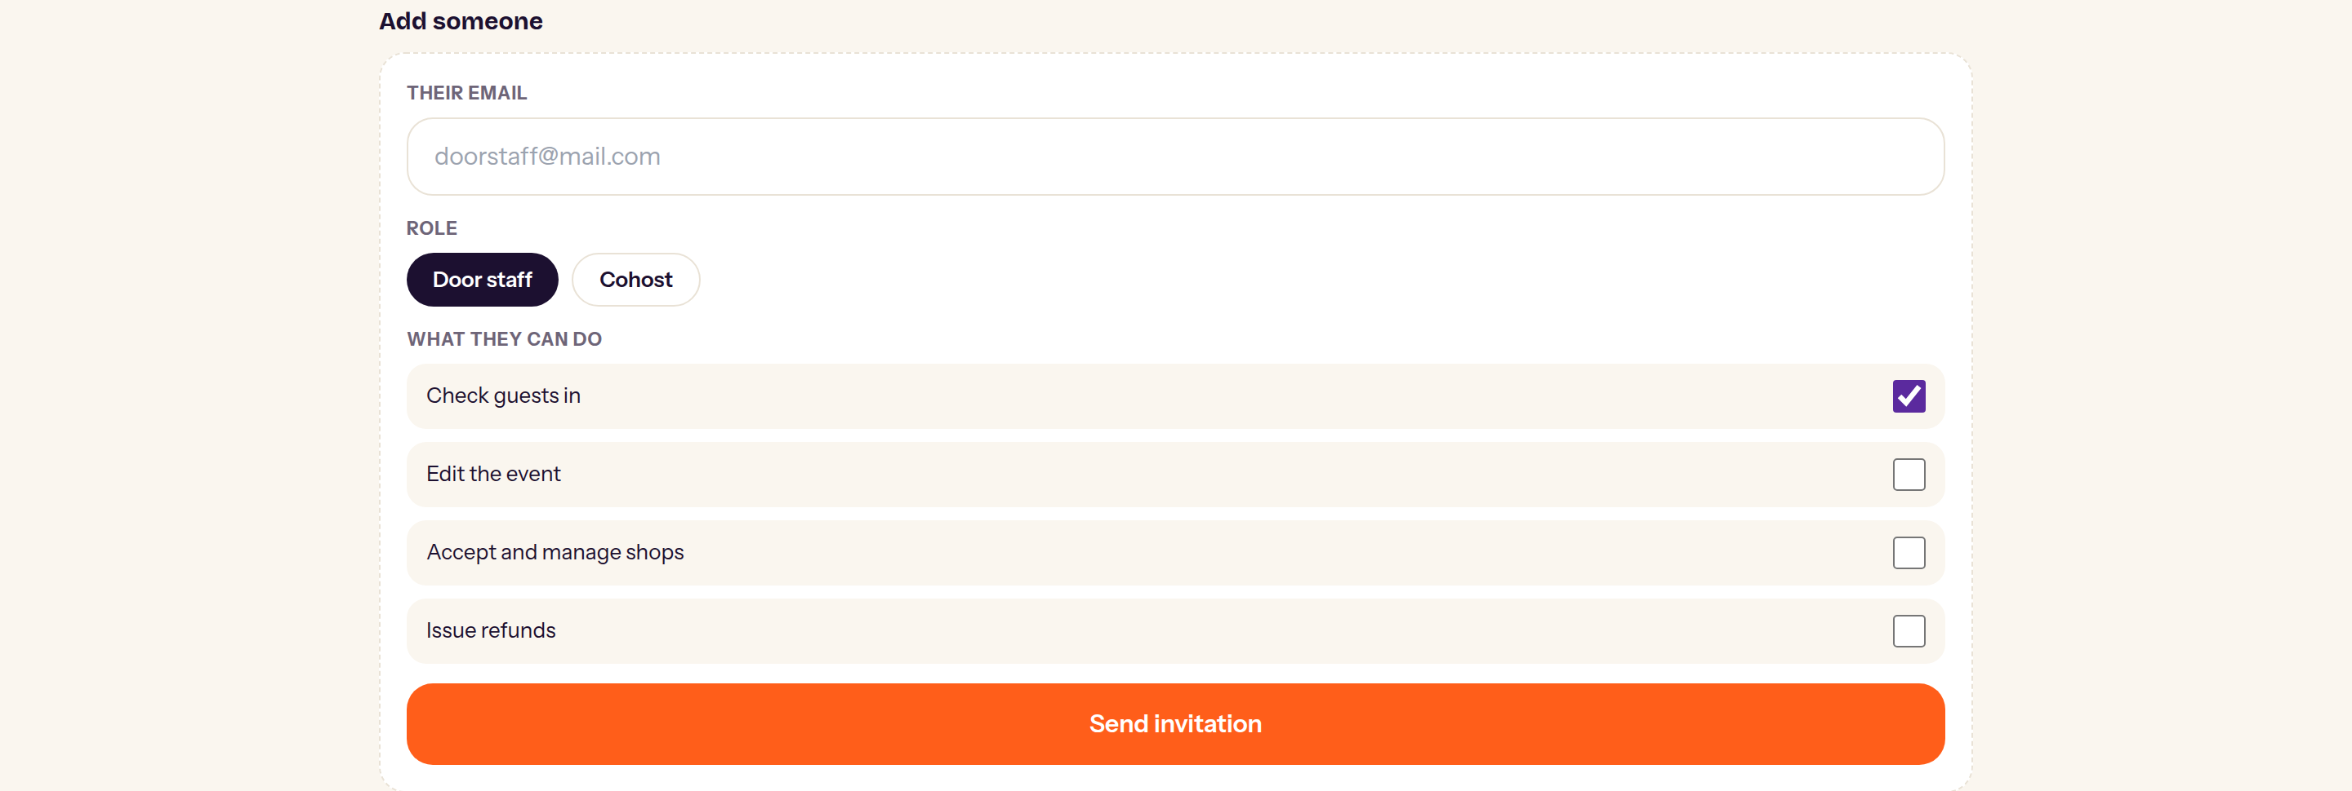
PRODUCT · EVENT DAY
The night is when software gets judged.
A venue with no signal, a queue at the gate, and a dead phone battery are not edge cases — they are Saturday. Check-in queues scans on the device and syncs when connectivity returns, each carrying an idempotency key so a replay cannot double-register anyone.
Works offline
Scans queue on the device and sync later. The gate never stops because the network did.
A real check-in, captured live — the counter moves, the guest is confirmed, and the session count increments.
Forgery fails first
QR payloads are signed. An edited code is rejected before any database lookup.
Staff are invited by email with capabilities mapped one by one — check in, edit, manage shops, issue refunds.
Live build. Demonstration data.
More than one phone
Door staff and cohosts check guests in without ever seeing revenue.
Notes:
Offline check-in is the single most operationally load-bearing feature. Lead with it in any organiser demo.

Slide 11
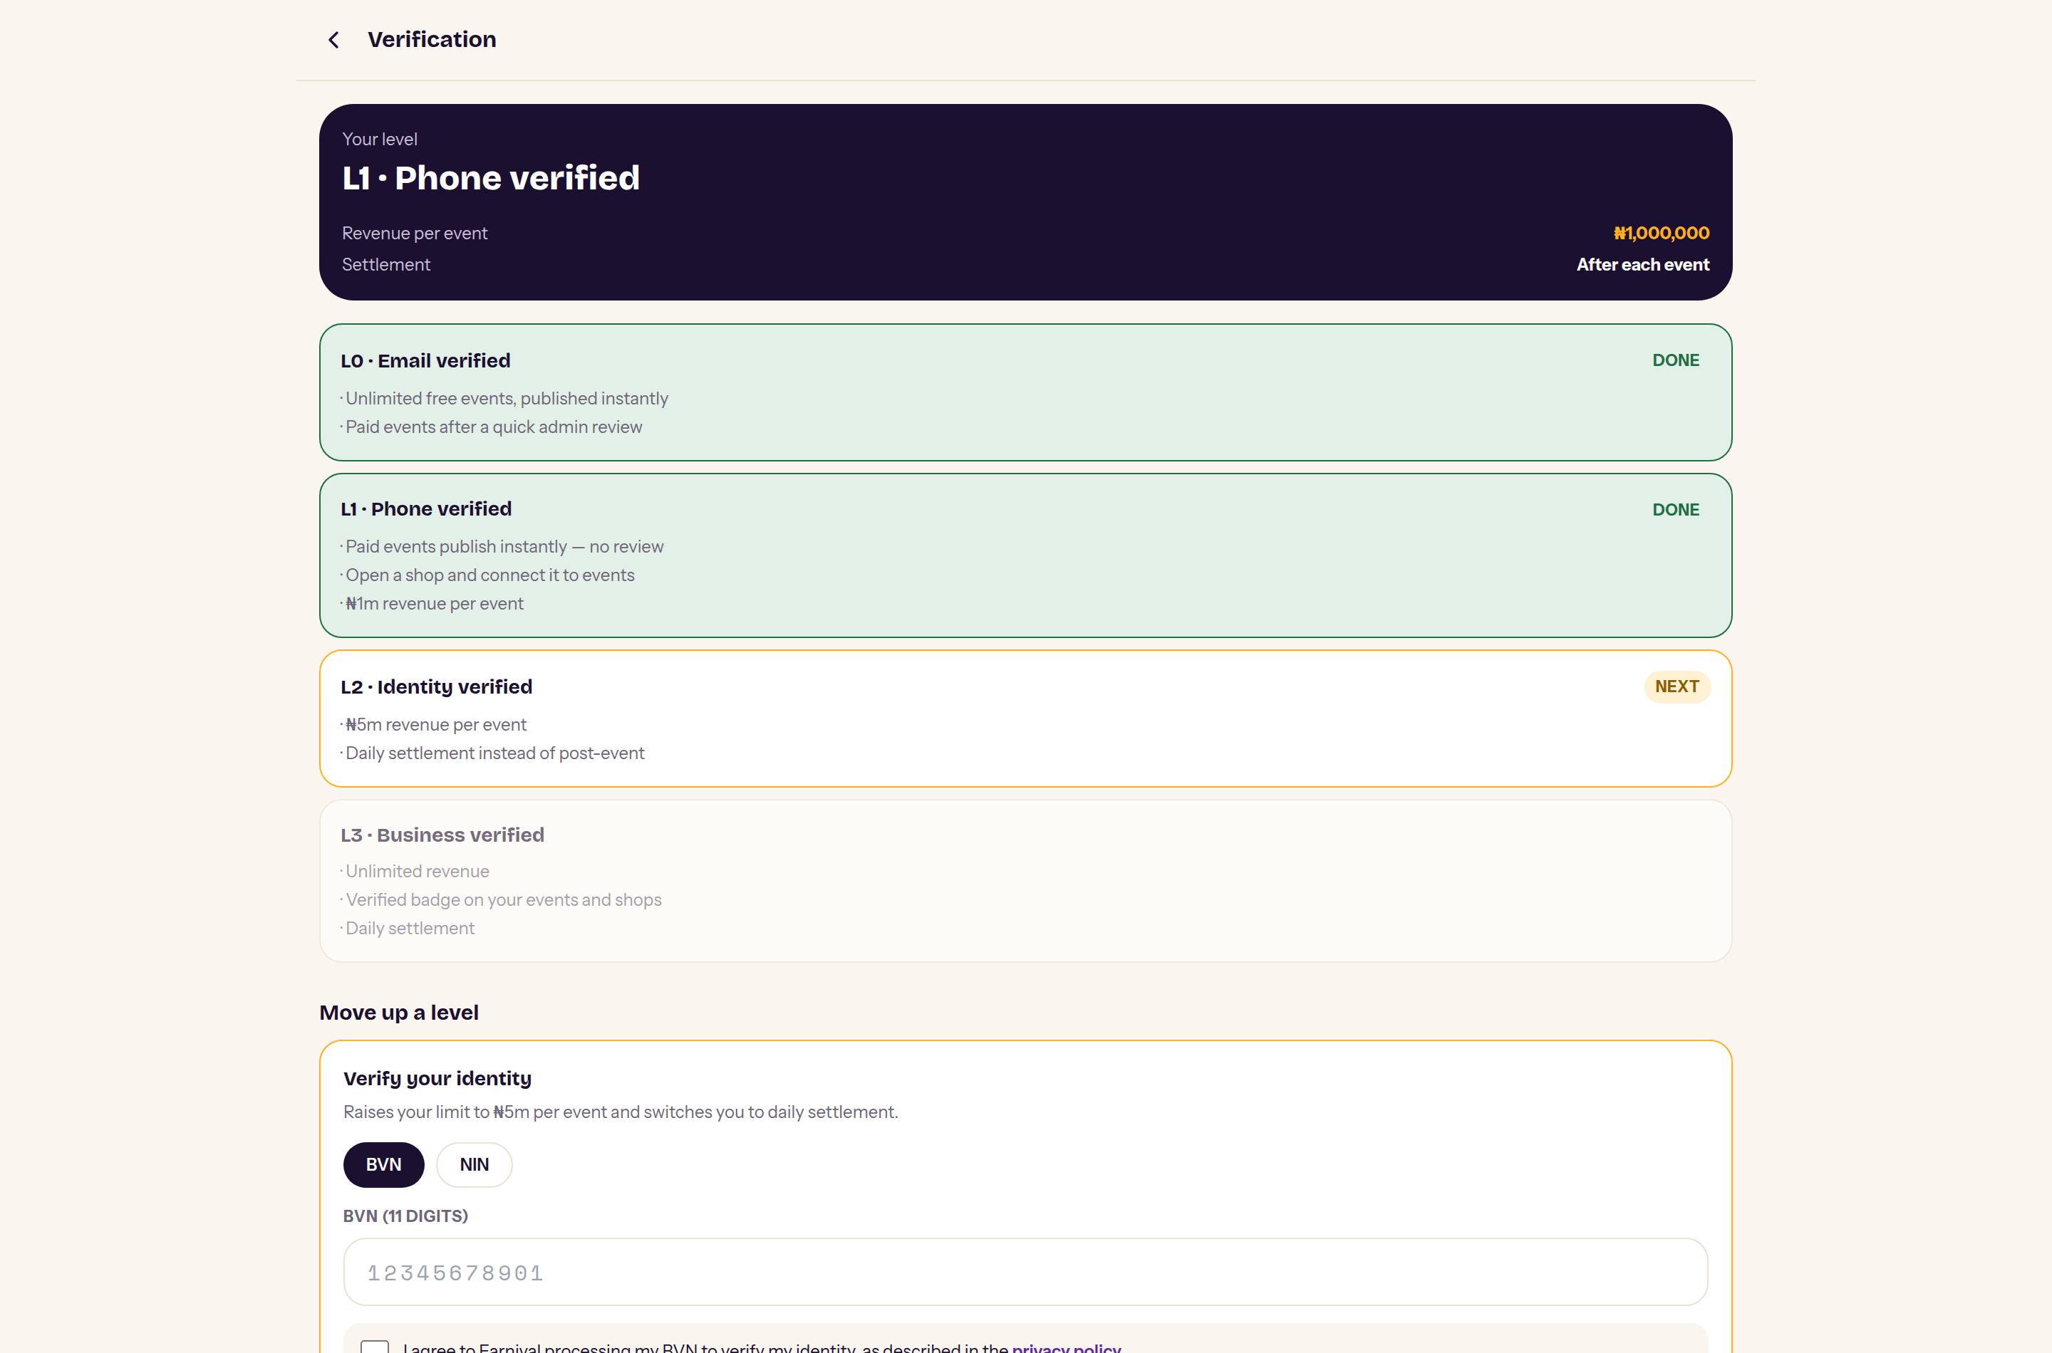
TRUST & COMPLIANCE
Risk is priced into the product, not bolted on.
Sellers climb a verification ladder. Each rung raises what they can earn per event and how fast they get paid — so the platform's exposure to an unverified seller is bounded by design.
L0
Email
₦500,000 per event · paid events reviewed
L1
Phone
₦1,000,000 · may open and connect a shop
L2
BVN or NIN
₦5,000,000 · daily settlement unlocked
L3
CAC + TIN
Unlimited · verified badge · daily settlement
BVN, NIN and TIN are encrypted at rest under a key held separately from the session secret. Only the last four digits are ever displayed — including to our own reviewers.
Notes:
For a fintech investor this is the de-risking slide: NDPR posture and CBN-shaped exposure limits are already in the product.

Slide 12
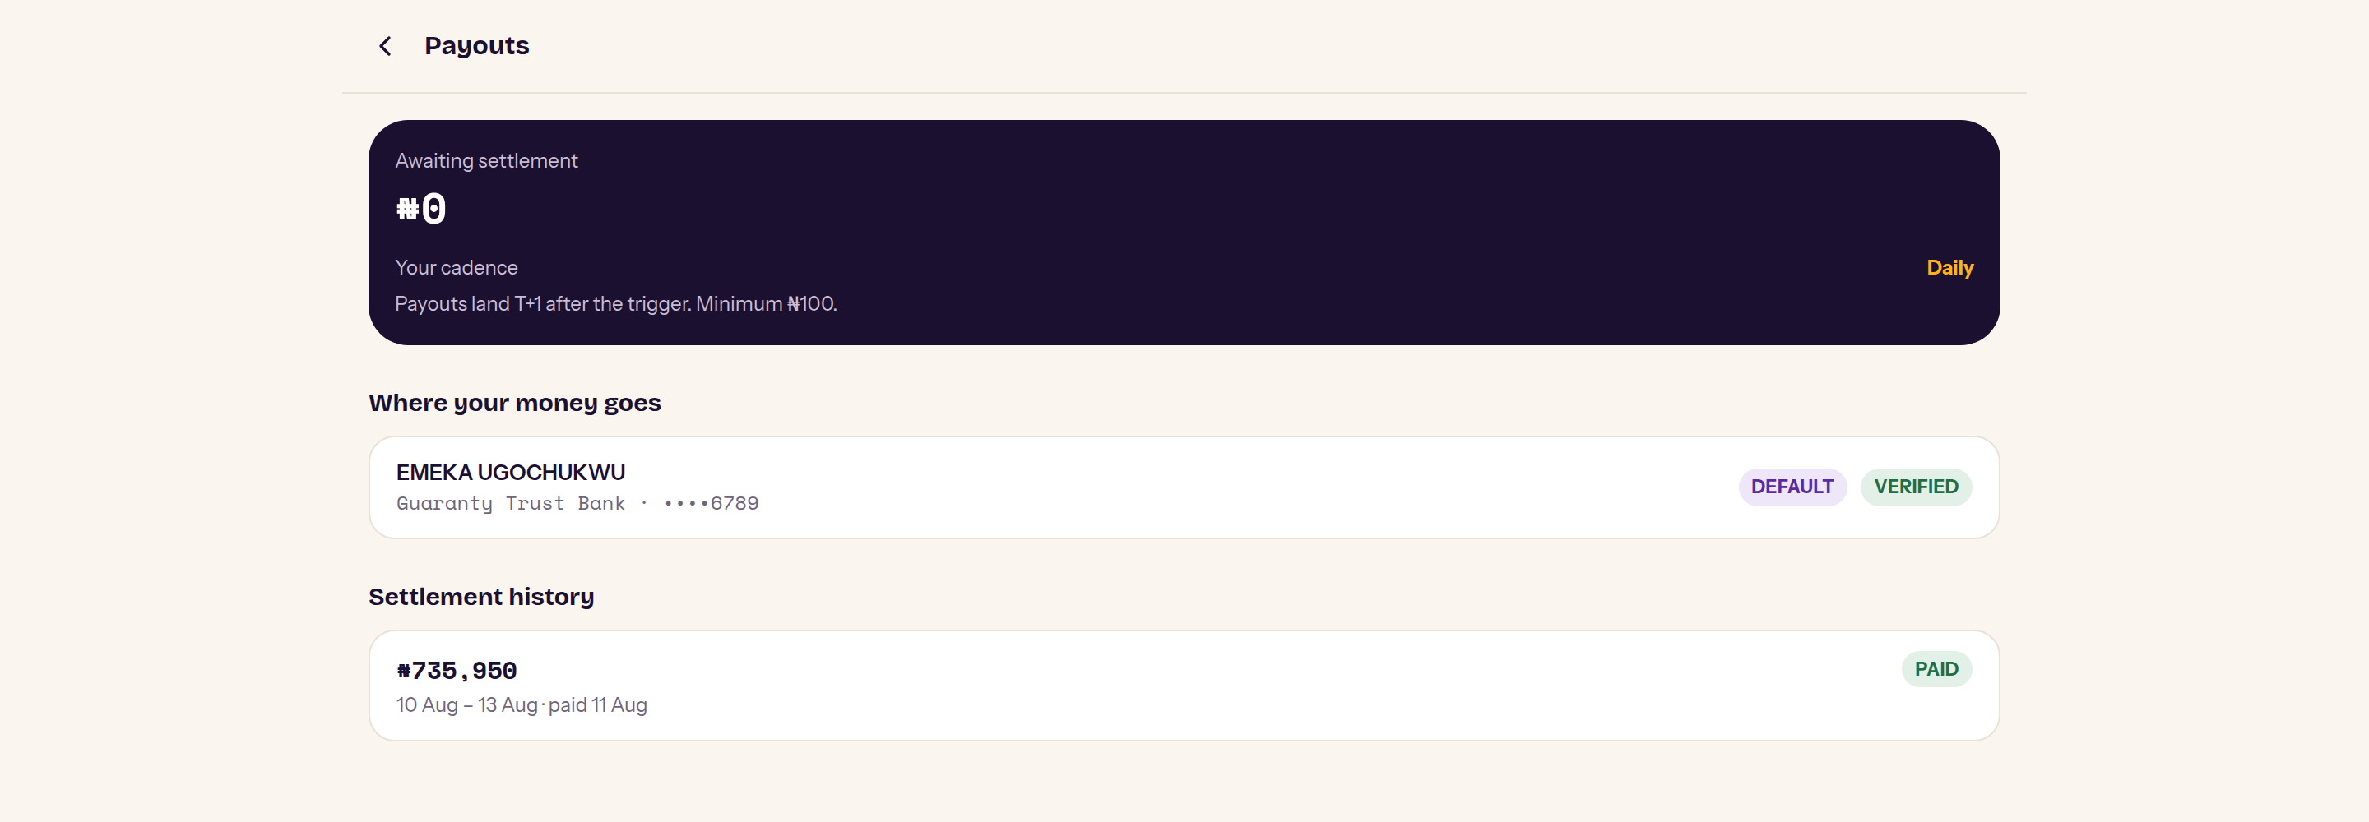
THE MONEY ENGINE
An append-only ledger, and money that leaves.
The five invariants
Money is integer kobo. No floating point anywhere in the money path.
Prices come from the database. Checkout accepts only IDs and quantities.
Inventory is reserved by conditional SQL, so concurrent buyers cannot oversell.
Only a signature-verified webhook can mark a payment successful.
The ledger is append-only. Balances are sums, never stored numbers.
A real settlement run against the build: ₦735,950 claimed from the ledger, paid to a bank-verified account, and the payable balance drained to zero.
82
40 → 5
0
AUTOMATED TESTS
OVERSELL RACE, VERIFIED
FLOATS IN THE MONEY PATH
Live build. Demonstration data.
Notes:
40 simultaneous buyers competing for 5 seats produce exactly 5 winners — that test runs against a real Postgres, not a mock.

Slide 13
BUSINESS MODEL
We take 7.5%, and we show our working.
A service charge of 7.5% is deducted from the seller per transaction. Processing fees are added to the buyer's total and shown before payment. No listing fee.
ONE ₦10,000 VENDOR SALE, ON A 5% CONNECTION
Two revenue lines, one transaction
Buyer pays
₦10,150
₦10,000 item plus the processing fee, shown separately
We earn on tickets and on vendor sales through the same rail — and the organiser's share is what makes them recruit the vendors for us.
Earnival
₦750
7.5% service charge — our revenue
Organiser
₦500
5% connection share, agreed before the event
Not yet live
Vendor
₦8,750
Net, settled to a verified bank account
Standard (5%) and Premium (2%) plan tiers are specified but unbuilt. The 7.5% Starter rate is the only live rate today.
Every split sums exactly to the gross. Rounding remainders go to the vendor.
Notes:
Take rate is deliberately simple for launch. Plan tiers are a known gap, not an oversight — see the risks slide.

Slide 14
STATUS
This is not a prototype. It runs.
Every requirement in our PRD carries a build status, so the gap between intent and reality is legible rather than asserted. Of 180 requirements across ten user journeys:
127
3
50
4
82
BUILT
PARTIAL
NOT BUILT
P0 GAPS
TESTS PASSING
17,560
25
24
13
25
5
lines
data models
pages
API routes
server actions
test suites
Next.js 15 · React 19 · TypeScript · PostgreSQL 16 via Prisma · Paystack · deployed as one application. Integration tests run against a real database, because the failures that matter are concurrency problems.
Notes:
The 50 unbuilt requirements are deliberately deferred scope, not debt — the non-goals are written down.

Slide 15
WHAT WE HAVE NOT DONE YET
The four things standing between us and a live event.
We would rather you hear these from us. Each has a named owner and sits on the critical path to first revenue.
Never tested against live Paystack
Every payment, refund and transfer has been exercised against sandbox stubs only. One small real event, end to end, is the gate before any external launch.
DPIA not yet completed
Level 2 collects BVN and NIN. The data protection impact assessment is launch-blocking and must land before that rung is enabled.
CBN treatment of pre-event payouts
Daily settlement pays out ticket revenue before the event happens. That needs regulatory comfort before we enable it broadly.
No admin audit log
Approvals, KYC decisions and refunds leave no trail beyond the row they change. Required before anyone but the founder is an admin.
Notes:
Naming your own gaps first is a credibility move. Every one of these has a fix with a date attached.

Slide 16
THE ASK
Fund the first hundred events.
The software is built. What we are buying is the operational proof — real money moving through real events, instrumented, so the second hundred sell themselves.
RAISING
Now → launch
One real event end to end on live Paystack. DPIA completed. Sending domain verified.
[ amount ]
First quarter
To be set by the founder. The milestones opposite are costed around a 12-month runway.
The three pilot cohorts onboarded by hand — DDP, FSN, Lere. Baselines replace every estimated metric in this deck.
Second quarter
Events & vendor onboarding
[ % ]
Plan tiers live. Admin audit log. Open the link beyond hand-onboarded organisers.
Engineering
[ % ]
Compliance & legal
[ % ]
Second half
Diaspora payments. The ₦5m and unlimited rungs carrying real volume.
earnival Emeka Ugochukwu · emeka.victor.ugochukwu@gmail.com
Notes:
Fill in the raise amount and allocation before sending. The milestones are real and traceable to the risks slide.

