Slide 1
Web FE Automation Online Shop application (UI)

Slide 2
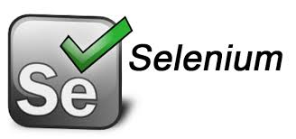






Architecture – Internal Design Process
Framework which combines the best practices of keyword, data driven, modular and POM approaches. It defines the method for scripting of business functionalities as reusable libraries that are repetitive among test cases.
Hybrid
Run Manager
<Batch Configuration>
Reusable Libraries
Customized
Test
Results
<HTML with
bootstrap>
Support Libraries
<Application
independent
reusable functions
With
Proper
Error Handling>
Driver Script
<Brain of the framework>
Business Components
<Building blocks of TCs>
Data Engine
<Hybrid Driven>
Business Flow
<Keyword Driven>
Test Data
<Data Driven>

Slide 3
Run Manager
Read all associated library (.java) files
Read GroupControlFile
To read group names whose Execute flag is “Y” from Group Control File
Read Keyword
To load the components/methods for each TCs
Looping through the group sheet
To read ID, TestCaseID, Description, Keyword etc. Corresponding to the scenario whose Execute flag is “Y’
DriverScript
Reporting

Slide 4
Call DriverScript
Run Components
Load Components sequentially as mentioned
in keyword column for the corresponding ID using
reflection API
Read TestData
Read the Test Data for the corresponding
component, stored in HashMap
Execution
Execute the components sequentially
Reporting
Generate the customized Test Report

Slide 5
Many Thanks

