Slide 1


Project Title STUDENT RECORD SHEET
NAME- Dharmendra kumar
ROLL NO-2000320130056
Section- IT ‘a’

Slide 2
Contents
Introduction
Requirement of project
Working {flow chart}
output screen
Conclusion
Future plans
Run Time Screen
Stored file in system
Course on coursera

Slide 3
Introduction
This project is to store the basic data/record of the students.
User get some choices in this project like insert, update or delete the record, display or search the updated record of any student by their roll no.

Slide 4



Requirements of Projects
Language used:- C language
A program in C language

Slide 5
Working { Flow Chart }
Start
choices
Insert the record
Search, Delete or update the record
Entries
Display the record
Enter roll no.
(Execute according to the choice)
End

Slide 6
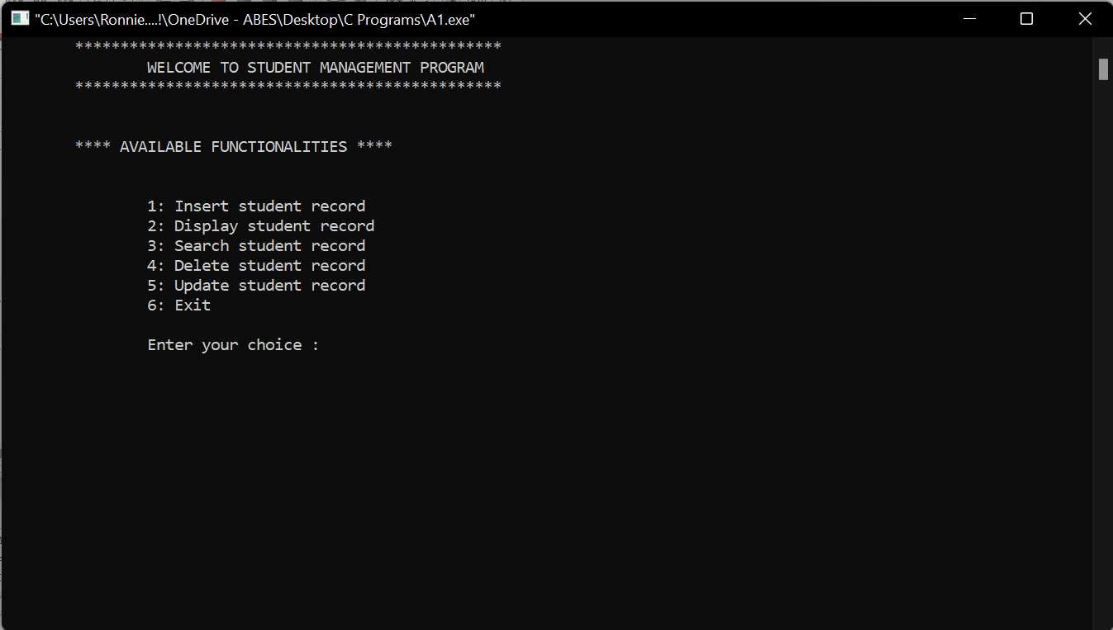
Output Screen Idea

Slide 7
Conclusion
We can store the record of the students and that record can be updated, deleted or accessed by student’s roll no.
User can access the record of any student.
This project gives me an opportunity to acquire good skills which help me to achieve perfection in my coding or programming.

Slide 8
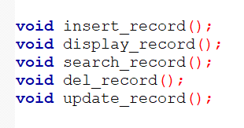
Future plans
I am trying to maintain presentation of the student’s record sheet.
Next time, Creating a function to Insert the student’s data.
Next time, Creating a function to Display the data of all students.
Next time, Creating a function to Search the recorded details of any student by student’s roll no.
Next time, Creating a function to Delete the data/record of any student by calling that’s roll no.
Next time, Creating a function to update any student by its roll no.

Slide 9
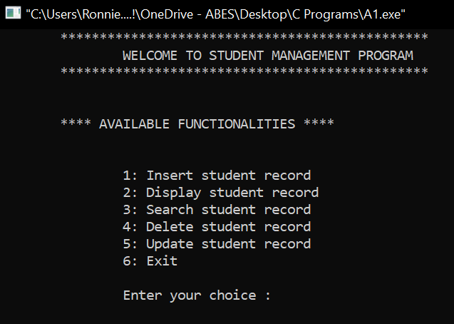
Run Time Screen…
First Screen

Slide 10
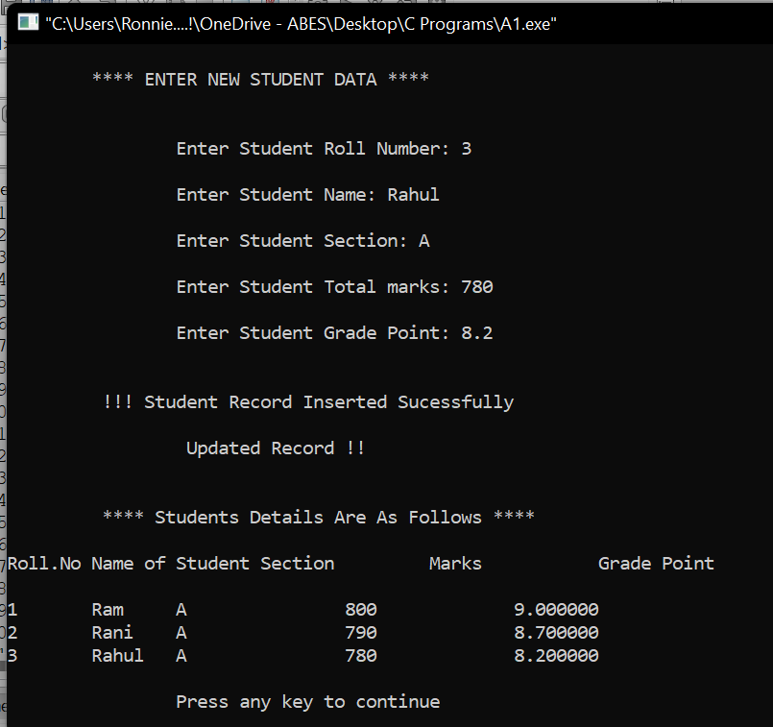
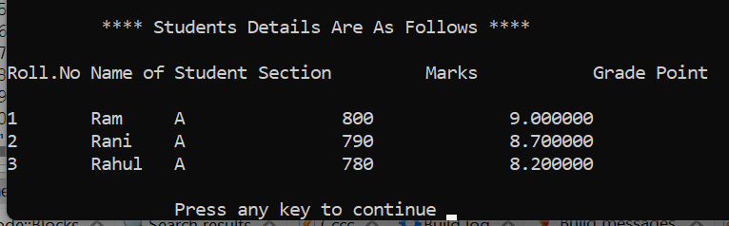
Run Time Screen…
Choice:1 “Insertion”
Choice: 2”Display”

Slide 11
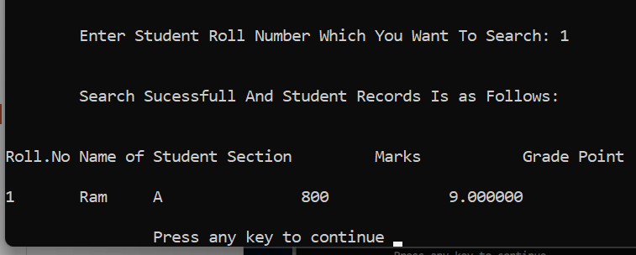
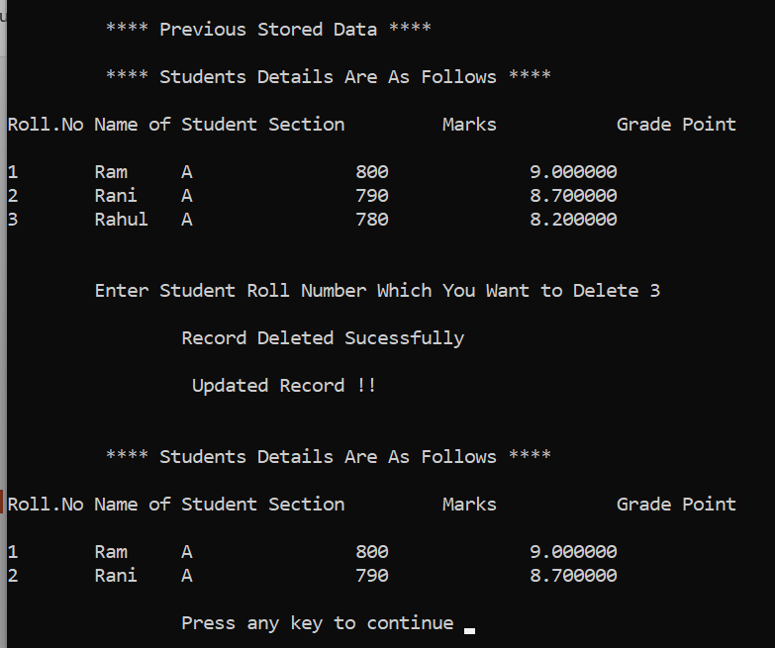
Run Time Screen…
Choice:3 “Search”
Choice: 4 “Deletion”

Slide 12
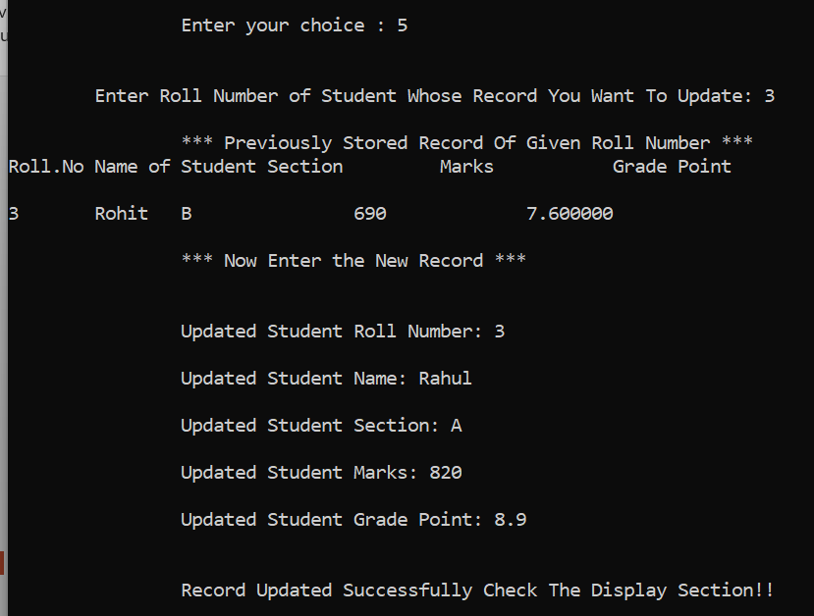
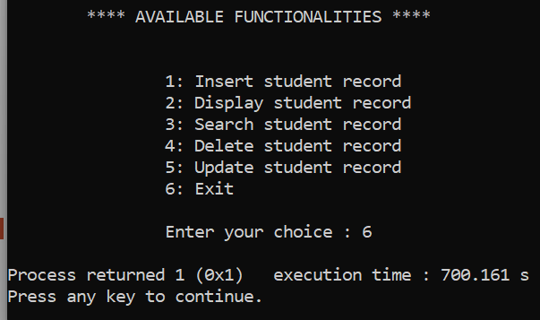
Run Time Screen…
Choice: 5 “Updation”
Choice: 6 “Exit”

Slide 13
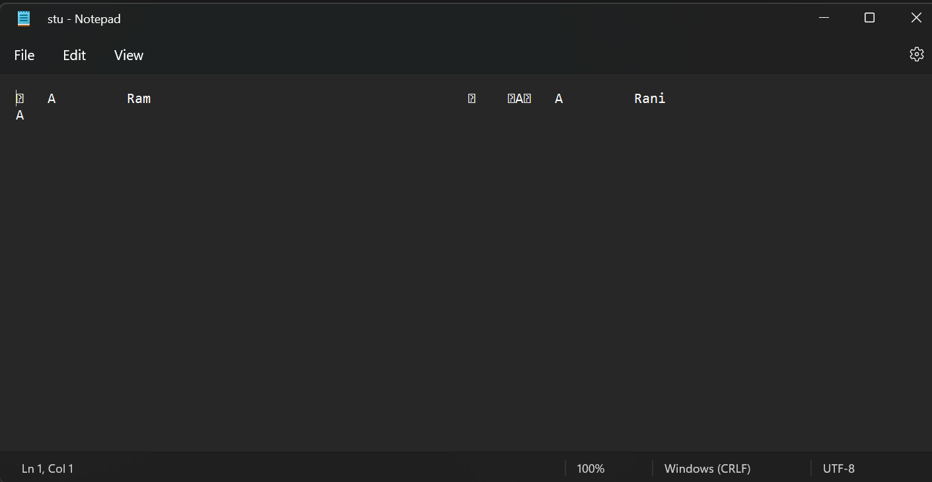
Stored File in System

Slide 14
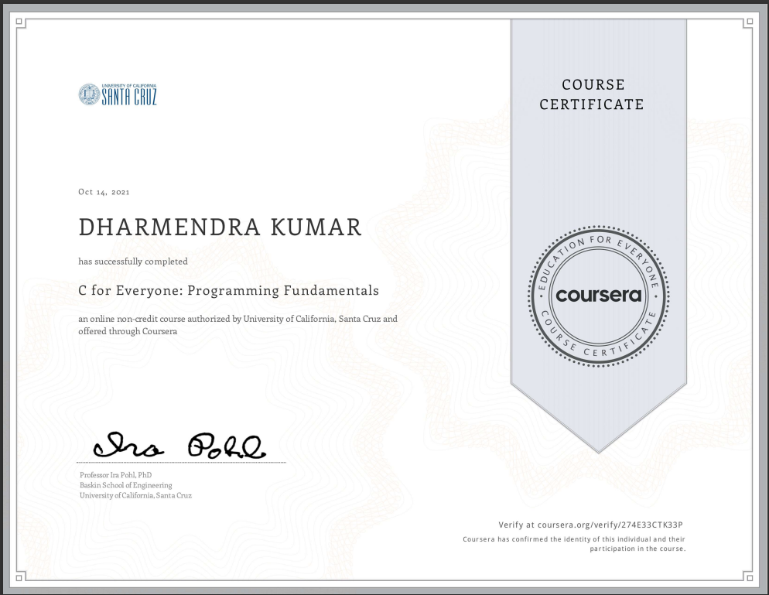
Course
I have joined a course on coursera.com.
The name of my course is “C for Everyone: Programming Fundamentals”.

Slide 15
Thank You !!!

