Slide 1
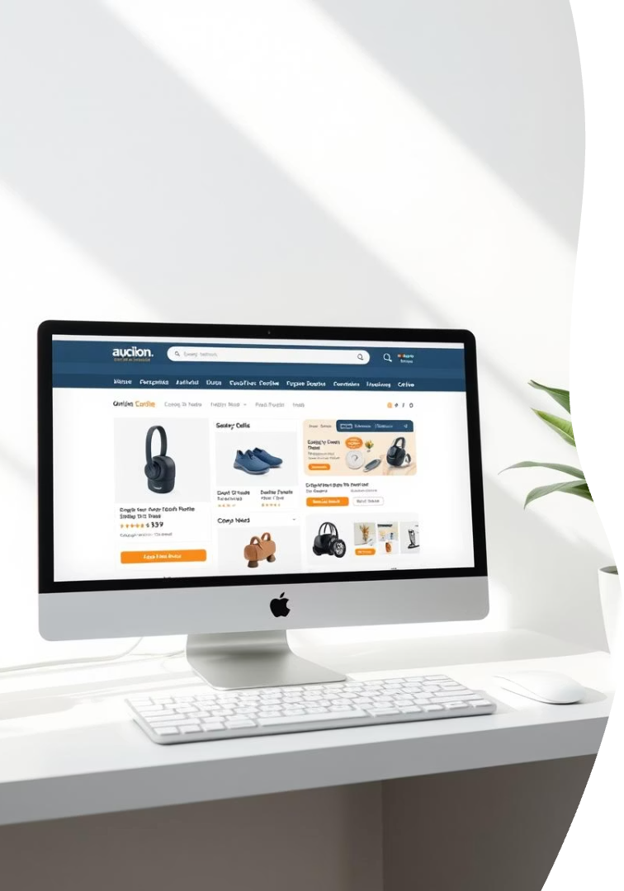
CS 527 Database Systems Project: Online Auction
Design and implement a relational database for an online auction system.
Use MERN stack for Frontend and Spring Boot for Backend and MYSQL for the DataBase.
Pradhyumn Kiledar
Shweta Malabada
Dharm Patel
Riyash Patel

Slide 2

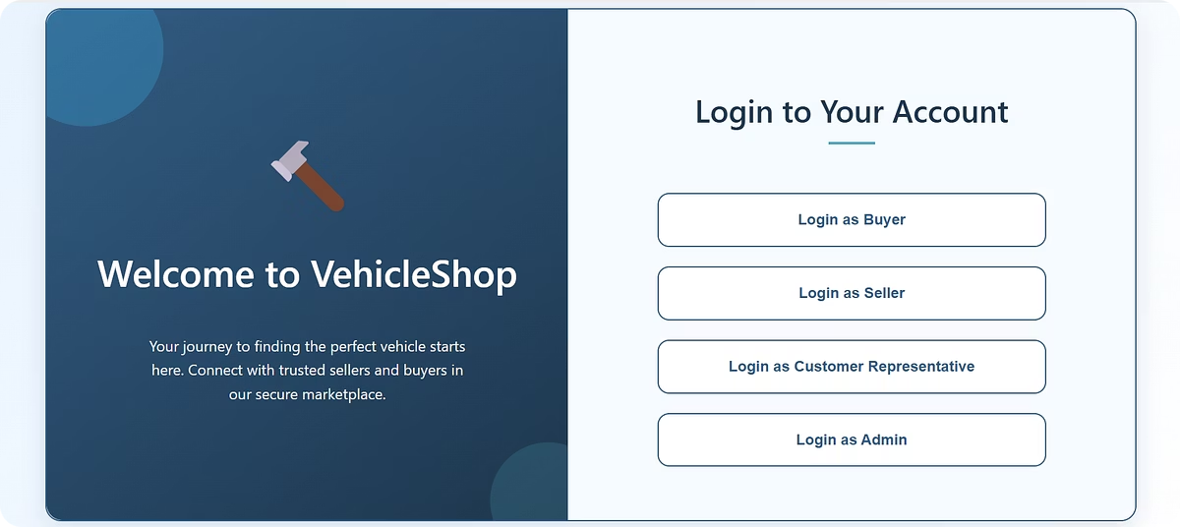
Project Overview and Inspiration
BuyMe Auction System
Seller Role
Posts items with initial price, bid increment, and secret minimum price.
Supports buying and selling items in online auctions, similar to eBay.
Buyer Role
Bids on items; highest bid wins at auction close and must buy the item.

Slide 3

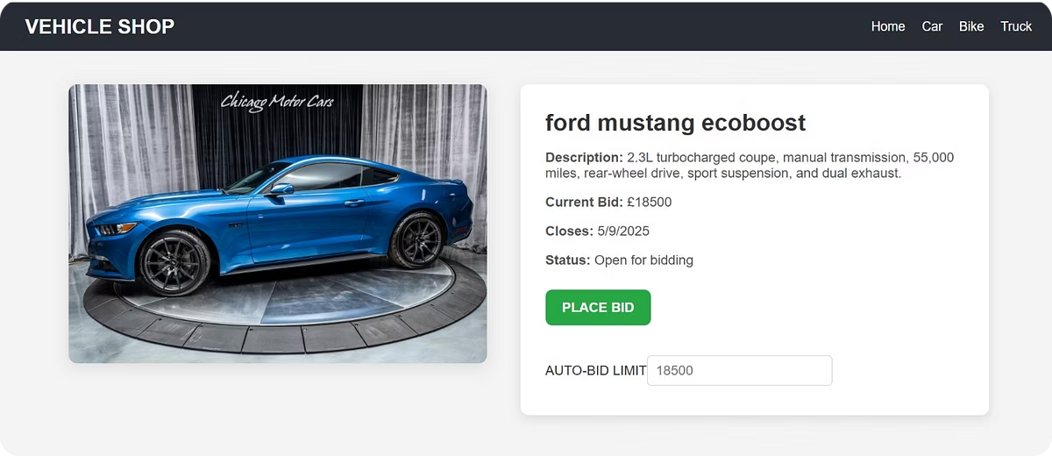
Automatic Bidding Feature
Automatic Bidding
Buyers set a secret upper limit for bids.
Bid Increments
System automatically raises bids until the upper limit is reached.
Alerts
BuyMe notifies buyers if someone exceeds their upper limit.

Slide 4
Item Categories and Requirements
Categories
CAR
BIKE
TRUCK
Bonus Feature
Change item kinds dynamically without recompiling code.

Slide 5

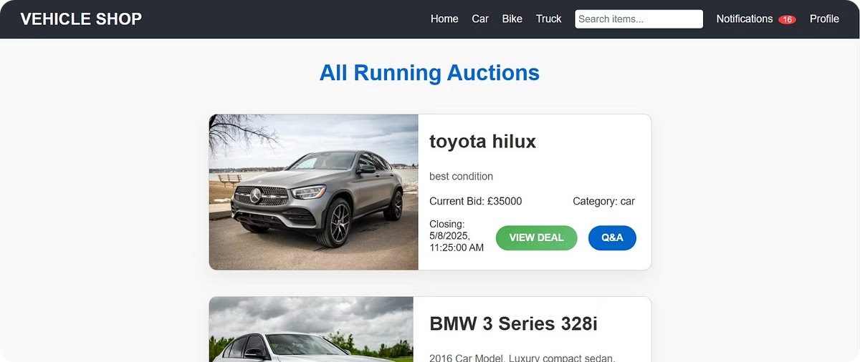




End-User Features
Account Management
Create, delete, login, and logout accounts.
Search and Alerts
Search items by criteria and set alerts for desired items.
Bid History & Similar Items
View bid history and similar auctions from the past month.
User Anonymity
Optional anonymization of login names and emails in auctions.

Slide 6

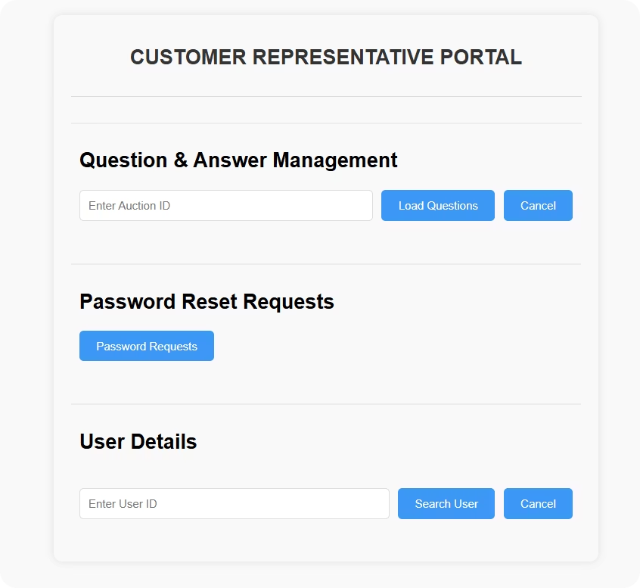
Customer Representatives' Role
Support End-Users
Manage Accounts
Answer questions and modify information as needed.
Reset passwords and remove bids without strict rules.
Remove Illegal Auctions
Authorized to delete auctions deemed inappropriate.

Slide 7

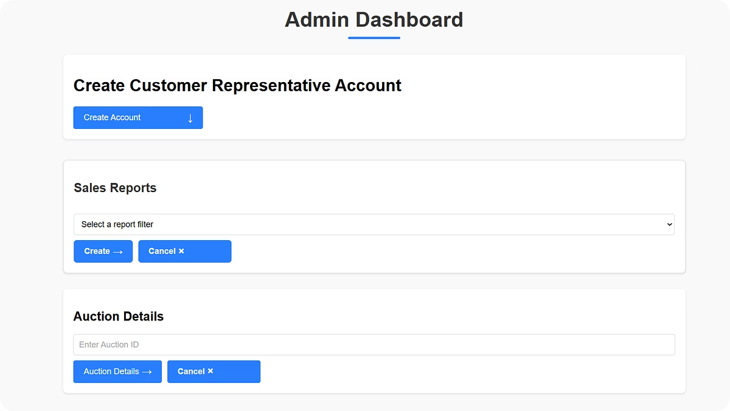
Administrative Staff Responsibilities
Create Customer Rep Accounts
Generate Sales Reports
Reports include total earnings and earnings by item, type, and user.
Admin creates accounts for customer representatives.
Identify Best Sellers
Reports highlight best-selling items and top end-users.

Slide 8

Thank You
We appreciate your time and interest in our Online Auction project.
Looking forward to your feedback and questions.

