Slide 1

Chicago Food INSpection
Clusters

Slide 2
Introduction
This project involves performing an Exploratory Data Analysis (EDA) on a food inspections dataset sourced from the City of Chicago. The dataset includes records of food inspections carried out at various establishments, detailing outcomes such as whether they passed or failed, and violations observed.
Objectives:
Analyze Inspection Outcomes: Classify and evaluate the distribution of inspection results, identifying trends in establishments that pass or fail.
Identify Common Violations: Use data exploration techniques to determine the most frequent violations, providing insights into areas of concern that require attention for public health.
Explore Temporal Trends: Analyze how inspection outcomes and violations have evolved over time, examining patterns that could inform better regulatory practices.

Slide 3
DataSet Description
Dataset Name: Food Inspections Data Source: City of Chicago’s data portal Link: https://data.cityofchicago.org/Health-Human-Services/Food-Inspections/4ijn-s7e5/about_data
Description:
This dataset contains records of food inspections conducted at various food establishments in Chicago.
It includes information about the establishment details, the date of the inspection, the result of the inspection (Pass, Fail, etc.), and descriptions of any violations found.
The data is structured in CSV format and includes multiple fields that provide detailed insights into food safety compliance across the city.

Slide 4
Key Columns:
Inspection Date: The date the inspection took place.
Inspection_Result: The outcome of the inspection (e.g., Pass, Fail).
Violations: Descriptions of any violations observed during the inspection.
Establishment Details: Information about the name and address of the food establishment.
Risk Level: A classification indicating the severity of potential food safety risks (e.g., Low, Medium, High).
Size and Format:
The dataset consists of thousands of records in CSV format, making it suitable for analysis using distributed computing frameworks like PySpark.
Relevance:
The data is crucial for analyzing trends in food safety, identifying frequently occurring violations, and understanding the effectiveness of food safety regulations over time.

Slide 5
Data Loading
1. Loaded the food inspections dataset into a Spark DataFrame from a CSV file:
Utilized PySpark’s read.csv method to efficiently import the data, specifying parameters such as header=True and inferSchema=True to ensure the header was correctly recognized and data types were inferred.
2. Verified data integrity through an initial check:
Performed a basic inspection using methods like show() to view a few rows and count() to determine the number of records.
This step ensured that the dataset was loaded completely without missing or misaligned data entries.
3. Examined the data schema to understand structure and identify columns needing transformation:
Used printSchema() to review each column’s data type.
Identified columns such as Inspection Date that needed conversion to a date format and categorical columns that required encoding for analysis.

Slide 6
Schema
For our dataset, all the columns had correct datatypes and changing datatypes was not required.

Slide 7

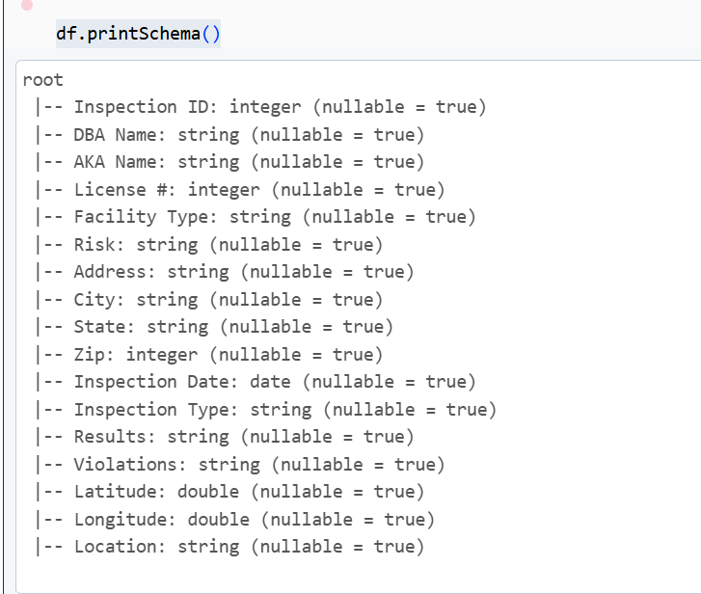
Schema
For our dataset, all the columns had correct datatypes and changing datatypes was not required

Slide 8
Data Cleaning and Transformation
Extracted and Categorized Risk Levels:
Used regular expressions to extract risk levels (Low, Medium, High) from the Risk column.
This transformation made it easier to categorize and analyze the severity of potential food safety risks for each establishment.
Encoded Inspection Results:
Transformed the Inspection_Result column by encoding the outcomes into binary values:
'Pass' as 1
'Fail' as 0
This simplification streamlined the analysis and improved the efficiency of data processing.
Dropped Irrelevant Columns:
Removed unnecessary columns from the dataset that were not essential for the analysis.
This step helped optimize the dataset, reducing complexity and making subsequent analysis more manageable.

Slide 9
Data Storage and temporary View Creation
Data Storage:
Saved the transformed Data Frame as a persistent table using Delta format:python
Ensures data is stored efficiently in an accessible format for querying and analysis within environment.
Temporary view creation:
This enabled executing SQL queries directly on the DataFrame using Spark SQL.

Slide 10
Data Exploration Using Spark SQL
1.Inspection Counts:
Queried to count the number of inspections for each result type (e.g., Pass or Fail).
Helped understand the overall compliance rate of food establishments.
2.Identifying Common Violations:
Ran SQL queries to find the most frequently cited violations across establishments.
This analysis highlighted areas where food safety practices needed improvement.
3.Yearly Distribution of Inspections:
Analyzed the number of inspections conducted each year.
Provided insights into trends over time, such as increases in inspections or changes in compliance rates.

Slide 11
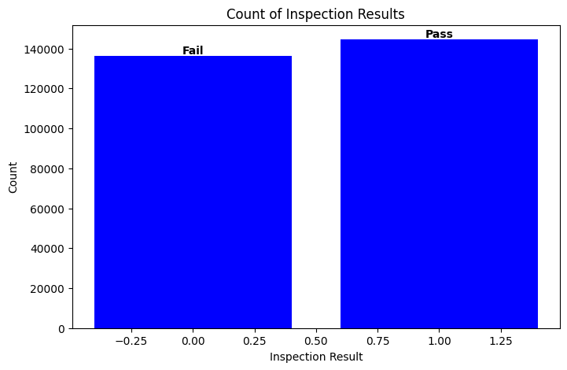
Data Visualization
Insights:
The plot shows a significant number of establishments passed the inspections compared to those that failed.
The nearly equal distribution indicates the effectiveness of regulatory food safety standards, yet there are still a considerable number of failures that warrant attention.

Slide 12
Conclusion
Performed EDA on the food inspections dataset, categorizing outcomes into "Pass" (1) and "Fail" (0) after comprehensive data cleaning and transformation.
The visual clearly highlighted the proportion of passes and failures, making trends easy to identify and understand, with labels enhancing readability.
The analysis uncovered key areas where food safety improvements are necessary and highlighted establishments showing consistent compliance.

Slide 13

Thank you

