Slide 1
FINAL PROJECT REVIEW
Circular E-Waste
Recovery & Refurbishment
Intelligence Platform
A connected two-application workflow for collection, recovery, device assessment and refurbishment coordination
PROJECT TEAM
Application 1: Collection & Recovery – Nideesh C G (Reg.No: 23MIC0092)
Application 2: Refurbishment Intelligence –Dharma S (Reg.No: 23MIC0104)
FINAL REVIEW • 2026

Slide 2
01 • OVERVIEW
Project Overview
Two independent applications connected through a shared REST API.
01 Collection & Recovery
02 Refurbishment Intelligence
Shared integration layer
• Capture electronic-device collection records
• Maintain device details and current status
• Manage images and supporting documents
• Prepare eligible devices for refurbishment
• Receive device information from Application 1
• Assess device condition and technical notes
• Record refurbishment decisions and outcomes
• Return results through the API
• REST API-based communication
• Structured JSON data exchange
• Authenticated requests
• Bidirectional status and result updates
Core idea
Connect separate workflows while keeping each application independently maintainable.
CIRCULAR E-WASTE RECOVERY & REFURBISHMENT INTELLIGENCE PLATFORM
02

Slide 3
02 • CONTEXT
Problem Statement
E-waste workflows span multiple operational stages and need consistent information flow.
Fragmented tracking
Limited coordination
Connected workflow
• Collection information may be stored separately
• Device status can be difficult to follow
• Repeated manual entry can cause inconsistencies
• Collection and refurbishment teams need shared records
• Assessment outcomes must reach the originating workflow
• Documents and metadata need traceability
• Separate applications with clear responsibilities
• Secure and structured API communication
• A clearer path from collection to recovery decisions
Project focus: improve coordination and traceability through a connected software workflow.
CIRCULAR E-WASTE RECOVERY & REFURBISHMENT INTELLIGENCE PLATFORM
03

Slide 4
03 • OBJECTIVES
Project Objectives
Operational tracking combined with cross-application data exchange.
Digitize collection
Enable assessment
Return outcomes
Capture and manage device-level collection information.
Share eligible device details with the refurbishment workflow.
Transfer assessment status and agreed result fields.
Support reporting
Keep modules independent
Prepare for hosting
Provide dashboards, summaries and reports where implemented.
Use a common REST API contract between applications.
Configure production settings and PostgreSQL data persistence.
CIRCULAR E-WASTE RECOVERY & REFURBISHMENT INTELLIGENCE PLATFORM
04

Slide 5
04 • ARCHITECTURE
System Architecture
High-level view of the two applications and their integration boundary.
APPLICATION 1
APPLICATION 2
Collection & Recovery
REST API
Refurbishment Intelligence
Device data →
Flask app • Routes • Models
File handling • Metrics • Reports
HTML templates and static assets
JSON payloads
Authenticated requests
Shared API contract
App entry point • API routes
Device assessment • Results
Reports/analytics • UI
← Results
Each application manages its own codebase; the REST API defines how information is exchanged.
CIRCULAR E-WASTE RECOVERY & REFURBISHMENT INTELLIGENCE PLATFORM
05

Slide 6
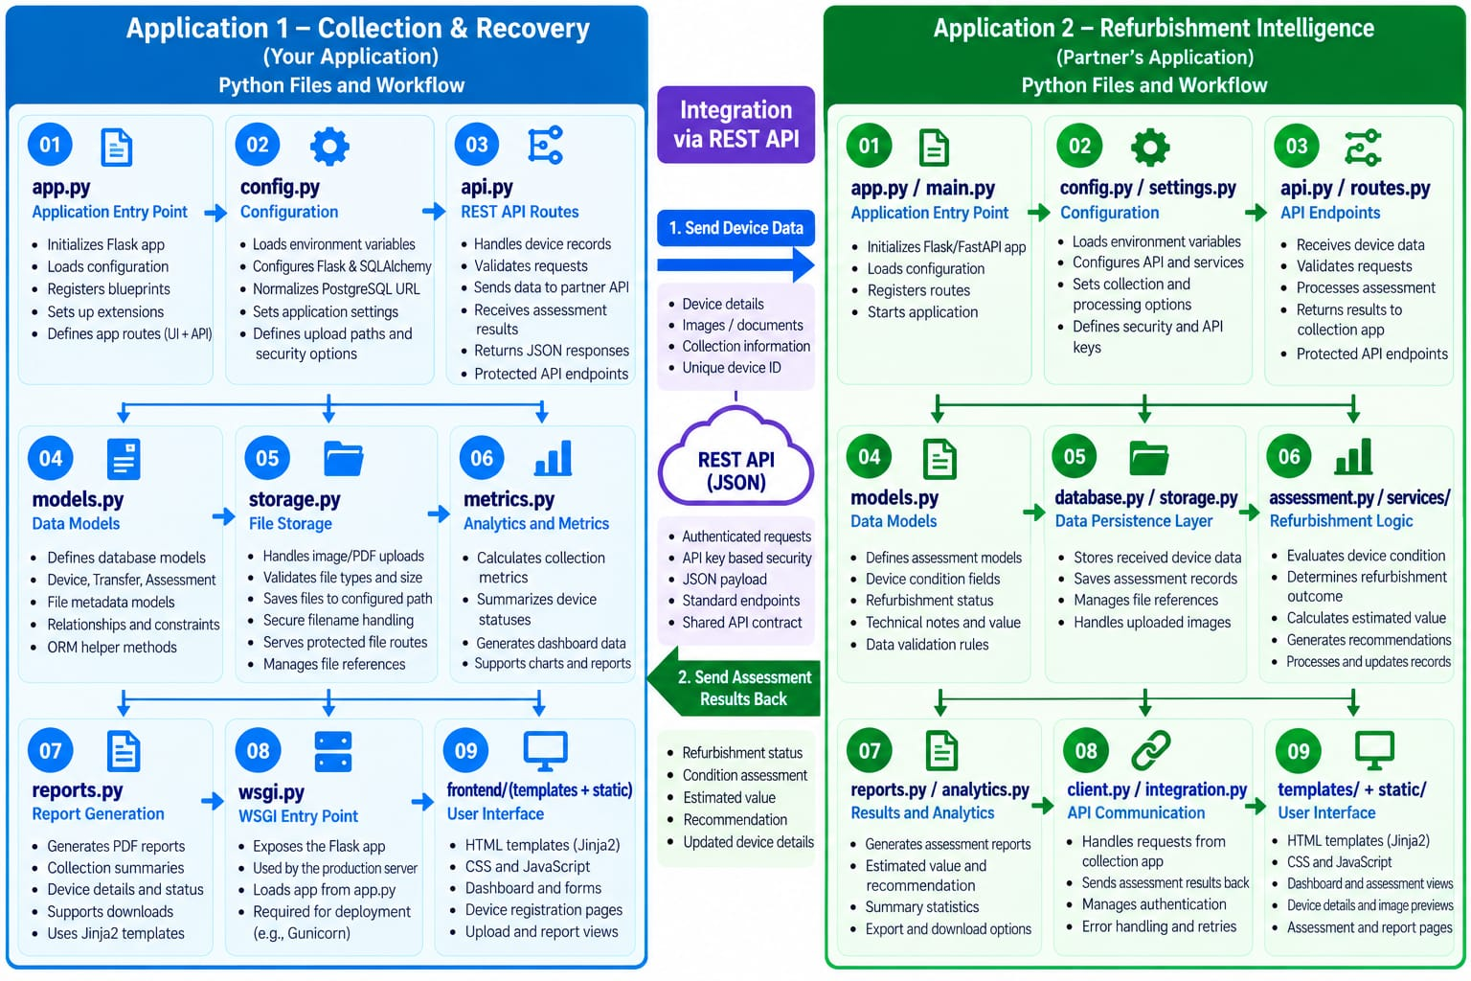
05 • PYTHON FILES
Python Files Workflow — Both Applications
Module-level view of Python files, responsibilities and API integration.
CIRCULAR E-WASTE RECOVERY & REFURBISHMENT INTELLIGENCE PLATFORM
06

Slide 7
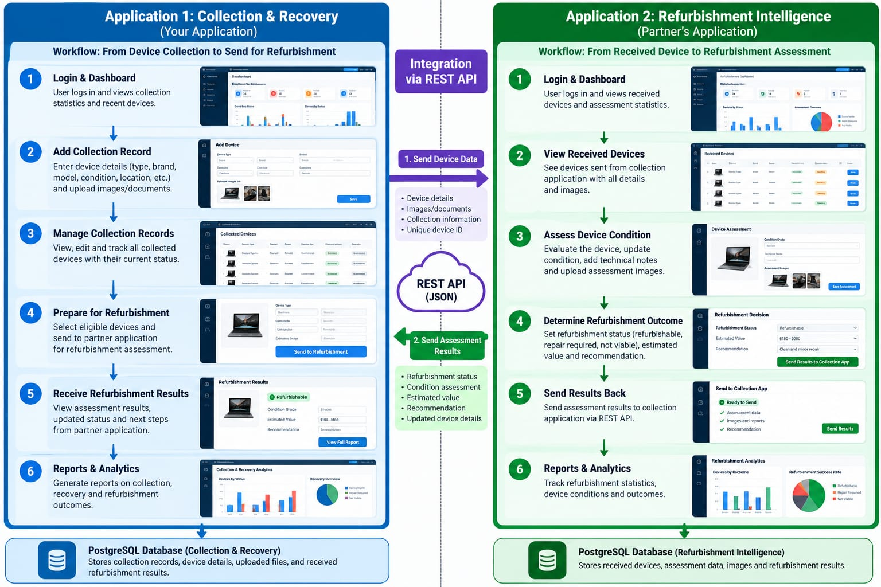
06 • WORKFLOW
End-to-End Application Workflow
From device collection through refurbishment assessment and results return.
CIRCULAR E-WASTE RECOVERY & REFURBISHMENT INTELLIGENCE PLATFORM
07

Slide 8
07 • APPLICATION 1
Application 1 — Collection & Recovery
Primary responsibilities of the collection-side application.
Capture and manage
Process and present
Coordinate with partner
• Register device and collection details
• Maintain status and metadata
• Support image/document workflows where enabled
• Expose UI and API routes
• Calculate collection metrics and summaries
• Present dashboards, records and report views
• Select devices for refurbishment
• Send details through the REST API
• Receive and display returned assessment results
Representative files: app.py, api.py, config.py, models.py, storage.py, metrics.py, reports.py, wsgi.py, migrations/, templates and static assets.
CIRCULAR E-WASTE RECOVERY & REFURBISHMENT INTELLIGENCE PLATFORM
08

Slide 9
08 • APPLICATION 2
Application 2 — Refurbishment Intelligence
Partner-side responsibilities; confirm exact filenames against the partner repository.
Receive device data
Assess and decide
Return results
• Expose endpoints for incoming records
• Validate received device information
• Link images/documents where supported
• Review device condition and technical notes
• Record refurbishment status and outcomes
• Provide estimates or recommendations if implemented
• Send assessment data to Application 1
• Handle API errors and authentication
• Support assessment summaries and reports
Representative roles: entry point, configuration, API routes, data models, persistence, assessment logic, integration client, reports and UI.
CIRCULAR E-WASTE RECOVERY & REFURBISHMENT INTELLIGENCE PLATFORM
09

Slide 10
09 • INTEGRATION
Bidirectional API Data Exchange
The REST API is the communication boundary between independently developed applications.
01
Collection → Refurbishment
Device identifier, collection details, condition metadata and supported file references.
02
Refurbishment → Collection
Assessment status, outcome, notes, recommendations and agreed result fields.
Implementation checks: shared API contract • authentication • validation • error handling • duplicate-request safety
CIRCULAR E-WASTE RECOVERY & REFURBISHMENT INTELLIGENCE PLATFORM
10

Slide 11
10 • TECHNOLOGY
Technology Stack & Deployment
Independent services, production configuration and API-based connection.
Application layer
Integration & data
Hosting readiness
• Python backend
• Flask for the collection application
• HTML templates, CSS and JavaScript UI
• Confirm partner framework from its repository
• REST API with JSON payloads
• Environment-based configuration
• PostgreSQL planned for production
• SQLite may be retained for local development
• Deploy each app independently
• Set production secrets securely
• Apply migrations safely
• Test health endpoints and file persistence
State hosting as completed only after the live deployment and end-to-end tests succeed.
CIRCULAR E-WASTE RECOVERY & REFURBISHMENT INTELLIGENCE PLATFORM
11

Slide 12
11 • VALIDATION
Validation & Testing
Demonstrate the complete workflow, not just individual screens.
UI
Login, dashboard, records and navigation
DATA
Create and retrieve device records
API
Valid request, invalid credential and error response
INTEGRATION
Send a device record and receive assessment results
FILES
Upload, preview, download and persistence checks
DATABASE
Verify records survive redeploy/restart
Only mark a test as passed after demonstrating it in the live or local application.
CIRCULAR E-WASTE RECOVERY & REFURBISHMENT INTELLIGENCE PLATFORM
12

Slide 13
PROJECT OUTCOME
A connected workflow for a
more circular electronics lifecycle
Collection & recovery → Device assessment → Refurbishment outcome → Traceable records
Traceability
Coordination
Reuse potential
Keep device information connected across stages.
Exchange data between separate applications.
Support informed recovery decisions.
Thank you
Questions & Discussion
CIRCULAR E-WASTE RECOVERY & REFURBISHMENT INTELLIGENCE PLATFORM
13

