Slide 1

Name: Anumuladasu Dharma Teja
Email: tejd11837@gmail.com
Branch: CSE(CS)
College: Ramachandra College of Engineering

Slide 2
Hiding a text inside an image using steganography

Slide 3
AGENDA
Problem Statement
Project Overview
Who are the end users of this project ?
Modelling
Methodology Involved

Slide 4
INTRODUCTION:
Steganography is the art and science of writing hidden messages in such a way that no one, apart from the sender and intended recipient, suspects the existence of the message, a form of security through obscurity.
The advantage of steganography over cryptography alone is that messages do not attract attention to themselves.
Using the theory of steganography, this research is wishing to hide a text file in the image. The encrypted image will looked like not differ to the original image. This can eliminate the suspicion of third party toward the encrypted image. The text file embedded in the image should be able to retrieve it back to the original state

Slide 5
Problem Statement
As stated earlier in the introduction, visible encrypted messages will draw the suspicion from others. This will make them attempt to decrypt the cipher text. Indirectly it arise the chance of message being viewed by third party in the exception of sender and viewer.
However by hiding or embedding the text file into image, it is hard to arise the suspicion of other whether it is contain any secret message or not as the processed image had not look differ from the original image in naked eye. This will make the message more secure. Indirectly, only the sender and receiver know the treat behind the image and hence ensure that the message can only view by sender and receiver.

Slide 6
PROJECT OVERVIEW
This project implements a steganography technique to securely hide and reveal secret within an image using the RGB color mechanism and a key based XOR operation for encryption. Steganography allows for concealing messages within non-secret text or data, ensuring secure communication by embedding sensitive information within an image in a way that is imperceptible to unauthorized viewers.
Image Encoding: Secret text is hidden within the image’s pixel values using the LSB method, with additional security provided by XOR the text characters with a user-provided security key.
Pixel Manipulation: The encoded text is distributed across the image’s pixels, maintaining the visual integrity of the image while embedding the hidden message.
Text Decoding: The project includes functionality to decrypt and retrieve the hidden text from the image using the correct security key, ensuring that only authorized users can access the information.
This project demonstrates a practical application of steganography for secure communication, embedding and retrieving secret messages within images in a secure and efficient manner.

Slide 7
WHO ARE THE END USERS of this project?
The primary end users for this steganography project include government and military personnel secure communication, corporate executives protecting proprietary data, and journalists sharing sensitive information discreetly.
IT and cyber security teams can integrate this technique to enhance organizational data security.
Additionally, the person who wants to send any secret message other person in a hidden format then this project will helpful for them.

Slide 8
Objective
The objectives of the research are to:
To store a text file (.txt) in image.
To protect the text file (.txt) from being viewed by third party using encryption.
To restore the stored text file in image.

Slide 9
Modelling
Text Steganography In Python
In order to protect statistics, we encrypt the message in a mystery technique that the receiver can understand most effectively.
In Steganography, a message is hidden inside a larger one in such a way that no one knows what the hidden message is or what it contains
Libraries:
Pillow: Python Imaging Library is an unfastened and open-supply extra library for the Python programming language that adds support for commencing, manipulating, and saving many exceptional picture document codecs. To install this module use the below command
pip install PIL

Slide 10
Steps to execute the code:
Note: Make sure you have added path while installing the software’s.
https://techieyantechnologies.com/2022/07/how-to-install-anaconda/
https://techieyantechnologies.com/2022/06/get-started-with-creating-new-environment-in-anaconda-configuring-jupyter-notebook-and-installing-libraries-using-requirements-txt-2/

Slide 11
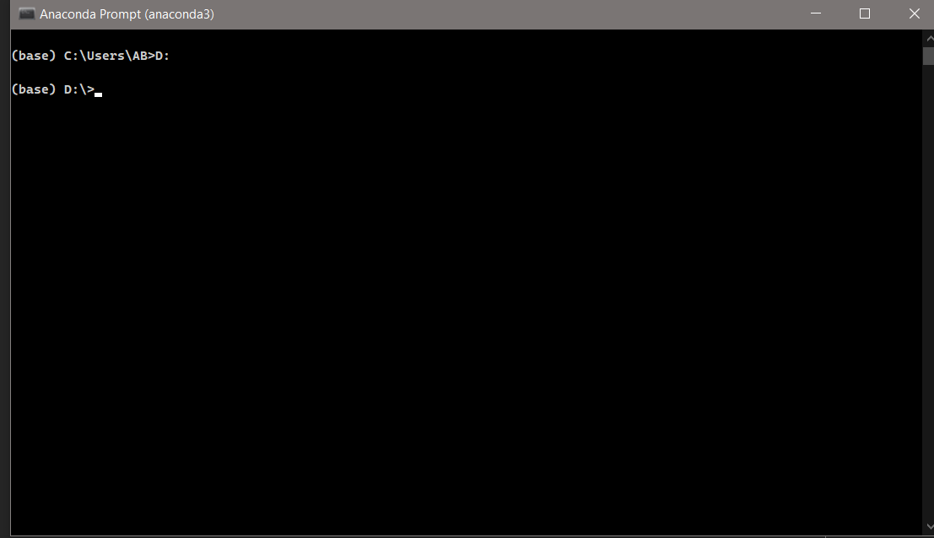
Install the prerequisites/software’s required to execute the code from reading the above blog which is provided in the link above.
Press windows key and type in anaconda prompt a terminal opens up.
Go to the directory where your requirement.txt file is present, not just requirement.txt, if you want to execute any .py or .ipynb files, you need to go to that specific folder or path, where they are saved
<<directory of your file:>>. E.g., If my file is in d drive, then
Type d:

Slide 12
cd d:\License-Plate-Recognition-main #CHANGE PATH AS PER YOUR PROJECT, THIS IS JUST AN EXAMPLE
If your project is in c drive, you can ignore step 4 and go with step 5
Run pip install -r requirements.txt or conda install requirements.txt (Requirements.txt is a text file consisting of all the necessary libraries required for executing this python file. If it gives any error while installing libraries, you might need to install them individually.), example: pip install “module_name”.

Slide 13
Methodology involved
Encrypt image :
Set a security key
Enter text to hide in image
Decrypt image:
Re-enter key to verify
Extract data from image

Slide 14
Execution of code Encryption
Write appropriate code for hiding the message in a image
Note: The code is provided in another folder you can verify the code there itself.
Save the file with extension .py
After saving the file, open cmd prompt
Copy the file path which contains the code.
Press Enter…
Now enter respective secret key.
After entering of secret key, Give the text to be hidden.
Now the text is hided inside an image.

Slide 15
Decryption:
Re-enter the security key to verify.
Now the data is extracted from image.

Slide 16
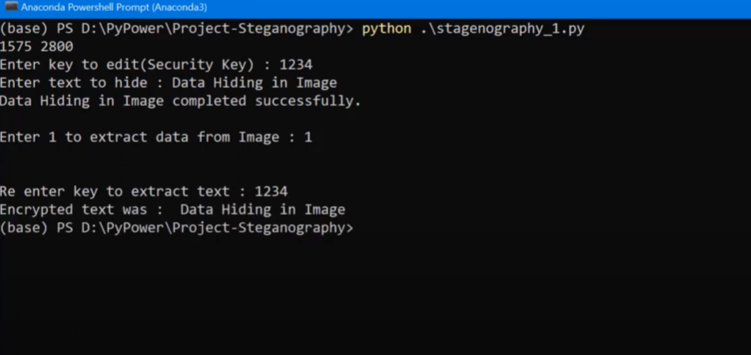
Result

Slide 17
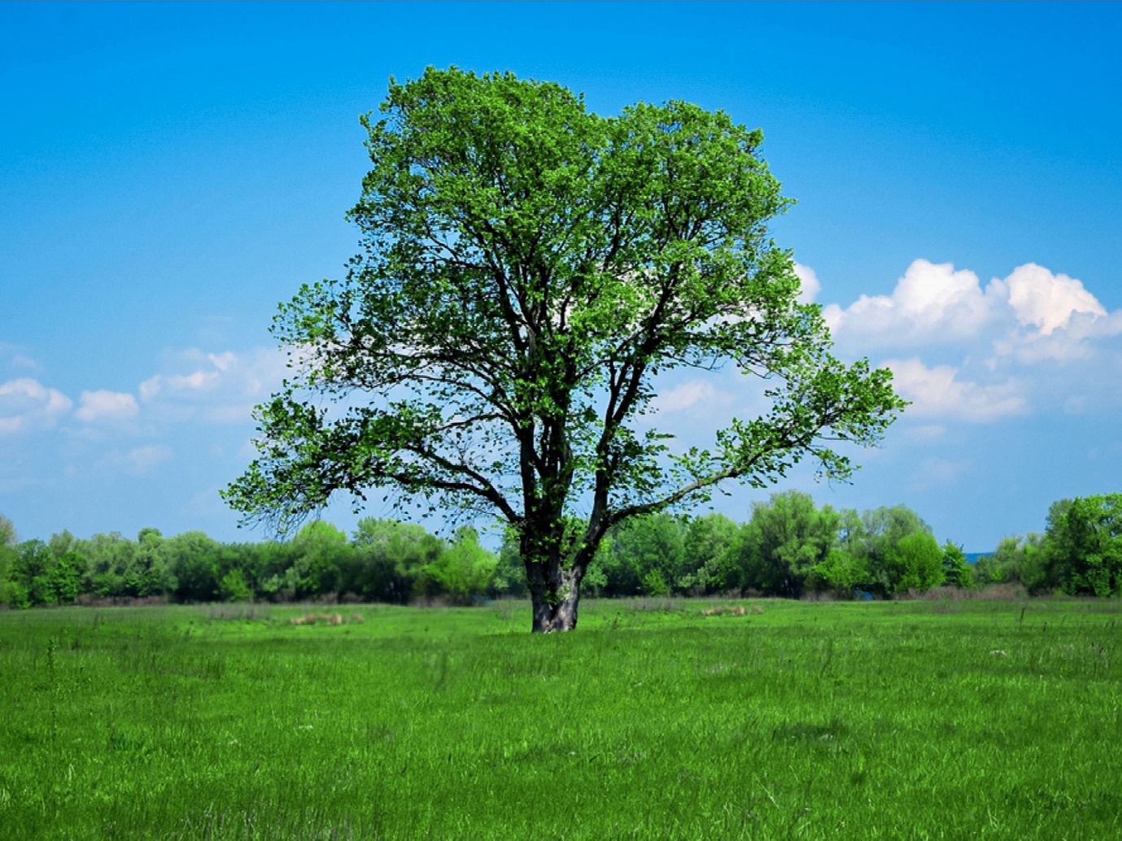
Dataset:
Two same images are used as input and output.
Input Image
Output Image

Slide 18
Links
https://github.com/DharmaTej791/Hiding-a-text-inside-an-image1.git

