Slide 1


FORECAST GOLD PRICES
GROUP – 5 (P-111)
SHUBHAM PAWAR
SATYAJEET SUDHIR DHARMADHIKARI
HARSHADA ANIL SHINDE
SUSHMA NARSAYYA GURAYYA
TOFIQAHEMAD BAG SHAIKH
VEDA GOWDA
PRIYANK JALINDAR UKIRADE
KOMAL GANESH RETAWADE
MENTOR - KARTHIK
1

Slide 2
BUSINESS OBJECTIVE
Business Objective: Data provided is related to gold prices. The objective is to understand the underlying structure in your dataset and come up with a suitable forecasting model which can effectively forecast gold prices for next 30 days. This forecast model will be used by gold exporting and gold importing companies to understand the metal price movements and accordingly set their revenue expectations.
GROUP 5
2

Slide 3
PROJECT ARCHITECTURE/FLOW
Define Business Goal
Data Collection
Explore & visualize series
Partition series
Apply Forecasting methods
Implement Forecast/System
Pre-process data
Evaluate & compare Performance
GROUP 5
3

Slide 4
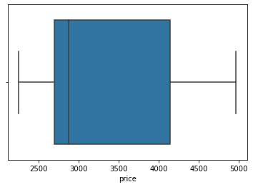
EXPLORATORY DATA ANALYSIS
Insights of the dataset:
2182 rows & 2 columns
No Null values and duplicate values observed
No outliers detected
GROUP 5
4

Slide 5
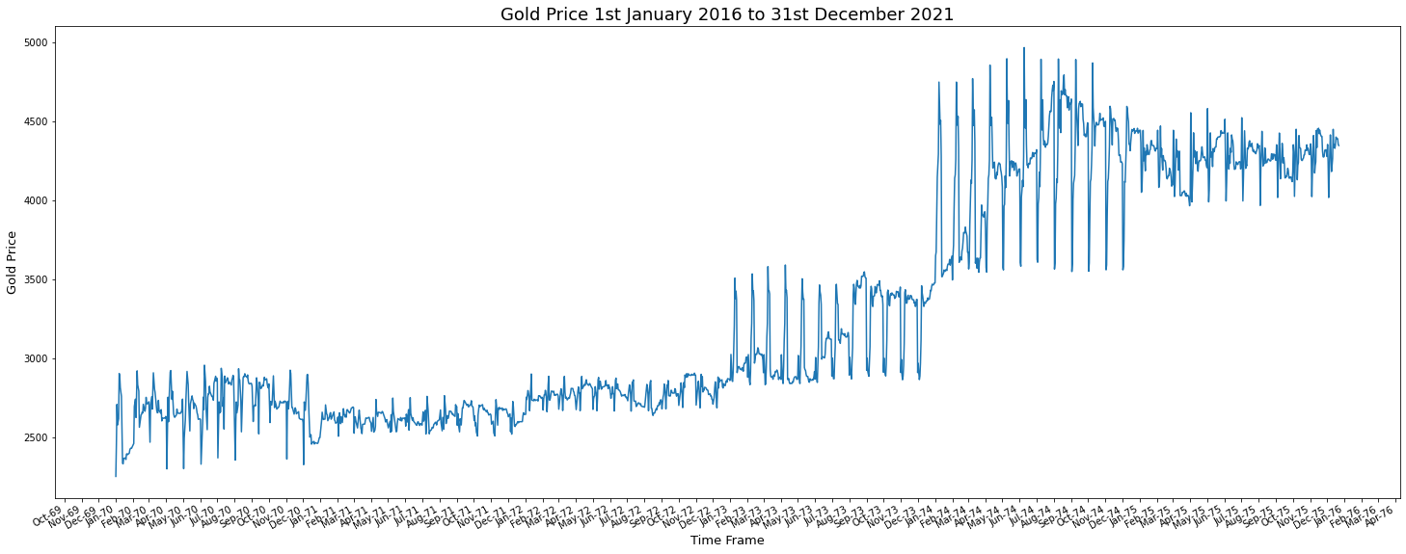
Time Plot
From the plot we can refer that with respect to the month and year price of gold also increasing
5
GROUP 5

Slide 6
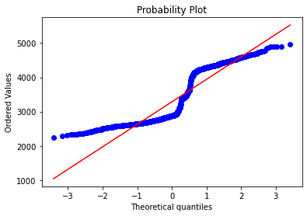
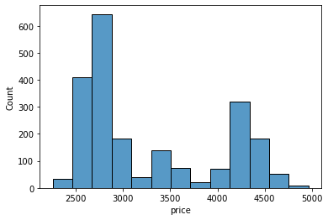
From the graph , we can analyze that data points are not following the normal distribution.
GROUP 5
6

Slide 7
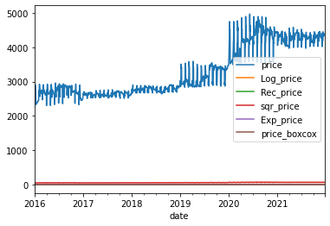
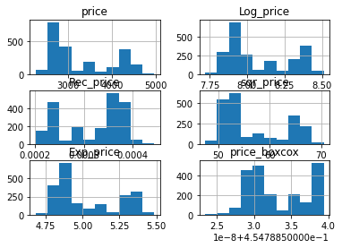
Transforming to Normal Distribution
Transforming techniques used:
logarithmic transformation
Reciprocal transformation
Square-root transformation
Exponential transformation
Box – cox transformation
Even after transformations data is
Not normal so we moved ahead
Without transformation
7
GROUP 5

Slide 8
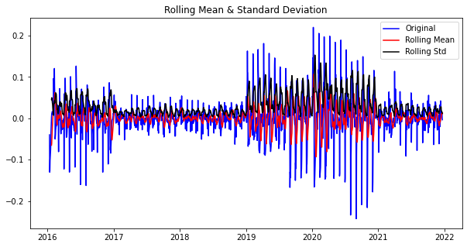
Rolling mean & standard deviation
GROUP 5
8

Slide 9
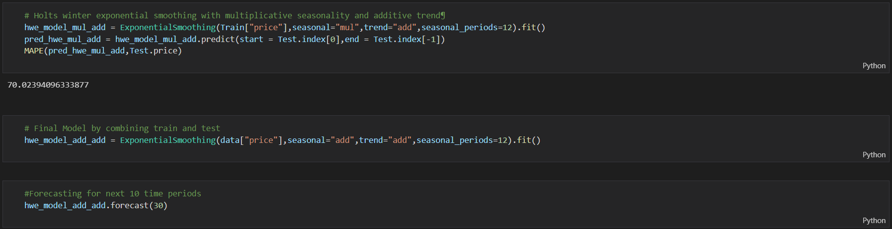
Holt winter exponential model
GROUP 5
9

Slide 10
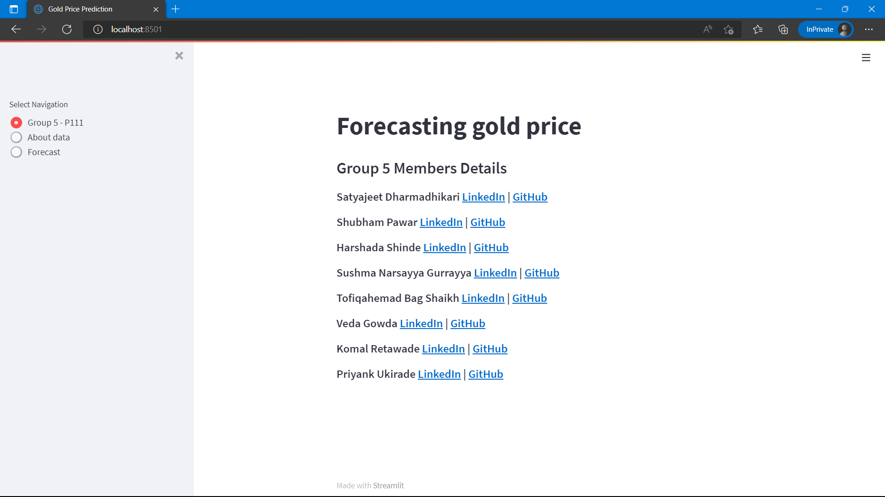
Deployment
GROUP 5
10

Slide 11
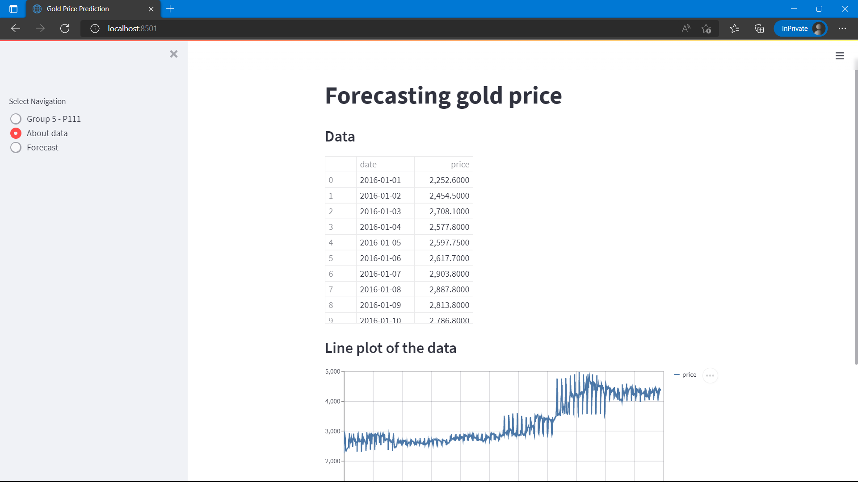
Deployment - About data
GROUP 5
11

Slide 12
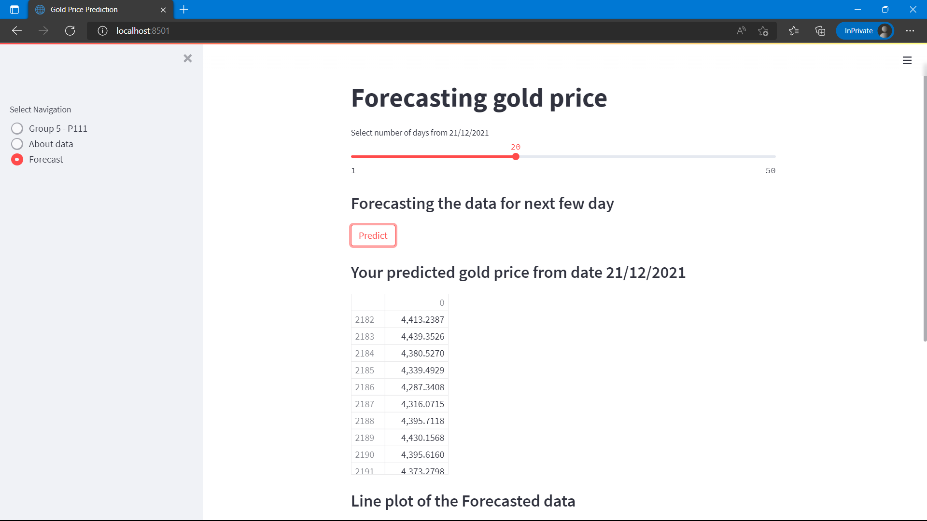
Deployment - forecasting
GROUP 5
12

Slide 13
Challenges
Model Building
ARIMA model slowed same values
Holt Winter Exponential Smoothing Model forecasted expected output
Deployment
Streamlit

Slide 14
Thank you
GROUP 5
13

