Slide 1

VARDHAMAN COLLEGE OF ENGINEERING, HYDERABAD Autonomous institute affiliated to JNTUH DEPARTMENT OF COMPUTER SCIENCE & ENGINEERING
Title: Crime pattern prediction and analysis.
BATCH ID : 22MPCS-B22
S. No | Roll. No | Student Name
1 | 22881A0573 | D SHIVARAM GOUD
2 | 22881A0575 | D CHINMAYI
3 | 22881A0582 | K TARUN BABU
Guide Details
Ms. J Srilatha
Assistant Professor
Department of CSE

Slide 2
Mini Project Review-2 Outlines
Main idea of the Project
Existing System Vs Proposed
Proposed Project Objectives
Proposed Project Outcomes
Software and Hardware Requirements
Process Model
Design Phase
Architectural Diagram [Modified]
[UML Diagrams or Data Flow Diagrams] and ER-Diagrams ; It should be detailed diagrams
Proposed Method s and Algorithms [ With example]

Slide 3
Main idea of the Project
The project addresses rising global crime rates by using advanced data mining techniques to analyze historical crime data. It aims to identify hidden patterns and predict future crimes to aid law enforcement agencies in proactive crime prevention.
Reinforcement learning (RL) is employed to dynamically optimize resource allocation for law enforcement, ensuring real-time responses to crime predictions. Additionally, causal inference models are used to uncover hidden factors, such as socio-economic and environmental conditions, that influence criminal behavior.
The project’s predictive models are rigorously trained and validated to ensure high accuracy and interpretability, providing law enforcement with effective tools to reduce crime and improve public safety.
By integrating data-driven insights, the system empowers law enforcement agencies to move from reactive to proactive strategies, improving decision-making and resource deployment in crime prevention efforts.
The ultimate goal is to enhance public safety by preventing criminal activities before they occur, offering a smarter, more efficient approach to combating crime at local, national, and global levels.

Slide 4
Existing System Vs Proposed
Existing System:
Manual Crime Analysis – Law enforcement agencies rely on manual record-keeping and traditional statistical methods to analyze crime trends..
Limited Use of Data Science – The current system does not fully utilize machine learning, reinforcement learning, or causal inference for crime prediction.
Resource Allocation Issues – Law enforcement resource deployment is static and not optimized based on real-time data.
Lack of Socio-Economic Insights – The influence of external factors like demographics, economic conditions, and environmental factors is often overlooked.
Proposed System:
AI-Driven Crime Prediction – Uses data mining techniques and machine learning models to identify hidden crime patterns.
Proactive Crime Prevention – Predicts future crimes using predictive analytics, enabling law enforcement to prevent incidents before they occur.
Reinforcement Learning for Resource Allocation – Implements dynamic real-time optimization of law enforcement resources.
Causal Inference Models – Analyzes external factors such as socio-economic conditions, weather, and demographics to understand crime patterns better.
Automated Decision Support – Provides law enforcement with actionable insights for better decision-making in crime detection and prevention.

Slide 5
Proposed Project Objectives
Analyze historical crime data to identify patterns and trends, enabling more accurate predictions of future crimes. This will help law enforcement agencies target crime hotspots and allocate resources more effectively.
Implement reinforcement learning (RL) to optimize real-time resource allocation for law enforcement, ensuring dynamic and efficient responses to crime predictions. The RL model will adapt based on incoming data for continuous improvement.
Use causal inference models to identify socio-economic, demographic, and environmental factors that contribute to criminal behavior. This will provide deeper insights into the root causes of crime, improving prevention strategies.
Develop predictive models that forecast future criminal activities, allowing law enforcement to take proactive measures before crimes occur. These models will be rigorously trained and validated for accuracy.
Equip law enforcement with actionable insights and tools for better decision-making in crime detection, prevention, and resource management. This will enable agencies to respond more effectively to emerging crime patterns.
Enhance public safety by providing data-driven tools that allow law enforcement to move from reactive to proactive crime prevention, ultimately improving the overall effectiveness of crime control efforts.

Slide 6
Proposed Project Outcomes
The project will enable law enforcement agencies to identify organized crime networks through data analysis. By recognizing patterns across multiple data points, agencies will be able to detect and dismantle criminal organizations more effectively.
Improved crime prediction accuracy will allow for better preparedness and preemptive actions by law enforcement. This proactive approach will reduce the need for reactive responses, minimizing the impact of crimes on communities.
By leveraging causal inference, the project will uncover previously unknown correlations between crime and external factors like economic conditions, weather, and demographic shifts. This deeper understanding will help law enforcement anticipate and mitigate crime based on broader social trends.
The integration of reinforcement learning will lead to the development of a continuously improving crime prevention system. As the system receives more data, it will learn and adapt its strategies to maximize the efficiency of crime prevention efforts.
Ultimately, the project will reduce crime rates by using evidence-based, proactive strategies rather than relying on reactive policing methods. This shift will lead to safer communities and more efficient use of law enforcement resources.

Slide 7
Software and Hardware Requirements
Software Requirements:
Programming Languages: Python, R, SQL
Libraries/Frameworks: Pandas, NumPy, Matplotlib, Seaborn, Scikit-learn, TensorFlow, Keras, PyTorch, OpenAI Gym, Stable Baselines3, CausalImpact, DoWhy
Database Management: MySQL, PostgreSQL, SQLite
Data Science Tools: Jupyter Notebook, Anaconda
Version Control: Git, GitHub
Development Environment: Visual Studio Code, PyCharm
Operating System: Windows, Linux, macOS
Hardware Requirements:
Processor: Intel Core i7 (minimum), Intel Core i9 (recommended)
RAM: 16 GB (minimum), 32 GB (recommended)
Storage: 1 TB SSD (minimum)
Graphics Card: NVIDIA GPU (optional, recommended for heavy ML tasks)
Network: Stable internet connection
Display: Full HD (1920x1080) resolution

Slide 8
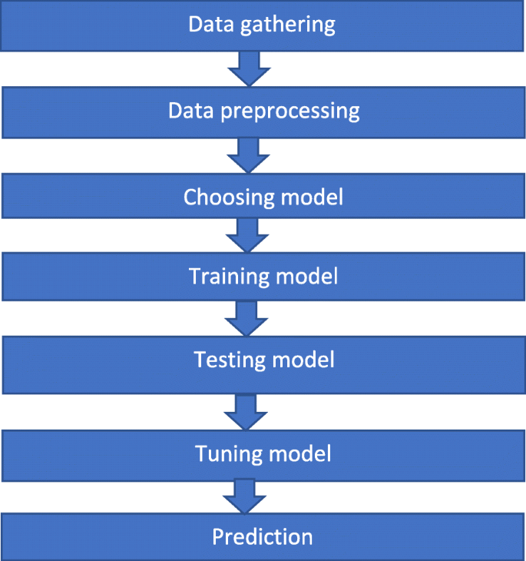
Process Model

Slide 9
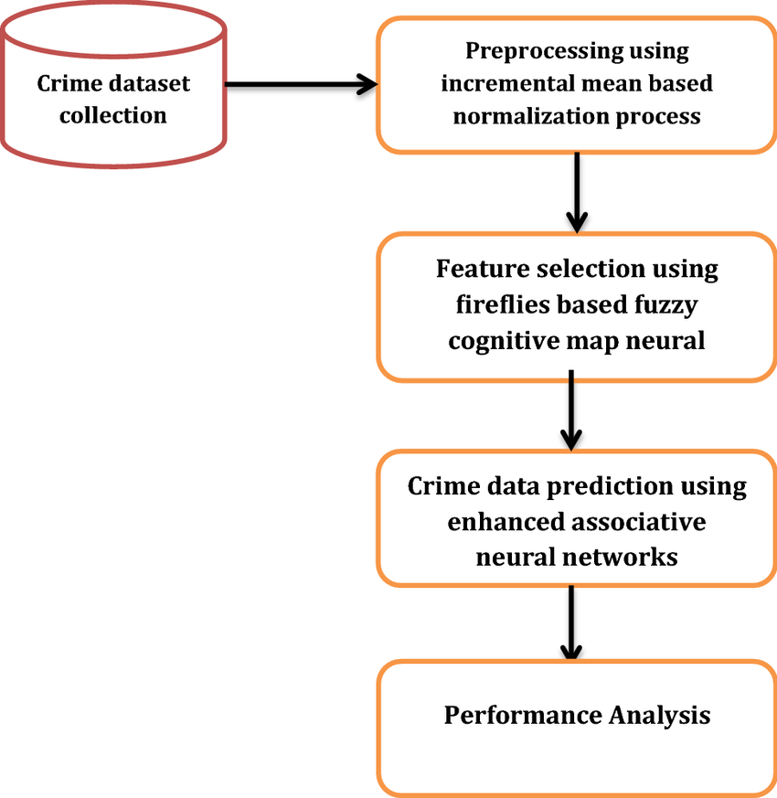
Architectural Diagram

Slide 10
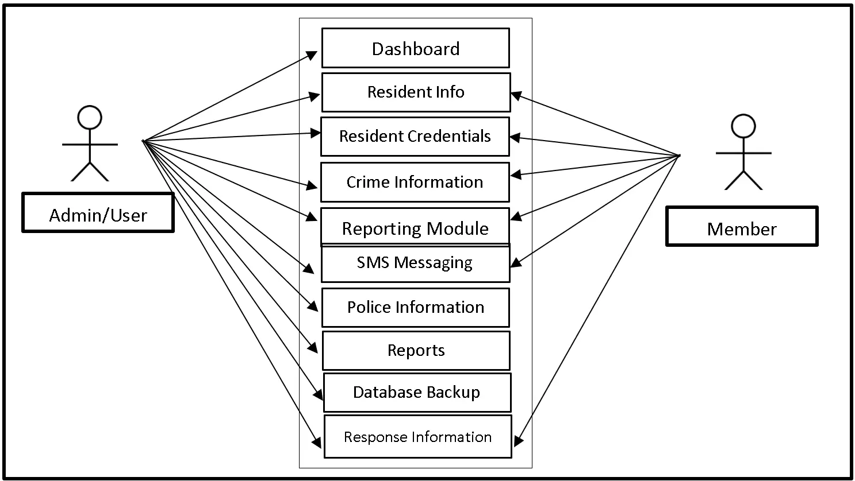
USE CASE DIAGRAM

Slide 11
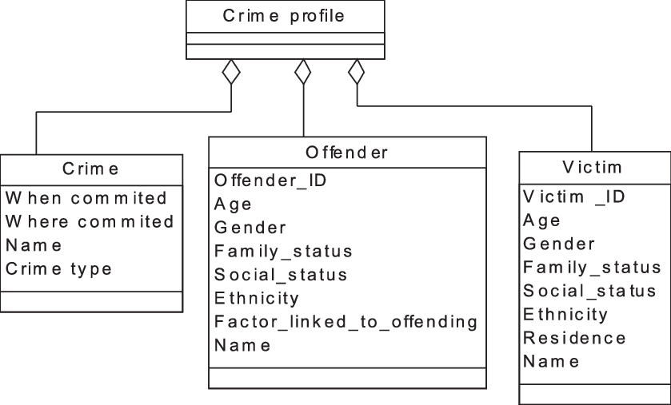
CLASS DIAGRAM

Slide 12
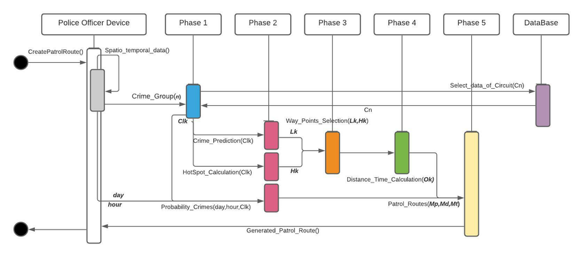
SEQUENCE DIAGRAM

Slide 13
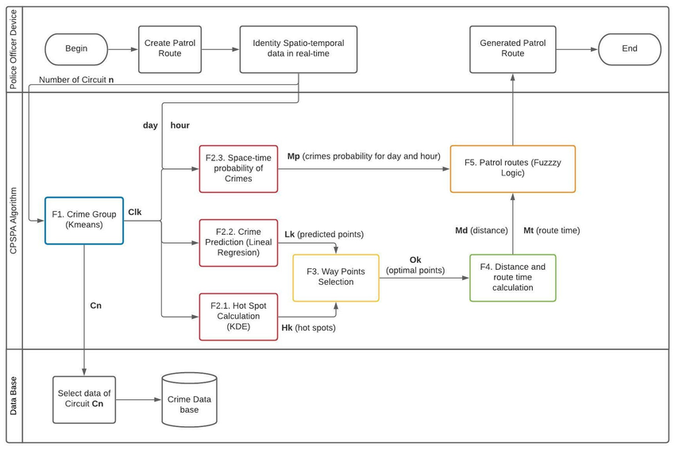
ACTIVITY DIAGRAM

Slide 14
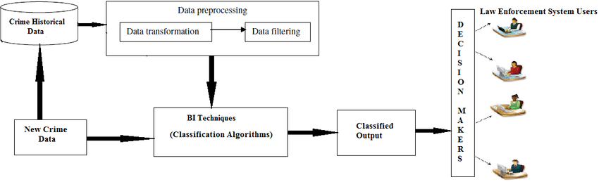
STATE CHART DIAGRAM

Slide 15
PROPOSED METHOD AND ALGORITHMS
PROPOSED METHOD
Preprocessing
Exploratory Data Analysis (EDA) : box plots, trend lines, pie charts, and heatmaps
Geospatial Analysis : Choropleth/Bubble Maps,K-Means Clustering: Group high-crime districts.
Time Series Forecasting : Applying ARIMA & VAR modeling.
Predictive Modeling :- RegressionPredict total crimes (Linear, KNN Gradient Boosting) ,,ClassificationCategorize districts by crime level (Random Forest)
Statistical Analysis : performing Correlation/Variance,T-Test.

Slide 16
PROPOSED METHOD AND ALGORITHMS
ALGORITHMS
Data Preprocessing : Label Encoding ,One-Hot Encoding,Covariance Matrix.
EDA (Exploratory Data Analysis) : Box Plot,Trend Plot ,Pie Chart ,Heatmap.
Geospatial Analysis : GeoPandas Centroid Extraction,Choropleth Map,Bubble Map,K-Means Clustering – Group high-crime areas.
Time Series Forecasting : ARIMA ,VAR ,ADF Test ,Differencing.
Machine Learning : Linear Regression,KNN Regressor,Gradient Boosting ,Random Forest Classifier.
Statistical Analysis : T-Test ,Correlation Analysis,Variance/IQR.

Slide 17
Internship Details
22881A0573 - D Shivaram Goud
at Edunet Foundation
22881A0575 - D Chinmayi
at codTech IT solutions
22881A0582 - k Tarun Babu
at codTech IT solutions

Slide 18
Thank You

