Slide 1


NAME: HARINI DHARMAPURI
collage’s student registered no : 22B61A0521
collage name : Satya Institute of Technology and Management
collage state: Andhra Pradesh
internship domain: AI & ML {ARTIFICIAL INTELLEGENCE AND MECHINE LEARNING
SKILLBUILD EMAIL ID:dharmapuriharini@gmail.com
Employee Burnout Prediction

Slide 2
Employees Burnout Prediction
This presentation delves into the prediction of employee burnout, a critical issue affecting workplaces globally. We will explore the problem, propose a solution, and showcase the potential impact of our approach.

Slide 3
Project Title/Problem Statement
Employee Burnout: A Growing Concern
1
Employee burnout is a significant issue impacting productivity, employee morale, and overall company performance.
The Need for Early Detection
2
Early detection and intervention are crucial for mitigating the negative consequences of burnout and promoting a healthier workplace.
Our Goal: Predictive Analytics
3
We aim to develop a predictive model that can identify employees at risk of burnout, allowing for proactive interventions.

Slide 4
Agenda
Project Overview
End User Focus
Solution & Value Proposition
A brief introduction to the problem of employee burnout and its impact.
Identifying the key stakeholders and their needs in relation to burnout prediction.
Presenting our proposed solution and its benefits for organizations.
Project Customization
Modeling Approach
Results & Impact
Highlighting the flexibility and adaptability of our model to different contexts.
A detailed explanation of the machine learning techniques employed.
Presenting the findings of our model and its potential impact on employee well-being.

Slide 5
Project Overview
The Problem
Employee burnout is a state of emotional, physical, and mental exhaustion caused by prolonged or excessive stress.
It can lead to decreased productivity, increased absenteeism, and a decline in employee morale.
The Impact
Burnout impacts not just individuals but also organizations. It can lead to decreased productivity, increased absenteeism, and a decline in employee morale.By proactively identifying at-risk employees, we can implement targeted interventions to improve employee well-being and boost company performance.

Slide 6
Who are the End Users?
Human Resources (HR)
HR professionals can use the model to identify employees at risk of burnout and implement targeted interventions.
Managers & Supervisors
Managers can receive alerts about employees at risk of burnout and provide personalized support.
Employees Themselves
Employees can benefit from the model by receiving personalized recommendations and resources to manage stress.
Occupational Health Professionals
These professionals focus on the health and safety of employees in the workplace

Slide 7




Our Solution and Value Proposition
Data Collection
We collect relevant data from various sources, such as employee surveys,
performance reviews, and HR systems.
Model Training
We train a machine learning model using this data to
identify patterns and predict burnout risk.
Real-time Monitoring
The model provides real-time predictions,
allowing for timely intervention and support.
Personalized Insights
The model generates personalized recommendations
for employees and managers to address specific risk factors.

Slide 8
Customization and Personalization of the Employee Burnout Prediction Project
Comprehensive Knowledge of Context
Advanced Methods for Processing Data
Choosing and Customizing a Model
Including Psychological Aspects
Framework for Continuous Improvement
Variable 1
Variable 2
Variable 3
Data Sources
Model Parameters
Intervention Strategies
Employee Surveys
Algorithm Tuning
Stress Management Programs
Performance Metrics
Feature Selection
Wellness Initiatives
HR System Data
Model Validation
Employee Support Groups

Slide 9




Modeling
Regression Analysis
Classification Models
Predicting continuous variables like burnout severity levels.
Categorizing employees into high, medium, or low burnout risk.
Ensemble Techniques
Feature Engineering
Combining multiple models to improve accuracy and robustness.
Transforming raw data into features that are more informative for the model.

Slide 10
Results
The Linear Regression model emerged as the superior choice for predicting burnout risk due to its exceptional performance metrics. It demonstrated superior accuracy and precision compared to other models, as evidenced by lower Mean Squared Error, Root Mean Squared Error, and Mean Absolute Error values. Additionally, the model's high R-squared score indicates its strong fit to the data and ability to explain a significant portion of the variance in burnout outcomes. Consequently, the Linear Regression model has been selected for deployment in predicting employee burnout.

Slide 11
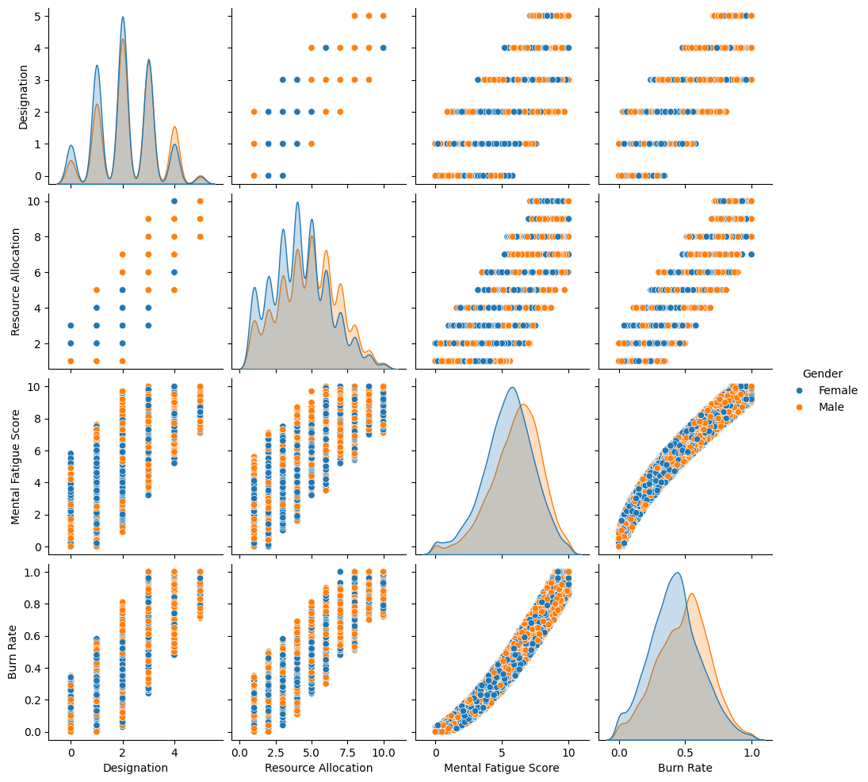
When people get more work (resources), they feel more tired and stressed, leading to burnout. This happens to both men and women. Women, on average, feel a bit more tired and stressed than men in this situation

Slide 12
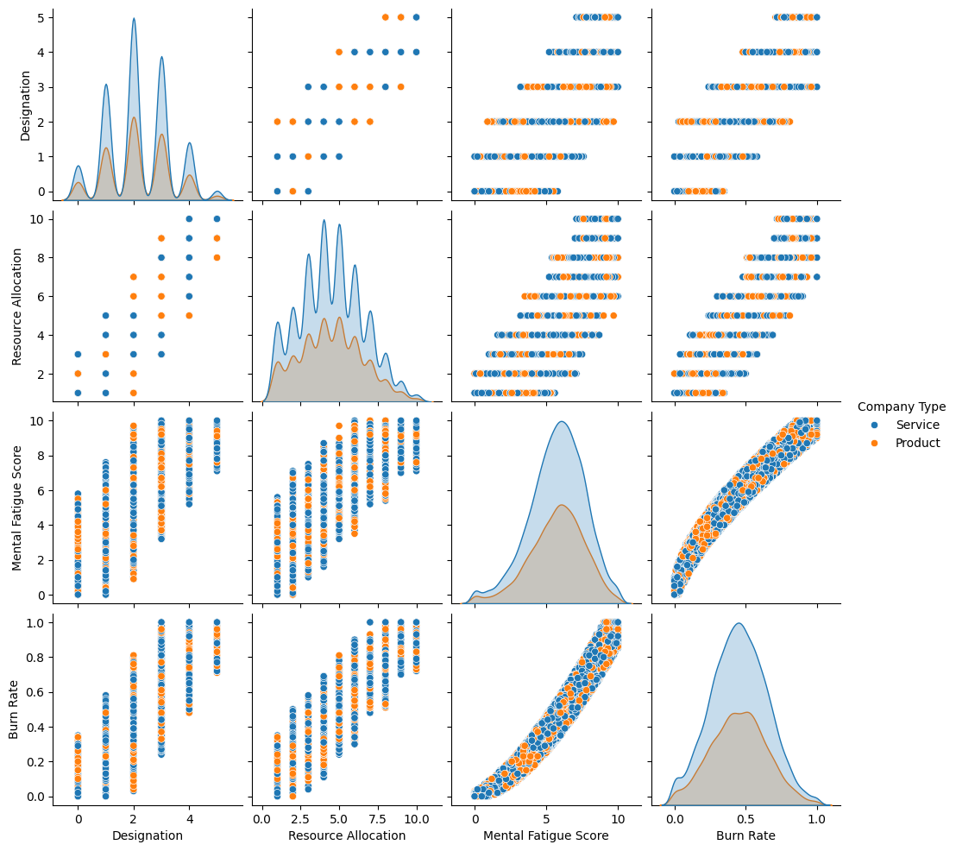
More work leads to feeling more tired and burned out.
People who feel tired are more likely to burn out.
The pattern is similar for both men and women. Some differences exist between companies offering services and those making products.

Slide 13
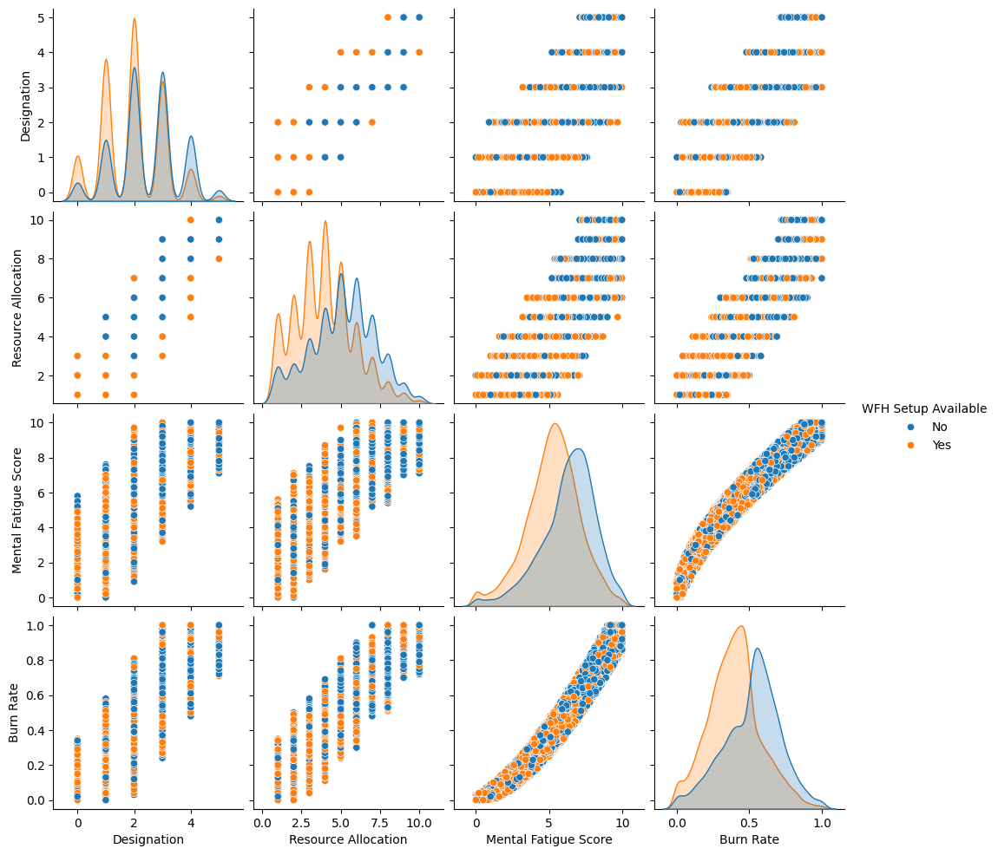
The pairplot analysis indicates a strong positive correlation between increased workload and elevated levels of mental fatigue and burnout. Notably, mental fatigue is a significant predictor of burnout. While work-from-home setup appears to have a minimal impact on these relationships, subtle variations in burnout levels across different WFH configurations warrant further investigation.

Slide 14
HOW EFFECTIVELY EMPLOYEE BURNOUT PREDICTION DOES WORK
Clarity and Labeling: Ensure graphs are clear, well-labeled, and easy to understand.
Data Visualization: Choose appropriate graph types to effectively represent the data.
Interpretation: Provide clear and concise explanations of what the graphs show.
Insights: Draw meaningful conclusions from the graphs and relate them to the problem.
Limitations: Acknowledge any limitations of the graphs or the underlying data.
Specific Considerations for Burnout Prediction
Correlation with Burnout: Identify variables strongly correlated with burnout for potential inclusion in the model.
Outliers: Investigate outliers as they might represent extreme cases or data errors.
Model Performance: Evaluate the performance of the prediction model using appropriate metrics (e.g., accuracy, precision, recall, F1-score).
Feature Importance: Determine which variables contribute most to the prediction.

