Slide 1

NAAN MUDHALVAN DATASCIENCE FUDAMANETAL PROJECT
PROJECT TITLE:
IPL data analysis using pandas A1
PRESENTED BY:
V.DHARMAR
REG.NO: 912321105006
SACS M.A.V.M.M. ENGINEERING COLLEGE
III YEAR EEE DEPT

Slide 2

Project statement:
**Project Statement: IPL Data Analysis**
The project aims to analyze the Indian Premier League (IPL) data to gain insights into player performance, team strategies, and overall tournament trends. Through comprehensive data exploration, visualization, and statistical analysis, we seek to uncover patterns, key influencers, and performance metrics crucial for team management, player selection, and strategic decision-making. This project will involve examining player statistics, match results, team dynamics, and historical trends to provide actionable insights for stakeholders, including team management, coaches, players, and cricket enthusiasts.

Slide 3

Project solution:
Finding insightful information that enables businesses to make wise decisions is the core of data analytics. I used Python to conduct exploratory data analysis for this project. The renowned Indian Premier League is a cricket competition that takes place in India annually in the months of March through May. The game is played in a professional T20 format.

Slide 4
System approach
Building the proposed solution would involve a combination of data processing, pyth0n programming and visualization skills.
System requirements:
Hardware :
A computer with sufficient processing power, preferably with multiple cores or a GPU for faster training of machine learning models.
Adequate RAM to handle the size of the dataset and computational requirements.
Software:
- An operating system compatible with the required python libraries (e.g., windows,linux,macOS).

Slide 5
ALGORITHM & DEPLOYMENT
Algorithm selection
Data exploration :
Explore the movie rating structure, features and variables.
Identify potential patterns, correlations and outliners.
Problem formulation:
Define the problem: Predict optimal booking times, likelihood of special requests based on historical data.
Algorithm selection:
Regression tasks(e.g., predicting daily rates)
Consider linear regression, decision tree, or ensemble methods
classification tasks(e.g., predicting special requests);
Consider logistic regressive, decision trees or random forests.

Slide 6
ALGORITHM & DEPLOYMENT
Data input:
Data collection:
Gather historical data including booking dates ,special requests,and relevant details.
Data cleaning:
Handle missing values, outliners, and any inconsistencies in the dataset.
Convert categorical variables into numerical representation through encoding techniques.
Feature Engineering:
Create new features or modify existing ones based on domain knowledge.
Extract meaningful information from date variables, such as day-of-week or month.

Slide 7
Rules:
IPL games utilise television timeouts and hence there is no time limit in which teams must complete their innings. However, a penalty may be imposed if the umpires find teams misusing this privilege. Each team is given a two-and-a-half-minute "strategic timeout" during each innings; one must be taken by the bowling team between the ends of the fith and 9th overs and one by the batting team between the ends of the 13th and 16th overs.

Slide 8
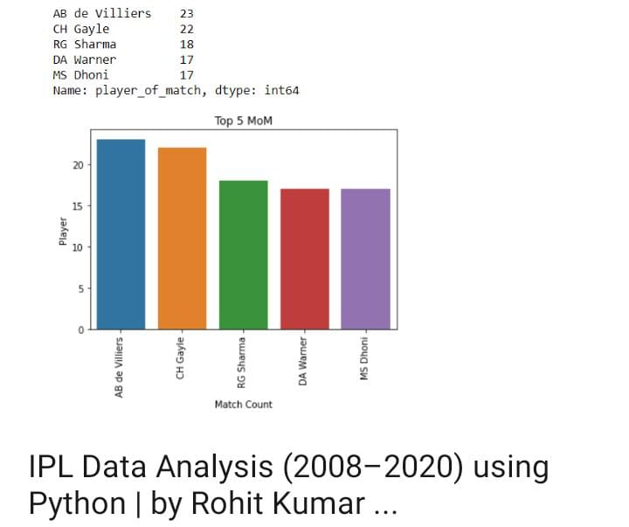
Result:

Slide 9
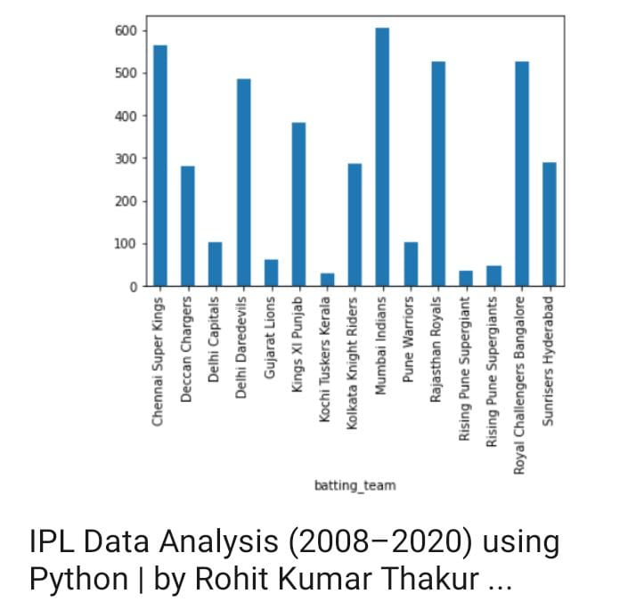
CONT.....

Slide 10
Conclusion:
Summarize key findings from the data analysis.
Present insights using visualizations and tables.
Draw conclusions and recommendations based on the analysis results.
By leveraging Pandas for data analysis, you can efficiently explore, clean, manipulate, and visualize IPL data to derive meaningful insights and draw informed conclusions about team performance, player statistics, and match outcomes.

Slide 11
Reference :
https://www.kaggle.com.
Jovian.ml.com

Slide 12
THANK YOU ....

