Slide 1








Revolutionizing Sales Performance :: Power BI's Data Driven Insights
This Photo by Unknown author is licensed under CC BY-ND.

Slide 2
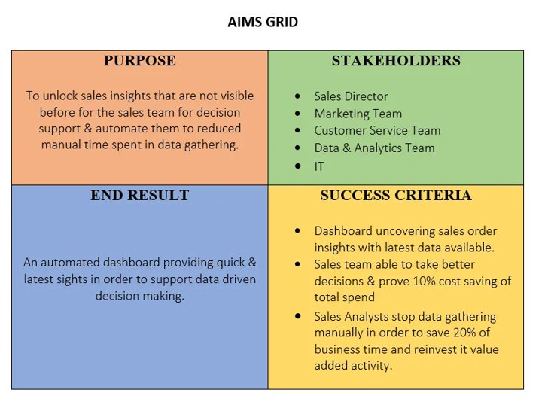

Slide 3
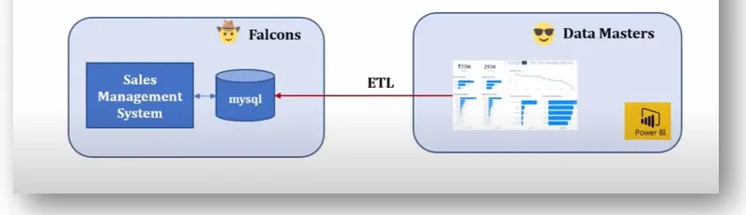

Slide 4
Tech. Stack
SpreadSheet/Excel
MySQL
PowerBI
Python(Twilio)

Slide 5

Used MySQL for retrieving the data from the database into Power BI.
Data Cleaning in power query.
Performed ETL process (Extract Transform and Load)
Created measure for needs and used them for creating visuals in PowerBi.

Slide 6
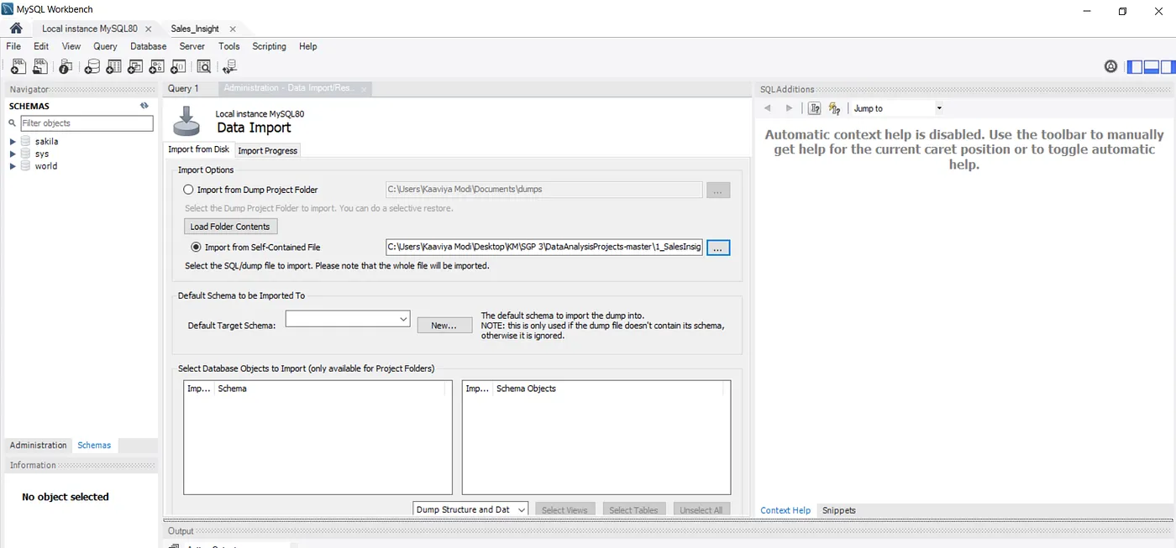
Data Analysis using MySQL

Slide 7

Transforming data with the help of Power Query

Slide 8

Here are some examples of how Power Query can be used to transform data:
Cleaning data. You can use Power Query to remove errors, duplicate values, and empty rows from data.
Filtering data. You can use Power Query to filter data based on criteria such as date, value, or text.
Reshaping data. You can use Power Query to change the structure of data, such as by pivoting or unpivoting data.

Slide 9

Building Dashboard or Reports

Slide 10

Twilio is a cloud communications platform that enables developers to build and run communications applications. It provides a set of APIs and SDKs that allow developers to integrate voice, video, and messaging into their applications.

Slide 11
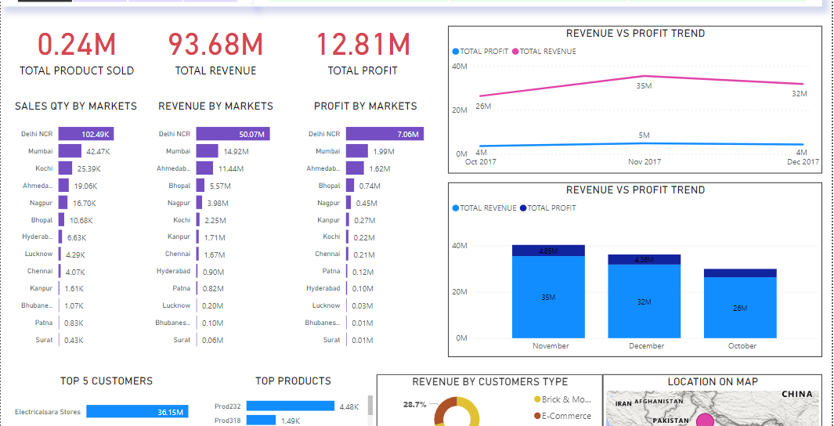

Slide 12
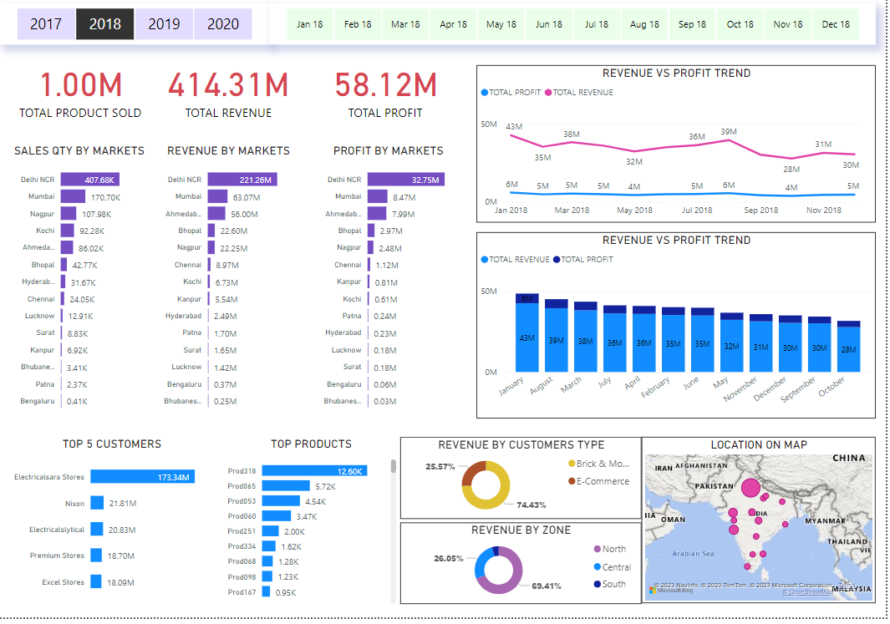

Slide 13

Scan This You will get Insights

Slide 14
TEAM MEMBERS
Dr. Mani Singh as Supervisor
Dharmbir as Project Lead
Abhinav Anand
Ayush

