Slide 1
Capstone Project: DemoBlaze Automation
Name - Dharmender
Email – dharmendernehra191919@gmail.com
Superset id : 5318691

Slide 2
Project Overview
Objective
Automate testing workflow for Demoblaze website.
Ensure end-to-end functionality from user signup to order confirmation.
Scope of Automation
Authentication: Signup & Login
Shopping Flow: Product Selection & Cart Management
Checkout: Payment & Order Confirmation

Slide 3
What we developed
Place Order (Financial Transaction)
Automation test suite for DemoBlaze (E-commerce website) covering:
Signup & Login
Product Browsing
Add to Cart
Place Order (Financial Transaction)
Transaction Verification

Slide 4
Tools & Technologies Used
Java
Selenium WebDriver
Maven
TestNG
Git/GitHub (Version Control)
Jenkins (CI/CD)
Jira +Zephyr (Agile Project & Test Management)

Slide 5
Tools used for Test Framework
Page Object Model (POM)
Data Driven Testing
TestNG Assertions & Reporting
Jenkins Pipeline Execution
Zephyr Test Case Management

Slide 6
Approach We Used
Agile – Scrum methodology
Work divided into Epics → Stories → Tasks
Managed sprints in Jira Agile Board
Continuous Integration with Jenkins

Slide 7
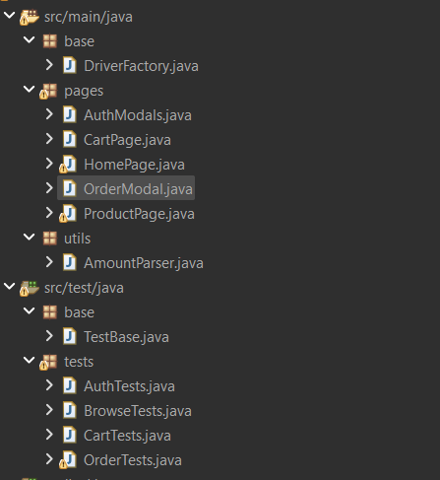
Architecture of the Application

Slide 8
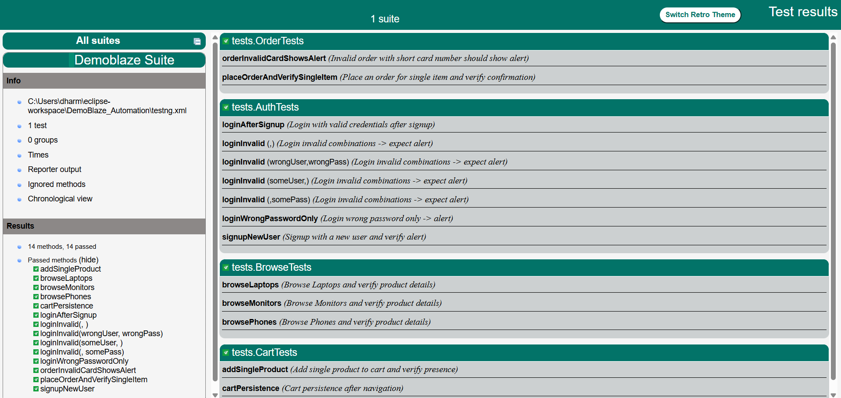
Test Report

Slide 9
Sprint Deliverables
Sprint 1: Project setup, DriverFactory, TestBase, GitHub + Jenkins setup
Sprint 2: Authentication automation (Signup/Login)
Sprint 3: Product browsing automation (Phones/Laptops/Monitors)
Sprint 4: Cart automation (Add items, validate cart)
Sprint 5: Place Order + Financial Transaction flow
Sprint 6: Transaction verification + Reporting + Zephyr integration

Slide 10
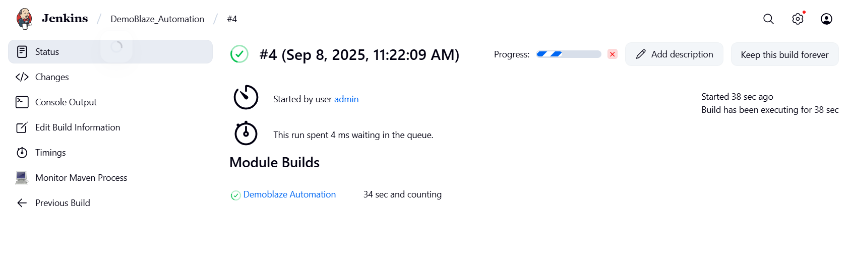
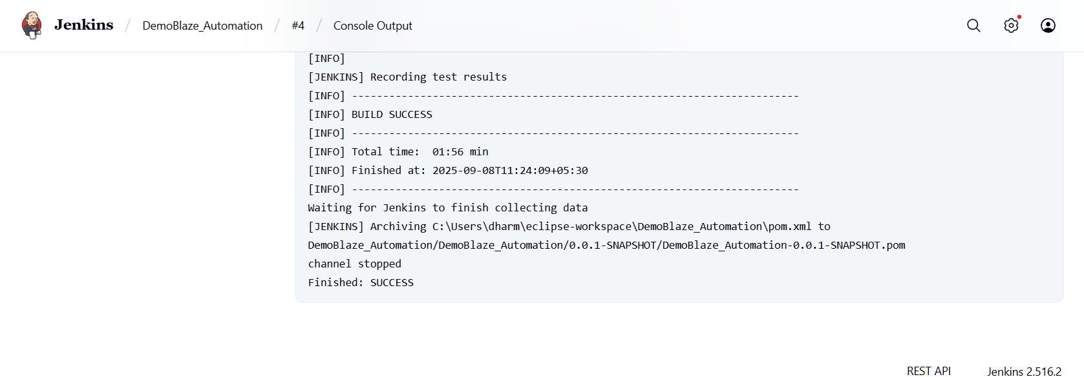
Jenkins Snapshot: Build & Test Results

Slide 11
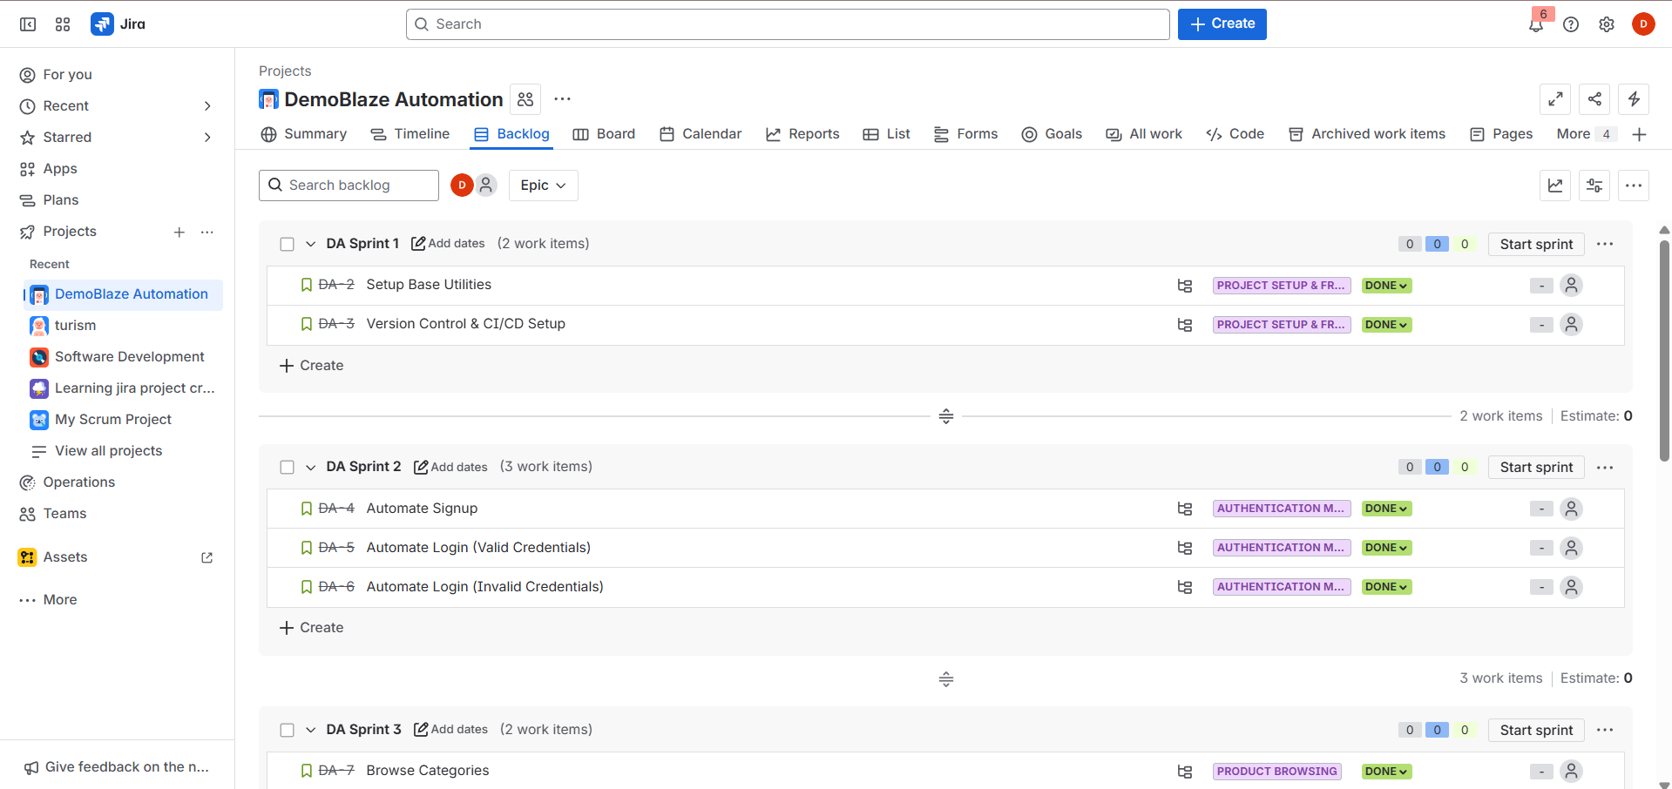
Jira Snapshot of the Sprint belongs to the App Development

Slide 12
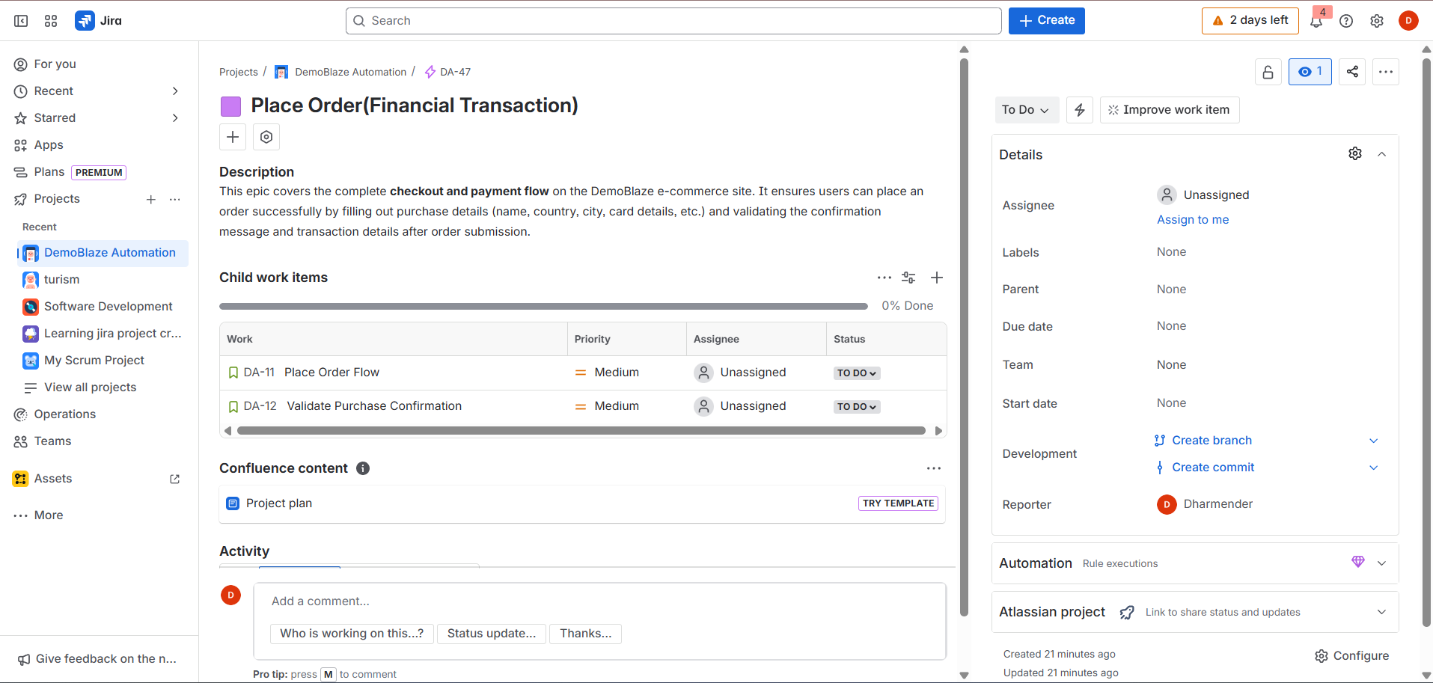

Slide 13
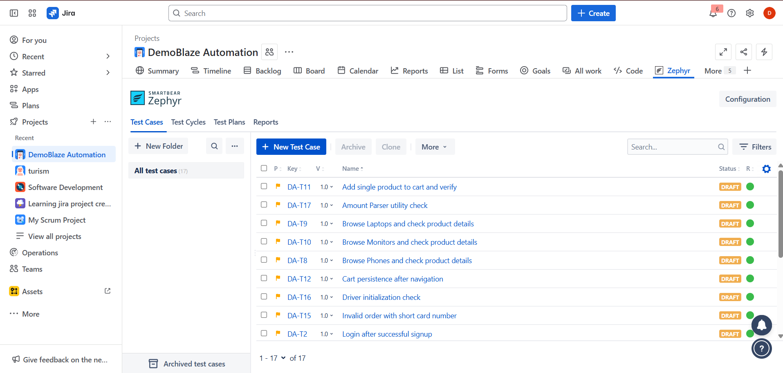
Zephyr Snapshot of Test Management for the Sprint

Slide 14
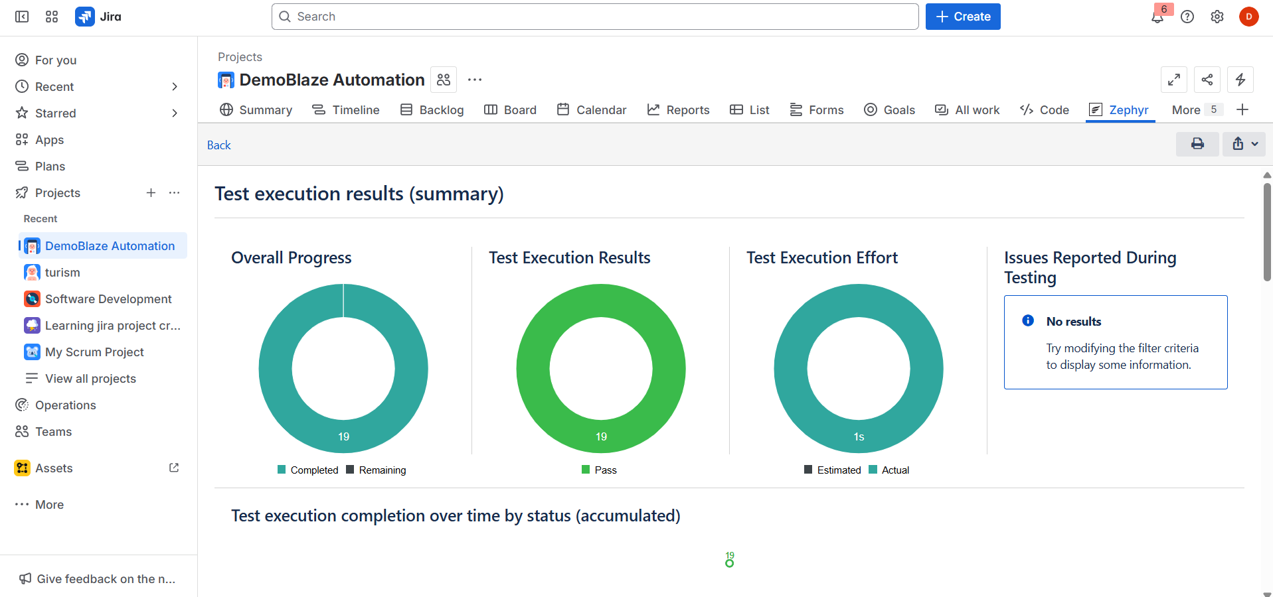

Slide 15
CONCLUSION
Successfully automated the DemoBlaze E-commerce website.
Improved efficiency, reliability, and reusability of test cases.
Framework is ready for integration into CI/CD pipelines.
Gained hands-on experience with Selenium, TestNG, Jenkins, Jira, and Zephyr.
Strengthened understanding of Agile methodology and real-world automation practices.
REFERENCES & LINKS:
GITHUB : https://github.com/Dharmender999/DemoBlaze-Automation.git
WEBSITE : https://www.demoblaze.com/

Slide 16
THANK YOU…

