Slide 1

Junit4 Annotations

Slide 2
Annotations in Junit4
@BeforeClass
@AfterClass
@Before
@After
@Test
@Ignore
@Deprecated
@FixMethodOrder
@Rule and @ClassRule
@Category
@RunWith(Parameterized.class) @Parameterized.Parameters

Slide 3
Dependency
<dependency> <groupId>junit</groupId> <artifactId>junit</artifactId> <version>4.13.1</version> <scope>test</scope> </dependency>

Slide 4
Annotations
@Test : public void method, annotated by this annotation is run as test case.
@Ignore: It is used to temporary disable a test or group of tests to be executed. If a class is annotated by @Ignore then all test methods of this class will be ignored.

Slide 5

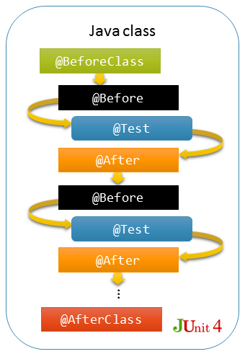
Junit4 LifeCycle

Slide 6
Annotations
@FixMethodOrder : This annotations allow the user to choose the order of execution of the methods within a test class.
@Rule & @ClassRule : The annotation is extended from the class TestRule that helps apply certain rules on the test cases. Ex:- creating a temporary folder prior to test case execution and deleting the folder post-execution can be set through a Rule.
@Category : This annotation helps for tagging and filtering the tests

Slide 7
@Runwith(Parameterized.class) & @Parameterized.Parameters
This annotation is used to run a method with test data variations multiple times. allows a developer to run the same test over and over again using different values. Follow 5 steps :-
Annotate test class with @RunWith(Parameterized.class).
Create a public static method annotated with @Parameters that returns a Collection of Objects (as Array) as test data set.
Create a public constructor that takes in what is equivalent to one "row" of test data.
Create an instance variable for each "column" of test data.
Create your test case(s) using the instance variables as the source of the test data.

Slide 8


