Slide 1


Slide 2
 | SQL Databases | NoSQL Databases
Data Storage Model | Tables with fixed rows and columns | Document: JSON documents, Key-value: key-value pairs, Wide-column: tables with rows and dynamic columns, Graph: nodes and edges
Development History | Developed in the 1970s with a focus on reducing data duplication | Developed in the late 2000s with a focus on scaling and allowing for rapid application change driven by agile and DevOps practices.
Examples | Oracle, MySQL, Microsoft SQL Server, and PostgreSQL | Document: MongoDB and CouchDB, Key-value: Redis and DynamoDB, Wide-column: Cassandra and HBase, Graph: Neo4j and Amazon Neptune
Primary Purpose | General purpose | Document: general purpose, Key-value: large amounts of data with simple lookup queries, Wide-column: large amounts of data with predictable query patterns, Graph: analyzing and traversing relationships between connected data
Schemas | Rigid | Flexible
Scaling | Vertical (scale-up with a larger server) | Horizontal (scale-out across commodity servers)
Multi-Record ACID Transactions | Supported | Most do not support multi-record ACID transactions. However, some—like MongoDB—do.
Joins | Typically required | Typically not required
Data to Object Mapping | Requires ORM (object-relational mapping) | Many do not require ORMs. MongoDB documents map directly to data structures in most popular programming languages.

Slide 3
Types of NoSQL Databases
Document databases
Key-value stores
Column-oriented databases
Graph databases

Slide 4

Benefits of NoSQL Databases -
Flexible data models
Horizontal scaling
Fast queries
Easy for developers
Modern application paradigms like microservices and real-time streaming
Storage of structured and semi-structured data
Huge volumes of data

Slide 5
In MySQL :-
ID | user_id | hobby
10 | 1 | scrapbooking
11 | 1 | eating waffles
12 | 1 | working
ID | first_name | last_name | cell | city
1 | Leslie | Yepp | 8125552344 | Pawnee
In MongoDB :-
{
"_id": 1,
"first_name": "Leslie",
"last_name": "Yepp",
"cell": "8125552344",
"city": "Pawnee",
"hobbies": ["scrapbooking", "eating waffles", "working"]
}

Slide 6


Slide 7


Slide 8


Slide 9
Find Command
show dbs or show databases
use sample_training
show collections
db.zips.find({"state": "NY"})
db.zips.find({"state": "NY"}).count()
db.zips.find({"state": "NY", "city": "ALBANY"})
db.zips.find({"state": "NY", "city": "ALBANY"}).pretty()
db.inspections.findOne();

Slide 10
Insert
db.inspections.insert({ "test": 1 })
db.inspections.insertOne({ "test": 1 })
db.inspections.insert([ { "test": 1 }, { "test": 2 }, { "test": 3 } ])
db.inspections.insertMany([ { "test": 1 }, { "test": 2 }, { "test": 3 } ])
db.inspections.insert([{ "_id": 1, "test": 1 },{ "_id": 1, "test": 2 }, { "_id": 3, "test": 3 }])
db.inspections.insert([{ "_id": 1, "test": 1 },{ "_id": 1, "test": 2 }, { "_id": 3, "test": 3 }],{ "ordered": false })
db.inspection.insert([{ "_id": 1, "test": 1 },{ "_id": 3, "test": 3 }])
use new_db_name

Slide 11
Update
db.zips.updateMany({ "city": "HUDSON" }, { "$inc": { "pop": 10 } })
db.zips.updateOne({ "zip": "12534" }, { "$set": { "pop": 17630 } })
db.zips.updateOne({ "zip": "12534" }, { "$set": { "population": 17630 } })
db.grades.updateOne({ "student_id": 250, "class_id": 339 }, { "$push": { "scores": { "type": "extra credit", "score": 100 } } })
To learn more about all available update operators in MQL, visit our excellent documentation page

Slide 12
Delete
db.inspection.drop()
db.inspections.deleteOne({ "test": 3 })
db.inspections.deleteMany({ "test": 1 })

Slide 13
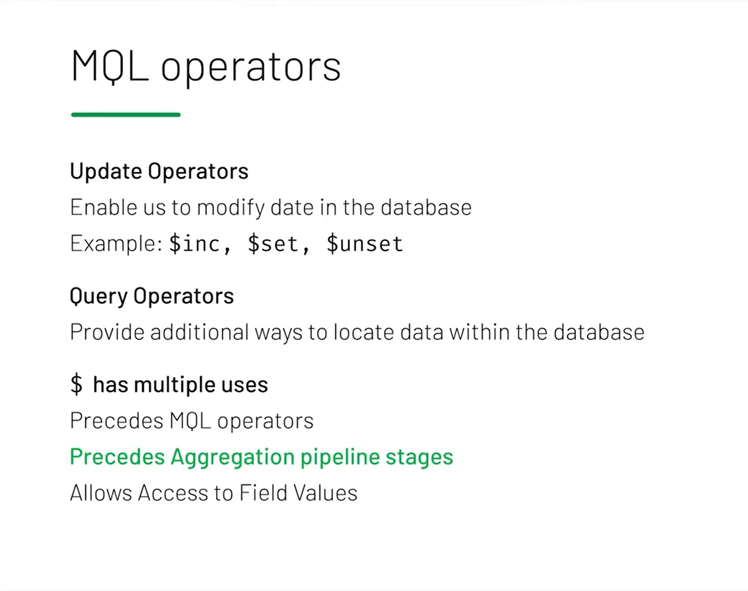

Slide 14
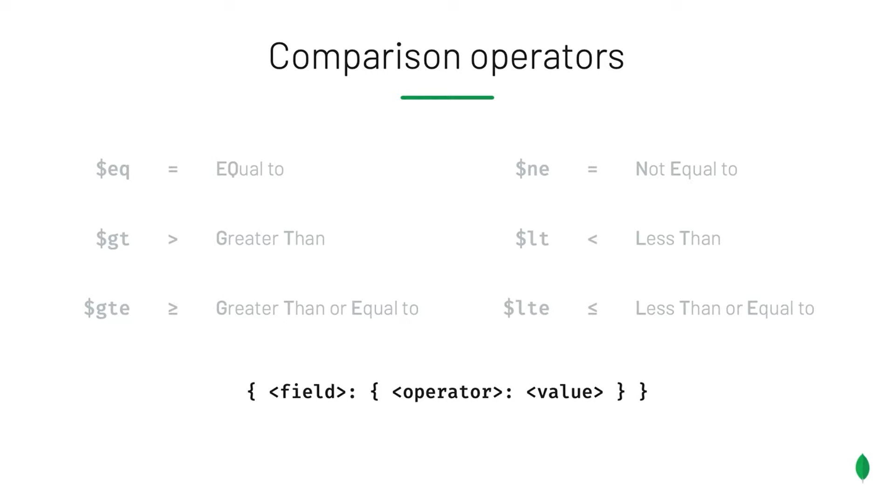

Slide 15

db.trips.find({ "tripduration": { "$lte" : 70 }, "usertype": { "$ne": "Subscriber" } }).pretty()
db.trips.find({ "tripduration": { "$lte" : 70 }, "usertype": { "$eq": "Customer" }}).pretty()
db.trips.find({ "tripduration": { "$lte" : 70 }, "usertype": "Customer" }).pretty()
db.routes.find({ "$and": [ { "$or" :[ { "dst_airport": "KZN" }, { "src_airport": "KZN" } ] }, { "$or" :[ { "airplane": "CR2" }, { "airplane": "A81" } ] } ]}).pretty()
db.trips.find({ "$expr": { "$eq": [ "$end station id", "$start station id"] } }).count()
db.trips.find({ "$expr": { "$and": [ { "$gt": [ "$tripduration", 1200 ]}, { "$eq": [ "$end station id", "$start station id" ]} ]}}).count()

Slide 16
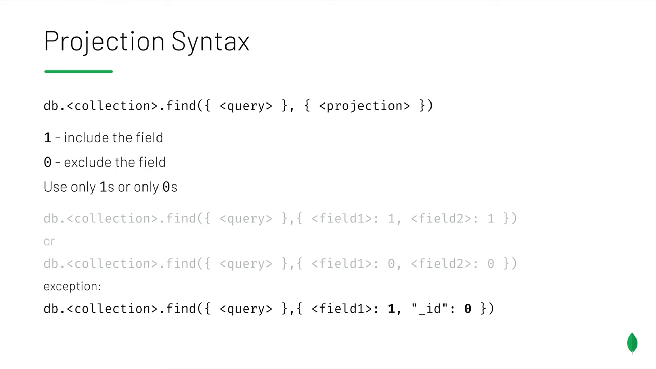

Slide 17
db.grades.find({ "class_id": 431 }, { "scores": { "$elemMatch": { "score": { "$gt": 85 } } } }).pretty()
db.grades.find({ "scores": { "$elemMatch": { "type": "extra credit" } } }).pretty()

Slide 18
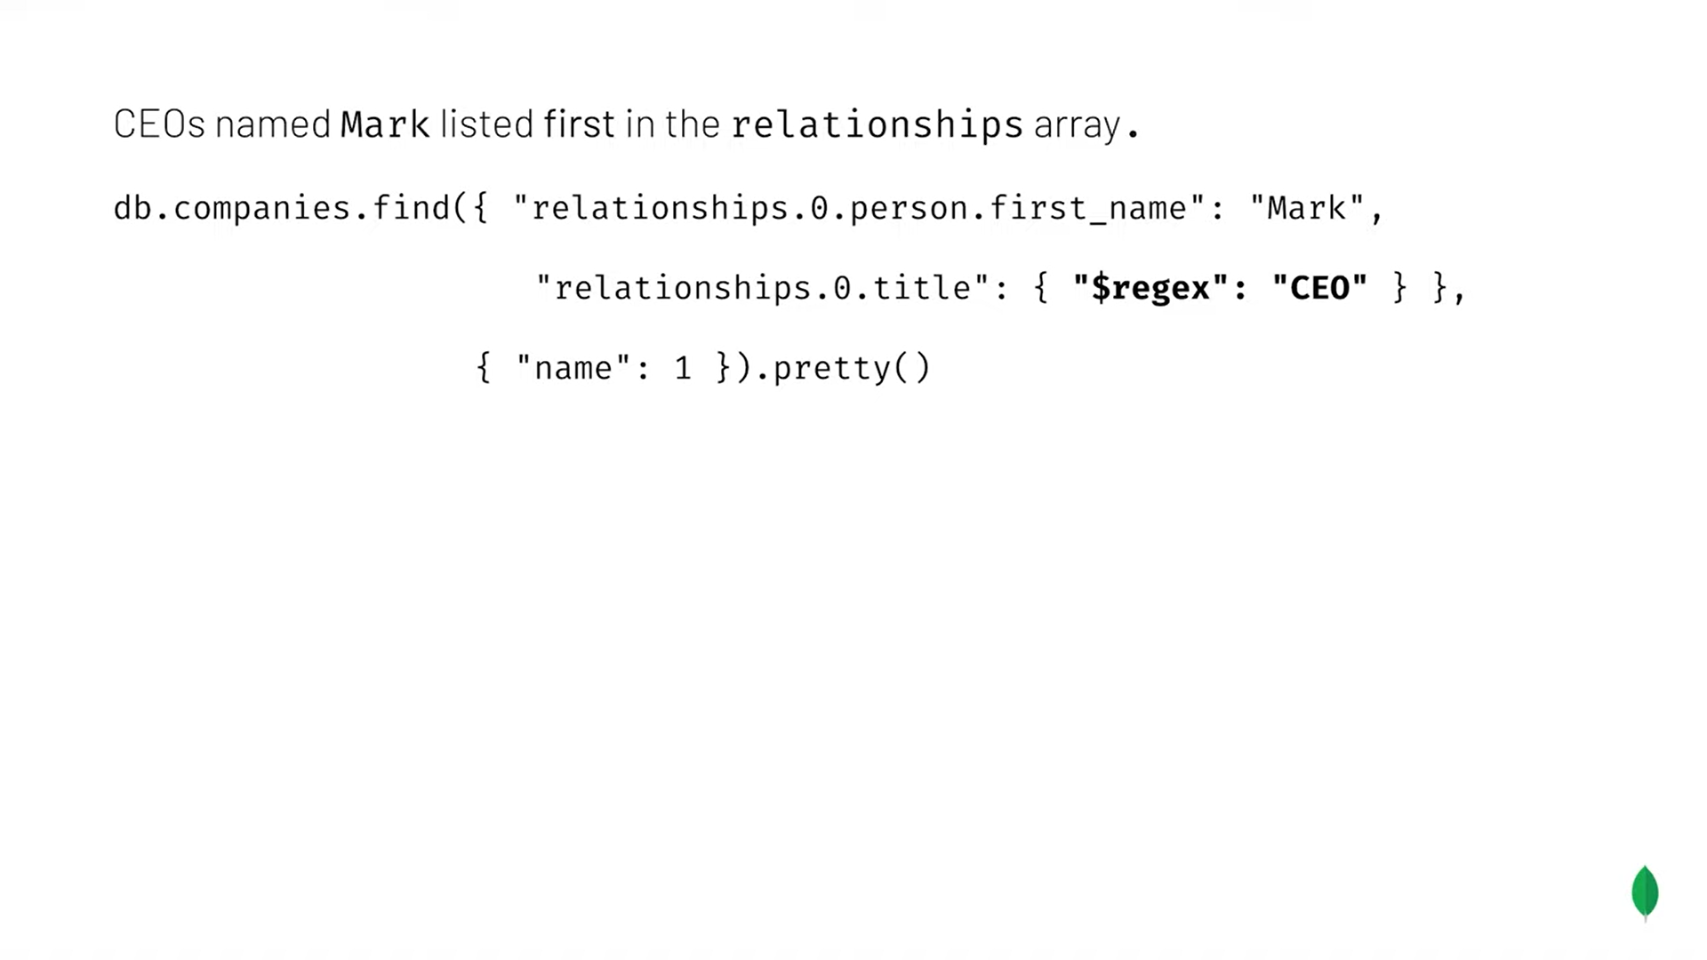
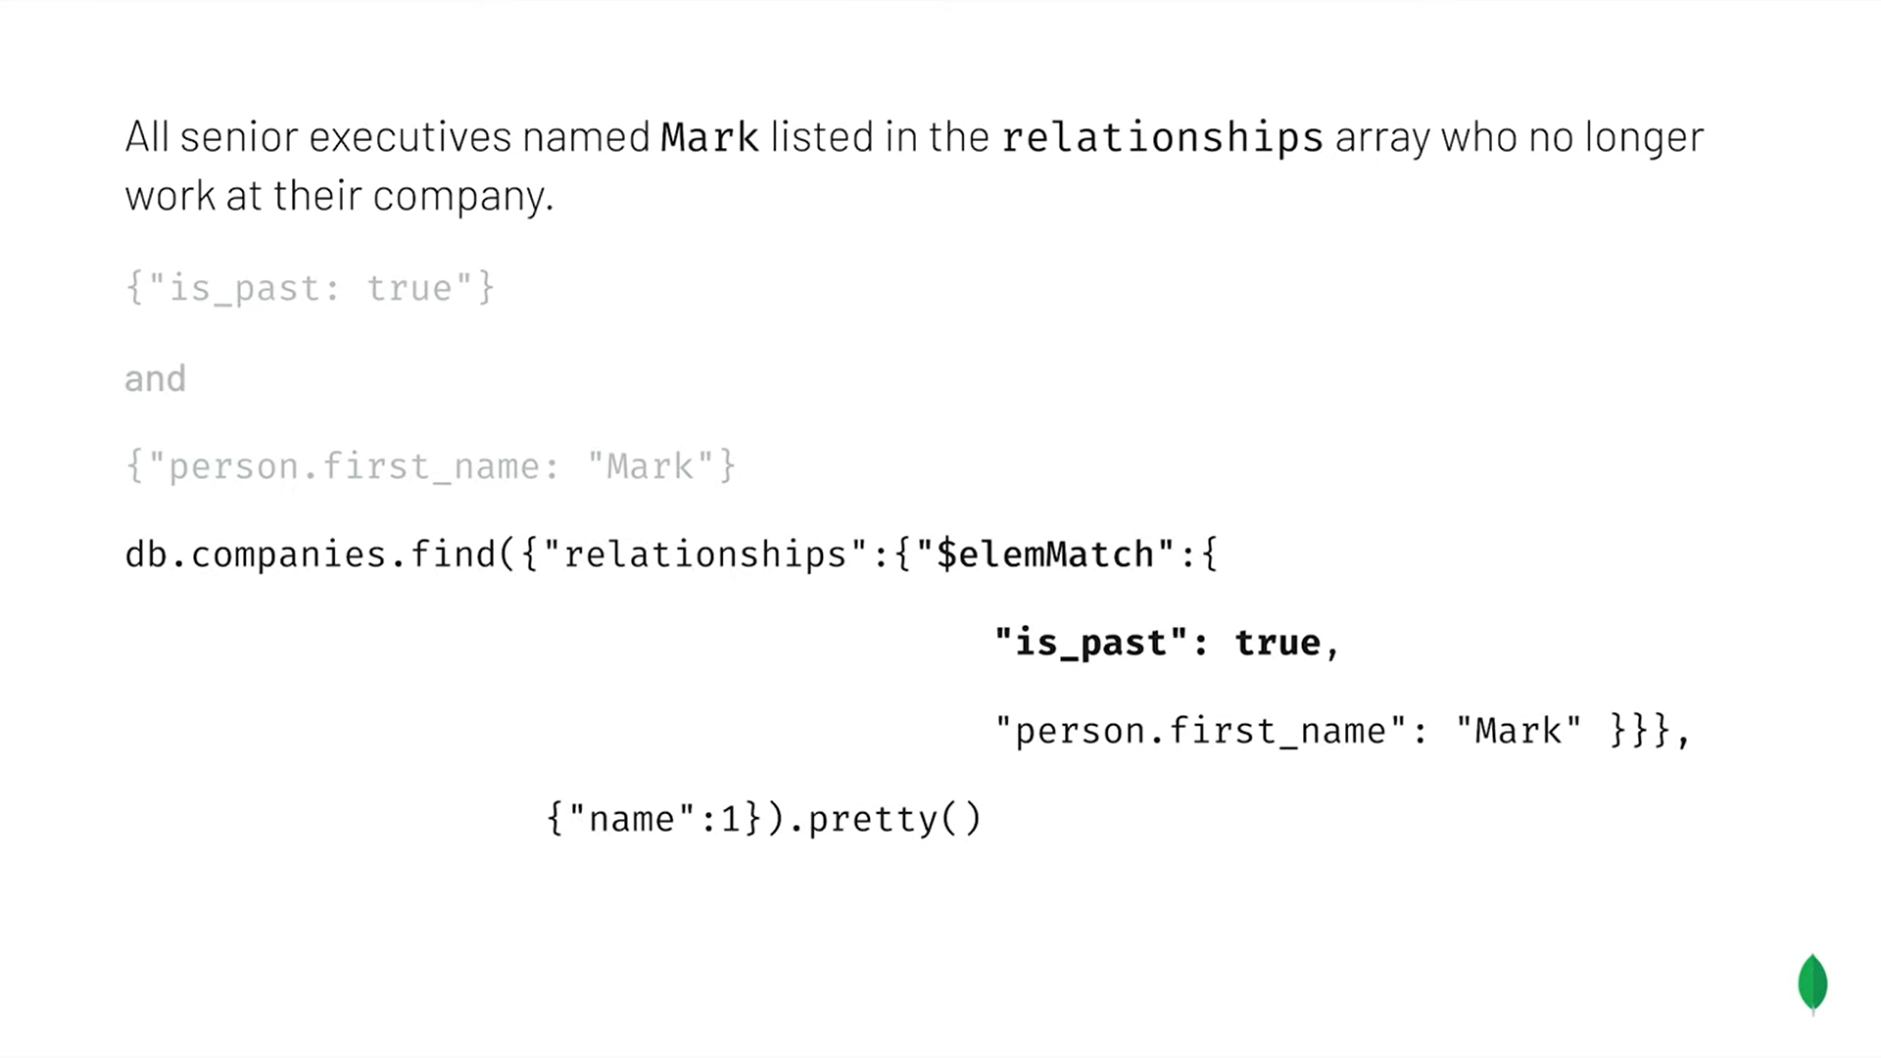

Slide 19
Aggregate Framework
db.listingsAndReviews.find({ "amenities": "Wifi" }, { "price": 1, "address": 1, "_id": 0 }).pretty()
db.listingsAndReviews.aggregate([ { "$match": { "amenities": "Wifi" } }, { "$project": { "price": 1, "address": 1, "_id": 0 }}]).pretty()
db.listingsAndReviews.aggregate([ { "$project": { "address": 1, "_id": 0 }}, { "$group": { "_id": "$address.country" }}])
db.listingsAndReviews.aggregate([ { "$project": { "address": 1, "_id": 0 }}, { "$group": { "_id": "$address.country", "count": { "$sum": 1 } } } ])

Slide 20
Sort() and Limit()
db.zips.find().sort({ "pop": 1 }).limit(1)
db.zips.find().sort({ "pop": -1 }).limit(10)
db.zips.find().sort({ "pop": 1, "city": -1 })

Slide 21
Upsert
db.iot.updateOne({ "sensor": r.sensor, "date": r.date, "valcount": { "$lt": 48 } }, { "$push": { "readings": { "v": r.value, "t": r.time } }, "$inc": { "valcount": 1, "total": r.value } }, { "upsert": true })

