Slide 1

Reflection in Java

Slide 2
Reflection in Java
Reflection API in Java provides the ability to examine or modify the runtime behaviour of applications running in the Java virtual machine.
Uses of Reflection
We can inspect a class and get information about the fields, methods, constructors, implemented interfaces, super classes at run time.
We can even access a private field and invoke a private method from another class.
Mainly used in - IDE (Integrated Development Environment) e.g. Eclipse, MyEclipse, NetBeans etc.
Debugger and Test Tools etc.

Slide 3
Disadvantages of using Java Reflection API
Performance Overhead: reflective operations have slower performance than their non-reflective counter parts and should be avoided in sections of code which are called frequently in performance-sensitive applications.
Exposure of Internals: Reflective code breaks abstractions and therefore may change behavior with upgrades of the platform.
Security restrictions

Slide 4
Class in java.Lang.Reflect package :-
Following is a list of various Java classes in java.lang.package to implement reflection-
Field: This class is used to gather declarative information such as datatype, access modifier, name and value of a variable.
Method: This class is used to gather declarative information such as access modifier, return type, name, parameter types and exception type of a method.
Constructor: This class is used to gather declarative information such as access modifier, name and parameter types of a constructor.
Modifier: This class is used to gather information about a particular access modifier.

Slide 5
How to get the object of class Class :-
There are 3 ways to get the instance of Class class. They are as follows:
forName() method of Class class
getClass() method of Object class
the .class syntax

Slide 6
Method | Description
1) public String getName() | returns the class name
2) public static Class forName(String className)throws ClassNotFoundException | loads the class and returns the reference of Class class.
3) public Object newInstance()throws InstantiationException,IllegalAccessException | creates new instance.
4) public boolean isInterface() | checks if it is interface.
5) public boolean isArray() | checks if it is array.
6) public boolean isPrimitive() | checks if it is primitive.
7) public Class getSuperclass() | returns the superclass class reference.
8) public Field[] getDeclaredFields()throws SecurityException | returns the total number of fields of this class.
9) public Method[] getDeclaredMethods()throws SecurityException | returns the total number of methods of this class.
10) public Constructor[] getDeclaredConstructors()throws SecurityException | returns the total number of constructors of this class.
11) public Method getDeclaredMethod(String name,Class[] parameterTypes)throws NoSuchMethodException,SecurityException | returns the method class instance.

Slide 7


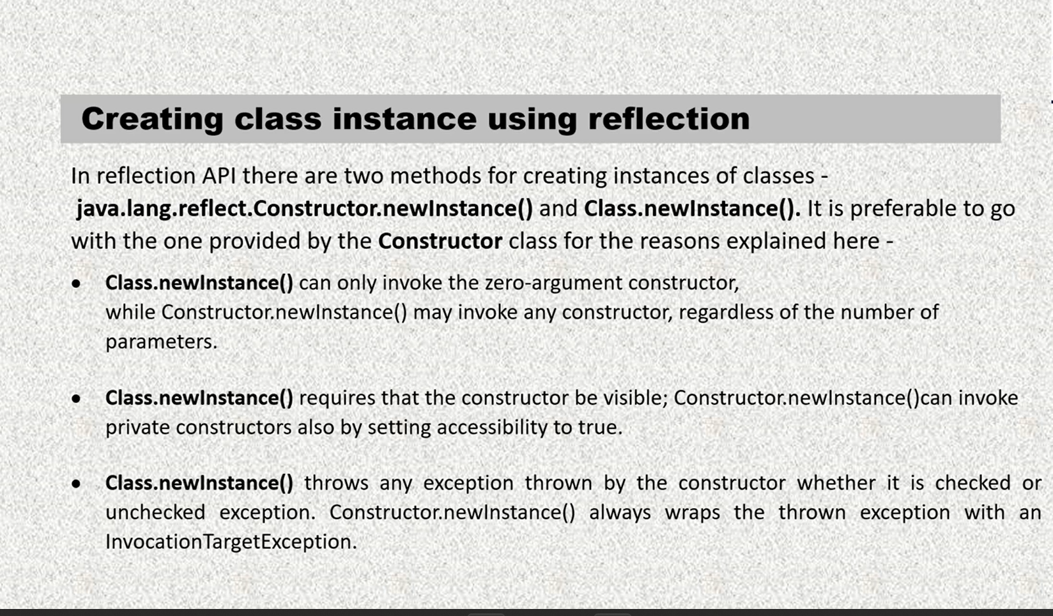

Slide 8


