Slide 1
Ph process simulator and feedback controller
water
CH23B008
Dharmesh S

Slide 2







Main equations

Slide 3
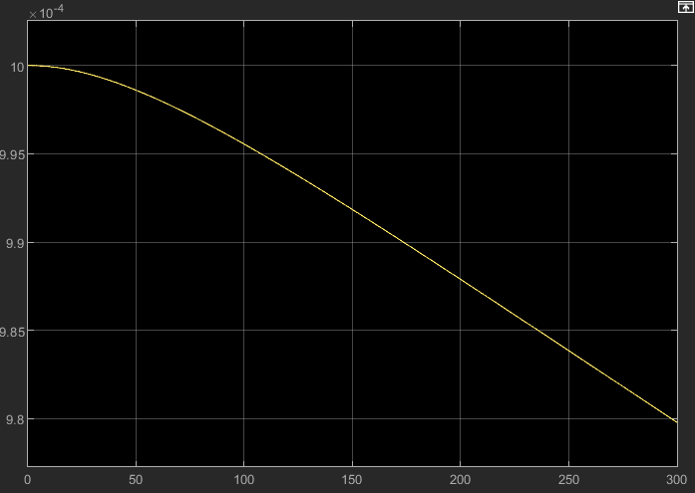
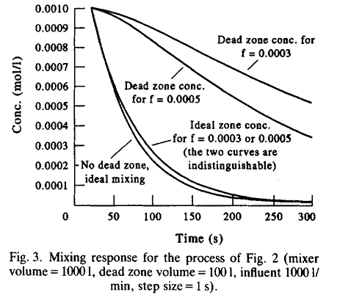
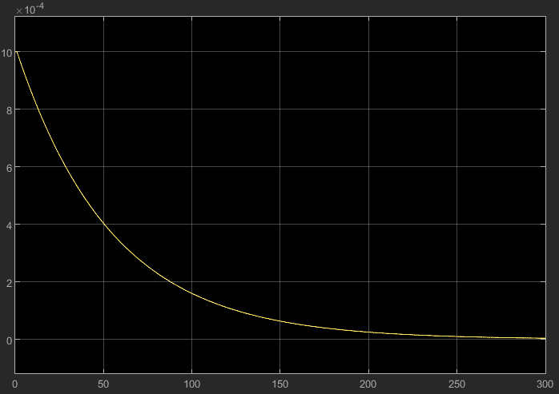
Dead zone conc
Comparing mixing response
ideal zone conc

Slide 4
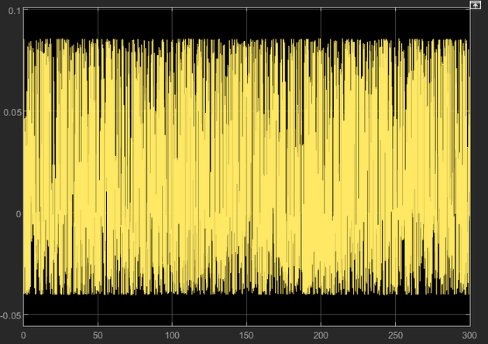
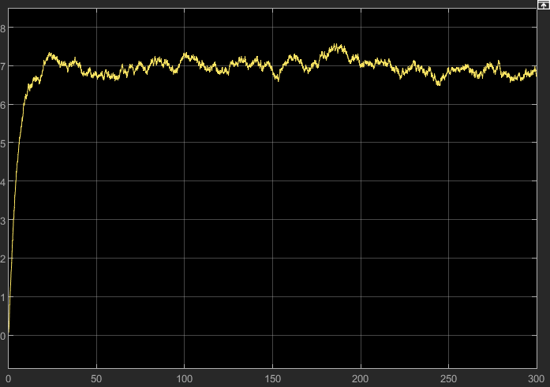
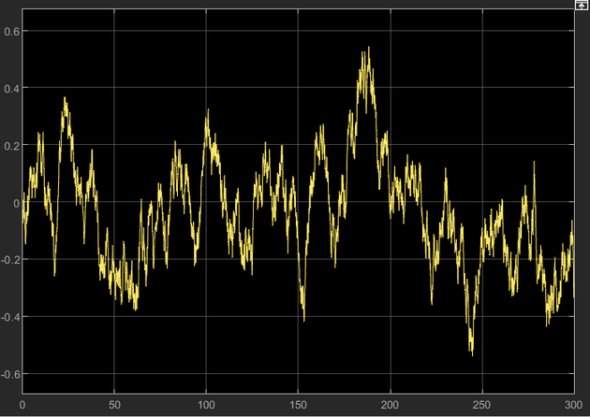
simulating errors
noise
pH vs time graph
drift

Slide 5
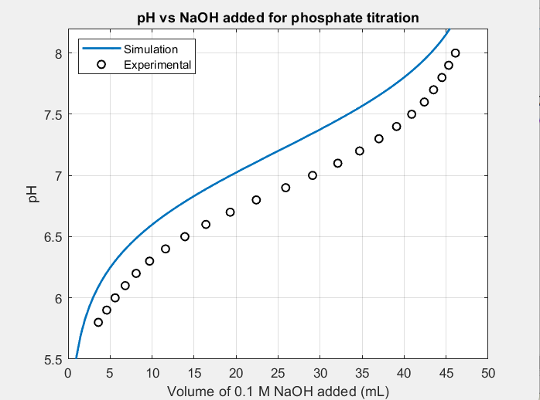
comparing simulation and experimental data

Slide 6
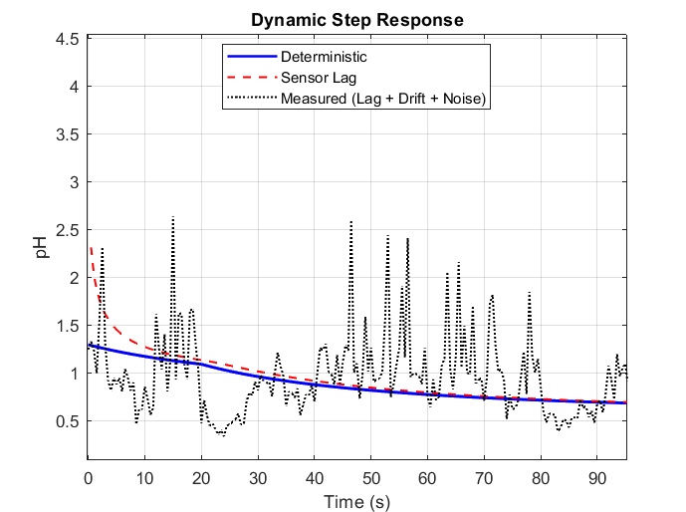
DYnamic step response simulated

Slide 7
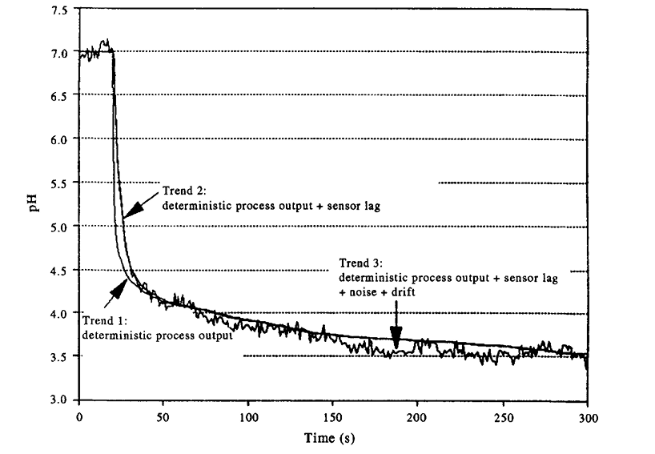
DYnamic step response Given

Slide 8
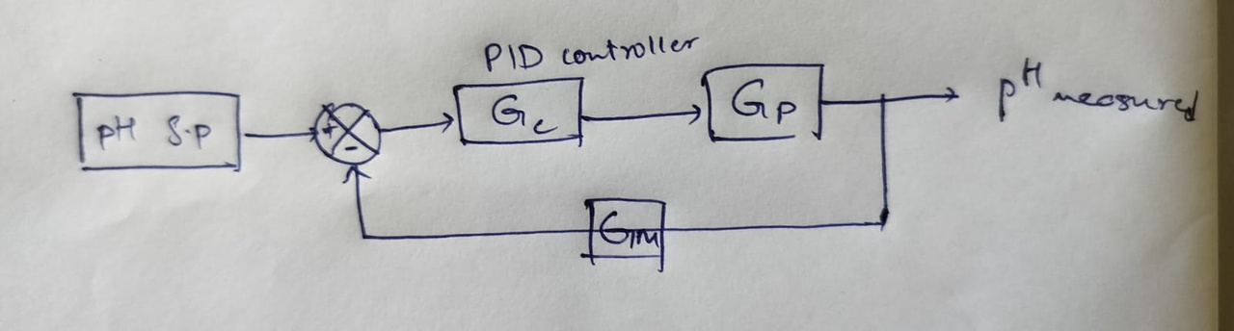
Approach for controller design
  we will use a pid controller
  ph will be process variable
  flowrate of influent is control variable

Slide 9
Thank you

