Slide 1
Soft-Sensor Development for Ethanol Distillation Column
Exploratory data analysis
Dharmesh S

Slide 2
Step 1
  Dataset size: 4408 samples × 21 variables
  Target variable:
    Ethanol concentration (distillate purity)
  Input variables:
    Tray temperatures: T1–T14
    Flow variables: L, V, D, B, F
    Pressure (constant)
  Observations:
    Pressure ≈ 1.01 bar (constant)
    Constant variables introduce bias
    Pressure removed from analysis
  Data type issues:
    L and V initially read as non-numeric
    Converted to numeric (float/int)

Slide 3
Step 2
  Ethanol concentration:
    Range: 0.54 – 0.89
    Mean ≈ 0.79
    Majority of operation near high purity
  Flow variables (L, V):
    Mean ≫ Median
    Large range
    Right-skewed distribution
  Inference:
    Raw L and V values are not ideal
    Ratio-based features are likely more meaningful
  Observation from variance trends:
    Variance changes systematically along tray number
    Middle trays (≈ T6–T10):
      Higher variance
      Greater sensitivity to composition changes
  Interpretation:
    Expected physical behavior:
    Middle trays respond strongly to separation changes
    Top & bottom trays more constrained

Slide 4
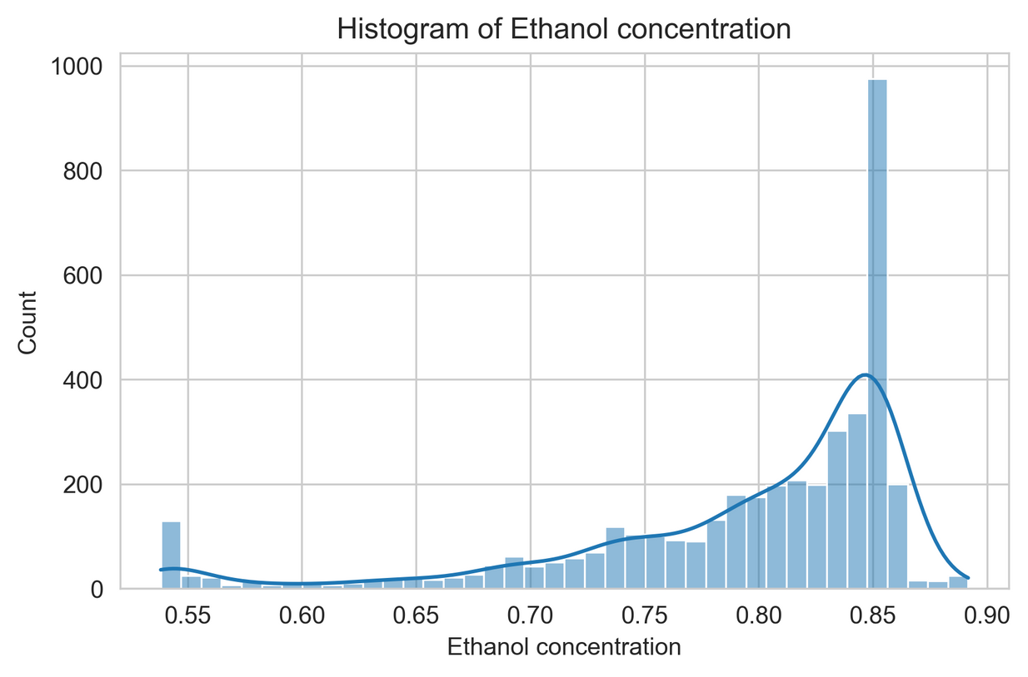
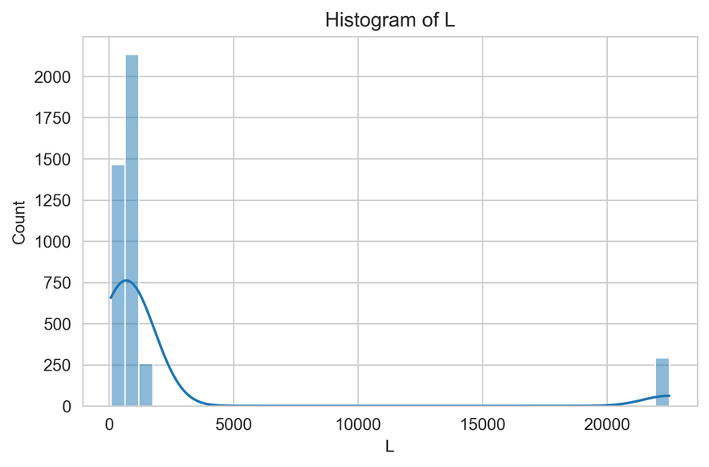
Step 3
  Ethanol concentration:
    Most data in 0.80–0.85
    Many apparent outliers
  Important insight:
    Outliers are process events, not bad data
    Removing them would remove valuable information
  Flow variables (L, V):
    Highly skewed
    Wide spread
  Conclusion:
    Better to use ratios than raw values

Slide 5
Step 4
  Ethanol concentration depends mainly on tray temperatures
  MI decreases from T1 → T14
  Correlation signs:
    Pearson & Spearman mostly negative
    As ethanol concentration ↑ → temperature ↓
  Explanation:
    From VLE:
      Higher ethanol → lower boiling point
      Hence, lower tray temperatures, high yield
  Flow variables:
    Affect ethanol concentration indirectly
    Influence temperature profile first

Slide 6
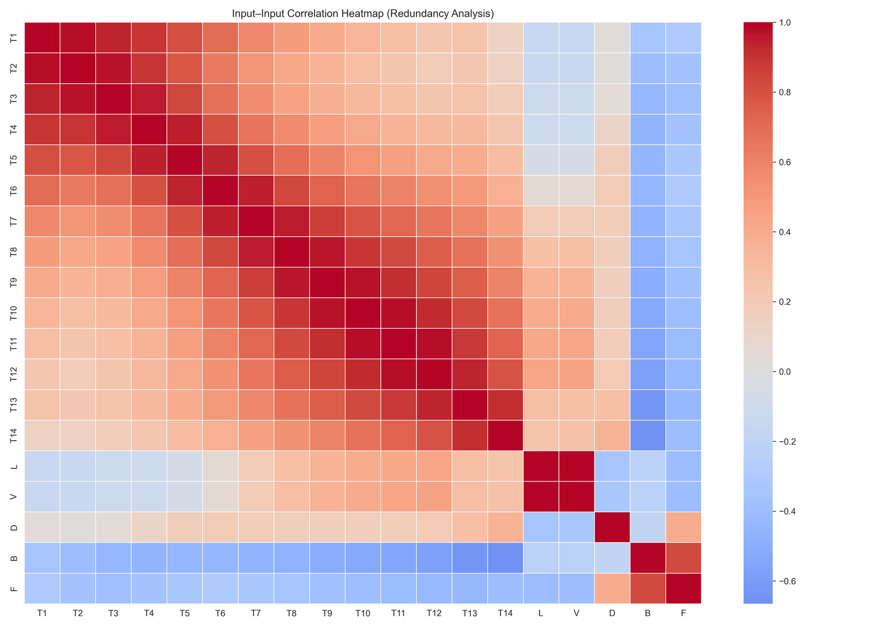
Step 5
  Key observations:
    Strong correlation between adjacent tray temperatures
    Clear axial structure along column
    L and V are almost perfectly correlated
  Inference:
    Using all trays is redundant
    Using both L and V is unnecessary
  Observed relationships:
    L ↔ V strongly correlated
    F, D, B related through mass balance

Slide 7
Step 6
  Tray compression
    T1–T3 → T2
    T4–T6 → T5
    T7–T9 → T8
    T10–T12 → T11
    T13–T14 → T14
  Reason:
    Preserve axial information
    Remove redundancy
  Temperature difference features:
    ΔT(T2 − T14)
    ΔT(T2 − T8)
    ΔT(T8 − T14)
  Meaning:
    Surrogates for composition gradients
    Capture separation driving behavior
  Ratios used:
    L/D → reflux intensity proxy
    V/F → vapor loading
    D/F → distillate recovery
  Important note:
    L/D is not true reflux ratio
    Used as a physically meaningful proxy

Slide 8
Step 7
  Results:
    ΔT features:
      High Mutual Information
      Pearson & Spearman ≈ 0
  Interpretation:
    Relationship is:
      Nonlinear
      Non-monotonic
      Regime-dependent
  Conclusion:
    Linear models are insufficient
    Nonlinear models justified

Slide 9
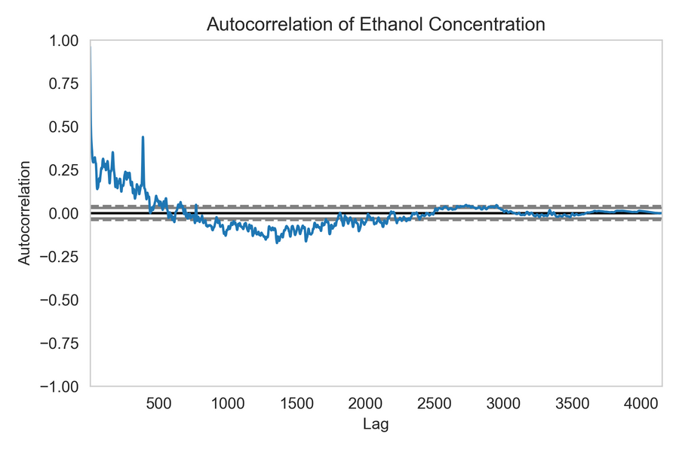
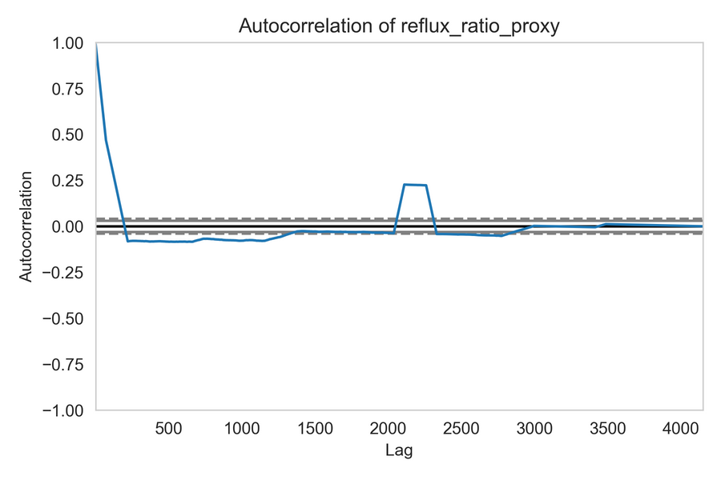
Step 8
  Observations:
    Ethanol concentration changes slowly
    Long steady regions and gradual transitions
  Autocorrelation results:
    Ethanol concentration → long memory
    Reflux proxy → short memory
  Physical explanation:
    Ethanol concentration affected by:
      Tray holdup
      Mass transfer delay
  Control variables:
    Act quickly
    Influence output with delay
  Conclusion:
    Lag features are physically justified

Slide 10
Conclusion
  EDA established that:
    System is nonlinear
    Inputs are highly redundant
    Engineered features outperform raw variables
    Process exhibits strong dynamics
  Modelling implications:
    Dynamic nonlinear soft sensor required
    Lag features are necessary
    GA-based feature selection justified
  Next steps :
    Lag feature construction
    Feature scaling
    GA-based model development

Slide 11
Thank you

