Slide 1
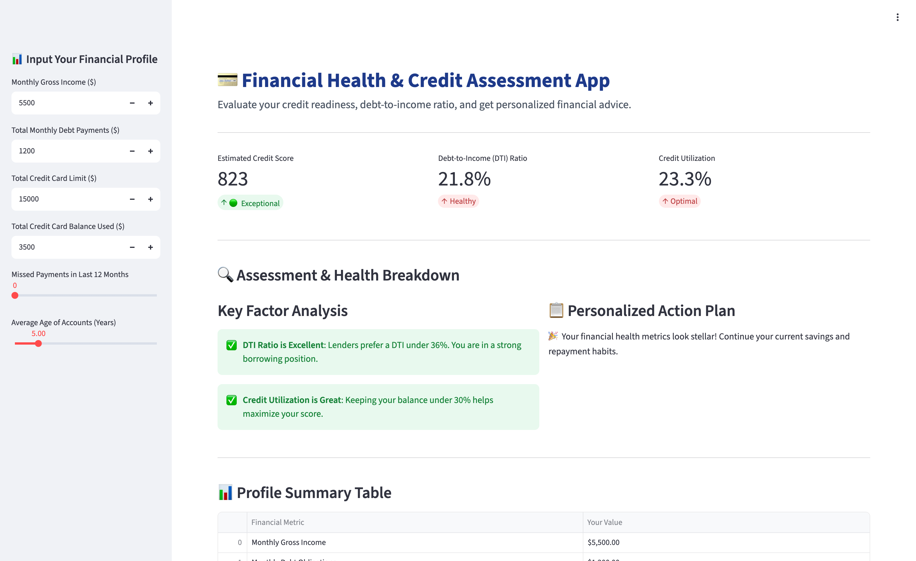
ICAI AI LEVEL 2 • CAPSTONE PROJECT
Financial Health &
Credit Assessment
A Streamlit decision-support app that turns six inputs into an estimated credit score, a debt-to-income check, a credit-utilisation check and a personalised action plan.
Presented by CA Asmita Shreeram Hirlekar
Membership No. 190982 • caasmitahirlekar@gmail.com
Branch Pune Batch 100
The app with the default profile
Notes:
Good day. I am CA Asmita Shreeram Hirlekar from the Pune branch, Batch 100 of the ICAI AI Level 2 programme. My capstone project is a Financial Health and Credit Assessment application, built in Python with Streamlit. It takes six inputs about a borrower and instantly returns an estimated credit score, a debt-to-income check, a credit-utilisation check and a personalised action plan.

Slide 2
Project at a Glance
1
PARTICIPANT
2
PROGRAMME
3
BRANCH • BATCH
CA Asmita Shreeram Hirlekar
Membership No. 190982
caasmitahirlekar@gmail.com
ICAI AI Level 2 Certification
Capstone project, Module C
Pune • Batch 100
4
APPLICATION
5
BUILT WITH
6
TYPE OF USE CASE
Financial Health & Credit Assessment
One-screen Streamlit web app
Python 3 • Streamlit
pandas • NumPy
Personal-finance decision support
Deterministic rules, no black box
Financial Health & Credit Assessment | CA Asmita Shreeram Hirlekar | ICAI AI Level 2 | Pune | Batch 100
2
Notes:
A quick summary. Participant: CA Asmita Hirlekar, membership number 190982. Programme: ICAI AI Level 2 Certification. Branch Pune, Batch 100. The application is a Financial Health and Credit Assessment app, built in Python with Streamlit, pandas and NumPy. It is a personal-finance decision-support use case, and everything in it is deterministic: the same inputs always give the same answer.

Slide 3
The Problem
Before a loan is applied for, nobody can answer a simple question: is this borrower credit-ready?
?
Opaque
⌛
Manual
≈
Generic
Borrowers do not know which of their habits is pulling the score down: the balance they carry, the payments they missed, or how young their accounts are.
As a practitioner, checking a client's debt-to-income ratio and credit utilisation means a calculator, a spreadsheet and the same explanation repeated for every client.
Online advice is one-size-fits-all. It does not say what this person should pay down, by how much, to reach a healthy position.
The result: the borrower discovers the problem only when a lender says no. The goal of this project is to move that discovery earlier, to a two-minute self-check with specific, numeric advice.
Financial Health & Credit Assessment | CA Asmita Shreeram Hirlekar | ICAI AI Level 2 | Pune | Batch 100
3
Notes:
Here is the problem I set out to solve. Before a loan is applied for, nobody can answer a simple question: is this borrower credit-ready? Three things make this hard. First, it is opaque: borrowers do not know which habit is pulling their score down. Second, it is manual: as a practitioner, checking a client's debt-to-income ratio and utilisation means a calculator, a spreadsheet and the same explanation every time. Third, the advice available online is generic. The result is that the borrower discovers the problem only when a lender says no. The goal of this project is to move that discovery earlier, to a two-minute self-check with specific, numeric advice.

Slide 4
The Solution: One Screen, Five Steps
Six inputs on the left; score, checks, advice and a summary on the right, recomputed the instant any input changes.
1
Input
2
Compute
3
Classify
4
Advise
5
Summarise
Six fields in the sidebar: income, debt payments, card limit, balance used, missed payments, account age.
Debt-to-income ratio, credit utilisation and a weighted estimated score, all in plain Python arithmetic.
Score band from Poor to Exceptional; DTI as Healthy, Warning or High Risk; utilisation as Optimal or High.
Rule-based action plan: how much to pay down, whether to set up auto-pay, whether to consolidate.
A profile summary table of every input, ready to screenshot or discuss with the client.
In one line: the application turns a borrower's six numbers into an explainable credit-readiness check and a to-do list, in under a second.
Financial Health & Credit Assessment | CA Asmita Shreeram Hirlekar | ICAI AI Level 2 | Pune | Batch 100
4
Notes:
The application does five things on one screen. Input: six fields in the sidebar. Compute: the debt-to-income ratio, the credit utilisation and a weighted estimated score, all in plain Python arithmetic. Classify: a score band from Poor to Exceptional, and a status for DTI and for utilisation. Advise: a rule-based action plan, with the exact amount to pay down. And summarise: a profile table of every input. In one line, it turns a borrower's six numbers into an explainable credit-readiness check and a to-do list, in under a second.

Slide 5
How I Built It
Seven steps, from the finance logic to a working web application
1
Define the metrics
5
Write the advice rules
Chose the three measures lenders actually look at: debt-to-income, utilisation and a score with its drivers.
Each rule fires on a condition and prints a specific action, including the amount to pay down.
2
Design the score model
6
Test scenarios
A base of 850 with a utilisation penalty, a missed-payment penalty and an account-age bonus, clamped to 300 to 850.
Ran healthy, borderline and stressed profiles and checked every number by hand.
3
Set the thresholds
7
Document and present
36 and 43 percent for DTI, 30 percent for utilisation, and five score bands from Poor to Exceptional.
Prepared this deck and the walkthrough video for the capstone submission.
4
Build the interface
Technology Python 3 • Streamlit (sidebar inputs, st.metric, st.columns, st.dataframe) • pandas (summary table) • NumPy • custom CSS header. Runs with one command: streamlit run app.py
Streamlit sidebar for inputs, three metric cards, a two-column breakdown and a summary table.
Financial Health & Credit Assessment | CA Asmita Shreeram Hirlekar | ICAI AI Level 2 | Pune | Batch 100
5
Notes:
I built it in seven steps. One, I defined the metrics: debt-to-income, utilisation and a score with visible drivers. Two, I designed the score model: a base of 850, a utilisation penalty, a missed-payment penalty and an account-age bonus, clamped to the 300-to-850 range. Three, I set the thresholds: 36 and 43 percent for DTI, 30 percent for utilisation, and five score bands. Four, I built the interface in Streamlit. Five, I wrote the advice rules. Six, I tested healthy, borderline and stressed profiles and checked every number by hand. Seven, I documented it. The technology is Python 3, Streamlit, pandas and NumPy, and the whole thing runs with one command: streamlit run app dot py.

Slide 6
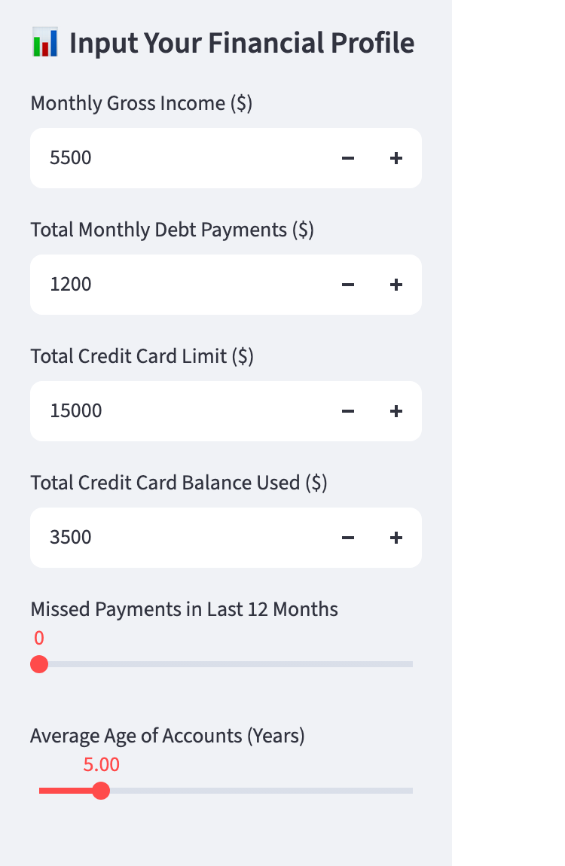
The Six Inputs
Everything the model needs fits in the sidebar; defaults describe a typical healthy profile
Input | Control | Default | Used for
Monthly gross income | Number input, step 200 | 5,500 | Debt-to-income ratio
Total monthly debt payments | Number input, step 100 | 1,200 | Debt-to-income ratio
Total credit card limit | Number input, step 500 | 15,000 | Credit utilisation
Credit card balance used | Number input, step 100 | 3,500 | Credit utilisation
Missed payments, last 12 months | Slider, 0 to 12 | 0 | Score penalty
Average age of accounts (years) | Slider, 0.1 to 30 | 5.0 | Score bonus
Note on currency. The labels currently show dollar signs because the inputs are plain numbers; the arithmetic is currency-neutral. Relabelling to rupees is a one-line change per input.
Financial Health & Credit Assessment | CA Asmita Shreeram Hirlekar | ICAI AI Level 2 | Pune | Batch 100
6
Notes:
Everything the model needs fits in the sidebar. Four number inputs: monthly gross income, total monthly debt payments, total credit card limit and the balance used. And two sliders: missed payments in the last twelve months, from zero to twelve, and the average age of accounts, from a tenth of a year to thirty years. The defaults describe a typical healthy profile: income 5,500, debt payments 1,200, a 15,000 limit with 3,500 used, no missed payments and five-year-old accounts. One note on currency: the labels currently show dollars, but the arithmetic is currency-neutral, and relabelling to rupees is a one-line change per input.

Slide 7
The Calculation Engine
Three formulas, written in plain Python. No model is trained, nothing is estimated.
Debt-to-Income (DTI)
DTI = monthly debt payments ÷ monthly gross income × 100
Zero income is guarded: DTI shows 0 instead of dividing by zero.
Healthy ≤ 36 % • Warning 36 to 43 % • High Risk > 43 %
Credit Utilisation
Utilisation = balance used ÷ total credit limit × 100
Zero limit is guarded the same way.
Optimal ≤ 30 % • High > 30 %
Estimated Credit Score
Score = 850 − utilisation penalty − missed-payment penalty + account-age bonus
Utilisation penalty = utilisation % × 1.8, capped at 200. Missed-payment penalty = 50 per missed payment. Age bonus = 3 per year, capped at 50.
Result clamped to the 300 to 850 range and rounded down to a whole number.
Financial Health & Credit Assessment | CA Asmita Shreeram Hirlekar | ICAI AI Level 2 | Pune | Batch 100
7
Notes:
The calculation engine has three formulas, all written in plain Python. No model is trained and nothing is estimated from data. First, the debt-to-income ratio: monthly debt payments divided by gross income, as a percentage. Healthy up to 36 percent, a warning up to 43, high risk above that. Second, credit utilisation: balance used divided by the total limit. Optimal up to 30 percent, high above it. Third, the estimated score. It starts from a base of 850. It subtracts a utilisation penalty, which is the utilisation percentage times 1.8, capped at 200. It subtracts 50 for every missed payment. It adds an account-age bonus of 3 per year, capped at 50. And the result is clamped to the 300-to-850 range. Division by zero is guarded in both ratios.

Slide 8
Score Bands and Status Thresholds
The same number is always read the same way
Estimated credit score, 300 to 850 (segment widths not to scale)
Poor
Fair
Good
Very Good
Exceptional
300 to 579
580 to 669
670 to 739
740 to 799
800 to 850
Debt-to-Income status
Credit utilisation status
Healthy ≤ 36 % • shown green
Warning 36 to 43 % • acceptable, larger loans scrutinised
High Risk > 43 % • focus on debt reduction
Optimal ≤ 30 % • helps maximise the score
High > 30 % • pay balances down below 30 %
Also drives the largest score penalty, up to 200 points
Financial Health & Credit Assessment | CA Asmita Shreeram Hirlekar | ICAI AI Level 2 | Pune | Batch 100
8
Notes:
Every number is read the same way, every time. The score falls into one of five bands: Poor below 580, Fair from 580, Good from 670, Very Good from 740 and Exceptional from 800. Debt-to-income is Healthy up to 36 percent, a Warning up to 43, and High Risk above that: that is the point where monthly debt consumes a major share of income. Utilisation is Optimal up to 30 percent and High above it; it is also the largest single driver of the score, with a penalty of up to 200 points.

Slide 9
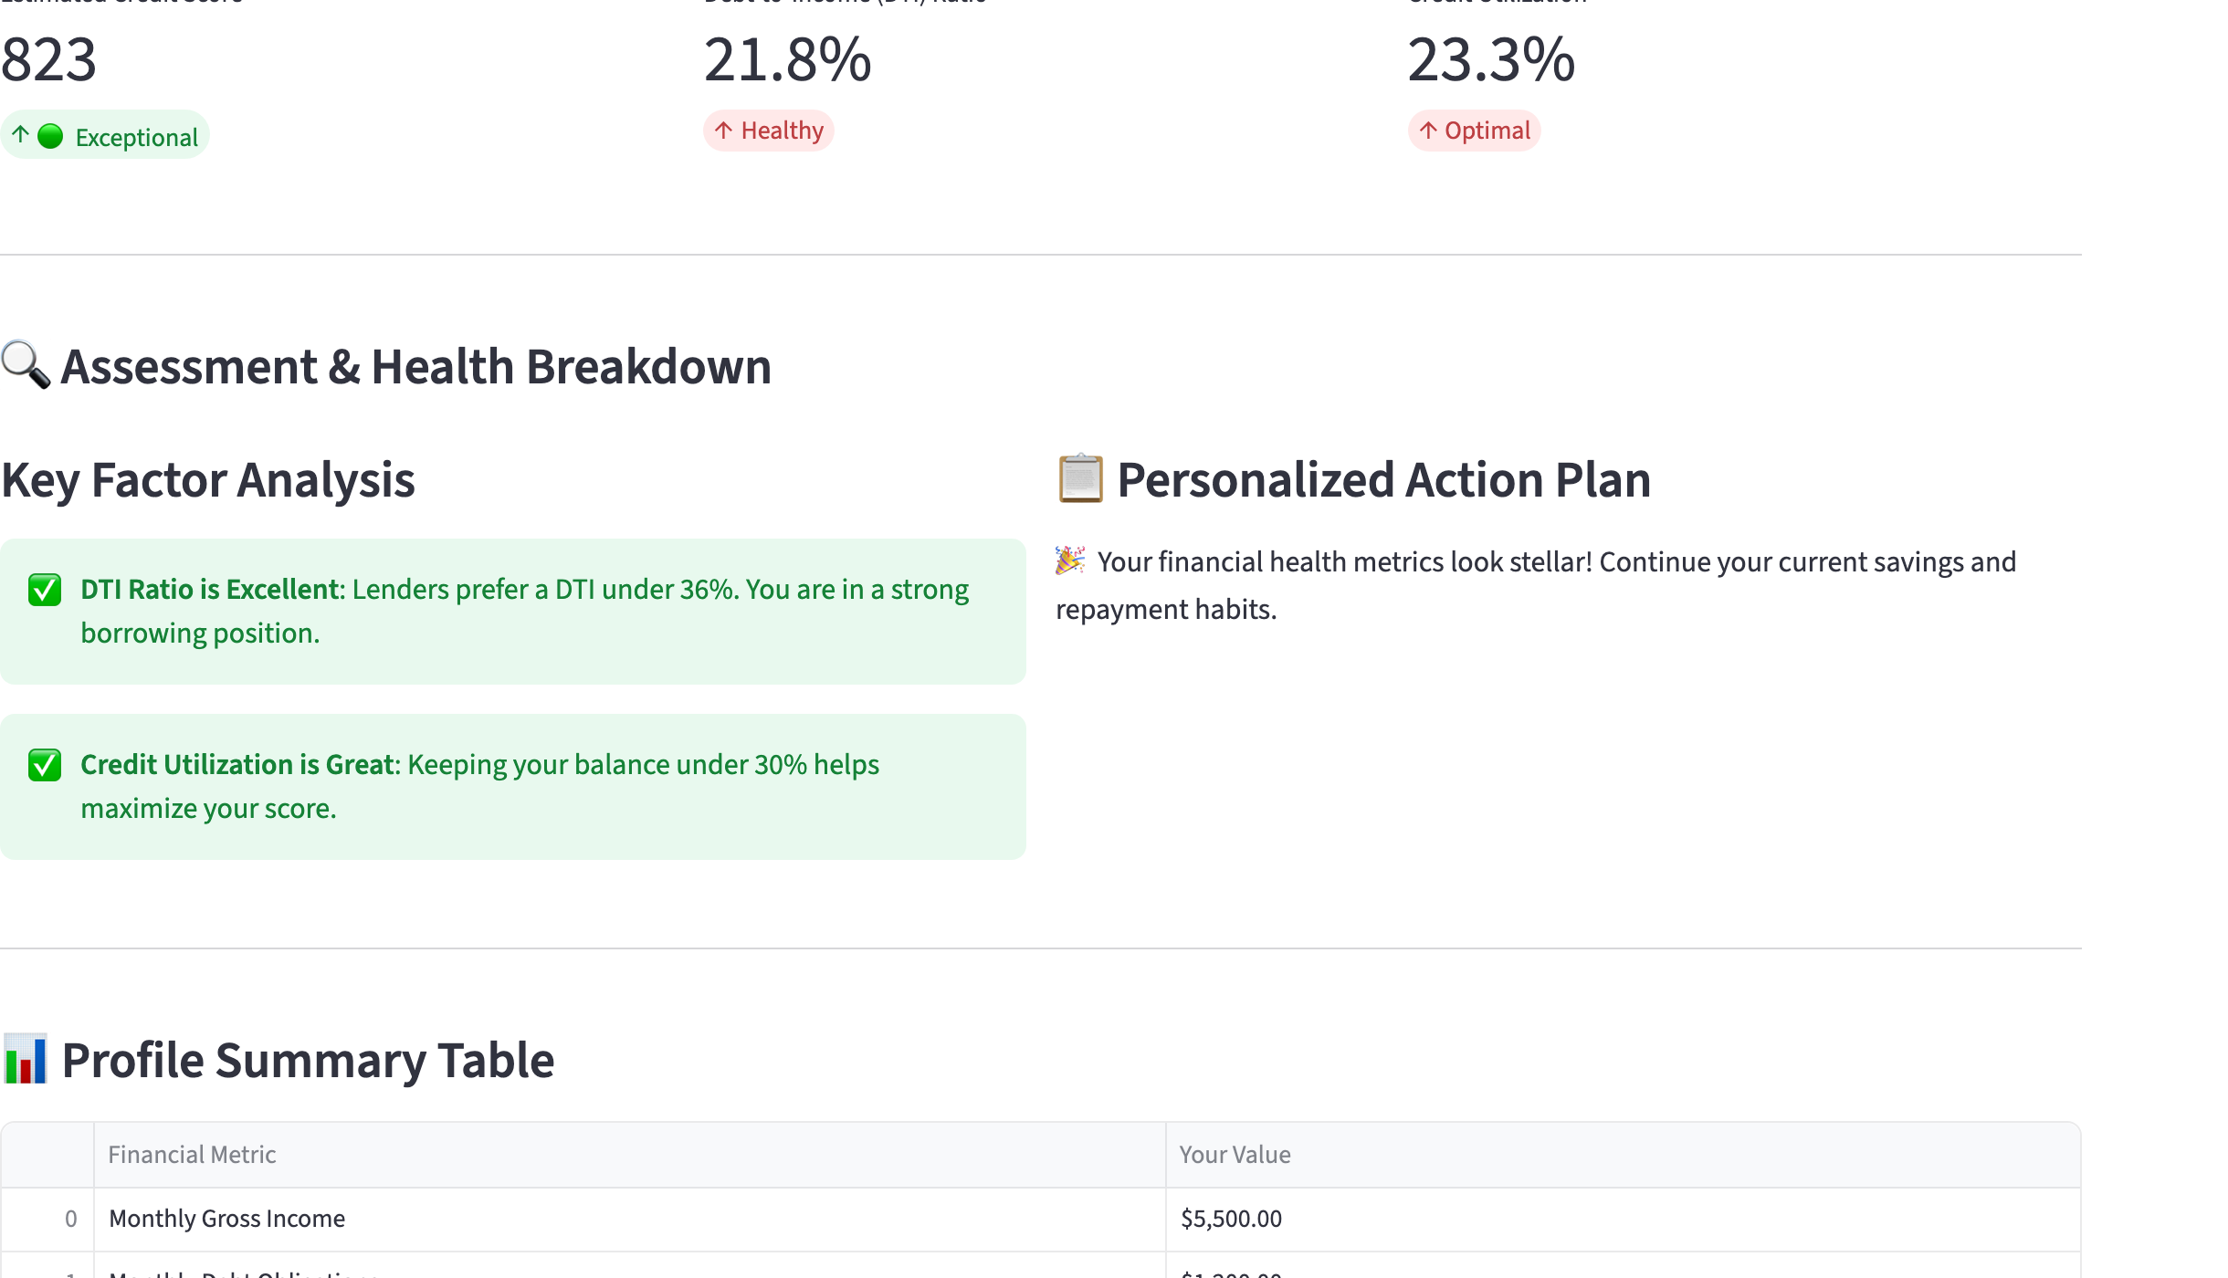
Walkthrough 1: the Default Profile
Income 5,500 • debt payments 1,200 • limit 15,000 • balance 3,500 • no missed payments • accounts 5 years old
823
Estimated score • Exceptional
21.8 %
Debt-to-income • Healthy
23.3 %
Credit utilisation • Optimal
Score arithmetic 850 − 42 (23.3 % × 1.8) − 0 + 15 (5 yrs × 3) = 823
Financial Health & Credit Assessment | CA Asmita Shreeram Hirlekar | ICAI AI Level 2 | Pune | Batch 100
9
Notes:
Let me walk through the default profile. Income 5,500, debt payments 1,200, a limit of 15,000 with 3,500 used, no missed payments and five-year-old accounts. Debt-to-income is 1,200 over 5,500: 21.8 percent, Healthy. Utilisation is 3,500 over 15,000: 23.3 percent, Optimal. And the score: 850, minus a utilisation penalty of 42, that is 23.3 times 1.8, minus nothing for missed payments, plus an age bonus of 15, three points a year for five years. 823, Exceptional. Both factor cards are green, and the action plan says the metrics look stellar: keep the current habits.

Slide 10
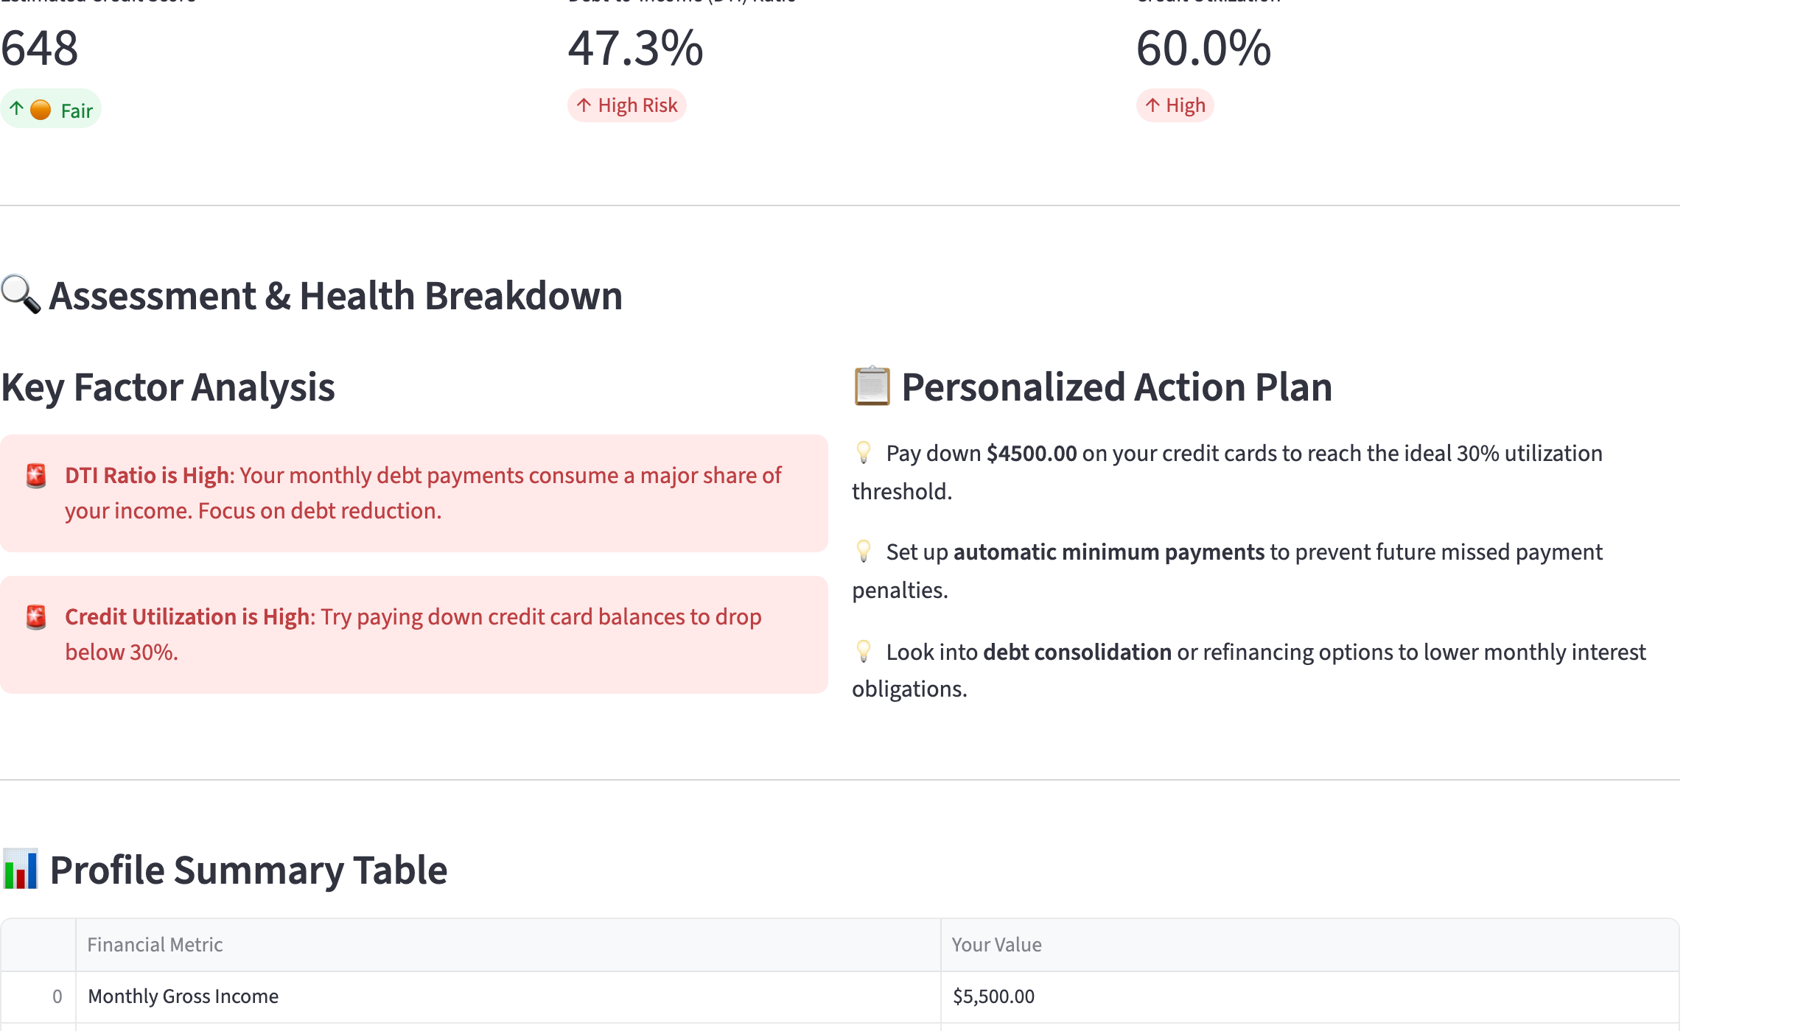
Walkthrough 2: a Stressed Profile
Same income and limit • debt payments 2,600 • balance 9,000 • 2 missed payments • accounts 2 years old
648
Estimated score • Fair
47.3 %
Debt-to-income • High Risk
60.0 %
Credit utilisation • High
Score arithmetic 850 − 108 (60 % × 1.8) − 100 (2 × 50) + 6 (2 yrs × 3) = 648
Financial Health & Credit Assessment | CA Asmita Shreeram Hirlekar | ICAI AI Level 2 | Pune | Batch 100
10
Notes:
Now a stressed profile, with the same income and limit. Debt payments rise to 2,600, the balance used to 9,000, two payments were missed, and the accounts are only two years old. Debt-to-income jumps to 47.3 percent, High Risk. Utilisation is 60 percent, High. The score: 850, minus 108 for utilisation, minus 100 for the two missed payments, plus 6 for account age. 648, Fair. Both factor cards turn red, and the action plan now has three specific items. Pay down 4,500 on the cards, which is exactly the amount needed to reach 30 percent utilisation. Set up automatic minimum payments. And look into debt consolidation, because DTI is above 40.

Slide 11
The Action Plan Rules and What Moves the Score
Each rule fires on a condition and prints a specific, numeric action
Utilisation > 30 %
1
Pay down (balance − 30 % of limit). Stressed profile: 9,000 − 4,500 = 4,500.
Missed payments > 0
2
Set up automatic minimum payments to stop further 50-point penalties.
DTI > 40 %
3
Look into debt consolidation or refinancing to lower monthly obligations.
None of the above
4
Metrics look stellar: continue current savings and repayment habits.
Financial Health & Credit Assessment | CA Asmita Shreeram Hirlekar | ICAI AI Level 2 | Pune | Batch 100
11
Notes:
The action plan is rule-based, and each rule prints a specific, numeric action. If utilisation is above 30 percent, pay down the balance minus 30 percent of the limit; for the stressed profile that is 9,000 minus 4,500, so 4,500. If any payment was missed, set up automatic minimum payments. If DTI is above 40 percent, look into consolidation or refinancing. And if none of these fire, the plan says the metrics look stellar. The chart shows what moved the score between the two profiles: utilisation cost 42 points in the default case and 108 in the stressed case; missed payments cost nothing and then 100; and the age bonus fell from 15 to 6. That is the whole 175-point gap, and the user can see every piece of it.

Slide 12
Design Principles, Controls and Limits
What the application does, and what it deliberately does not claim
✓
Transparent by construction
✓
Deterministic
Limits, stated plainly
Every formula, weight and threshold is visible in about 120 lines of code. A reviewer can re-perform any number by hand.
No training data, no randomness. The same six inputs always produce the same score, status and advice.
The score is an indicative, mock weighted model, not a bureau score. It is not CIBIL, Experian or FICO.
Three factors are modelled; payment history depth, credit mix and recent enquiries are not.
Labels are in dollars today; thresholds follow common lender rules of thumb (36/43 % DTI, 30 % utilisation).
It is decision support. The lending decision stays with the lender; the financial decision stays with the person.
✓
Instant feedback
✓
Nothing stored, nothing sent
Streamlit re-runs the script on every input change, so the user sees cause and effect as they move a slider.
Inputs live only in the browser session. No database, no login, no data leaves the machine.
The principle behind all of this: code calculates, the person decides. The application gets the numbers and the next steps ready; it never pretends to be the lender.
Financial Health & Credit Assessment | CA Asmita Shreeram Hirlekar | ICAI AI Level 2 | Pune | Batch 100
12
Notes:
Four principles guided the design. Transparent by construction: every formula, weight and threshold is visible in about 120 lines of code, and a reviewer can re-perform any number by hand. Deterministic: no training data, no randomness. Instant feedback: Streamlit re-runs the script on every change, so the user sees cause and effect. And nothing is stored or sent: there is no database and no login, and nothing leaves the machine. I also want to state the limits plainly. The score is an indicative, mock weighted model, not a bureau score. Three factors are modelled, not the full bureau set. The labels are in dollars today, and the thresholds follow common lender rules of thumb. It is decision support. Code calculates, the person decides.

Slide 13
Problem Solved and Next Steps
Before | After
Borrower does not know what drives the score | Three drivers, with the points each one costs or adds
Practitioner computes DTI and utilisation by hand | Both ratios and their status, recomputed instantly
Advice is generic | Numeric actions: the exact amount to pay down
Discovery happens at loan rejection | A two-minute self-check before applying
Next steps
• Indian context: rupee labels, CIBIL-style 300 to 900 scale and Indian lender norms for DTI.
• Loan-eligibility and EMI module: maximum affordable EMI from the DTI headroom.
• Downloadable PDF summary for the client file.
• Save and compare client profiles over time.
• Natural-language explanation of the result using an LLM, grounded on the computed numbers only.
• Optional bureau-report upload to replace manual inputs.
Decision support, not a decision. The application prepares the numbers and the questions; the lending decision remains with the lender and the financial choices with the person.
Financial Health & Credit Assessment | CA Asmita Shreeram Hirlekar | ICAI AI Level 2 | Pune | Batch 100
13
Notes:
What changed. Before, the borrower did not know what drives the score; now there are three drivers, with the points each one costs or adds. Before, the practitioner computed DTI and utilisation by hand; now both ratios and their status update instantly. Before, the advice was generic; now it is numeric, down to the exact amount to pay down. And discovery moves from the moment of loan rejection to a two-minute self-check before applying. Next steps: an Indian context, with rupee labels and a CIBIL-style 300-to-900 scale; a loan-eligibility and EMI module built on the DTI headroom; a downloadable PDF summary; saving and comparing client profiles; a natural-language explanation generated by an LLM but grounded strictly on the computed numbers; and an optional bureau-report upload. One point to close: this is decision support, not a decision.

Slide 14
Thank you
Code calculates. The person decides.
A two-minute credit-readiness check with specific, numeric advice.
CA Asmita Shreeram Hirlekar
Membership No. 190982 • caasmitahirlekar@gmail.com
ICAI AI Level 2 • Pune Branch • Batch 100
Application
Source code (app.py) submitted with the project; runs with: streamlit run app.py
Video walkthrough
https://drive.google.com/file/d/1D1lmrh_Fz02fp9O2dsXc6aYKn-CL6iyP/view?usp=sharing
The application and all figures use illustrative inputs. The score is indicative and is not a credit-bureau score.
Notes:
To sum up in two lines: code calculates, the person decides. And the result is a two-minute credit-readiness check with specific, numeric advice. Thank you to the panel and to ICAI. The application link and the video link are on the screen. I am CA Asmita Shreeram Hirlekar, Pune Branch, Batch 100. Thank you.

