Slide 1
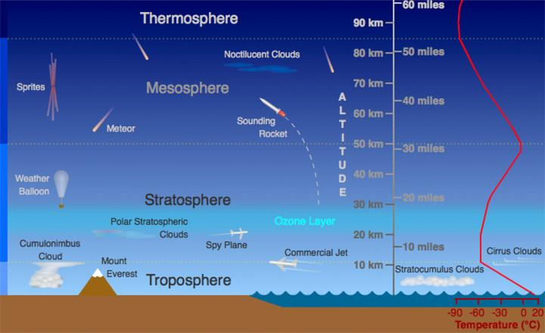
The earth is divided into 5 atmospheric layers

Slide 2
Troposphere The troposphere is the lowest layer of our atmosphere. Starting at ground level, it extends upward to about 10 km (6.2 miles or about 33,000 feet) above sea level. We humans live in the troposphere, and nearly all weather occurs in this lowest layer. Most clouds appear here, mainly because 99% of the water vapor in the atmosphere is found in the troposphere. Air pressure drops, and temperatures get colder, as you climb higher in the troposphere.

Slide 3
Stratosphere The next layer up is called the stratosphere. The stratosphere extends from the top of the troposphere to about 50 km (31 miles) above the ground. The infamous ozone layer is found within the stratosphere. Ozone molecules in this layer absorb high-energy ultraviolet (UV) light from the Sun, converting the UV energy into heat. Unlike the troposphere, the stratosphere actually gets warmer the higher you go! That trend of rising temperatures with altitude means that air in the stratosphere lacks the turbulence and updrafts of the troposphere beneath.

Slide 4
Mesosphere Above the stratosphere is the mesosphere. It extends upward to a height of about 85 km (53 miles) above our planet. Most meteors burn up in the mesosphere. Unlike the stratosphere, temperatures once again grow colder as you rise up through the mesosphere. The coldest temperatures in Earth's atmosphere, about -90° C (-130° F), are found near the top of this layer. The air in the mesosphere is far too thin to breathe (the air pressure at the bottom of the layer is well below 1% of the pressure at sea level and continues dropping as you go

Slide 5
Thermosphere The layer of very rare air above the mesosphere is called the thermosphere. High-energy X-rays and UV radiation from the Sun are absorbed in the thermosphere, raising its temperature to hundreds or at times thousands of degrees. However, the air in this layer is so thin that it would feel freezing cold to us! In many ways, the thermosphere is more like outer space than a part of the atmosphere. Many satellites actually orbit Earth within the thermosphere! Variations in the amount of energy coming from the Sun exert a powerful influence on both the height of the top of this layer and the temperature within it.

Slide 6
Exosphere Although some experts consider the thermosphere to be the uppermost layer of our atmosphere, others consider the exosphere to be the actual "final frontier" of Earth's gaseous envelope. As you might imagine, the "air" in the exosphere is very, very, very thin, making this layer even more space-like than the thermosphere. In fact, the air in the exosphere is constantly - though very gradually - "leaking" out of Earth's atmosphere into outer space. There is no clear-cut upper boundary where the exosphere finally fades away into space. Different definitions place the top of the exosphere somewhere between 100,000 km (62,000 miles) and 190,000 km (120,000 miles) above the surface of Earth. The latter value is about halfway to the Moon!

Slide 7


