Slide 1
Tic Tac Toe In TTL
This is a human versus TTL circuit version of Tic Tac Toe, but with no
CPU. It's all plain old digital logic.

Slide 2
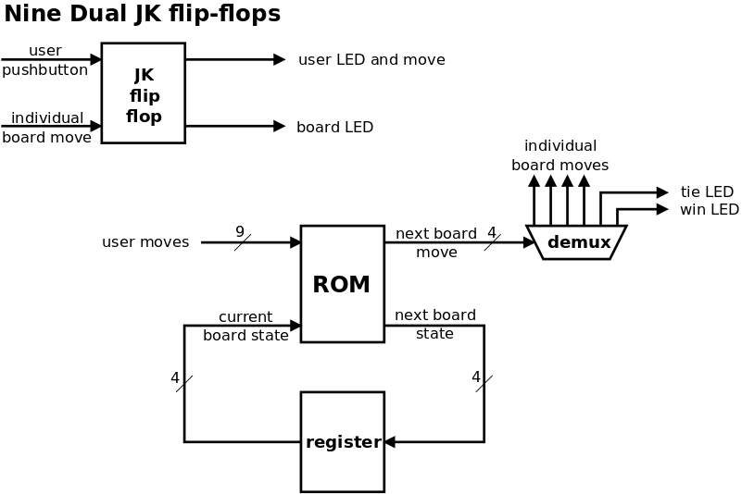

Slide 3
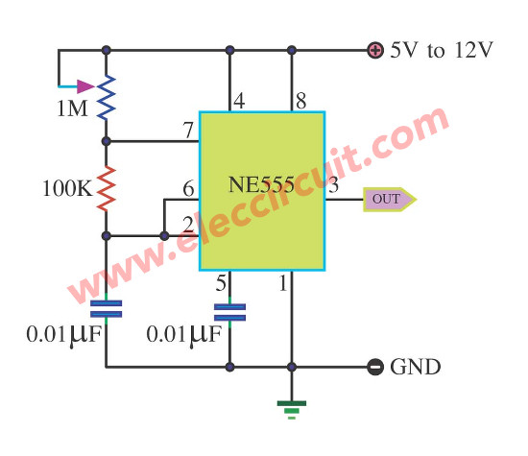
555 Timer

Slide 4
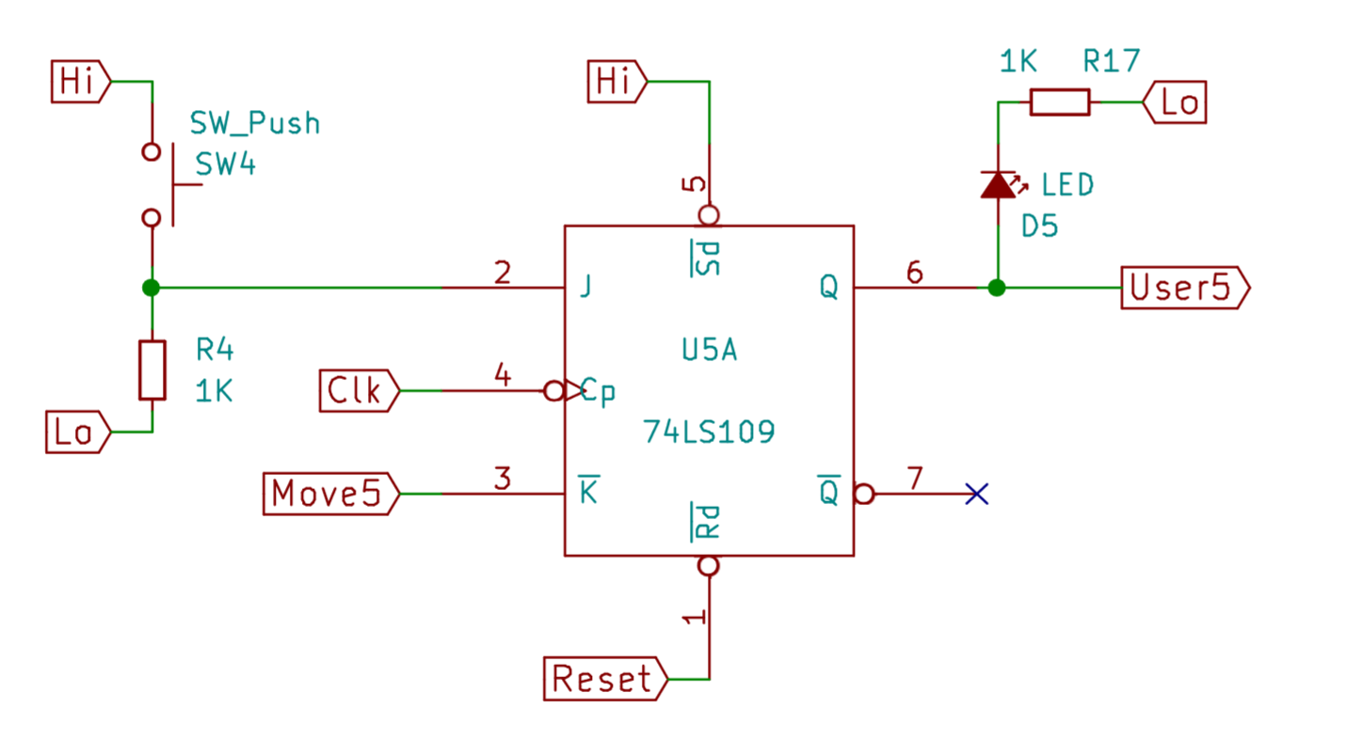
User Moves

Slide 5
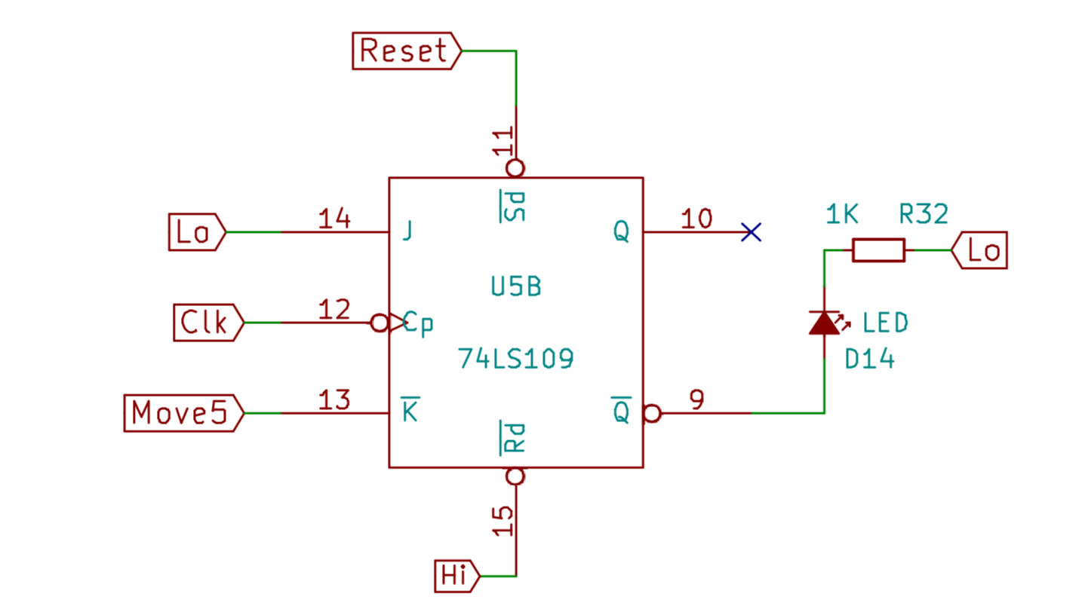
Board Moves

