Slide 1

Name the founder and founder of this Indian payment and commerce company based out of Delhi NCR, India.

Slide 2
Kris Gopalakrishnan, co-founder and CEO of Infosys, has founded a digital app that chronicles growth of Indian IT industry. What is it called?

Slide 3
Answer-
Ittihaasa

Slide 4

What are jump stick, nerd stick, Geek stick, chip stick, travel stick and magic stick different versions of?

Slide 5
Answer-
Pen drives and USB drives

Slide 6
Who is the most well known friend of Angela, hank, Ginger and Ben?

Slide 7
Answer-
Talking Tom

Slide 8
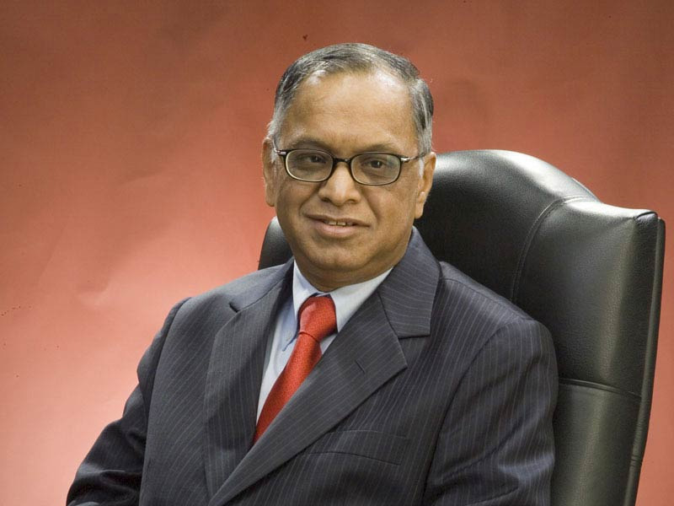
Identify this Padma Vibhushan and Padma Shri awardee who was listed among the 12 greatest entrepreneurs of our time by fortune magazine.

Slide 9
Answer-
N.R. NARAYANA MURTHY

Slide 10

Firefox for mobile, how do we better know it as?

Slide 11
Fennec Browser

Slide 12

This is the logo of which file extension.

Slide 13
Answer-
.ogg (audio/video /application)

