Slide 1
GCS Account Health & Realized ARR
A North Star Metric for the GCS Organization
$8.1B
$81M
22/22
NGS ARR at Q3 FY26
Per 1-Point PRS Gain
Automated Tests Pass
PANW Committed Base
Revenue Unlock Potential
Data Quality Gates
Synthetic prototype results are scaled here to show enterprise-level business impact.
Agenda · Introduction · Context & Problem · Technical Deep Dive · Evaluation &Results · Q&A
Notes:
Talking points to touch during the slide
What are these nos?
How they come into picture?
1000 vs Real world scale

Slide 2
Who I Am & How I Think
Dharmesh Bhagat · Principal PM, Data & AI Analytics · GCS Case Study
Engineer → Principal PM · 7+ years building post-sales data products at Microsoft Azure · 15+ years in Enterprise IT
⚙️
📈
🤖
Technical Foundation
Product Leadership (Azure)
AI-First PM Philosophy
Enterprise infrastructure & data systems
How complex systems scale at cloud scale
Technology → business impact translation
Quality Hub: 5-day VP prep → 4 hours
Iridias: 60% incident effort reduction
FastTrack: 3,179 customer signals → 74% accept
Spec-driven AI development (BRD → code)
Prototype without engineering bottleneck
Post-sales analytics & GTM intelligence
Start Small, Iterate Fast, Scale Reliably.
SAP · RLI · Apple Inc · SanDisk · KLA-Tencor · Microsoft · Axari
Notes:
Talking points to touch during the slide
Why reliable is important?
Why technical and product plays role in overall design?
What exposure in customer space in post sales?

Slide 3
The Problem GCS Is Solving
Transitioning from TCV bookings to a consumption-based ARR model creates a measurement gap
OLD MODEL — TCV/Bookings
NEW MODEL — Realized ARR
Deal closes → commercial success recognized
No visibility into deployment
No signal on actual usage
$3M TCV booked = success on paper
Shelfware goes undetected for months
CS inherits adoption risk without enough leading signals
Measure what customers actually use
Signal shelfware before it hits renewal
Reward deployment + sustained usage
CSMs act on math, not gut feel
Overages → expansion signal, not surprise
Shared metric across CS, PS, Support, Sales
→
🔑 Key Insight: Shelfware in cybersecurity ≠ just revenue risk. Undeployed software = unprotected attack surface.
Notes:
Talking points to touch during the slide
Why this problem is real?
What is important problem to solve for – my take uncover hidden behavior rest will follow?
Are we measuring the right things ?

Slide 4
Realized ARR — The North Star Metric
Realized ARR = Contracted ARR × PRS
Platform Realization Score = (Deployment × 0.40) + (Sustained Usage × 0.30) + (Tech Health × 0.20) + (Expansion × 0.10)
40%
30%
20%
10%
Deployment Score
Sustained Usage
Technical Health
Expansion Momentum
MIN(1.0, consumed / committed)
Capped so overages don't inflate scores
Overages flagged for expansion
Trailing 12-month window
30% monthly threshold for 'healthy'
Prevents spike-and-drop false positives
health_color (MVP) P1/P2 ticket rate, MTTR, #escalation, open rate (Future)
Missing → defaults to 0.60 (Yellow)
Detects deployment vs. efficacy illusion
Multi-contract expansion signals
<3 months history → defaults to 0.10
Turns overagers into pipeline
⚠ SHELFWARE OVERRIDE: IF Deployment = 0 AND Sustained Usage = 0 → PRS = 0.00 (hard floor — no phantom realized value)
Notes:
Talking points to touch during the slide
Why ARR?
Why 40/30/20/10 ? – why only these components?
Why not compensation?

Slide 5
Data Pipeline Architecture
Spec-driven AI development: BRD → Markdown spec → Claude Code → BigQuery pipeline → Tests → Dashboard
Data
Generation
DQ Gates
BigQuery
Pipeline
22/22
Tests
Streamlit
Dashboard
~1K accounts
~50K health rows
~200K usage logs
Python + Faker
→
DQ-001 Orphaned
DQ-002 Rogue dates
350 flagged rows
clean_usage_logs view
→
5 tables
MAX() overlap fix
PRS computation
Realized ARR grain
→
pytest assertions
Invariant checks
Edge case coverage
All green ✓
→
Portfolio view
Region/Rep drill
Month selector
Live on cloud
5 Injected Anomalies — All Handled:
1. Spike & Drop
2. Shelfware
3. Overages
4. Mid-Year Exp.
5. Orphaned Logs
5% of accounts — trailing CoV penalizes Sustained Usage Score
10% — hard floor override forces PRS → 0.00 exactly
15% — MIN(1.0) cap + expansion flag fires automatically
MAX() logic prevents double-counting ARR across contracts
DQ-001 / DQ-002 gates filter before any PRS calculation
Notes:
Talking points to touch during the slide
Why only use these technical arch why not something else?
Why only 22 test, how did u priotize?
Why only 5 anomalies?

Slide 6
How We Handle Messy B2B Data
Every edge case maps to a GTM or post-sales pain point — not just a data problem
🛡️ Shelfware Hard-Floor Override
In cybersecurity, undeployed software = unprotected attack surface. No partial credit for phantom value. Forces CSM to run deployment play immediately.
For CS VP: strips toxic ARR from portfolio view in real-time.
IF Deployment = 0 AND Usage = 0
THEN PRS = 0.00
📋 Mid-Year Expansion / Overlap Fix
Overlapping contracts create double-counted ARR in a naive JOIN. MAX() logic selects the highest active commitment at point-in-time — preventing false quota inflation.
For Analytics Lead: prevents Cartesian explosion that distorts every CSM's book of business.
SELECT MAX(annual_commit_dollars)
WHERE month BETWEEN start AND end
🚀 Consistent Overager → Expansion Signal
15% of accounts exceed 120% of monthly credits. Cap prevents score inflation, but a separate flag fires automatically — turning a billing risk into an upsell conversation.
For SC: overage accounts are the highest-quality expansion pipeline in the portfolio.
deployment_score = MIN(1.0, consumed/committed)
flag_overage = consumed > 1.20 × committed
Notes:
Talking points to touch during the slide
Why these are important?
How post sales drives these?
What is there for post sales team?

Slide 7
Evaluation Framework & Results
Moving beyond loss functions — tied directly to business KPIs and GTM outcomes
PRS Health Bands → CSM Action Triggers
22/22 Automated Tests — ALL PASS
🟢 GREEN 0.80–1.00
QBR maintenance + expansion play
DQ Gate Tests
~55% of accounts
✓ No orphaned logs in clean view
✓ No rogue dates in clean view
🟡 YELLOW 0.60–0.79
Proactive outreach, check CBV
✓ 350 flagged rows in dq_report
~20% of accounts
✓ Zero negative consumption
Invariant Tests
🟠 ORANGE 0.30–0.59
CSM intervention + PS support
✓ Deployment score ≤ 1.0 always
~15% of accounts
✓ Realized ARR ≤ Contracted ARR
✓ Shelfware PRS = 0.00 exactly
🔴 RED 0.00–0.29
Executive escalation + sprint
✓ Portfolio PRS weighted correctly
~10% of accounts
Edge Case Tests
✓ Shelfware → zero realized ARR
✓ Spike-drop → Orange/Red band
✓ Overagers → flag_overage = TRUE
✓ Mid-year → no double-count ARR
Notes:
Talking points to touch during the slide
Why these values?
Why not take real support tks in considerations?
Why these 3 sets only?

Slide 8
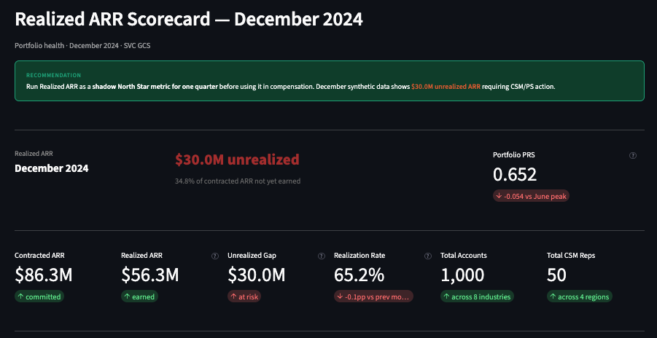
Live Dashboard — Streamlit Demo
Executive account health view · Built with Claude Code · Connected to BigQuery
🔷 GCS Account Health
· North Star Dashboard |
Month: Dec 2024 |
Region: All | Segment: All
Demo
🔗 Live at: dbhagatnsdemo.streamlit.app · Code: github.com/DharmeshBhagat/panw-gcs-northstar
Notes:
Talking points to touch during the slide
Walk through various personas
Executive
CSM mgr
IC and
Data analytics team

Slide 9
Retrospective: If I Did This Again
Honest hard truths + what the next-gen tech stack unlocks
Hard Truths Learned
With Today's Tech Stack
01
Start cross-platform data cleanup in parallel
🤖 Agentic Workflows
Don't sequence PRS v1 → v2. Clean platform entitlement data Week 1, so Phase 2 is a formula change, not a data project.
Claude Agents that autonomously flag at-risk accounts, draft CSM intervention emails, and schedule QBR prep.
Agent drafts. Human approves. System logs the action.
02
POC-to-Prod tenant mapping is Day 1 work
📡 Real-time Streaming
Discovered late: healthy accounts look like shelfware when usage logs point to the POC tenant, not production. Invert the signal before you show it to anyone.
Replace batch BigQuery runs with Pub/Sub + Dataflow for sub-hour Realized ARR updates. PRS degrades in real-time when telemetry goes dark
03
Commitment Exhaustion Alert is 30 lines of SQL
🔮 Predictive PRS
Linear regression on credit burn rate fires 30 days before an account goes dark. Cost: 2 hours. Cost of not building it: surprise renewal conversation.
LightGBM or XGBoost on 12-month PRS sequences predicts which accounts will drop a band 45 days in advance — before the CSM's gut feel fires
04
Instrument the metric itself
🔗 Phase 2: Platform Breadth
Build csm_action_log. Measure whether CSM interventions on flagged accounts improve PRS in 60 days. Without this, the feedback loop exists in theory only.
PRS Option 2 adds Platform Breadth (25% weight). Cross-platform entitlement data is the unlock — 8× ARR multiplier when customers activate 3 platforms
Notes:
Talking points to touch during the slide
How to use AI / ML
Why data is important across org
Add if require what other technical solution could be used

Slide 10
The Ask & Summary
I built this as a post-sales decision system, not a metric, not a dashboard.
The goal: help GCS identify where customer value is being realized,
where ARR is at risk, and where CS, Support, PS, and GTM teams should act.
1,000+
250K+
22/22
Accounts in pipeline
Usage log rows generated
Tests passing
Top 3 ask:
Approve Realized ARR as a shadow North Star metric Run alongside TCV / ARR for one quarter.
Pilot in 1–2 regions: Weekly CSM review, monthly regional review, exception tracking.
Assign production data owners: Support tickets, telemetry, contracts, account hierarchy, lifecycle stage.
Measure first .
Validate behavior.
Govern data.
Then scale.
Notes:
Talking points to touch during the slide
End to end roadmap
Why not considered compensation
How can I help ?

Slide 11
Q&A
Notes:
Talking points to touch during the slide
- If they do not have questions double click on things which came up in presentation
Show case github and docs
Go more into dashboard if required, showcase minute features u added

Slide 12
Future GTM Alignment (not Phase 1 compensation design)
One metric that aligns CS, Support, PS, Sales, and Finance around a shared commercial outcome (Future Incentive Design)
Illustrative Future Incentive Design (not Phase 1)
What Each Team Gets
Validated by CS Leaders Roundtable · June 2025
CS / CSM:
Dollar-denominated tier tells exactly where to deploy capacity — no subjective gut feel
40%
Base Commission
On contracted ARR at signing — maintains sales momentum
Support:
THS component connects P1/P2 ticket volume directly to account health band
PS / Deploy:
Orange/Red accounts surface as immediate deployment sprint candidates
35%
eARR Milestone
Account hits 80% PRS within 180 days — requires CS+PS+Sales collaboration by design
Sales / SC:
Overage accounts = expansion pipeline. Overagers are your best expansion targets
25%
Expansion Conversion
Finance:
Realized ARR vs Contracted ARR gap = revenue risk reserve calculation
Overage → new committed ARR — Expansion Cannibalization Rate prevents ghost revenue
Exec / VP:
Portfolio PRS% is a board-level number — $665K unrealized in banking segment
⚠ Key insight: Hard expansion quotas on CSMs cause lead hoarding. The 40/35/25 structure makes CS/Sales collaboration a prerequisite, not a choice.
⚠ Note: Not recommended until PRS is back-tested against renewal, expansion, support, and deployment outcomes
Notes:
Talking points to touch during the slide
Bring up only compensation is insisted
This is not the driver its long vision – needs bigger financial evaluation
Behavior over revenue , customer value over business operations ease

Slide 13
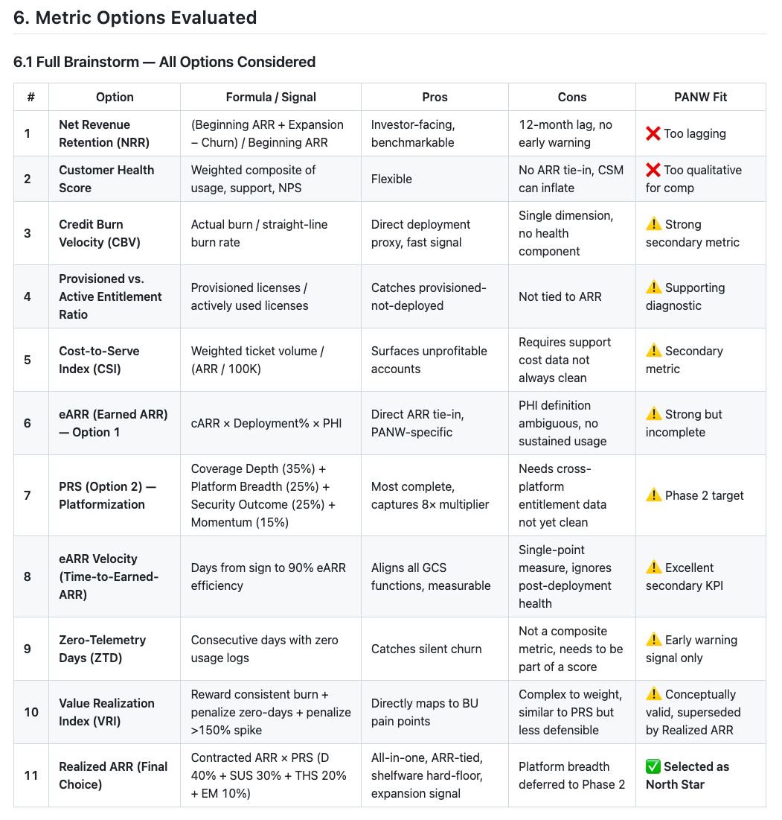
Why choose Realized ARR metric
Detailed explanation found
In BRD Section 6 Link
PANW’s platformization strategy creates the need for post-sales realization intelligence — Realized ARR is my proposal for that operating layer.

Slide 14
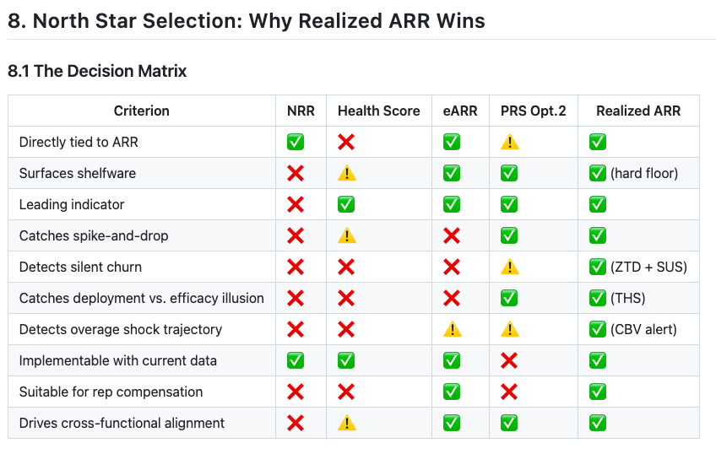
Why choose PRS?
Detailed explanation found
In BRD Section 8 Link
With current data info Choose PRS Option 1
PRS Weights – 40/30/20/10
Deployment Score (40%)
+ Sustained Usage Score (30%)
+ Technical Health Score (20%)
+ Expansion Momentum (10%)
With additional data Choose PRS Option 2
With platformization in consideration (Phase 2)
Coverage Depth (35%)
+ Platform Breadth (25%)
+ Security Outcome (25%)
+ Momentum (15%)

Slide 15
Why choose 40/30/20/10?
My thought process
Phase 1, we are deliberately choosing a deterministic framework over a statistical one for three strategic reasons:
Metrics Drive Field Behavior - Deploy first, sustain second, resolve tickets third, grow fourth.
Avoiding Legacy Data Over-fitting - Training an ML model on bad historical data simply automates past blind spots.
Weights are the Dial – which can and will be changed with learnings and modeling
Phase 1 is about validating the pipeline and the components. Once the data contract is stable,
Phase 2 is exactly where we use empirical renewal and churn data to back-test, calibrate, and fine-tune these weights. We start deterministic to drive cultural alignment, and we evolve to statistical to optimize precision.
Trade-off is Operational Governance vs. Statistical Over-fitting
The "Napkin Test" for Field Trust: To drive cultural change across Sales, CS, and Support, the metric must be transparent and legible. If scores fluctuate due to black-box algorithmic shifts, the field loses trust and abandons the playbook.
The Legacy Data Trap: Training a Machine Learning model on historical Palo Alto Networks data would over-fit the algorithm to legacy, non-consumption-based renewal behaviors, institutionalizing past blind spots.

