Slide 1

Ecommerce Sales Analysis Project
Data Analysis | Tools: Python, Excel
Dataset: 2014–2017
by Dharmesh Parmar

Slide 2





Objective of This Project
Analyze sales performance
Identify trends and patterns in sales data across the 3-year period.
Identify product performance
Discover which categories drive revenue and profitability.
Understand customer segmentation
Analyze buying behaviors across different customer segments.
Evaluate discounts effect
Measure how promotional strategies impact the bottom line.

Slide 3








Business Questions
Strategic Impact
Sales vs. profit growth; regional performance
Financial Performance
Discount impact; high sales, low profit products
Operational Efficiency
Shipping & satisfaction correlation
Market Understanding
Sales trends; top categories; customer segments

Slide 4
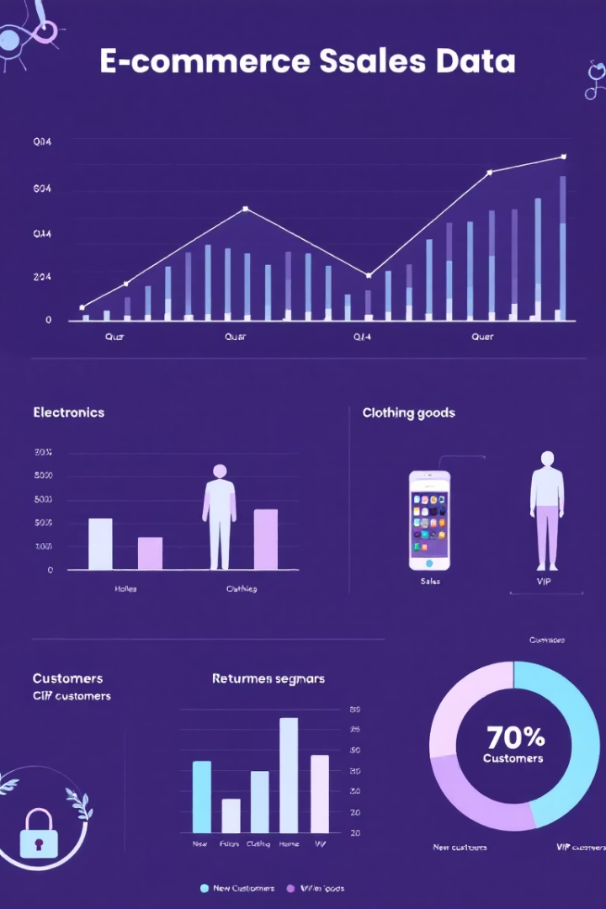




Insights & Key Findings
Sales Patterns
Strong Q4 spikes across all years
Phones & Chairs lead in revenue generation
Customer Behavior
Consumer segment dominates total sales volume
West & East regions show strongest performance
Profitability Factors
High discounts correlate with reduced profit margins
Canon copiers show concerning profitability issues
Customer Satisfaction
Faster shipping directly improves satisfaction scores
Sales and profit show consistent growth trajectory

Slide 5








Conclusion & Recommendations
Seasonal Strategy
Pricing Optimization
Maximize Q4 promotions with targeted campaigns
Keep discounts in 10-30% range for optimal profitability
Market Expansion
Operations Improvement
Develop strategies for underperforming regional markets
Enhance shipping speed for better customer satisfaction

Slide 6

Thank You
Project Presented by Dharmesh Parmar
Thank you for your attention and engagement throughout this ecommerce analysis presentation. I hope the insights provided will help drive strategic business decisions.
Contact Information:
For questions, further analysis, or to discuss implementation strategies:
Email: dhparmar2119@gmail.com
Notes:
Be prepared to answer questions about specific data points or methodology. Mention availability for follow-up meetings if stakeholders want to dive deeper into particular findings.

