Slide 1

Internship Progress: API Development & Full-Stack Fundamentals
This presentation outlines the learning objectives and project accomplishments from weeks 5-11 of the internship. The primary focus was on API Development & Full-Stack Fundamentals.
Topics covered include RESTful APIs, Node.js, Express.js, and MongoDB. The goal was to build a solid foundation for full-stack development.

Slide 2
RESTful API Fundamentals
GET
POST
PUT
DELETE
Retrieves movie data. Example: GET /movies/123 fetches a movie by ID.
Adds new movies to the database. Includes a request body with movie details.
Updates existing movie information. Example: PUT /movies/123 replaces the movie resource.
Removes movies from the database. Example: DELETE /movies/123.
Week 5 focused on understanding and implementing the core HTTP methods for building RESTful APIs. A mini searchable movie web app was introduced.

Slide 3





Node.js and Express.js
Node.js
File System Module
HTTP Module
Server-side JavaScript runtime. Event-driven, non-blocking I/O model.
Interacts with files and directories. Reads movie data from a JSON file.
Creates HTTP servers and clients. Handles requests and responses.
NPM
Express.js
Manages dependencies. Installs Express.js, Mongoose.
Web application framework. Routing, middleware, templating.

Slide 4




API Testing, Middleware, and MongoDB
API Testing
Validates API endpoints. Tests status codes and response data.
Middleware
Request processing pipeline. Authentication, logging, error handling.
MongoDB
NoSQL database with Mongoose. Schemas, models, CRUD operations.
This week introduced crucial elements for building robust APIs. API testing ensures reliability. Middleware enhances request handling. MongoDB provides flexible data storage.

Slide 5
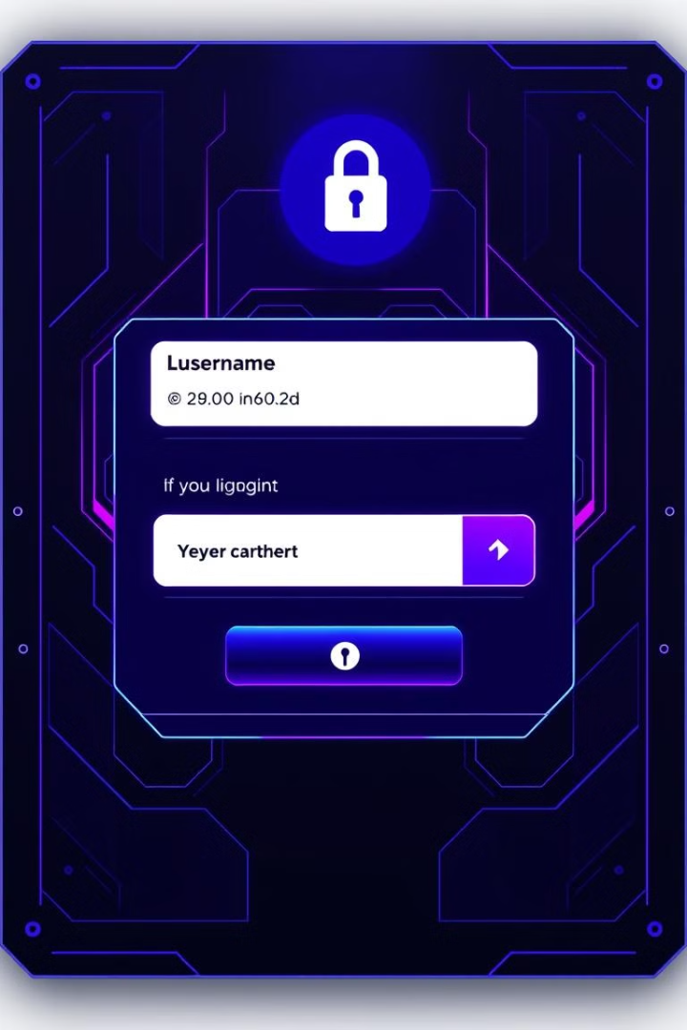



User Authentication & CRUD API
User Authentication
Secures API endpoints. Implements registration, login, logout.
JWT
Uses JSON Web Tokens for authentication. Hashing passwords with bcrypt.
CRUD API
Implements endpoints for creating, reading, updating, deleting.

Slide 6

Project Setup & Database Design
Project Setup
npm init
npm install dependencies
Structure: models/, routes/
Users Schema
username, email, password
role (admin, garage owner)
Garage Schema
garageName, location, capacity
amenities, openingHours
Booking Schema
userId, garageId, date, time
vehicleDetails

Slide 7



Role-Based Access Control
Admin
1
Manage users and settings
Garage Owner
2
Manage garage details
User
3
Book garage slots
RBAC is implemented to protect API endpoints. Middleware checks user roles. Admins can create garage owners.

Slide 8








Garage Booking Functionality
Select Garage
Check Availability
User chooses location and time
API checks for open slots
Save to DB
Confirm Booking
Booking details stored
User finalizes reservation

Slide 9
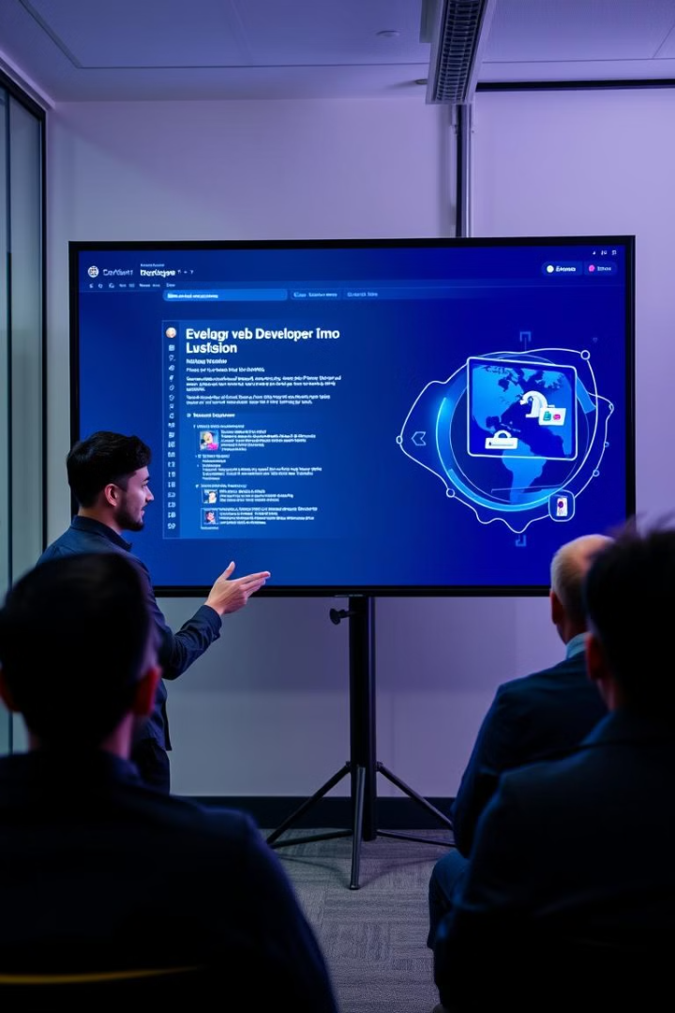
Project Demonstration
Live demo of the mini movie search web app. Showcase the CRUD API functionality.
Highlight the garage booking system with role-based access.

Slide 10
Authentication & Dashboard UI
User Authentication
User Dashboard
Garage Owner Dashboard
Admin Panel UI
Implemented secure user registration and login using JWT. Integrated form validation to prevent vulnerabilities.
Developed a personalized user dashboard providing access to key features. Utilized React components for a responsive interface.
Designed an admin panel interface for managing users and system settings. Ensured a clean layout for efficient tasks.
Created a dashboard for garage owners to manage services and bookings. Implemented role-based access control.
Stored user credentials securely using bcrypt with salt.

Slide 11
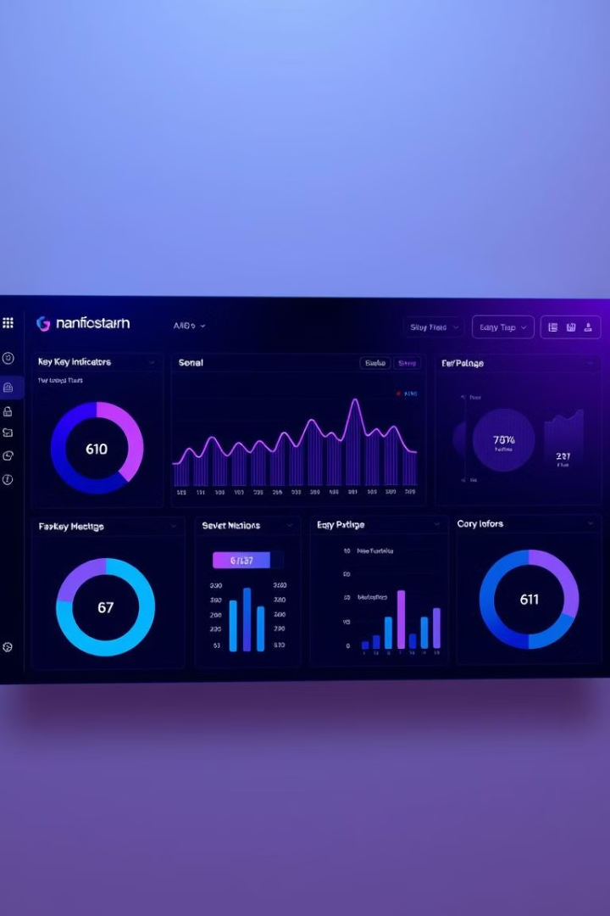




Key Performance Indicators
99.9% Authentication
<2s Load Time
90/100 Security
Optimized dashboard load times.
Initial security audit score using OWASP ZAP.
Success rate in user login and signup processes.
Positive Feedback
Initial user testing results.

Slide 12

Password Management & Integration
Forgot Password
Reset Password
Implemented a secure feature using email verification.
Developed a functionality allowing users to securely update passwords.
Frontend/Backend
Integrated the frontend components with the backend API.

Slide 13
UI/UX & Landing Page
Navbar & Sidebar
Landing Page
Finalized the design for improved navigation and experience.
Created a compelling page for all user types with clear messaging.

Slide 14

Bug Fixing & Refinement
Bug Identification
Conducted thorough testing to identify bugs.
Bug Fixing
Fixed bugs with guidance, ensuring code quality.
Code Refinement
Refactored code to improve readability.

Slide 15

Challenges & Solutions
Integration Issues
Security Concerns
UI Responsiveness
Solved with careful API design and testing.
I will Address with secure coding and validation.
I will Improve with responsive design techniques.

Slide 16

Conclusion
We enhanced user experience and system security. Future plans include continued development.
Thank you to the trainer and team for their support. We improved secure coding practices.

Slide 17

Summary and Next Steps
Key Accomplishments
Future Plans
Review of learning outcomes
Payment gateway
Real-time updates
Improve UI/UX
This internship provided a solid foundation in full-stack development. Future development plans include payment integration and improved user experience.

