Slide 1

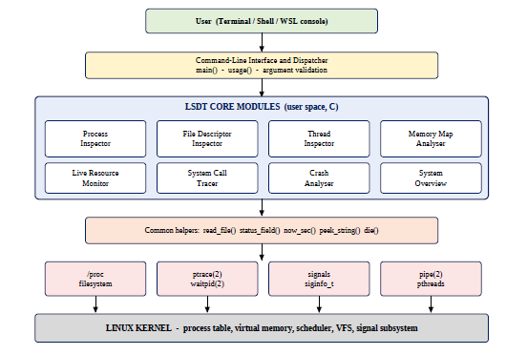
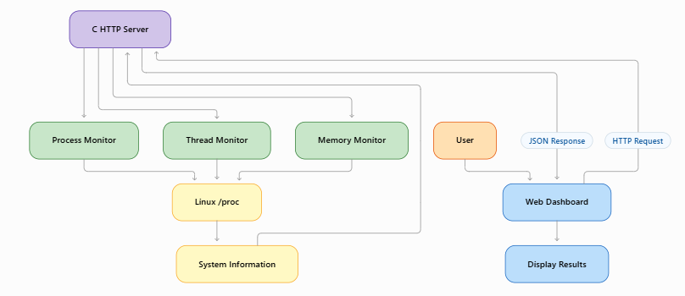
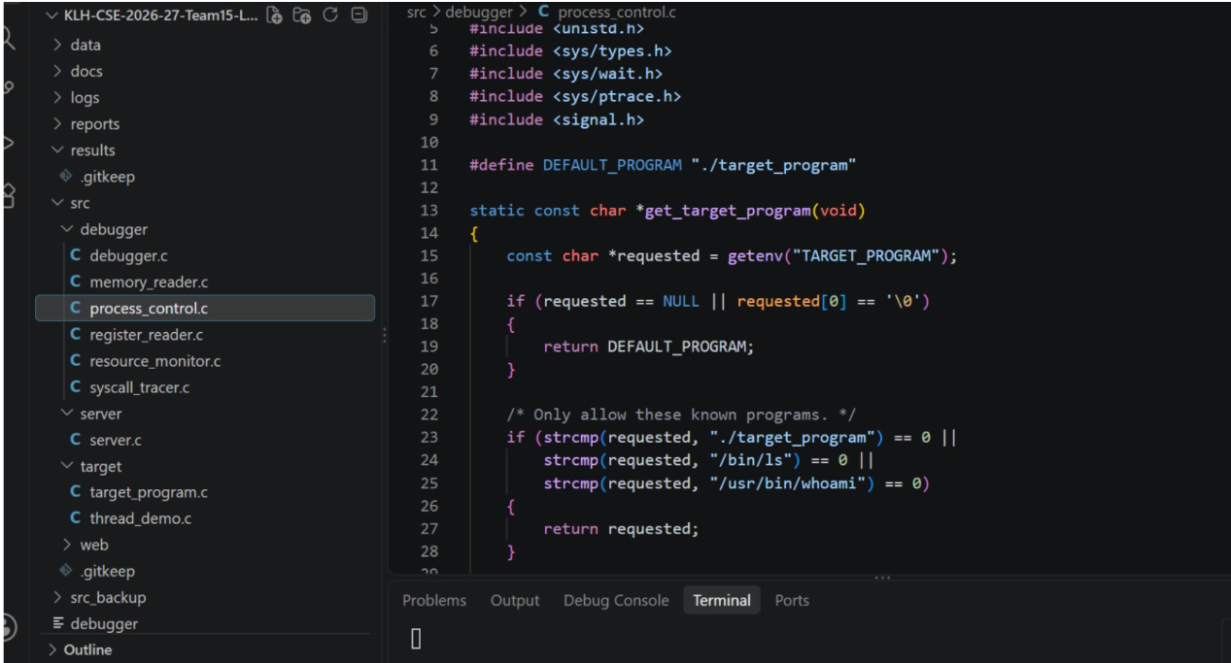
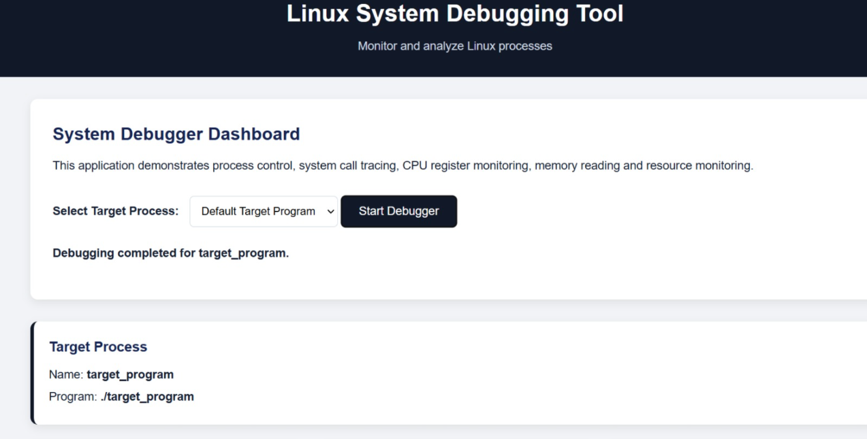
KLH Logo
LINUX SYSTEM DEBUGGING TOOL]
Team ID: [____] | Section: [S-5] | Members: [Dharmika – 2520030012], [Anushka K – 2520030501], [S.Rushvini – 2520030542] | Guide: [Dr. Mrs. Harika ]
Operating Systems and Systems Programming (OSSP) | KLH Bachupally Campus, CSE | PBL 2026–27
Abstract
Tools & Technologies
Our project addresses the difficulty of monitoring and debugging Linux processes. It helps students and developers analyze system calls, CPU registers, memory usage, process control, and POSIX threads using C programming and Linux system concepts.
Key Outcome: Provides a simple, colourful web dashboard for real-time process monitoring and debugging, making troubleshooting easier and more efficient.
Programming: C programming and shell scripting.
Platform: Linux / Ubuntu (WSL or native).
OS Concepts: Process management, scheduling, memory management, system calls, and POSIX threads
System Calls / APIs: [fork(), exec(), wait(), pipe(), signals, etc.]
Tools: GCC, GDB, Git & GitHub, and VS Code.
Problem Statement & Objectives
Problem: Linux users often find it difficult to identify process errors, monitor resource usage, and understand system behaviour during program execution.
Objective 1: Monitor running processes, threads, and system calls.
Objective 2: Track CPU registers, memory usage, and process activities.
Objective 3: Display debugging information through a simple web dashboard.
Scope: Designed for Linux students and developers to monitor processes, threads, and memory usage. It provides basic debugging features using C programming and Linux system concepts.
System Workflow / Architecture
[Insert a clear workflow or architecture diagram. Show user input → C program/modules → relevant system calls or kernel services → output/results. Label each component.]
Existing vs Proposed System
Aspect | Basic / Existing Approach | Proposed Project
Process handling | Manual process monitoring using Linux commands. | Displays process IDs and monitors running processes.
Communication | Limited process communication. | Monitors threads and process activity.
Resource handling | [Difficult to track memory and system resources. | Displays memory usage and resource information.
Error handling | Limited validation and error reporting. | Validates inputs and handles invalid PIDs and errors.
Key gap | No centralized view of process information. | Provides a single dashboard for process monitoring and debugging.
Process, IPC & Resource Design
[Insert a suitable design diagram: process tree, parent–child relationship, pipe/FIFO communication, shared resources, synchronization flow or file structure. Include only concepts used in your project.]
Feasibility Study
Technical: Uses C programming, Linux/Ubuntu, system calls, GCC, and basic Linux tools.
Economic: Uses free, open-source tools with no additional hardware or hosting costs
Operational: Easy-to-use dashboard; requires a Linux system and basic permissions.
Schedule: Complete design, development, testing, and documentation within the semester.
Implementation Screenshots
[Screenshot 1: program execution / main interface]
[Screenshot 2: output, process states, IPC or test result]
Results & Testing
Conclusion
Future Scope
Sample Input/Output: Enter a valid PID to view process details, thread IDs, and memory usage. The dashboard displays the results.
Testing: Tested valid and invalid PIDs, process monitoring, thread behaviour, and error handling to ensure proper functioning.
Implementation: Developed a Linux debugging tool with process monitoring, thread tracking, memory monitoring, and a web dashboard.
Objectives & OSSP Concepts: Meets the objectives by simplifying debugging and demonstrating system calls, process management, memory management, and POSIX threads using C.
Enhancement 1: Add process termination and improved error handling.
Enhancement 2: Improve dashboard usability and optimize monitoring performance.
References: [1] Linux man-pages [2] Operating Systems textbook / course material [3] GCC / GNU documentation
QR: GitHub

