Slide 1
Steganography Tool – Hide Secret Text Message Inside Image
CAPSTONE PROJECT
Presented By: Dharmika
Student Name : Dharmika
College Name & Department : Bharat Institute of Engineering and Technology & CSE

Slide 2
OUTLINE
Problem Statement
Technology used
Wow factor
End users
Result
Conclusion
Git-hub Link
Future scope

Slide 3
Problem Statement
Problem:
In an increasingly digital world, data security and privacy have become major concerns. Traditional methods of communication can be intercepted easily. Steganography provides a way to hide sensitive information inside seemingly harmless files (like images) to enhance security.
Objective:
To build a Python-based GUI tool that allows users to hide secret messages within images using Least Significant Bit (LSB) Steganography. This ensures secure communication by embedding the message inside an image, which can only be extracted with the correct method.

Slide 4
Technology used
Python: The programming language used for the backend logic.
Tkinter: For building the Graphical User Interface (GUI).
Pillow: Python library for image processing (used to load and manipulate images).
Bitarray: To handle and convert text messages into binary format for encoding and decoding.
filedialog: To help users browse and select files for encoding and decoding images.

Slide 5
Wow factors
User-friendly GUI: A simple and intuitive interface that allows easy interaction for encoding and decoding messages.
Image Security: The tool uses LSB steganography, which is a hidden yet effective way of concealing messages inside an image.
Real-time encoding/decoding: Instant visual feedback where users can see the image with the encoded message and decode it back easily.

Slide 6
End users
Security Enthusiasts: People looking to enhance communication security without needing advanced encryption techniques.
Students & Researchers: For learning and exploring the concepts of steganography and image processing.
Companies: Especially in secure communications, such as internal messages or protecting sensitive intellectual property.
Anyone Concerned with Privacy: People looking for an easy and secure way to send private messages without relying on traditional encryption.

Slide 7
Results
Working Encoding & Decoding Functionality: The secret message is successfully embedded in an image and retrieved without distortion.
Image Integrity Maintained: The image remains visually unchanged, and the secret message is hidden in the least significant bits of the pixel data.
GUI Success: Users can easily input the image, type a message, and hide or extract the message using the interactive GUI.

Slide 8
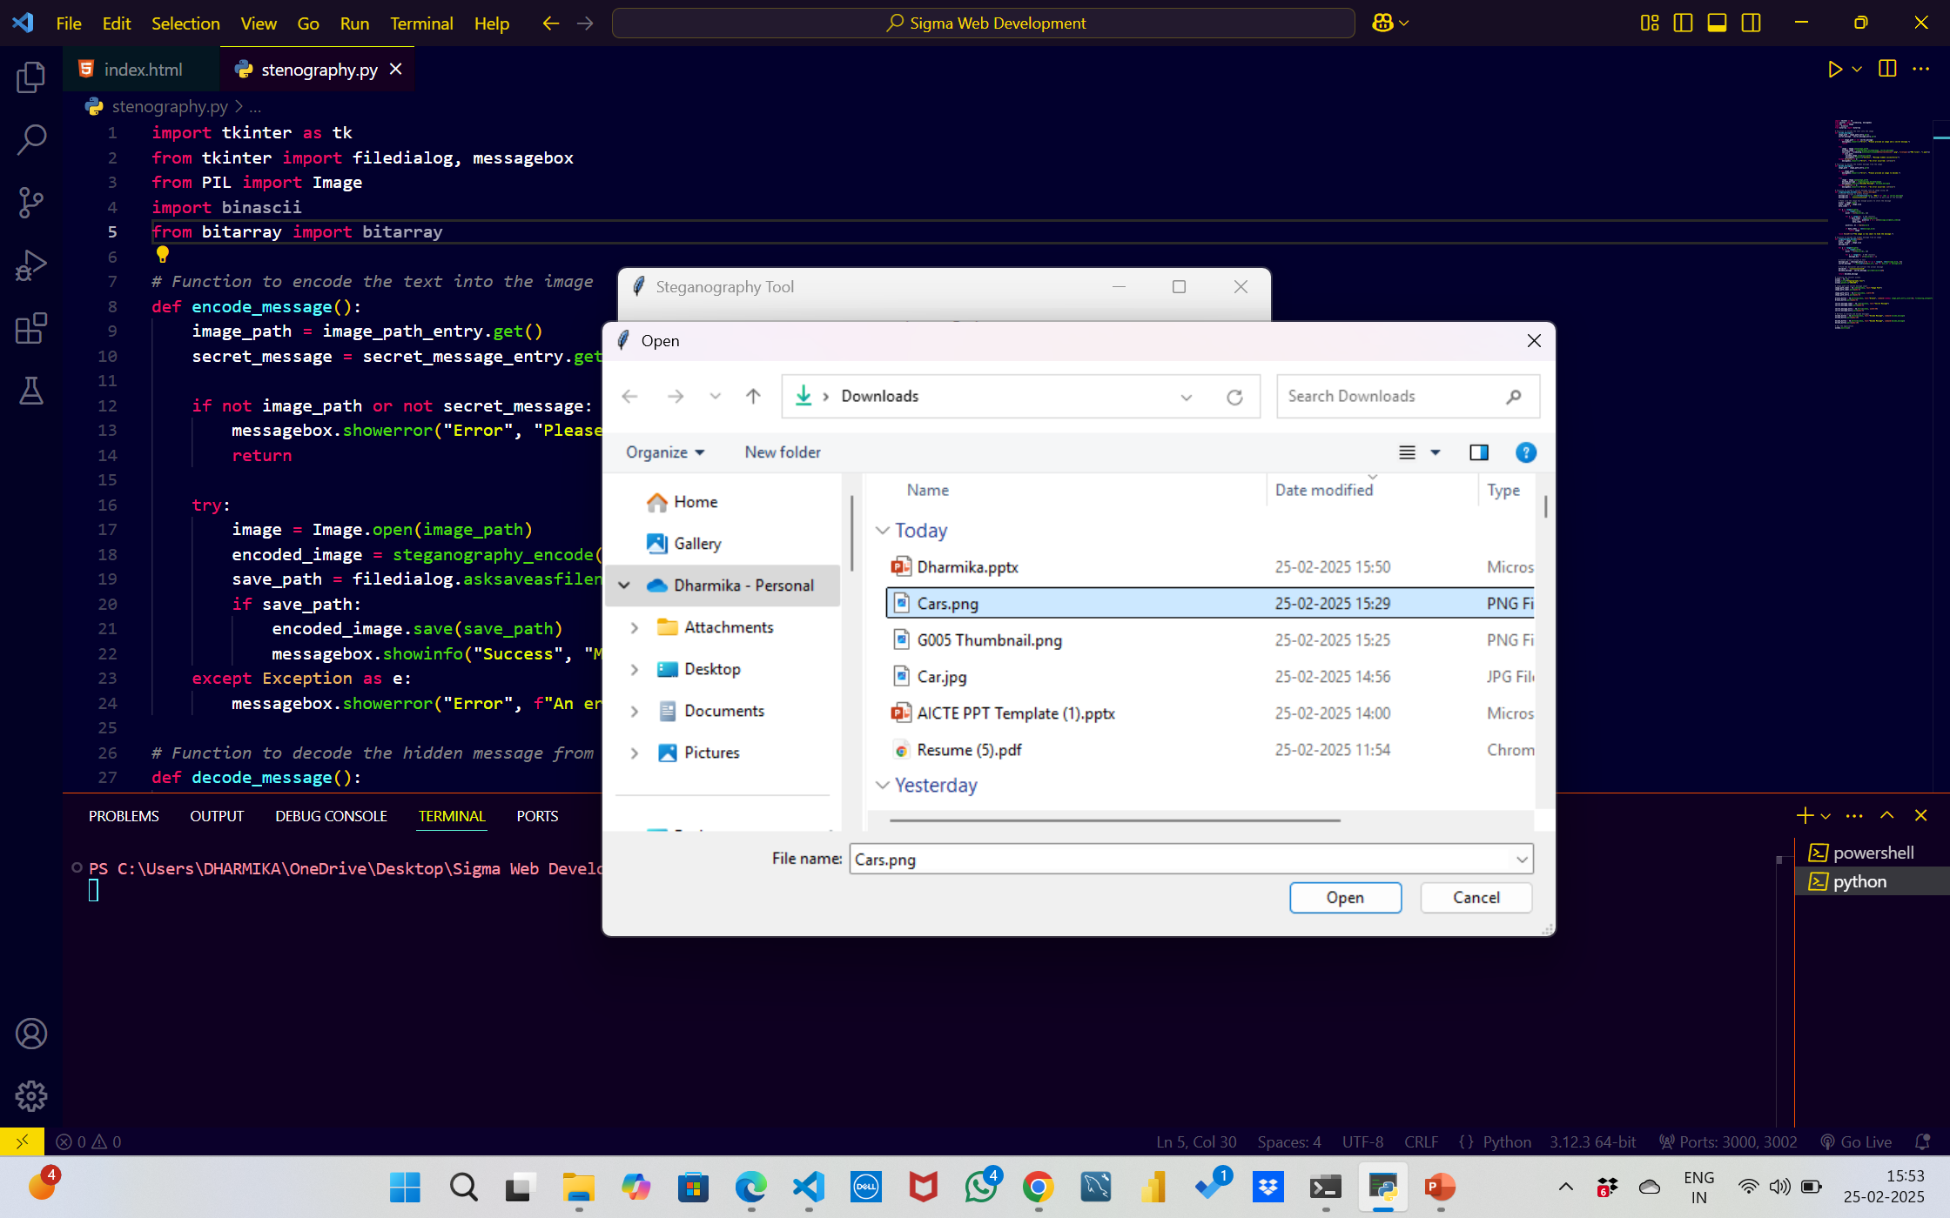
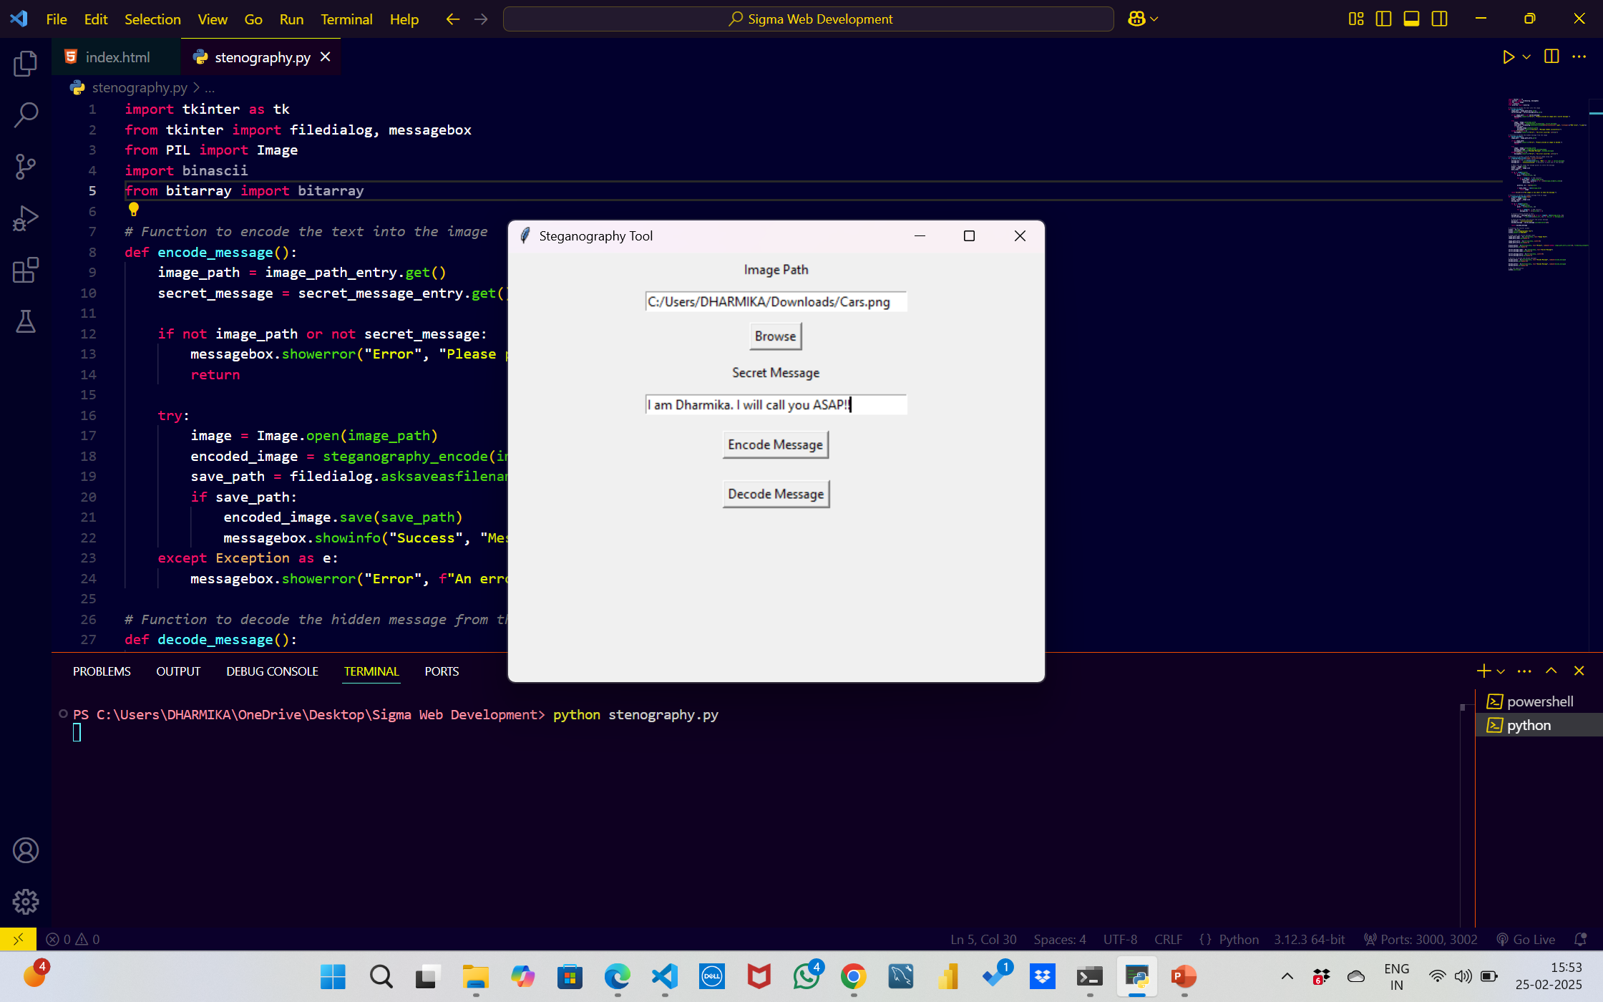
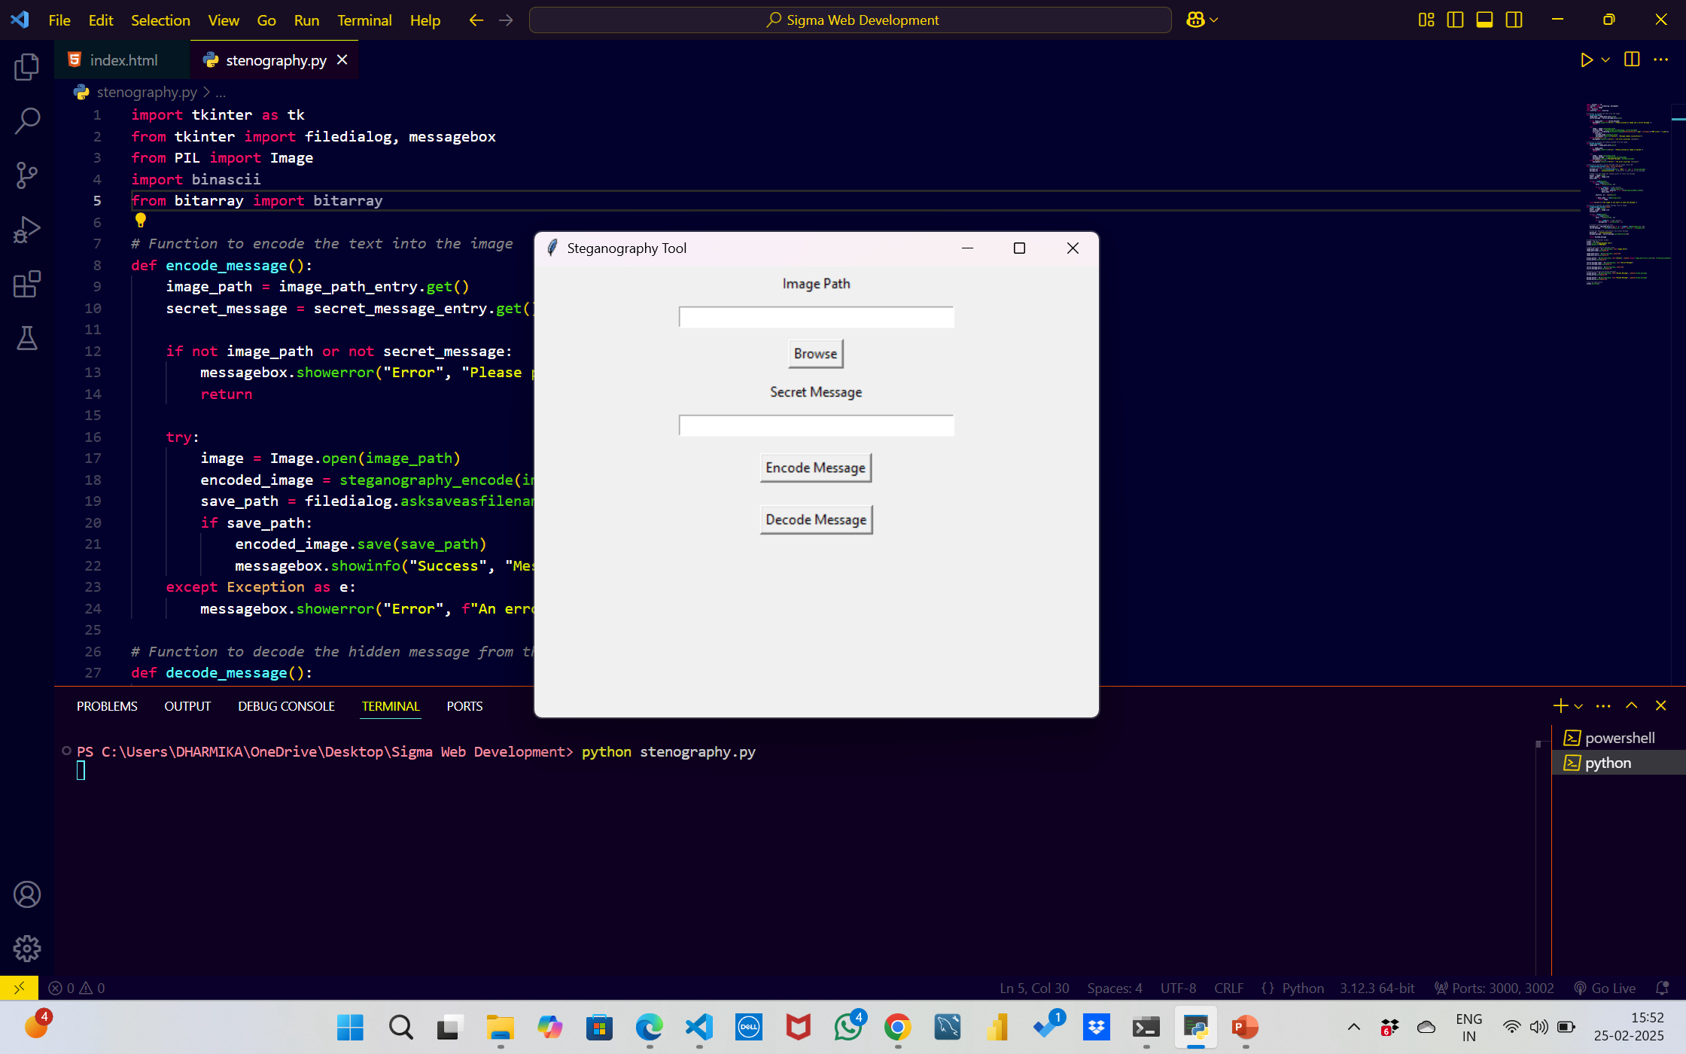
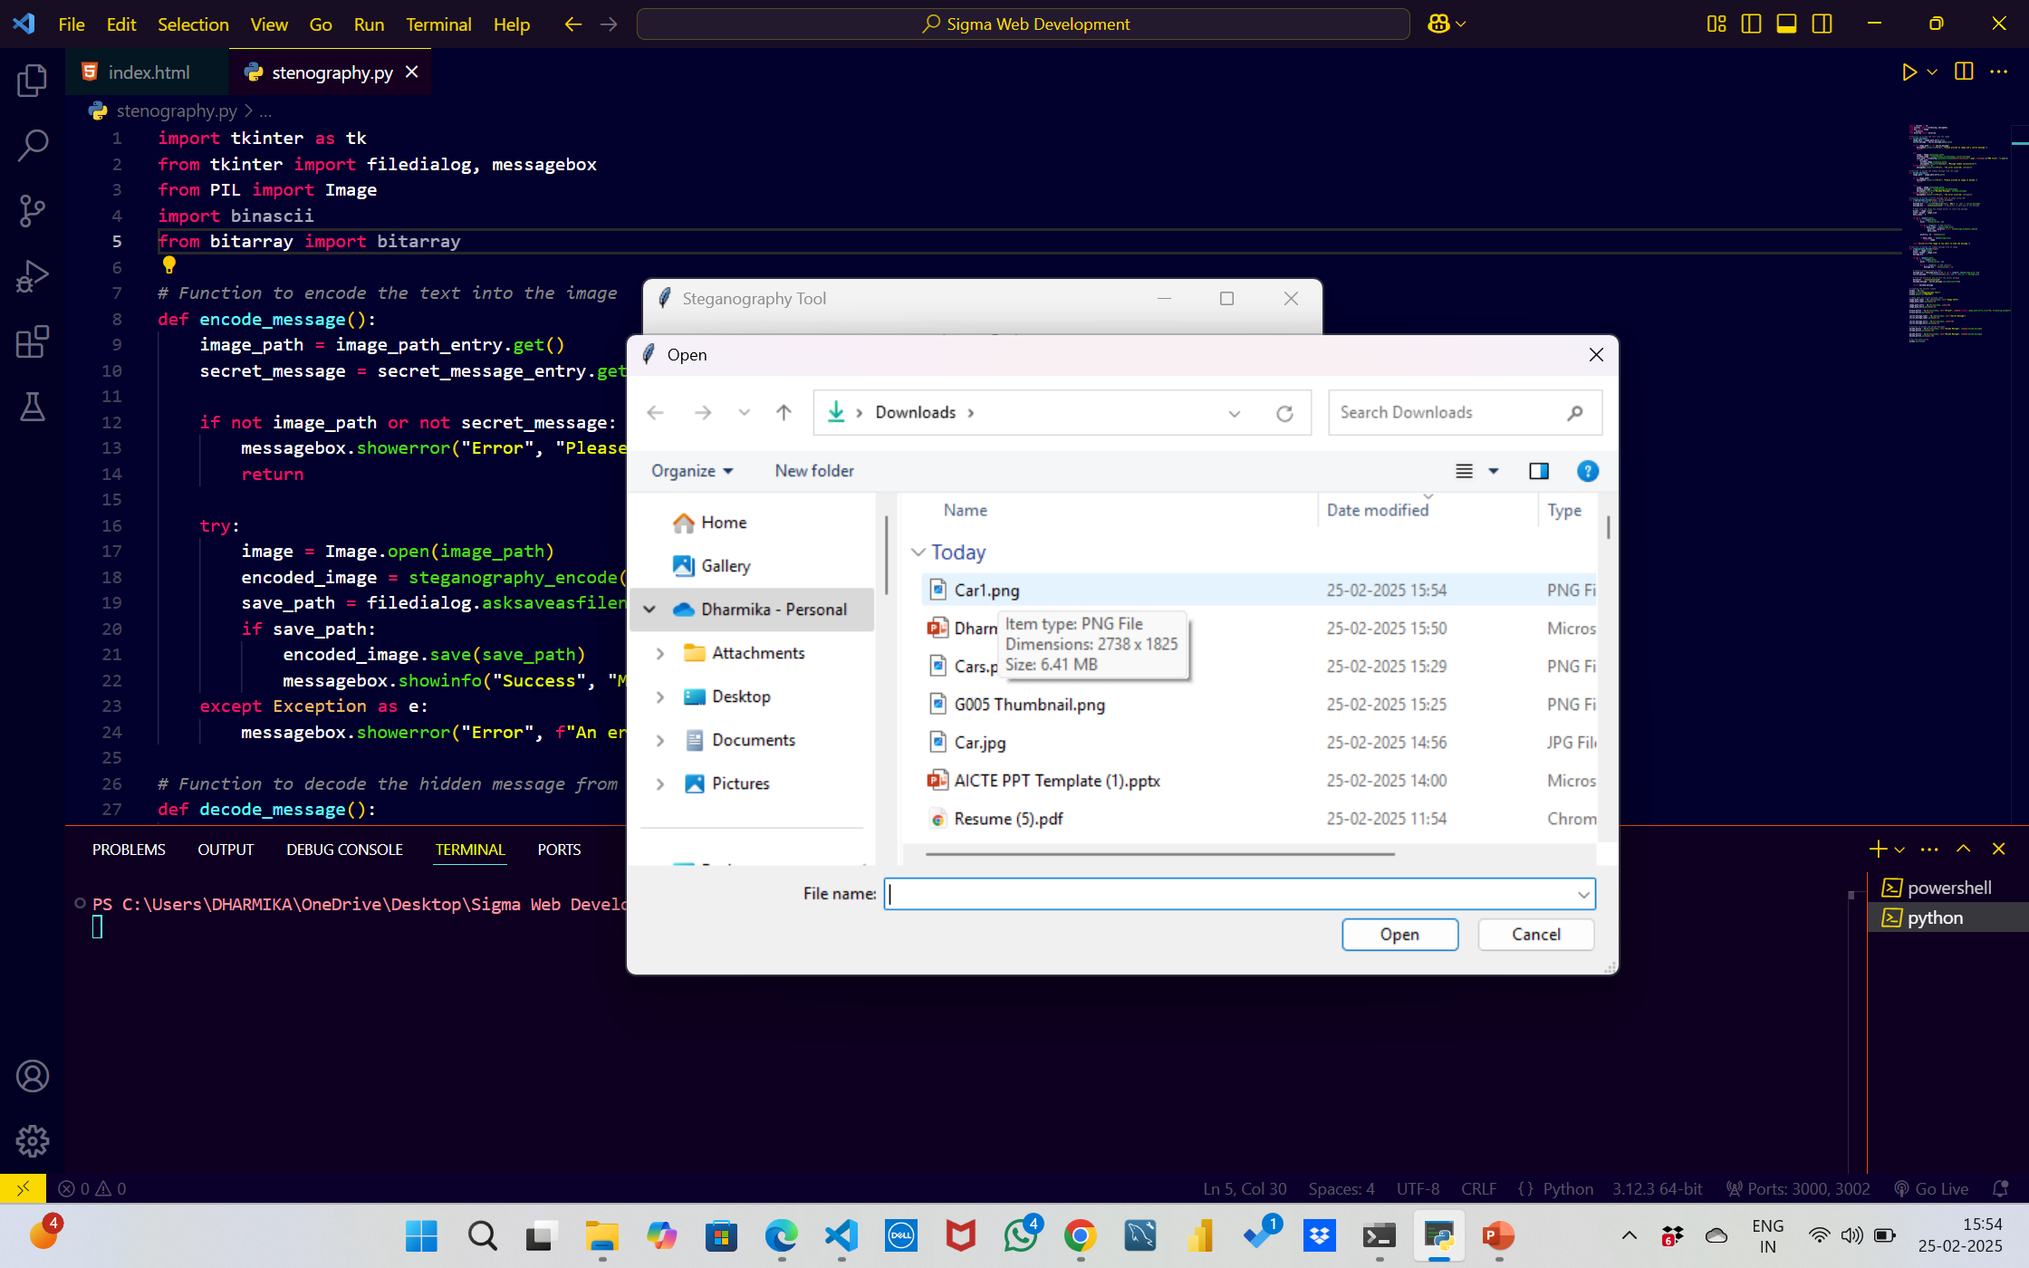
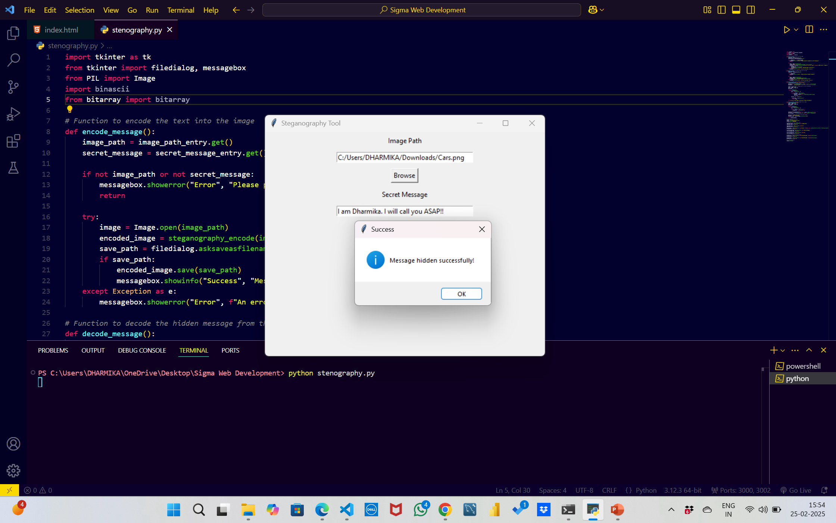
Results

Slide 9
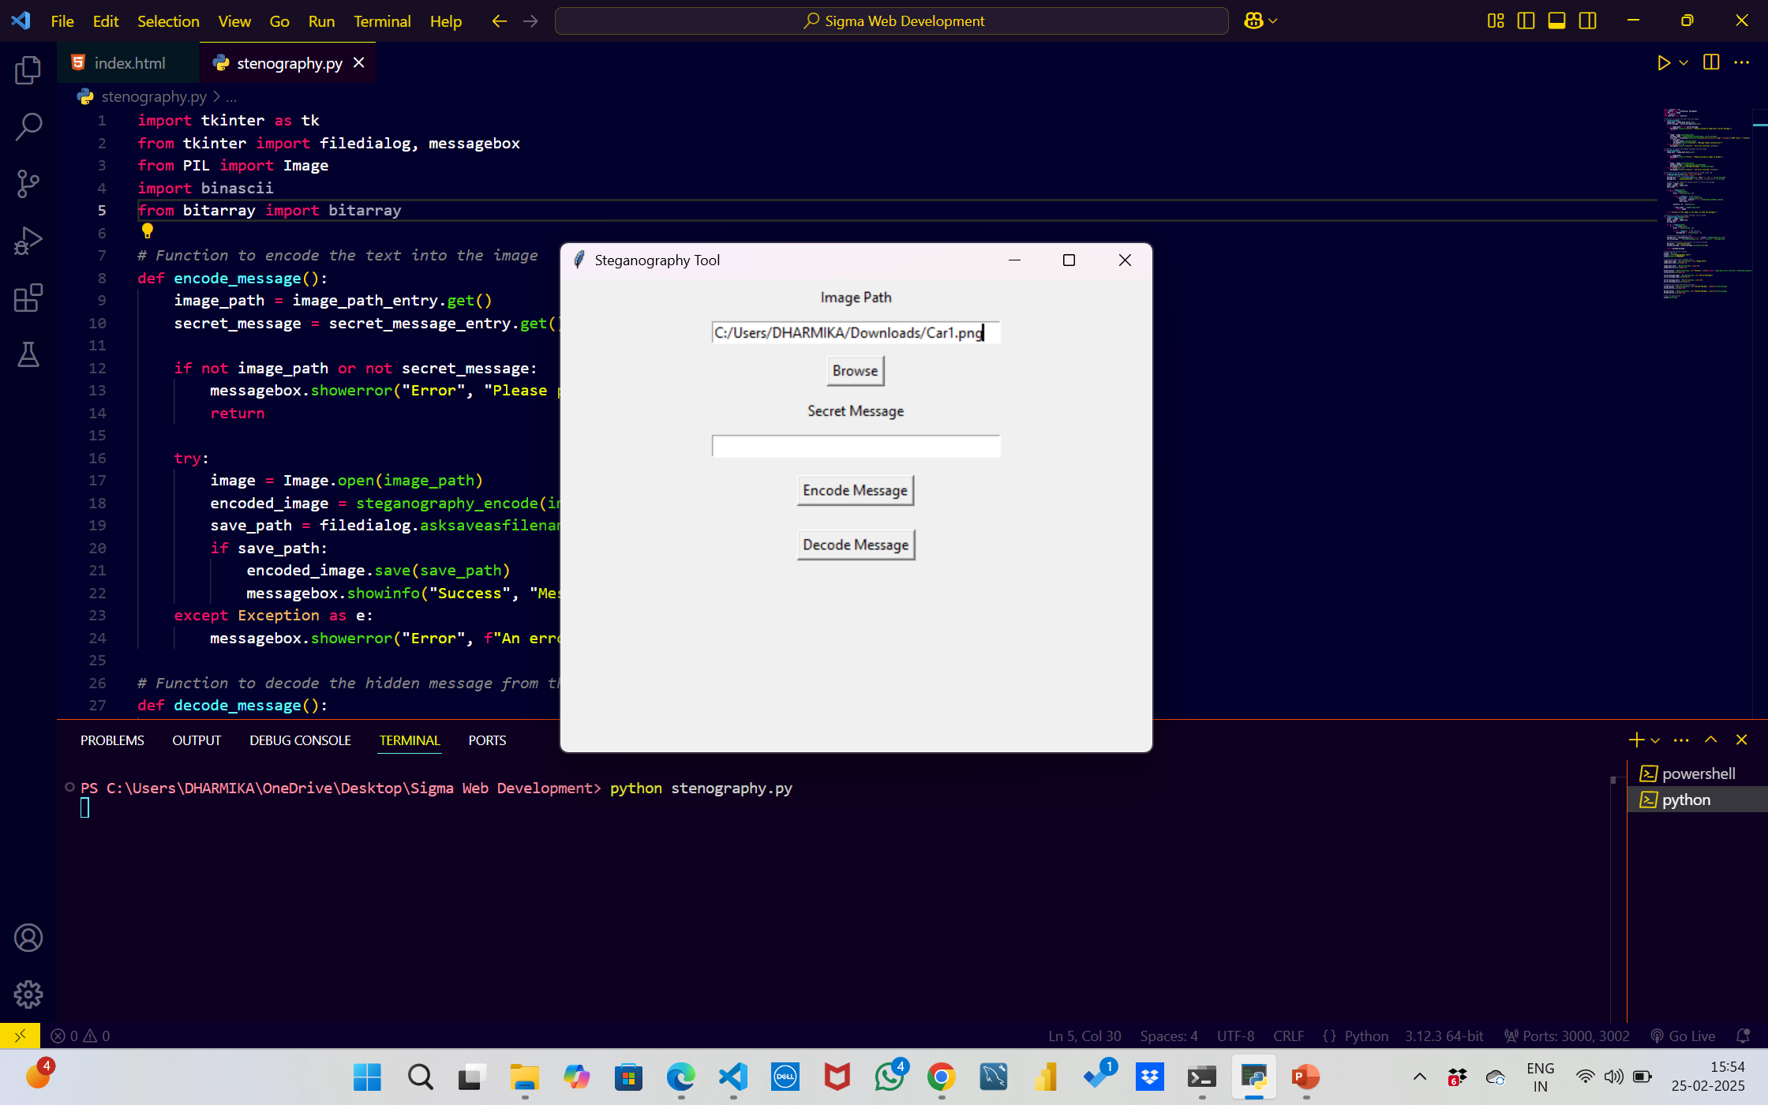

Result

Slide 10
Conclusion
This project showcases a simple but effective application of steganography, which hides data inside images.
The tool is implemented using Python and offers both encoding and decoding capabilities with an easy-to-use graphical interface.
It demonstrates how Python can be used in practical applications like securing private messages, providing an additional layer of communication privacy.
By using LSB Steganography, the hidden message remains almost invisible, which enhances security.

Slide 11
GitHub Link
GitHub Repository:
You can access the complete source code and project files here:
https://github.com/Dharmika01/Steganography

Slide 12
Future scope(optional)
Support for Multiple File Formats: Extend the project to work with more file types (e.g., audio, video, and text files) for more diverse steganographic applications.
Advanced Encoding Techniques: Implement advanced methods like adaptive steganography and cryptography for added security.
User Authentication: Add a feature for authenticating users before encoding or decoding to prevent unauthorized use.
Compression and Encryption: Integrate message compression and encryption techniques to further secure the hidden message.
Web Application: Extend the project to a web-based app that allows users to encode/decode messages directly in the browser.

Slide 13
THANK YOU

