Slide 1

Customer Segmentation Group : 11
Project :2
Dharmik Patel - 0813537
Manav Patel - 0804383
Nimesh Prajapati - 0816765
Mayur Parmar - 0811597
Deep Chaudhary - 0813502

Slide 2
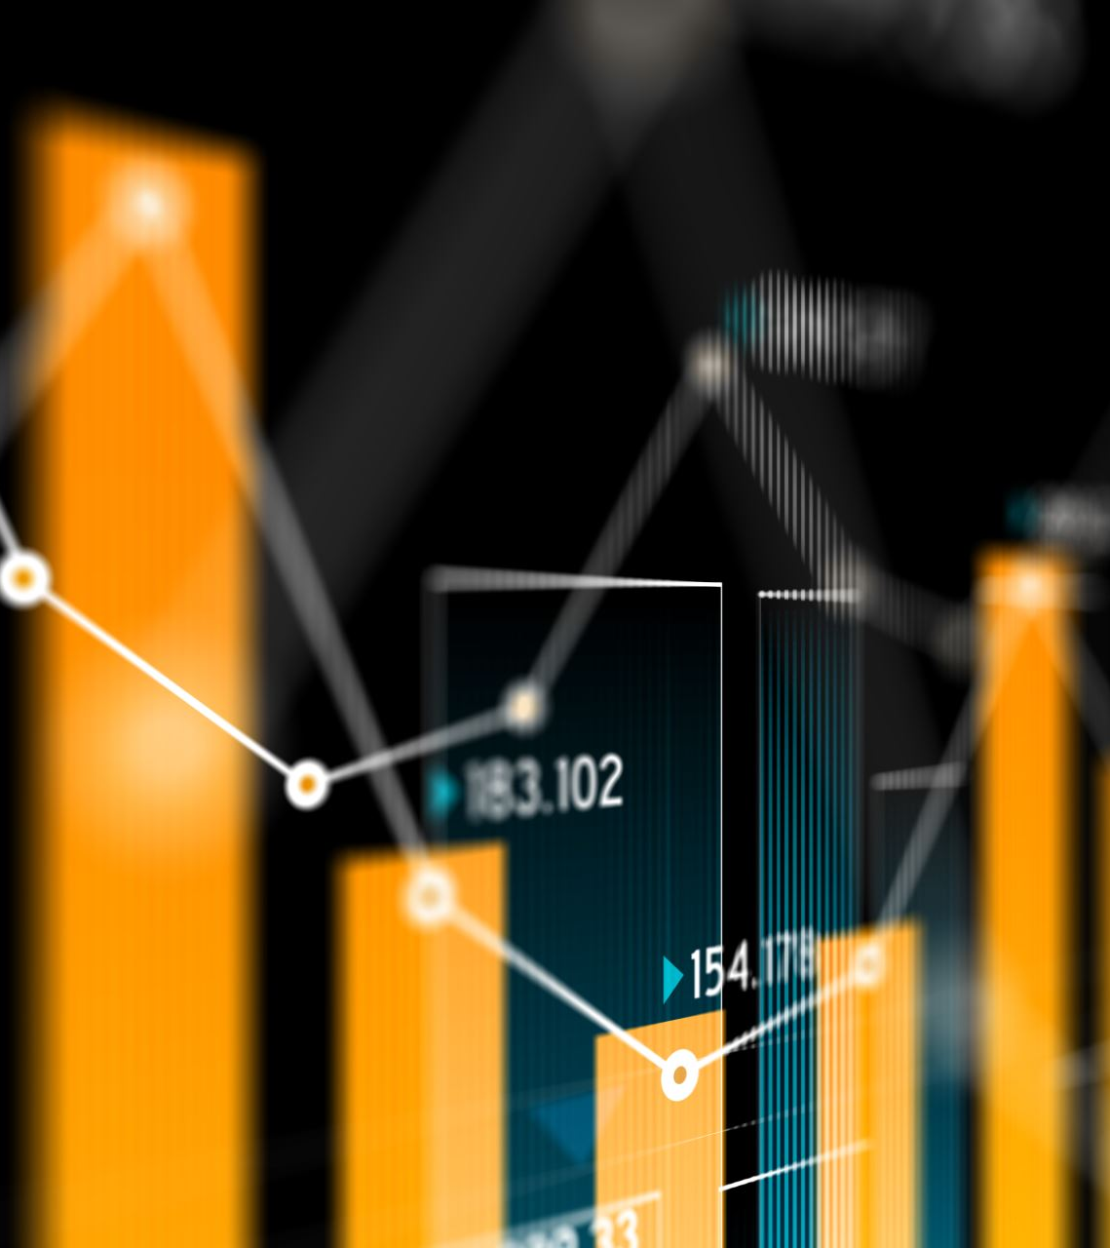
Business Objectives
Objective: Utilize RFM (Recency, Frequency, Monetary Value) analysis on online sales data.
Goal : Divide customers into segments to identify potential customer groups, enabling the design of targeted and profitable marketing strategies.

Slide 3
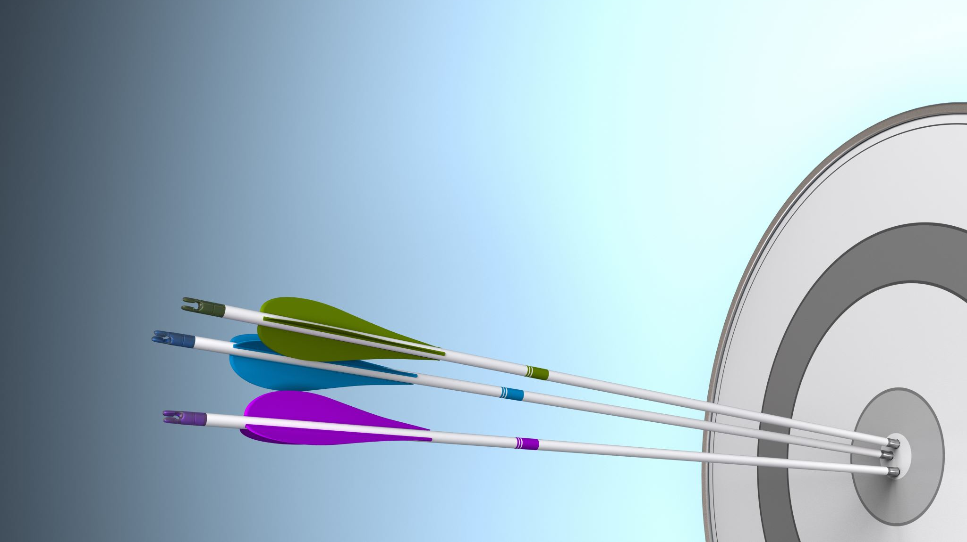
What is Customer Segmentation
Customer segmentation is the process of dividing a customer base into distinct subgroups based on shared characteristics, behaviors, or preferences. These subgroups or segments represent subsets of the overall customer population.
This strategic approach enables businesses to tailor their marketing efforts and strategies to better meet the unique needs and preferences of each customer segment.

Slide 4
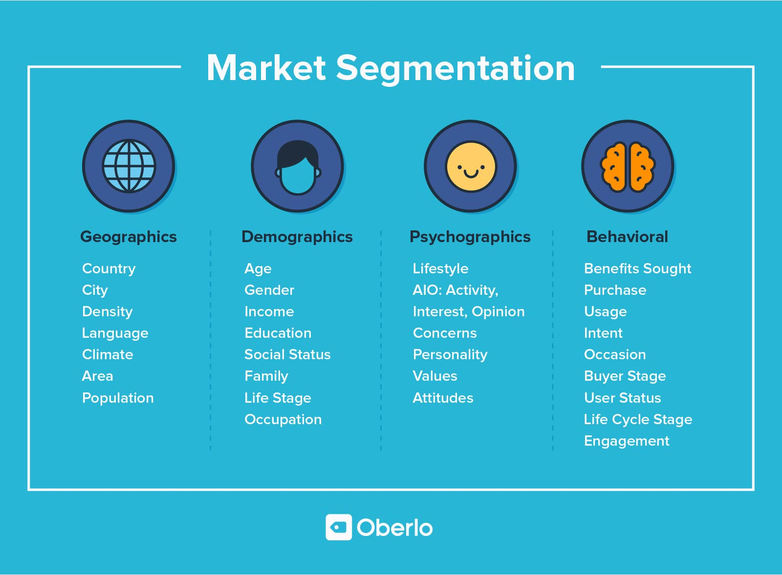

Slide 5
Why do we do customer segmentation?
Targeted Marketing: Tailor marketing strategies to specific customer groups, increasing engagement and conversion rates.
Resource Efficiency: Optimize resource allocation by focusing on segments with the highest potential ROI.
Customer Satisfaction: Understand and meet unique needs, enhancing customer satisfaction and loyalty.
Competitive Edge: Gain a competitive advantage by aligning offerings with distinct market segments.
Product Enhancement: Develop products that cater to specific segment preferences, driving sales and customer retention.
Market Expansion: Identify new market opportunities for business growth and diversification.
Data-Driven Insights: Use data to make informed decisions and continually improve products and services.
Long-Term Value: Nurture high-value segments for sustained profitability and business success.

Slide 6
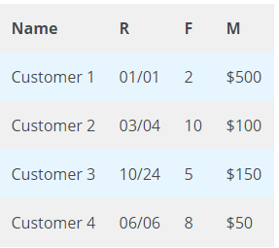
What is RFM?
RFM is a method used to analyze customer value. RFM stands for RECENCY, Frequency, and Monetary.
RECENCY: How recently did the customer visit our website or how recently did a customer purchase?
Frequency: How often do they visit or how often do they purchase?
Monetary: How much revenue we get from their visit or how much do they spend when they purchase?

Slide 7
Why is it needed?
RFM Analysis is a marketing framework that is used to understand and analyze customer behavior based on the above three factors RECENCY, Frequency, and Monetary.
The RFM Analysis will help the businesses to segment their customer base into different homogenous groups so that they can engage with each group with different targeted marketing strategies.

Slide 8
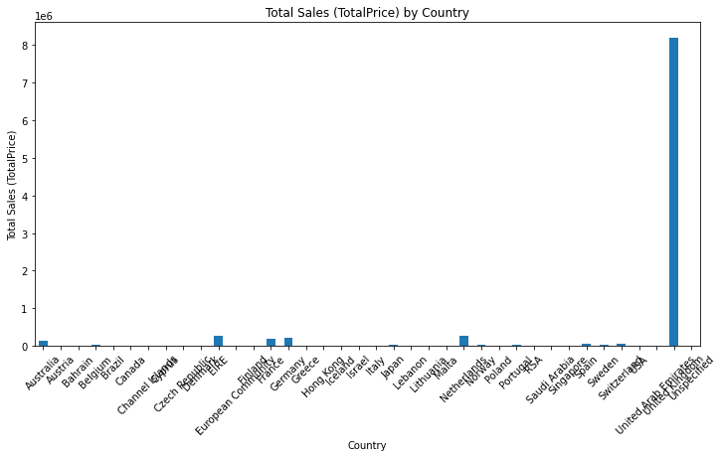
Insights:
Identify top-performing countries based on total sales.
Analyze purchasing patterns and trends in each country.
Recommendations:
High-Spending Countries:
Target high-spending countries with exclusive offers and premium products.
Emerging Markets:
marketing for emerging markets to boost sales and customer engagement.
Localized Marketing:
Customize marketing strategies for each country based on cultural and regional preferences.

Slide 9
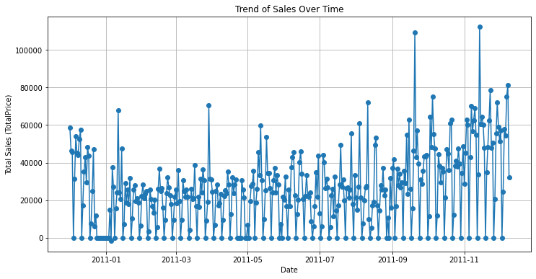
Insights:
Total sales trends to segment customers based on buying behavior, preferences, and purchase frequency during peak and off-peak periods.
Recommendations:
marketing strategies for each segment to maximize sales during peak seasons and engage dormant customers during slower periods. Personalize promotions and incentives based on segment preferences to drive consistent sales growth.

Slide 10
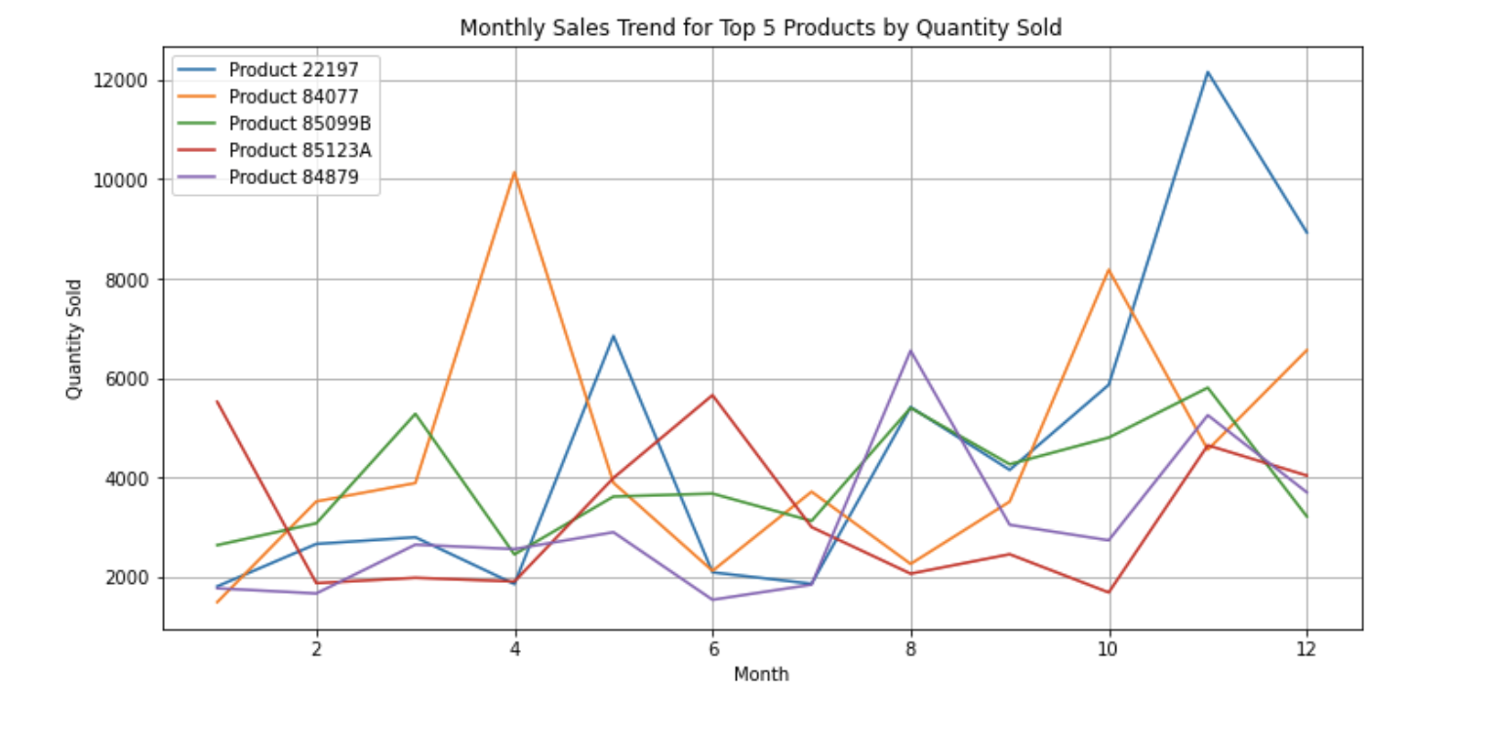
Insights:
Identify top-performing products based on quantity sold by month .
Recommendations:
They can create the marketing strategies for the least sold product give cashback benefits or rewards gift card.
Product 2 has drastic change find out any problem with that and review product 2 customer reviews .

Slide 11
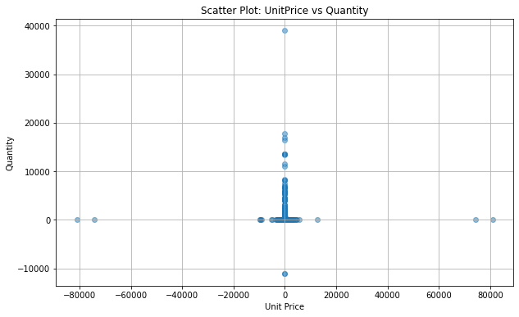
Insights:
Unit Price vs. Quantity Purchased: Segments based on spending behavior.
High Unit Price, Low Quantity: Potential high-value customers who purchase premium products.
Low Unit Price, High Quantity: Potential budget-conscious customers who purchase frequently.
Recommendations:
Marketing Strategies:
Premium Segment: Offer personalized discounts on premium products to encourage repeat purchases.
Budget-Conscious Segment: Promote bulk discounts or loyalty programs to incentivize higher spending.

Slide 12

Clustering
Unsupervised Learning Approach
Definition:
Clustering, is an unsupervised machine learning technique, involves grouping similar entities by analyzing their proximity to one another.
Process:
Data points are organized into distinct clusters based on their similarity, with the goal of maximizing intra-cluster similarity and minimizing inter-cluster similarity.
K-means Clustering: A widely used unsupervised machine learning algorithm that partitions data into 'K' clusters by iteratively assigning each data point to the nearest centroid and updating the centroids based on mean values, optimizing cluster formation.
Objective: Minimize the within-cluster variance and maximize inter-cluster variance to obtain distinct and meaningful clusters.

Slide 13
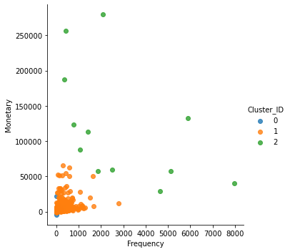
Insights:
We created three cluster. Based on this graph, there are very few customer has monetary and Frequency is very high compare to other customers. Recommendations:
Give exclusive offers or loyalty programs to retain and increase purchases from high-spending customers.
Frequency-Focused Segment: Implement marketing strategies to encourage more frequent purchases and upselling to increase their transaction value.

Slide 14

Final Thoughts
Retail customer segmentation using K-means clustering separates the customer base into unique groups based on purchasing habits, enabling focused marketing strategies and personalized experiences to cater to various customer preferences and increase total sales and satisfaction.
Retailers can tailor their product selection, price policies, and marketing initiatives to better serve various needs of their consumer base by finding similarities and trends among customers.

Slide 15
Thank you…

