Slide 1

E-commerce Data EDA for Customer Behavior Analysis Group : 11
Project :3
Dharmik Patel - 0813537
Manav Patel - 0804383
Nimesh Prajapati - 0816765
Mayur Parmar - 0811597
Deep Chaudhary - 0813502

Slide 2
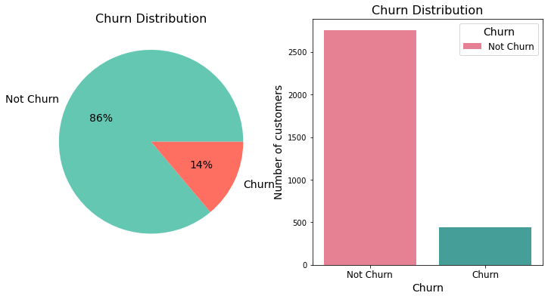
Insights:
This pie chart and bar chart see that not churn customers play most important role as compared to churn customers.
Recommendations:
Prioritize Customer Retention and customer segmentation if we will have more customers then we will have more customers segmentation.

Slide 3
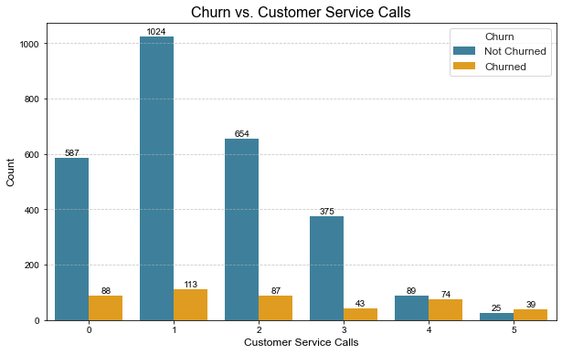
Insights :
Non-churn customers are more active in seeking customer service assistance, which can be an opportunity to enhance their experience and reduce churn.
Recommendations:
Find and save the unhappy customers before they leave by using smart tools and also Help your happy customers more to keep them happy.

Slide 4
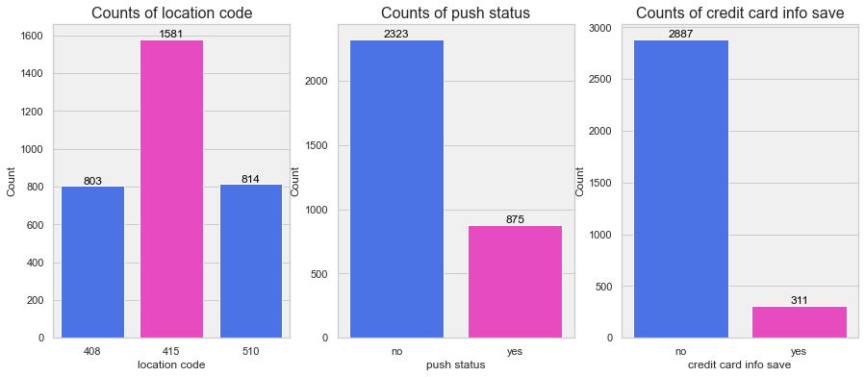
Insights :
Into first graph some location code has high count as compared to others while push status almost doubled in no status and we can see that no counts of credit card info save is almost three times more than yes.
Recommendations:
Pay extra attention to areas with many customers leaving and make their experience better.
Check why some customers aren't getting messages and make sure they do.
Tell customers why it's good to save their credit card info to make them more likely to do.

Slide 5
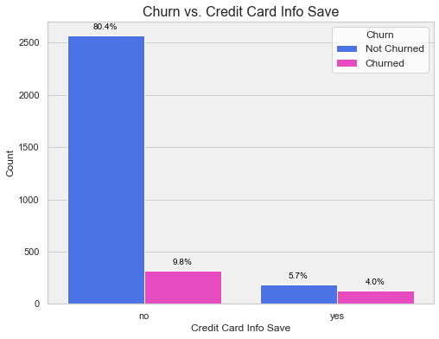
Insights:
Non churned customers don’t want to give their credit card info. Save into their account while both not churned and churned people have least count to prefer to save their credit info.
Recommendations:
Offer clear benefits, such as convenience and enhanced security measures, to encourage all customers to consider saving their credit card information while respecting their privacy concerns.

Slide 6
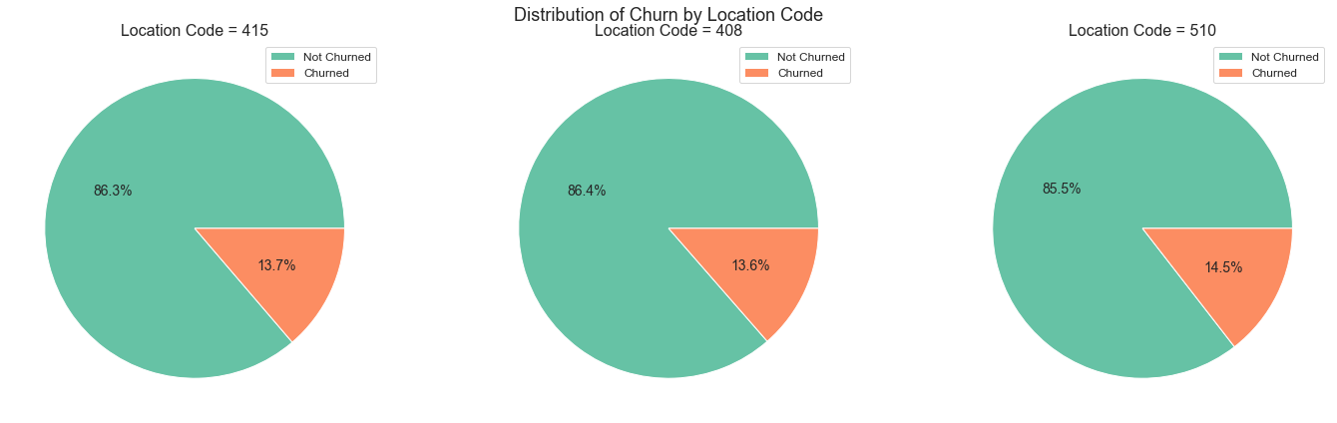
Insights:
Code 415 has not churned rate 86.3% ,code 408 has 86.4% while 85.5% for the code 510.
Recommendations:
Identify and address specific issues unique to each area code to improve their already high non-churn rates further.
Implement retention strategies and customer satisfaction enhancements across all areas to maintain the high non-churn rates and potentially reduce churn even further.

Slide 7

Why use Random Forest Classifier?
E-commerce data often requires categorizing customers into different groups, like loyal customers, occasional shoppers, or those who have stopped using the service. The Random Forest model is well-suited for such classification tasks.
E-commerce datasets can be complex, with many features, and Random Forest excels at handling this complexity while identifying the most relevant features. Predicting and preventing customer churn is a top priority for E-commerce businesses, and Random Forest can achieve this with high accuracy, enabling companies to proactively address the issue.
Moreover, Random Forest provides a degree of interpretability, making it more straightforward for E-commerce companies to explain the reasoning behind their customer behavior predictions. This transparency is vital for making well-informed decisions.
Additionally, Random Forest offers valuable insights into feature importance, aiding E-commerce companies in understanding which factors have the most significant influence on customer behavior.

Slide 8

Final Thoughts
Customer behavior analysis is a crucial aspect of business strategy in the modern age. It helps companies gain insights into their customers' preferences, needs, and habits. By leveraging data and advanced analytics, businesses can tailor their offerings, improve customer experiences, and drive growth.
The use of machine learning model like Random Forest can enhance the accuracy of predictions, enabling proactive measures such as churn prevention and personalized recommendations.

Slide 9

Thank you..

