Slide 1
COLLEGE REVIEW • NSE • 8 MIN
Which way will NSE move tomorrow?
UP / FLAT / DOWN in 5 days • leakage-free • real costs • news tested, baseline still wins
47.14% vs 47.85%
model vs majority • n 37,292 • −0.71 pp
AUC 0.55
ranking holds
ECE 0.04
calibrated ✓
−0.28
best Sharpe < 0
190k news rows collected
NSE 93k • DOC 9k • BigQuery 89k • FinBERT 26k
One command → full run
start_run.py • NIFTY 50 • 16 years
Your Name • Guide • Dept • Sept 2026
01 / 12

Slide 2
01 • THE QUESTION
Price alone doesn't explain moves.
Results, policy and group shocks move many stocks together.
16 years
2010 → 2026 • daily NSE bars
50 stocks
NIFTY 50 together, not one chart
~145 feats
price + volume + macro + ranks
02 / 12

Slide 3
02 • DATA WE GATHERED SINCE V1
From zero news to 190k rows.
All free sources. No faked sentiment.
92,960
NSE announcements • 50 symbols • since 2004
9,179
GDELT DOC • 38 symbols • 90 days
88,798
BigQuery events • 2015–26 • 11 symbols
26k
FinBERT scored • cached
Skew is real: LT 22k, INFY 21.7k — 39 symbols near-zero. Banks/FMCG rarely coded as events.
03 / 12

Slide 4
03 • PIPELINE
Five stages. No future peek.
1 INGEST
yfinance + NSE 93k
DOC 9k + BQ 89k
2 STORE
Parquet per symbol
as_of <= 15:30
3 FEATURES
~145 cols
ranks + macro
4 LEARN
LightGBM vs Logistic
Optuna 25
5 DECIDE
calibrate, 0.60
or silence
Rule: feature(t) sees only data ≤ t 15:30 • entry t+1 open
04 / 12

Slide 5
04 • MODEL
Two models. One decision rule.
LightGBM • primary
200 numbers → trees fix errors
→ 3 probabilities
Logistic • check
same input, simple line
ruler, not partner
Decide • τ flat 0.40
soften → pick best → <0.60 silence
DM +9.14, economics same
Validation: train → test year by year, 5-day gap, sealed 2023–now.
05 / 12

Slide 6
05 • HEADLINE RESULT
Baseline still wins. −0.71 pp.
47.14% vs 47.85% • AUC 0.554 • MCC 0.037 • FLAT F1 0.21 • n 37,292
UP-AUC 0.51
floor ≈ 0.515 • 4 tries, noise
DM −4.8
worse than linear
ECE 0.042
calibrated ✓
Sharpe −2.5
V0, 3,080 trades
06 / 12

Slide 7
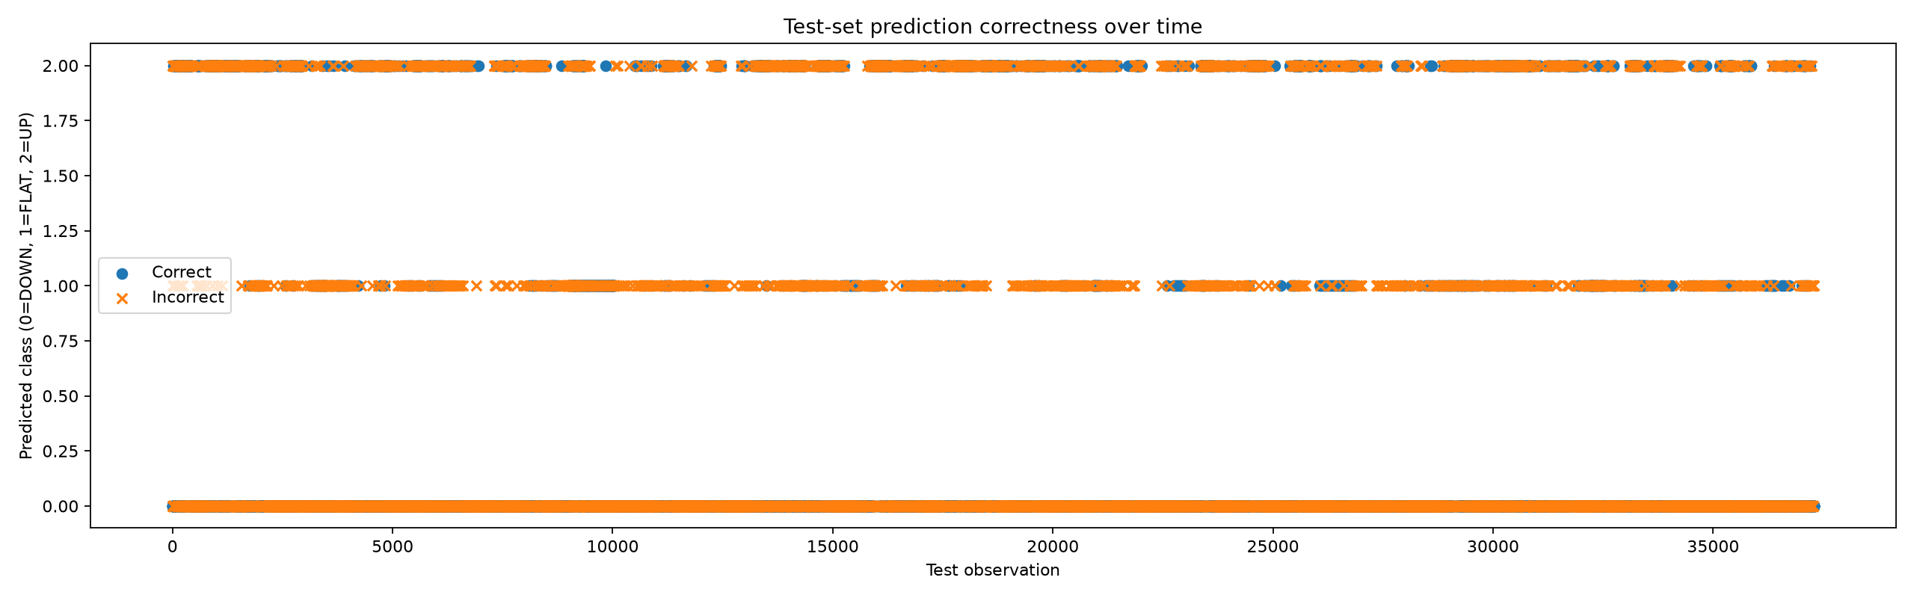
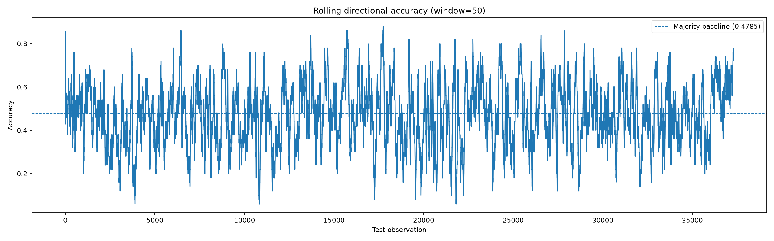
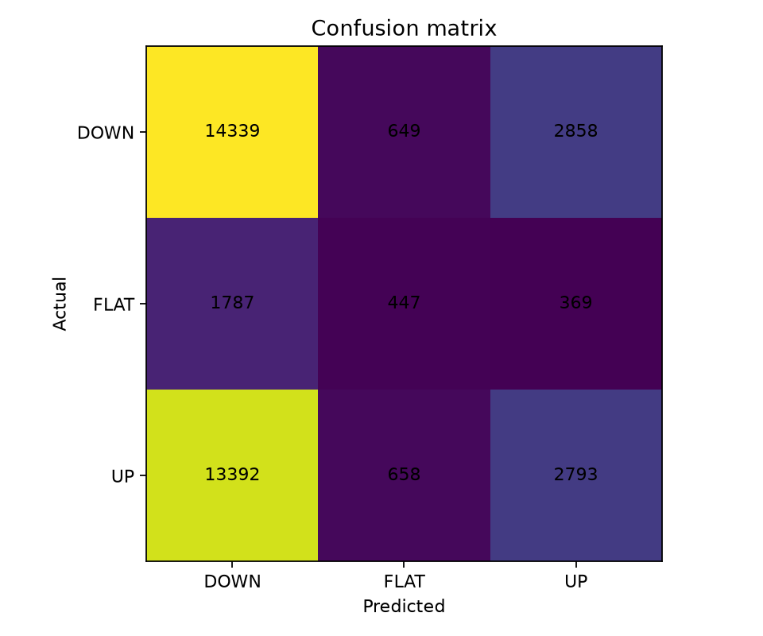
06 • PROOF • CLASSIFICATION
What the model got right.
prediction_correctness.png
rolling_accuracy.png
confusion_matrix.png
07 / 12

Slide 8
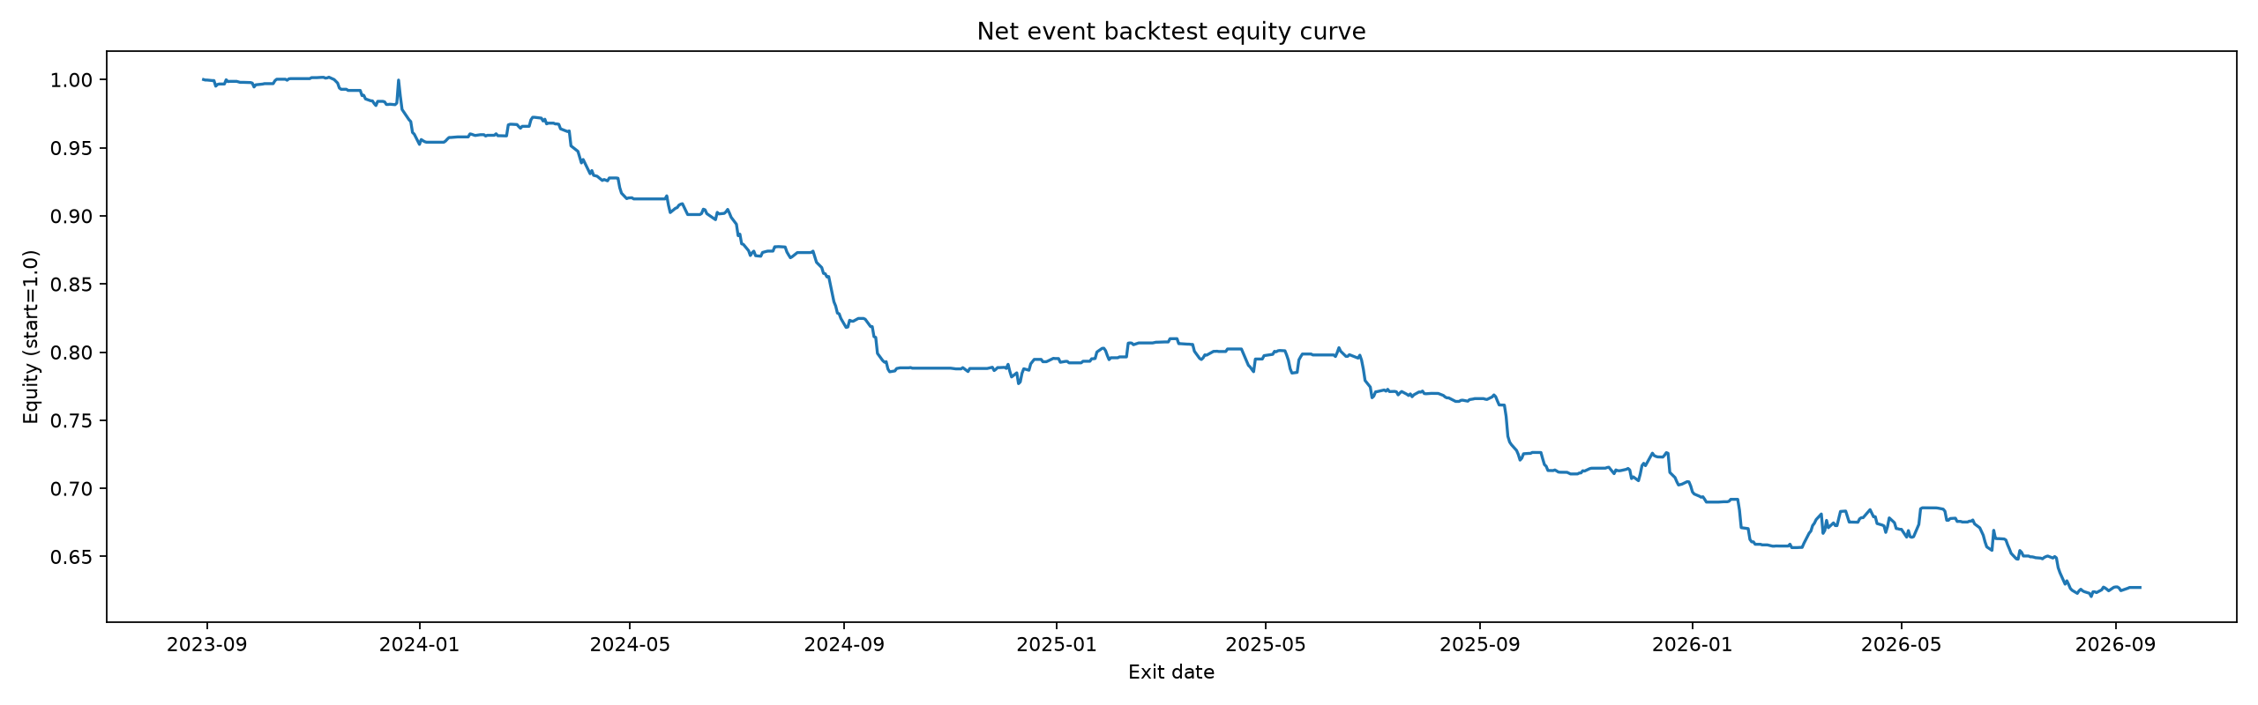
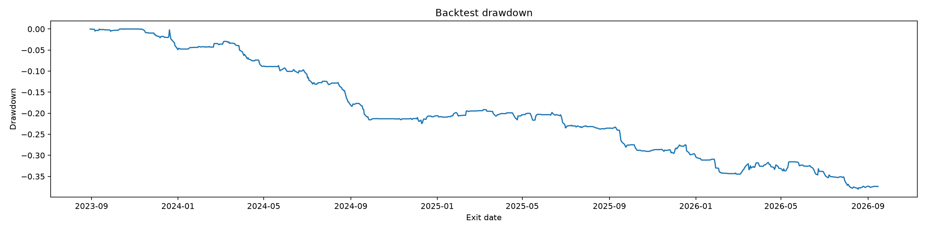
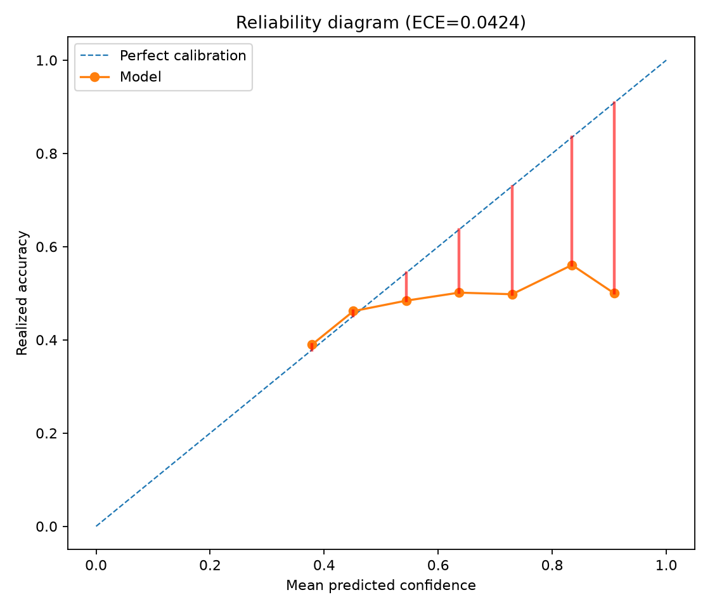
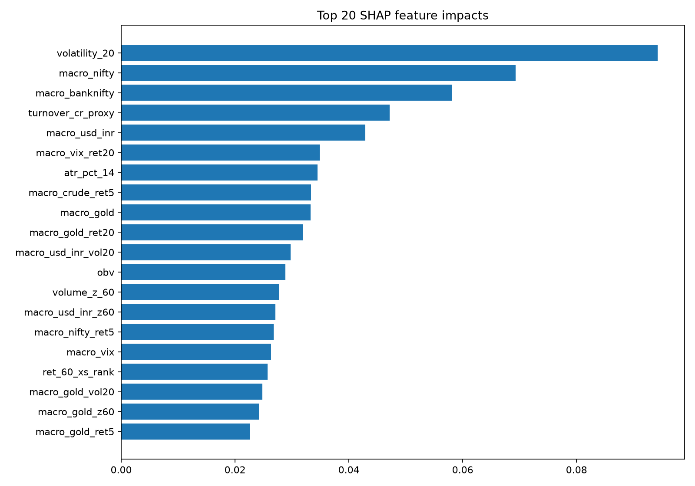
07 • PROOF • MONEY + CALIBRATION
Costs beat edge. Every time.
equity_curve.png
drawdown.png
calibration.png
shap_summary.png
08 / 12

Slide 9
08 • WHY BASELINE WINS
Four honest failures.
UP 0.51
4 attempts within 2SE • ceiling, not bug
Sentiment ∅
pos-sent 0.486 < coin • 43% ≈ no-news
Memorized
train–test gap 21.7pp • disqualified
Costs 2:1
every bucket negative
Scope check ~null • DOWN reframe failed • details: up_autopsy.json, u3_d1.json, worst_20.csv
09 / 12

Slide 10
09 • ECONOMICS VERDICT
Pause trading. Keep research.
V0 −37% (−2.49) → thr70 −4.5% (−0.85) → futures-proxy −4.2% (−0.28). PBO 0.0 = clean fail, not luck.
3,080 → 338
fewer trades help, still < 0
Costs > edge
0.024% vs 0.012% per trade
22 touches
ledgered, no luck-mining
10 / 12

Slide 11
10 • STATUS
Done. Failed. Next.
DONE
NSE 93k • DOC 9k • BQ 89k • calendar • maps • ECE 0.042 • τ-flat
FAILED
H1 / H1b / U / U3 / DOWN / G3 — UP-AUC never > 0.53
NEXT
entity map → one U2 gate • else Door C + thesis write-up
11 / 12

Slide 12
11 • OUTCOME
Paper. Poster. Repo.
Paper
negative-result study + ledger
Poster
boxes + 7 original charts
Repo
reproducible • API demo
Thank you — Questions?
12 / 12

